Slide 1
Content Area 4
Enlightenment
Rococo
Neoclassicism
Romanticism

Slide 2
Works
Art of the Enlightenment
98. Hogarth, Marriage a la Mode
100. Derby, Philosopher Giving a Lecture at the Orrery
Rococo
101. Fragonard, The Swing
Neoclassicism
102. Jefferson, Monticello
103. David, Oath of the Horatii
104. Houdon, George Washington
105. Vigee-Lebrun, Self Portrait
Romanticism
106. Goya, Y no hai remedio (And there’s nothing to be done)
107. Ingres, La Grande Odalisque
108. Delacroix, Liberty Leading the People
109. Cole, The Oxbow
111. Turner, Slave Ship
112. Pugin & Barry, Houses of Parliament

Slide 3
Overview
Enduring Understanding 4-1. From the mid-1700s to 1980 C.E., Europe and the Americas experienced rapid change and innovation. Art existed in the context of dramatic events such as industrialization, urbanization, economic upheaval, migrations, and wars. Countries and governments were re-formed; women’s and civil rights’ movements catalyzed social change.
Essential Knowledge 4-1a. The Enlightenment set the stage for this era. Scientific inquiry and empirical evidence were promoted in order to reveal and understand the physical world. Belief in knowledge and progress led to revolutions and a new emphasis on human rights. Subsequently, Romanticism offered a critique of Enlightenment principles and industrialization.
Essential Knowledge 4-1b. Philosophies of Marx and Darwin impacted worldviews, followed by the work of Freud and Einstein. Later, postmodern theory influenced art making and the study of art. In addition, artists were affected by exposure to diverse cultures, largely as a result of colonialism. The advent of mass production supplied artists with ready images, which they were quick to appropriate.

Slide 4
Role of Artists
Enduring Understanding 4-2. Artists assumed new roles in society. Styles of art proliferated and often gave rise to artistic movements. Art and architecture exhibited a diversity of styles, forming an array of “isms.”
Essential Knowledge 4-2a. Diverse artists with a common dedication to innovation came to be discussed as the avant-garde. Subdivisions include Neoclassicism, Romanticism, Realism, Impressionism, Post-Impressionism, Symbolism, Expressionism, Cubism, Constructivism, Abstraction, Surrealism, Abstract Expressionism, Pop Art, performance art, and earth and environmental art. Many of these categories fall under the general heading of modernism.
Essential Knowledge 4-2b. Artists were initially bonded by sanctioned academies and pursued inclusion in juried salons for their work to be displayed. Later, when this system broke down, they joined together in self-defined groups, often on the margins of the mainstream art world, and they often published manifestos of their beliefs. Change and innovation dominated this era and became goals in their own right. Women artists slowly gained recognition as many artists competed for admiration of their individuality and genius.
Essential Knowledge 4-2c. Artists employed new media, including lithography, photography, film, and serigraphy. They used industrial technology and prefabrication, as well as many new materials, to create innovative and monumental works, culminating with massive earthworks. Performance was enacted in novel ways and recorded on film and video.
Essential Knowledge 4-2d. Architecture witnessed a series of revival styles, including classical, Gothic, Renaissance, and Baroque. In the mid-19th century, advances in technology, such as the steel frame, ferroconcrete construction, and cantilevering, hastened the development of building construction. Skyscrapers proliferated and led to an international style of architecture that was later challenged by postmodernism.

Slide 5
Function of art
Enduring Understanding 4-3. Works of art took on new roles and functions in society and were experienced by audiences in new ways. Art of this era often proved challenging for audiences and patrons to immediately understand.
Essential Knowledge 4-3a. Art was displayed at public exhibitions such as the Salon in Paris and later at commercial art galleries. The museum became an important institution of civic and national status and pride. The sale of art to the public became the leading driver of art production. The collection of art increased, driving up prices, as art became a commodity that appreciated in value. After the devastation of Europe in World War II, artists in the United States dominated the art market.
Essential Knowledge 4-3b. Church patronage declined and corporate patronage emerged. The influence of the academies receded in favor of radical individualism; some artists worked without patronage. Audiences ranged from private patrons to the public, which was sometimes hostile toward art that broke with tradition.

Slide 6
Art of the enlightenment

Slide 7
Context-History 18th Century in Northern Europe
The Enlightenment
Great advances in the pure and natural sciences; decline of the church
Beginning of democratic movements
Democratic movements and revolutions
Decline of monarchies
French Revolution of 1789 and the decline of absolute monarchies in Europe
Beginnings of the Industrial Revolution
Begins with the invention of steam engine and electricity
Exploration of the new world
Also, the emergence of Britain as the dominant maritime power
Colonialism
Beginning of colonization of Africa, India, and the South Seas
New Archaeological Discoveries
Herculaneum (1709) and Pompeii (1748) lead to Neoclassicism
Rise of the Academies
Theoretical writing and training of artists in Royal Academies and Societies
Great age of music
Handel, Bach, Mozart, Haydn

Slide 8
Painting-Styles or “Sensibilities”
Rococo- “The pursuit of happiness and the pursuit of love”
Watteau, Fragonard, Boucher
Watteau focused on the nuance of feeling, transitory nature of happiness
Expressing the optimism of the Enlightenment and the pursuit of pleasure and celebration of love and reaction to the heavy Baroque classicism of Versailles
Naturalism (the opposite of Rococo style)
Genre paintings of Chardin (quiet morality)
Greuze (rural sentimentality)
Political reportage
Hogarth art as social critic
Sturm und Drang
Antiquarianism (Romanticized view of the past in etchings by Piranesi)
Discovery of Herculaneum in 1709 and the discovery of Pompeii in 1748 create passionate interest
Writings of Winckelmann, especially his “Thoughts on the Imitation of Greek Works in Painting and Sculpture” (1755)
Academies- especially the Royal French Academy and the British Royal Academy
Salons- yearly shows put on by the Academies, juried by senior members of the Academy is a form of “gate keeping” for up-coming artists and stifling innovation
Piranesi’s vendute- historical renderings (prints, etchings) of ruins of Rome and Paestum for foreign aristocratic tourists wanting to take back souveneirs from their “Grand Tour” with attending implications of the passing of time

Slide 9
Painting-Styles or “Sensibilities”
The Picturesque- “Grand Tour” paintings
“Grand Tour” for aristocrats began in Paris, then the south of France, Italy, ending in Rome
Piranesi’s renderings (etchings) of ruins with a fanciful aspect to heighten nostalgic aspect or carpriccio (architectural rendering of complete fantasy with narrative aspect)
The Grand Portrait
Aristocratic portraiture, in the grand manner
Gainsborough, Reynolds, Copley
History Painting
A new kind of history being told
Copley, Benjamin West
The Enlightenment
The wonders of science and the universe
Joseph Wright of Derby

Slide 10
The enlightenment
New way of thinking critically about the world and humankind, independent of myth, tradition or religion
Issac Newton and Empiricism
Based on using reason to reflect physical experiments
Based on the work of Descartes, Pascal, and Newton
Newton insisted on empirical proof of his theories and encouraged others to reject metaphysics and the supernatural
Emphasis on tangible data and concrete evidence
John Locke and the rights of man
Tabula rasa, blank slate, every thing we know we learn from sense perceptions of the world, ideas are not innate
All humans are born good, no original sin
Granted life, liberty, and property
Government is by contract, if abuse occurs, people have the right to revolt
Philosophes and “The Doctrine of Progress”
French designation
Shared the conviction that ills of humanity could be remedied by applying reason and common sense to human problems
Criticized the church and state for placing irrational limits on political and intellectual freedom
By accumulating enough knowledge, humanity would eventually become happier
Humans are perfectible
Systematic and planned progress of society
Created an acceptable climate for the first Encyclopedia by Denis Diderot

Slide 11
The enlightenment & Revolution
Expanding knowledge had many consequences
French Revolution, American Revolution, and Industrial Revolution all took place during this time
Growth of cities and urban working class
Colonialism expanded as demand for raw materials increased
More closely associated with scientists and inventors
But also artists
Spread Enlightenment ideas via the written word and printed image

Slide 12
Voltaire & rousseau
Voltaire as the personification of the Enlightenment
Attacked, through writings, the divine right of kings, privileges of the nobility, and religious intolerance (ancien regime)
Convinced people that a fundamental change was necessary
Believed that science and rationality showed the progress of man
Would NOT have agreed with the French Revolution, did not believe that all people were created equal
Rousseau as preparation for the French Revolution
Believed that arts, science, and society corrupted man from his “natural state”
Man should return to something like “ignorance, innocence, and happiness”
Human morality was measured by how out of reach a person was from the corrupt society
Both were reacting against the frivolous Rococo style, favoring the “natural” over the “artificial”

Slide 13
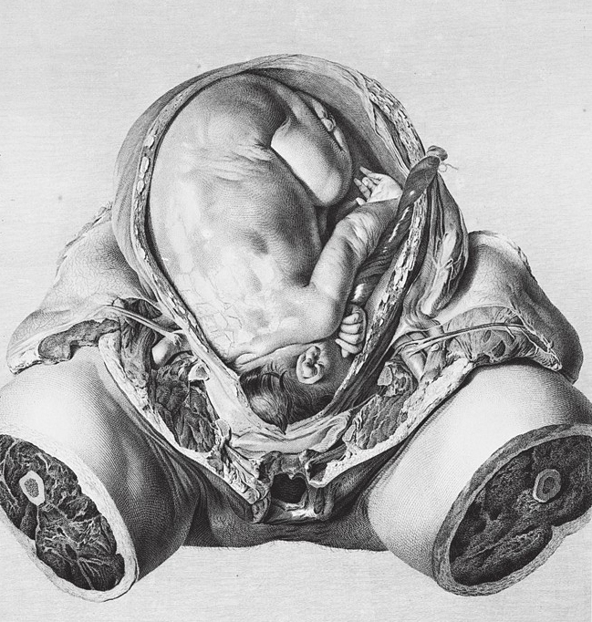
William Hunter Child in Womb from Anatomy of the Human Gravid Uterus 1774, England** NOT IN 250 Study of the human body became more prevalent Descriptions became more exact and complete, artist’s skills became a specialty for the instruction and practice of physicians and surgeons not a preliminary study but a tool for specialists contribution as a technological device

Slide 14
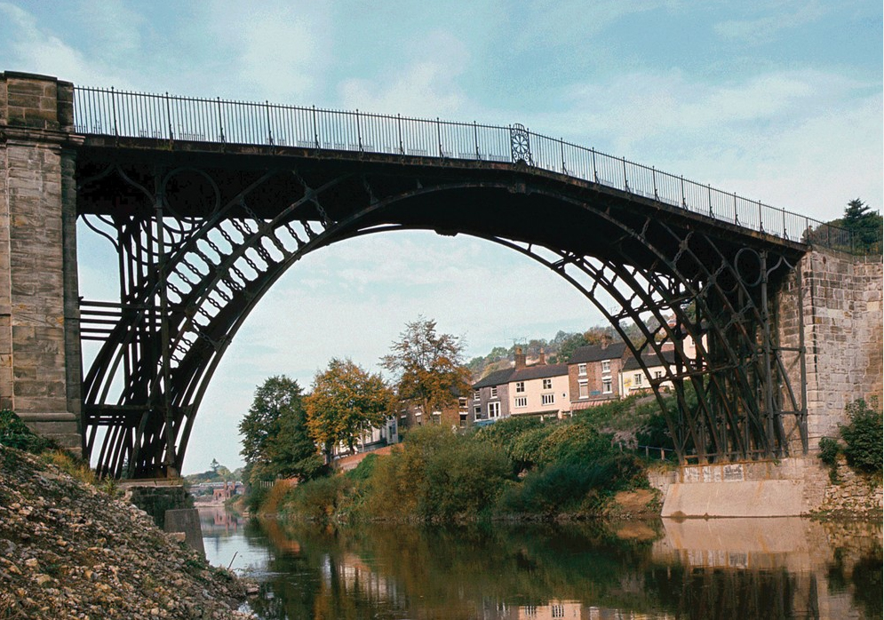
Abraham Darby III and Thomas E. Pritchard Iron Bridge at Coalbrookdale Coalbrookdale, England 1776-1779 *NOT IN 250 use of industrial materials that foreshadowed the technology of the future first ever iron bridge, spans 100 ft, most bridges of stone and wood, could not handle industrial transportation prefigures skeletal iron structures of the 19th century

Slide 15
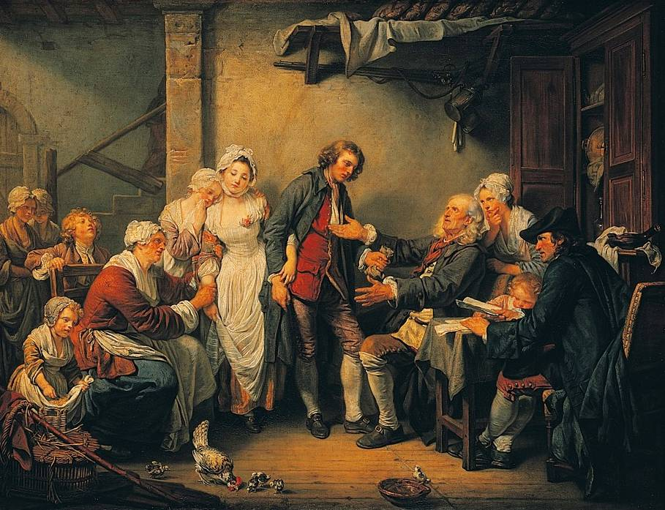
Jean-Baptiste Greuze The Village Bride 1761 oil on canvas, france ** NOT IN 250 SETTING IS UNADORNED ROOM IN RUSTIC DWELLING FATHER IS GIVING DOWRY TO HUSBAND-TO-BE, OVERSEEN BY NOTARY (NOT PRIEST) TEARFUL MOTHER HOLDING ON TO WIFE WHO IS HOLDING HUSBAND’S HAND, JEALOUS SISTER LOOKS ON HAPPY CLIMAX OF RURAL MARRIAGE MORAL IS HAPPINESS IS THE REWARD FOR MORAL VIRTUE HIS WORK WAS EMBRACED BY MIDDLE CLASS, WHICH WAS TURNED OFF BY FRIVIOLITY OF ROCOCO

Slide 16
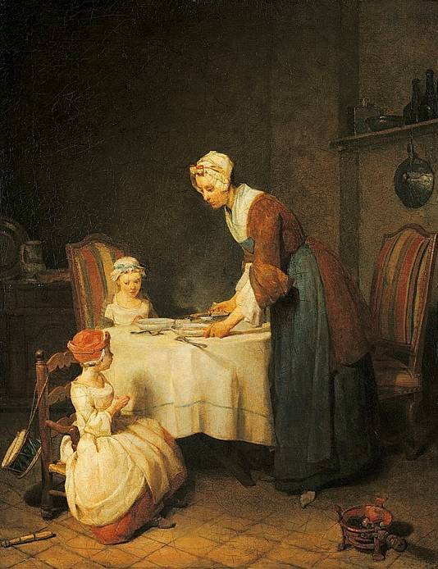
Jean-Baptiste-Siméon Chardin Grace at Table 1740 oil on canvas, france ** NOT IN 250 middle classes preferred narratives with moral lessons quiet scenes of domestic life, praising the simple goodness of ordinary people mother and daughters are about to dine, mother and older sister are supervising youngest daughter praying before a meal muted lighting, illuminated figures with dark background, still life accessories unpretentious house of urban middle class

Slide 17
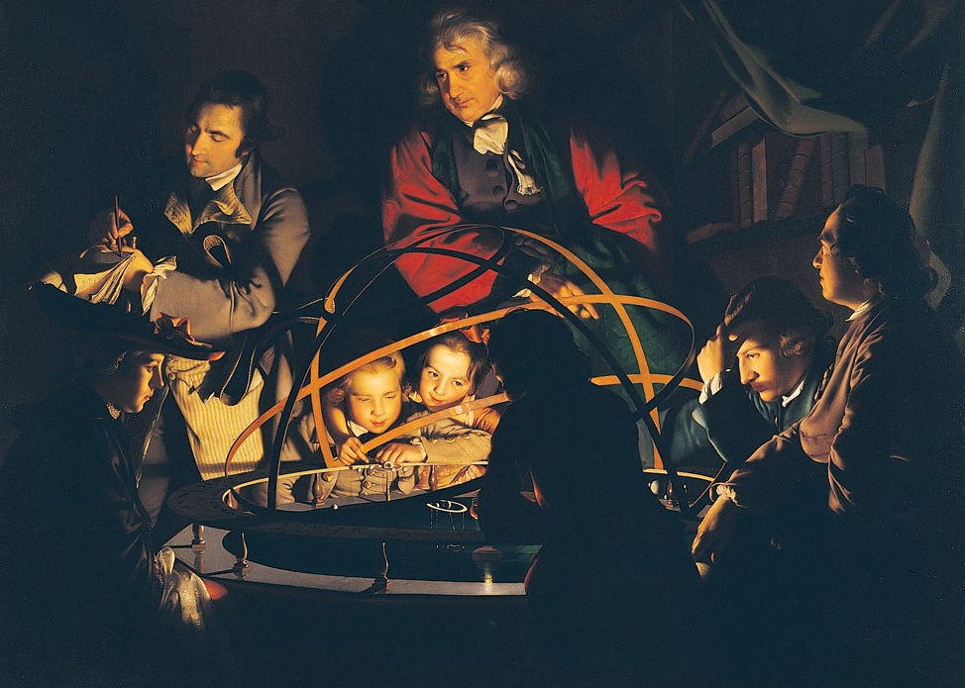
Joseph Wright of Derby A philosopher giving a lecture at the orrery 1768 oil on canvas, england

Slide 18
Joseph Wright of Derby
Joseph Wright was born in Derby, England
Lived there his entire life
Called “of Derby” to differentiate himself from another painter of the same name
Most prominent painter of the 18th century
Operated outside the constraints of mainstream London art world
Free to explore general interest in science with his friends, that included the grandfather of Charles Darwin
Known for deft depictions of contrasts between light and dark
Also unflinching portrayal of subjects, unpopular as a portrait painter
Joseph Wright of Derby was the unofficial artist of the Enlightenment, depicting scientists and philosophers like gods and Biblical heroes

Slide 19
Context
Key idea of Age of Enlightenment-empirical observation grounded in science and reason can advance society
Shows philosophical shift from traditional religious models towards universal, empirical approach
Scientific investigation allowed for humans to understand their world in a new way: electricity, combustion, steam power, iron, was combined with a celebration of progress

Slide 20
Orrery
Orrery is a mechanical model of the solar system, like a miniature, clockwork planetarium
Planet with moons rotates on a swing arm that allows it to rotate around the sun when cranked by hand
When in motion it depicts the orbits of the planets and their relative relationship to each other
Orrery depicted by Wright has large metal rings which can simulate eclipses, giving it three dimensional capabilities

Slide 21
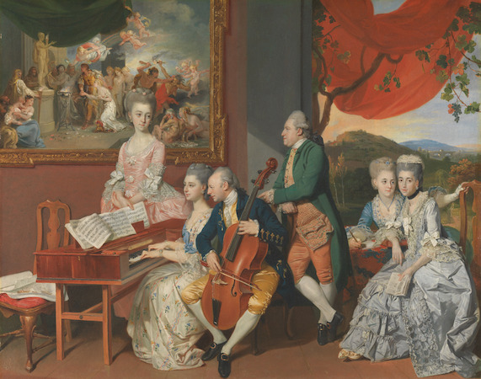
Scientific discovery
1760s-Wright began to explore boundaries of painting
History painting was considered the highest genre of painting
Depicting Biblical or classical subjects to demonstrate a moral lesson
Took this method of portraying events to apply to a contemporary, scientific subject

Slide 22
Not a moral on leadership or heroism, moral is pursuit of scientific knowledge
Collection of non-idealized men, women, boys, and girls informally arranged in a small physical space around a central organizing point
Mimics an informal group portrait, like Zoffany’s below
Uses dramatic lighting and scale
Depicts a religious ephiphany
Zoffany’s Gore Family, 1775, oil on canvas

Slide 23
Content
Clearly modeled on specific people, but was not meant to be a conversation piece
Deliberate selections of individuals to be in the same space, though it may never have happened
Man standing, taking notes: Peter Perez Burdett, Wright’s friend
Man seated to far right: Washington Shirley, 5th Earl Ferrers, initial owner of the work Several theories about the philosopher: Issac Newton or member of Lunar Society in Birmingham

Slide 24
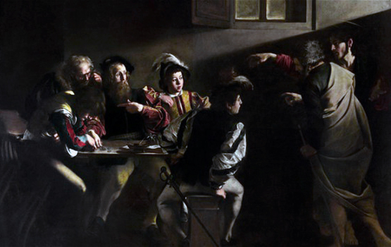
FOrm
Light illuminates faces, everyone in rapt attention
Internal light source, lamp takes on role of sun
Earlier, light source would have been Christian subjects (such as Jesus)
Mimics Caravaggio inserting strong light sources in dark compositions to create a dramatic effect
Gas lamp acts as a sun, symbolizing the active enlightenment in which those figures are participating Ordinary lecture becomes a history

Slide 25
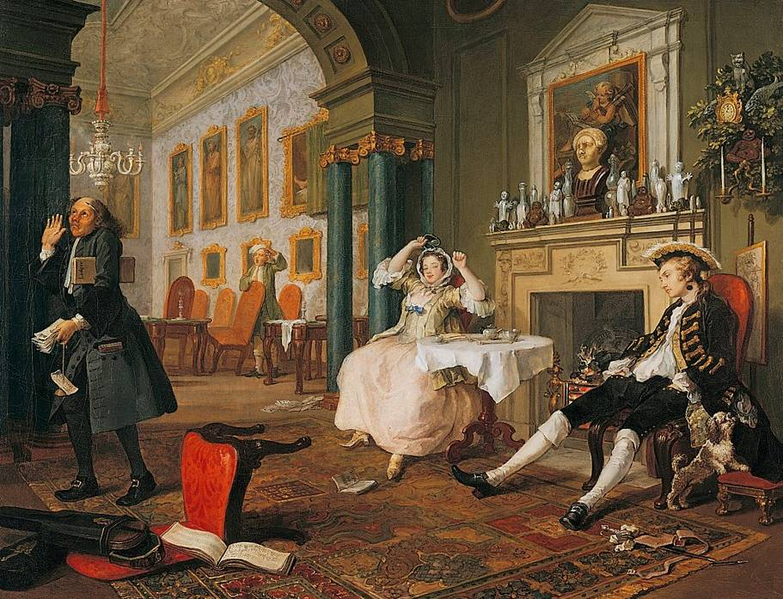
William Hogarth Breakfast Scene from Marriage à la Mode ca. 1745 oil on canvas, England

Slide 26
Marriage a la Mode Series
Set of 6 paintings
Best known for prints, not paintings
Beginnings of Industrial Revolution and middle class that wants to buy art
Aristocracy is losing power
Art had served monarchs and church
Prints are sold to public, art as a commodity
Less expensive than paintings
Wanted to use paintings as a model for prints he would produce
Sold for more than working class
Art and commerce connection

Slide 27
Marriage a la Mode Series
Purpose is to make fun of aristocracy
Marriages were arranged for economic benefits than love
A la mode-of the day
Tell story of aristocratic family
Squanderfields
Son marries daughter of wealthy merchant, to get money
Daughter gets last name of well-known family
Economic deal taking place

Slide 28
Marriage Settlement
Called the Marriage Contract by Hogarth
Earl’s mansion is being built outside the window
Needs to be financed
Usurer negotiates for further payment
Attending to business transaction
Architect stares out the window
Everyone for their own purposes
Earl shows his lineage going back to medieval period
From William the Conqueror
Gout-ridden foot
Merchant is miserly
Son looks at himself in mirror, in blue; not paying attention to his wife-to-be
Sad daughter is consoled by lawyer, Silvertongue
Making fun of him
Two dogs chained mirror the fate of the couple

Slide 29
Tete a Tete
hogarth satirized contemporary life , which appealed to prosperous and confident middle class created a series of narratives that follow a character or group of characters in their encounters with some social ill from the “marriage a la mode” series that show the immoralities practiced by the English moneyed classes husband has been out all night, woman’s cap in his jacket religious images and erotic images designed to be a series of engravings-appeal of subjects and democratization of knowledge

Slide 30
Tete a Tete
Face to face, head to head
Husband has returned from night of gambling, drinking, and womanizing
Dog is sniffing at bonnet
Bodice is undone, chair is overturned, implication of lovemaking and has just ended
Music was symbol of pleasure and lovemaking
Also images of saints to judge this
Accountant is giving up because the couple can’t manage their finances
Knick knacks that look recently bought and are very gaudy
Contrasts with portraits in gilded frames
Reputation of aristocracy that doesn’t reflect the reality of their lives
Back room-nude foot that is partially covered, indicating a nude portrait
Classical sculpture with nose broken, Cupid in ruins, love in ruins

Slide 31
Inspection
Takes place in doctor’s office
Doctor on left is cleaning glasses
Not a good inspection
Both he and woman are suffering from syphilis
So does Lord Squanderfield
Throughout canvases, likely visiting prostitutes, infecting wife and other young woman
Young woman applying ointment to sore
Remove sympathy for young man
Telling him the medicine isn’t working
Caricature of figures
Cabinet
Model of human figure and skeletal model
Skull is symbol of death
Not taking it seriously

Slide 32
Toilette
Woman is at her dressing table, getting hair and makeup done
Surrounded by friends
Not with child
Coral beads nearby tells us there is a child
Bedroom is a public place, not uncommon for aristocracy
Far left, counselor Silvertongue
At ease, illicitly her lover
Figures suffering from syphilis
Paintings on wall comment
Trespassing of norms of behavior
Zeus disguising himself to have a love affair
Foreshadows what is in the next painting

Slide 33
Bagnio
At night, not in aristocratic house
Where Silvertongue and wife went after the ball
Room to hire when you were being secretive
Woman on her knees, Silvertongue leaves through window
Has just stabbed the husband
Wife is pleading for forgiveness

Slide 34
Lady’s Death
Shows the death of the wife
Wife has poisoned herself
Read that her lover has been hanged for murder of her husband
Brings child to mother to say goodbye
Has syphilis spot on her cheek
Father takes gold ring from her and dog eats from table
Shows greediness
Problems with this type of marriage
Back in her home
Thames river and city through window
Reminder of how London had changed so drastically

Slide 35
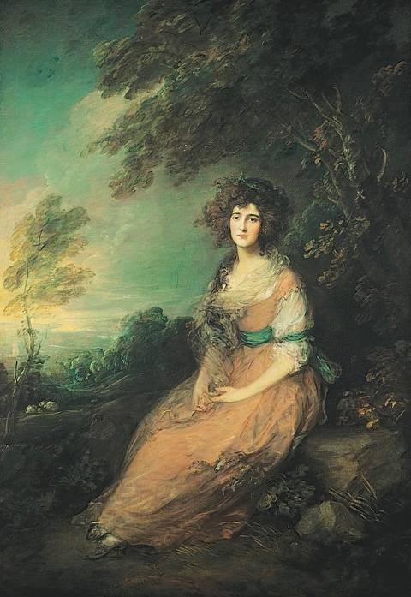
Thomas Gainsborough Mrs. Richard Brinsley Sheridan 1787 oil on canvas, England** Not in 250 naturalistic representation in a rococo setting woman dressed informally, seated in a rustic landscape soft hued light and wispy brushstrokes deep interest in landscape painting grand manner portraiture: he was one of the leading painters while they were individualized, they were also elevated by conveying refinement and elegance: large scale of figures relative to the canvas, controlled poses, landscape, low horizon

Slide 36
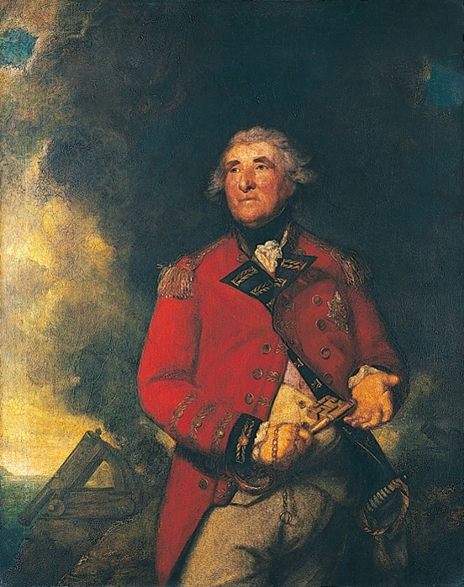
Sir Joshua Reynolds Lord Heathfield 1787 oil on canvas, England ** NOT IN 250 also part of “naturalness” was honor, valor, and love of country nobility related to character, not birth courage, patriotism, and self-sacrifice assumed greater importance specialized in portraits of contemporaries who participated in great events commander of the fortress at gibralter, had defended itt against the spanish and the french holds large key, which symbolizes his control of forthress refer to actual revolutions

Slide 37
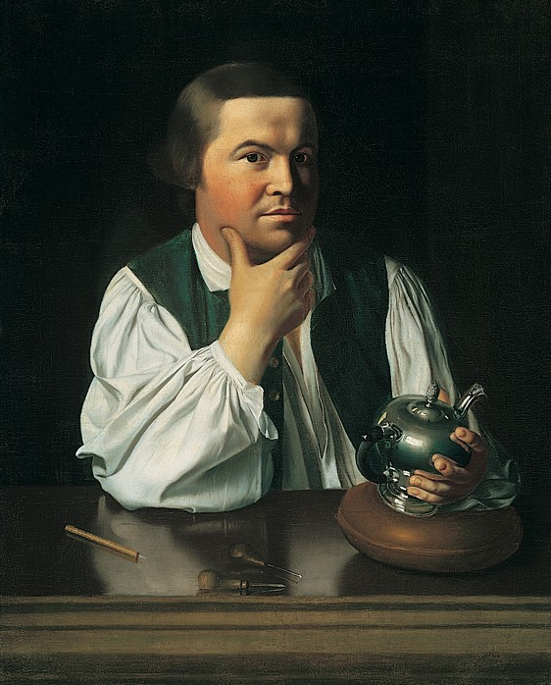
John Singleton Copley Portrait of Paul Revere ca. 1768-1770 oil on canvas, America ** NOT in 250 influenced by grand manner portrait style sense of directness and faithfulness to plainness of america at this time working in his everyday profession as a siversmith looks viewer straight in the eye reflections are treated with care prominence to his eyes spare style and emphasis on down to earth character

Slide 38
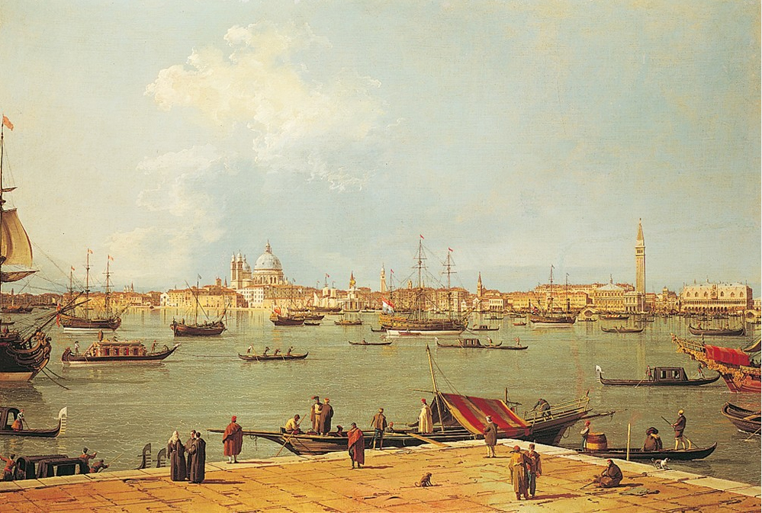
Canaletto dome of the Chapel of Saint Ivo College of the Sapienza Rome, Italy ** NOT IN 250 naturalness was also sought in landscapes, documentation of particular places became popular also served the needs of scientific expeditions and mementos of vacations for nobility grand tour was considered part of a well-educated person Vedute (views) of the city to sell to the british as evidence of their visit trained as a scene painter, made drawings on location, and then painted in the studio used the camera obscura

Slide 39
Camera obscura
Used darkened chambers, some like portable closets
Optical lenses fit into a hole in one wall through which light projected an inverted image on to the chamber’s opposite wall
Artist could trace the maid details from this image for later re-working and refinement
Allowed painters to create a visually convincing painting that included variable focus of objects at different distances

Slide 40
Rococo

Slide 41
Rococo-Context
Death of Louis XIV brought aristocrats from Versailles into towns
Caused resurgence of aristocratic social, political, and economic power
Retained traditional privileges and extended their power
Re-established their roles as patrons
Rococo is associated with the reign of Louis XV
Appeared around 1700
Perfect expression of the gaiety of the wealthy
“Rococo” comes from the world rocaille (pebble), but refers to small stones used to decorate grotto interiors.
Shells and shell forms were principal motifs in Rococo ornament.
Seminal idea of Rococo art
Visual pleasure (a reaction to the heavy classicism of Versailles)
Expressing the optimism of the Enlightenment and the pursuit of pleasure/celebration of love
Difference between Baroque and Rococo art
Baroque was primarily religious (context and subject matter) coming out of southern Europe
Rococo was secular in nature, originating in France

Slide 42
Rococo-Notes from Kenneth Clark
Stylistic roots of northern Rococo architecture
Southern Baroque architecture, especially Borromini
Northern European (Germanic) tradition of local craftsmanship
Visual appearance of architectural interiors done in the Rococo style
Curvilinear/undulating surfaces
“sweetness’
lavish
“decorative invention”
Joyful
Child-like (cupids)
Elegant
Overdone
Ornate
Intricate
Complex
Decorative
Melodious flow
Delicate
Stylized
Optimistic

Slide 43
Watteau, Return to Cytherea, 1719, Rococo, France, oil on canvas** Not in 250
-Responsible for the type of painting called “Fete galante” amorous festival
-Depicted the outdoor entertainment or amusements of French high society
-Was the artist’s entry into the French Royal Academy of Painting and Sculpture (a new category was created to accept his entry)
-Two competing doctrines divided the French academy. Poussin believed that form was the most important element. Rubens said color was.
-Watteau was influenced by Rubens
-Cytherea-land of eternal youth and love, sacred to Aphrodite
-Experimented with nuance of posture and movement, also shades of color difference

Slide 44
Boucher, Cupid a Captive, 1770, Rococo, France, oil on canvas ** not in 250
-Dominated French painting after death of Watteau, mostly because of Madame du Pompadour’s patronage
-Popular because of his works of nymphs and goddesses
-Pink and rosy flesh against green leaves
-Used criscrossing diagonals, curvilinear forms, slanting recessions (Baroque devices), but changes them

Slide 45
Fragonard, Swing, 1754, Rococo, France, oil on canvas
-Student of Boucher
-Old bishop swings young woman while her younger lover watches from below
Pink and lacy white in center of painting
Sitting on red, velvet and gold seat
White silk stocking, flips shoe into the air
Woman kicks off shoe towards Cupid
-Colors also convey sensuality
Decades before revolution
Decadence and pleasure that characterizes the aristocray
About only pleasure
Enlightentment artists and thinkers are going to call for a more virtuous art, not base human aspiration

Slide 46
Pink and lacy white in center of painting
Sitting on red, velvet and gold seat
White silk stocking, flips shoe into the air
Figure in left corner looking down
Being pushed by another man, slightly older
Ignorant of young man in front
Inside a fence, not supposed to be there
Hiding
Shows an angel, putti, who shushes
Make out architecture in the distance
Garden that is overgrown and out of control
Fertile and speaking to sexual and sensual being
Dream-like trees and mists
Blast and bough like lightning crossing the canvas
Appropriate
Other putti being playful
With beehive, stings of love
Dog yapping
Symbol of fidelity
Little upset, giving the secret

Slide 47
Clodion, Nymph and Satyr, 1775, Rococo, France, terracotta** NOT IN 250
-Small scale works for intimate moments and fantasies
-Incorporates Mannerist sculpture
-Both satyr and nymph were followers of Bacchus (god of wine)
-Designed for a tabletop

Slide 48
Boffrand, Hotel de Soubize, 1740, Rococo, France**NOT IN 250
-Exteriors were plain but interiors were ornate
-Parisian salons were the center of Rococo social life, usurped the role of Versailles
-Lines are soft, flexible, sinuous, mirror reflections
-Irregular shapes, sculpture, separated by rocaille shells
-Curving tendrils, look like nature
-Permanently prepared for a festival

Slide 49
De Cuvillies, Amalienburg, 1740, Rococo, Germany ** NOT IN 250
-Feminine look of Rococo style suggests the tastes and social initiative of women
-Madame du Pompadour (mistress of Louis XV), Empress Elizabeth and Catherine the Great of Russia
-Salons as center of society, hosted by women to attract accomplished people to their salons (femmes savantes- learned women)
-Importance of wit and artifice
-Show interplay of stucco, relief, bronze mirrors, and crystal
-Reflections of light play on the walls and ceiling coves
-Everything seems organic, growing, and in motion

Slide 50
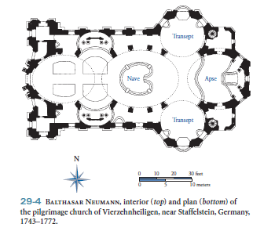
Neuman, Veirzenhnheiligen, 1772, Rococo, Germany** NOT IN 250
-Pilgrimage church in Germany
-Dynamic fantasy, like Southern Baroque, but without dark drama
-Light, colorful, and delicate
-Plan is made up of tangents, ovals, and circles, undulating space with continuous motion

