Slide 1
PART 3
FLORENTINE RENAISSANCE ART
EARLY RENAISSANCE 1450

Slide 2
Context
Cosimo Medici establishes his Neo-Platonic Academy:
Cosimo “rules” Republic of Florence by 1434, then Piero, the Lorenzo, Medici are exiled in 1494
Showed advancement of humanistic and scientific knowledge
Expanding wealth of merchant classes and guilds.
Florence develops into powerful and wealthy republic with a few merchant families controlling politics of city
Caused the merchant and artisan classes challenging the entrenched position of nobility
International trade and banking continued growth of cities
Wealthy patrons support the arts
Creates unparalleled productivity in the arts
Accomplishments of Cosimo de Medici
Establish the florin as the most stable currency in Europe
Wool trade and fabric production with papal funds
Lenders of money to capitals of Europe
Serious student of ancient Greek and Roman culture
Commissioned works of art, founded and supported his Neo-Platonic Academy

Slide 3
Context
Expansion of national states
Discovery around the globe
Created a new world view, the individual’s relationship to the world-Humanism
Emergence of the artists’ social position
Sometimes equal to the status of their patrons
Created the idea of the artist as hero, as divinely inspired, as genius
Intellectual approach to beauty and art
Including the rediscovery of linear perspective
Created a relationship between mathematics, ratios, modules, proportions, harmony/balance/symmetry, and beauty
In Florence the Ghibellines are loyal to imperial ideal (aristocrats) vs. the Guelphs who are loyal to the Pope (middle classes)
Constantinople falls to the Ottoman Turks in 1453-final end of the “Eastern Roman Empire”
Church in Rome becomes a military and political force prone to abuses of power and wealth
Savonarola preaches reform, controls city by 1494, leading to a “Bonfire of the Vanities”

Slide 4
Neo-Platonic Academy & Humanism
Eternal absolutes of truth, goodness, and beauty only existed only in the divine mind
Such absolutes are not wholly within human grasp
Mortals, by learning, observation and creativity, could catch occasional glimpses of them
Truth by pursuing scientific knowledge
Goodness through performing and observing good deeds and through the experience of love, first physical then spiritual
Beauty through nature and experiencing great works of art
Rediscover the beauties of life in the here and now (not the hereafter)
Reaffirmation of man: “nothing is more wonderful than man”
Invention of the printing press (Gutenberg press invented in 1456)
Investigation of ancient texts and writers from Classical Greece and Rome
Promoted the revival of interest in the affairs of the everyday world
Reasserted the faith of men and women in themselves
Reinforce role of individuals in all spheres

Slide 5
TERMS AND TECHNIQUES
Perspective (one and two point)
Atmospheric perspective
Synoptic organization
Modeling
Chiarascuro
Sacra conversazione
Pietra serena
Rusticated stone

Slide 6
RENAISSANCE ARCHITECTURE
Use of Roman building motifs
Application of Classical elements to contemporary buildings
Use of geometry as a primary organizing device
Circle and square form the basis on design and proportion of plan, interior, and façade
Mathematic ratios and modular units in repetition as a basis for harmonic relationships – basis for the “beautiful”
Emphasis on symmetry, logic, and clarity
Crisp delineation by architectural elements and moldings done in pietra serena (gray stone) framing white plastered walls, apses, and domes
Emphasis on the wall as an important structural element
Facades separated into stories by horizontal string courses topped by a heavy cornice

Slide 7
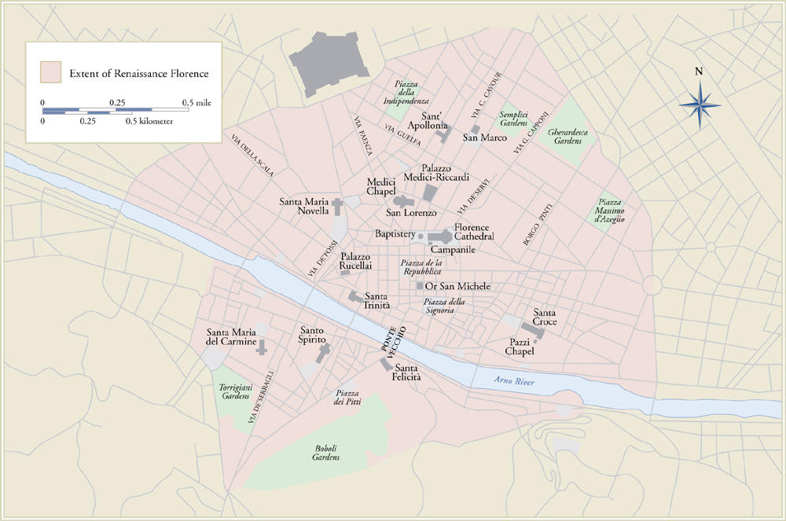
Renaissance Florence

Slide 8
ITALIAN ARCHITECTURE

Slide 9
Filippo Brunelleschi & Architecture
Was once a sculptor
Also a skilled goldsmith, mathematician, clock builder
Was responsible for building the Dome of Florence Cathedral
Known as the 8th Wonder of the World
Known as the father of modern engineering
Discovered mathematical perspective, championed the centrally-planned church over the medieval basilica
Four Rs
Rome-continued passion for the classics. Architects systematically measured their work against Roman ruins to copy their style and proportion
Revived elements like the rounded arch, concrete construction, domed rotunda, portico, barrel vault, and column
Rules- Architects considered themselves scholars rather than mere builders. Based their work on theories, expressed in treatises
Reason-Theories emphasized architecture’s rational bias, grounded in science, math, and engineering. Reason over the mystical approach of the middle ages
‘Rithmetic- depended on arithmetic to produce beauty and harmony. Systems of ideal proportions related parts of a building to one another. Layouts relied on geometric shapes, especially the circle and the square

Slide 10
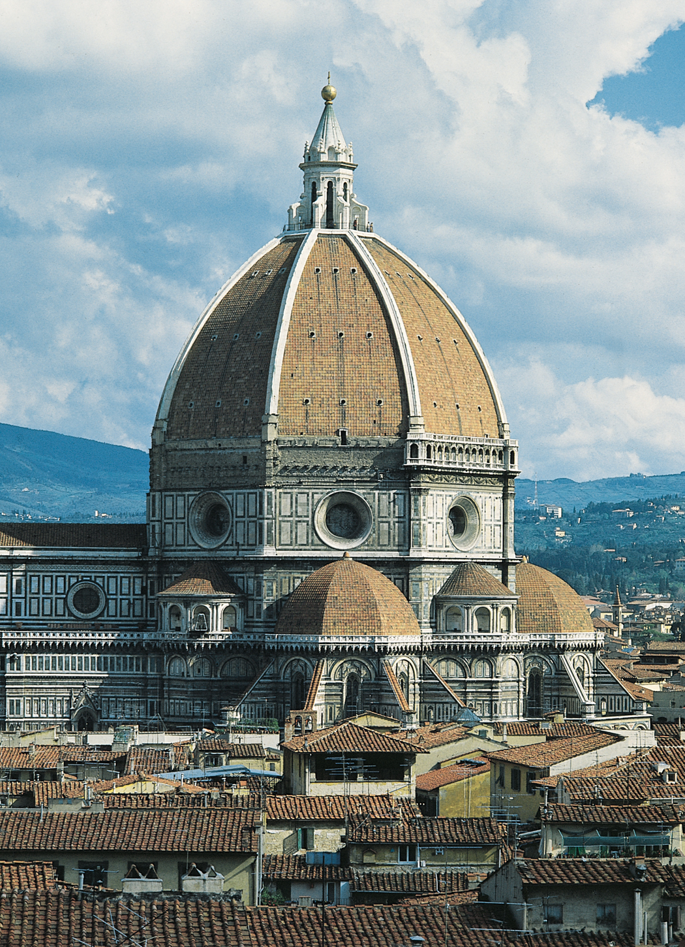
FILIPPO BRUNELLESCHI, dome of Florence Cathedral (view from the south), Florence, Italy, 1420–1436.

Slide 11
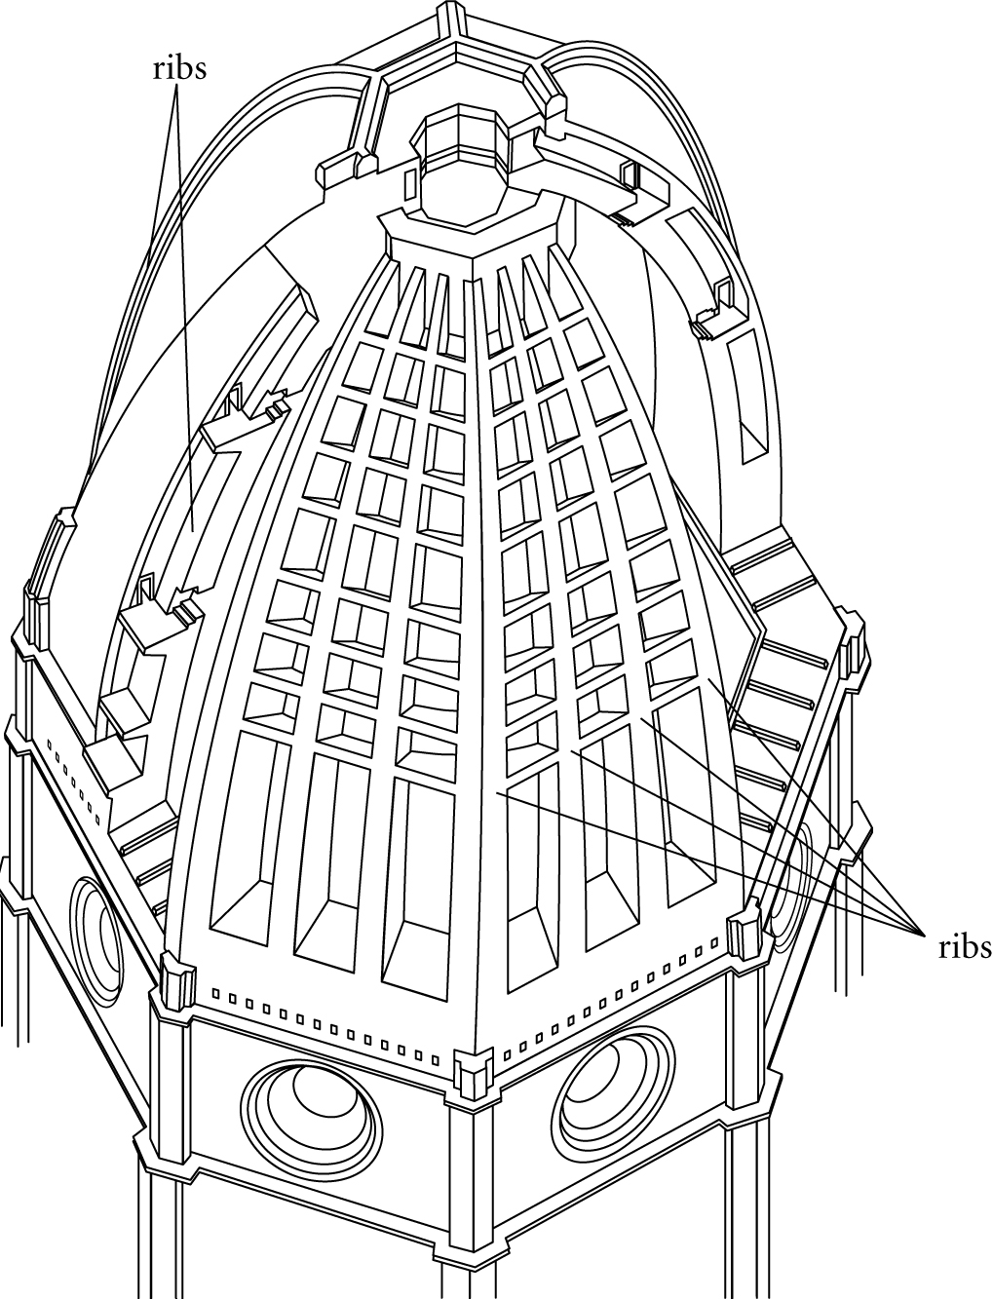
Cutaway view of dome of Florence Cathedral (after P. Sanpaolesi).

Slide 12
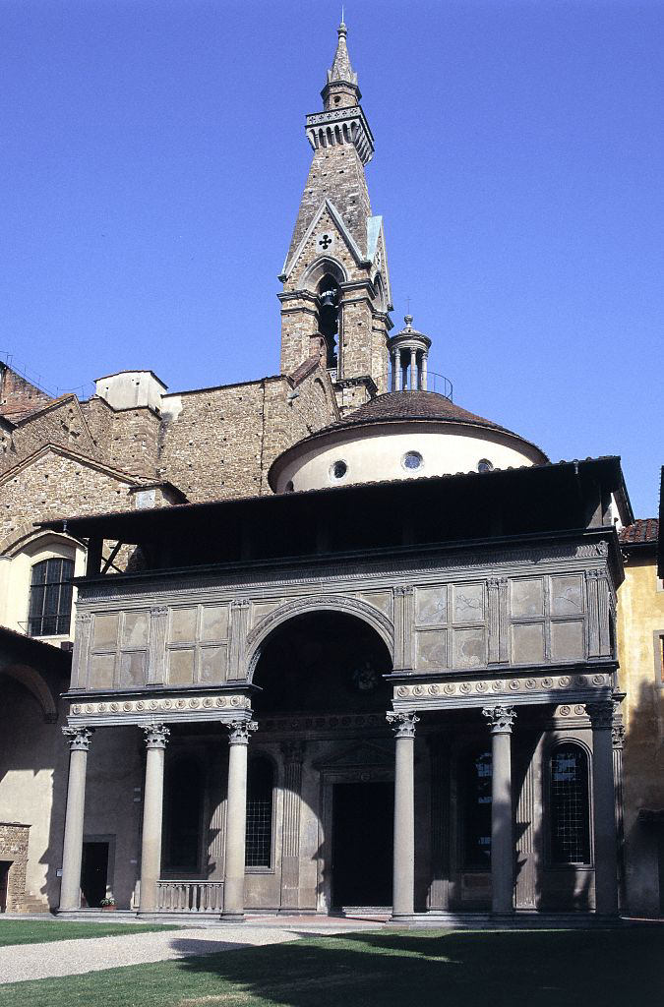
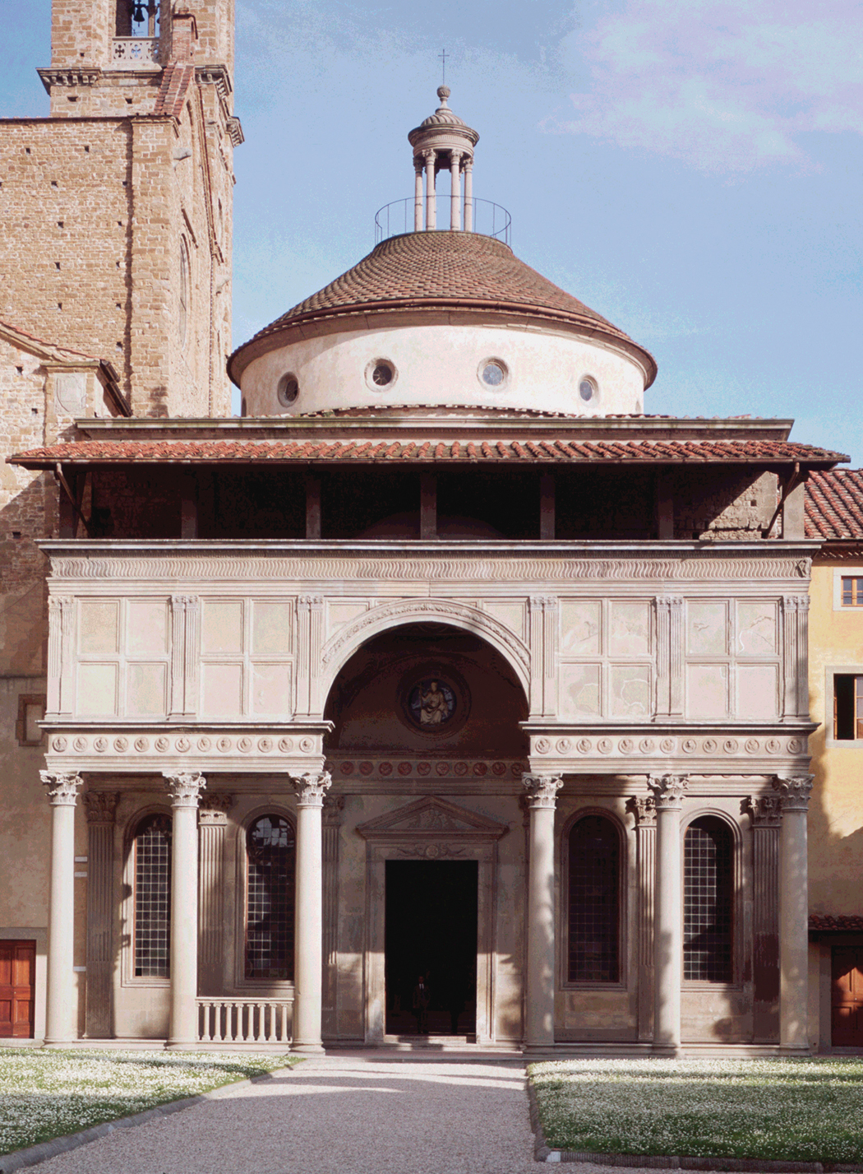
Figure 21-17 FILIPPO BRUNELLESCHI, facade of the Pazzi Chapel, Santa Croce, Florence, Italy, begun ca. 1440.
Pazzi chapel

Slide 13
Pazzi chapel
Dome supported by pendentives
Roundels on the pendentives
Transition into High Renaissance, became more obsessed with geometry, rational
Subservient to design
Portico in the front
Round arches
Dome dominates the façade
First independent Renaissance building conceived as a centrally-planned structure, all emphasis is placed on the dome, short barrel-vaulted sections support it (do not look like support, rather decoration)
Meeting room for monks of the church, off the cloister (where they lived)
Was a gift from the Pazzi family to the Franciscan church
Completed after his death
Pietra serena-gray-green stone, dominance of perfect geometry
Rectangles, circles, squares, and semi-circles
Like Ancient Roman temple
Centrally-planned like the Pantheon
Little broader than long
Dome has small barrel vaults
Took rectangular space to make it circular
Revival of Ancient Rome
Oculus
Windows that invite light

Slide 14
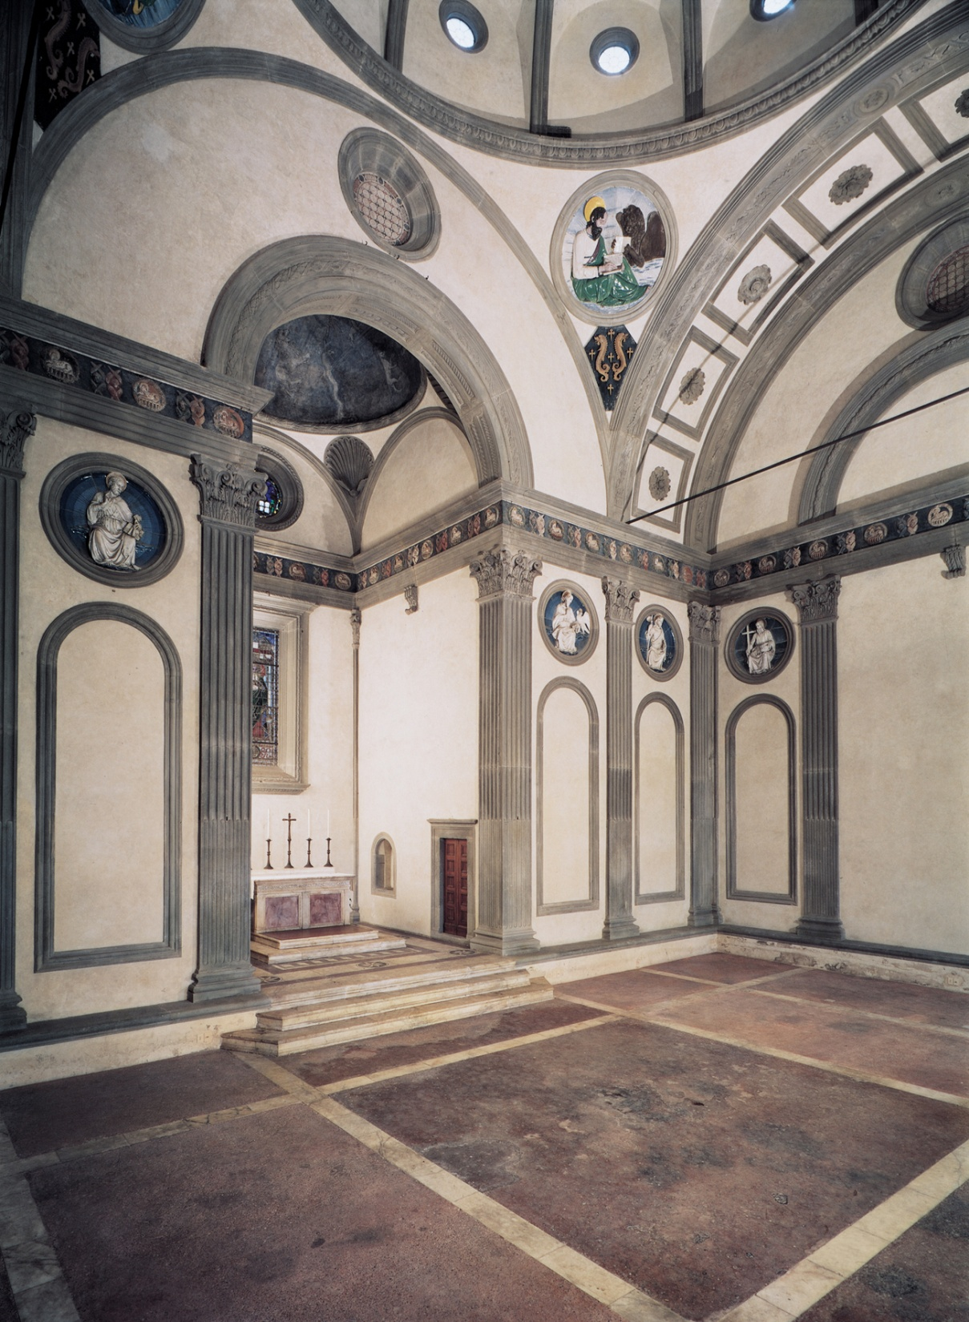
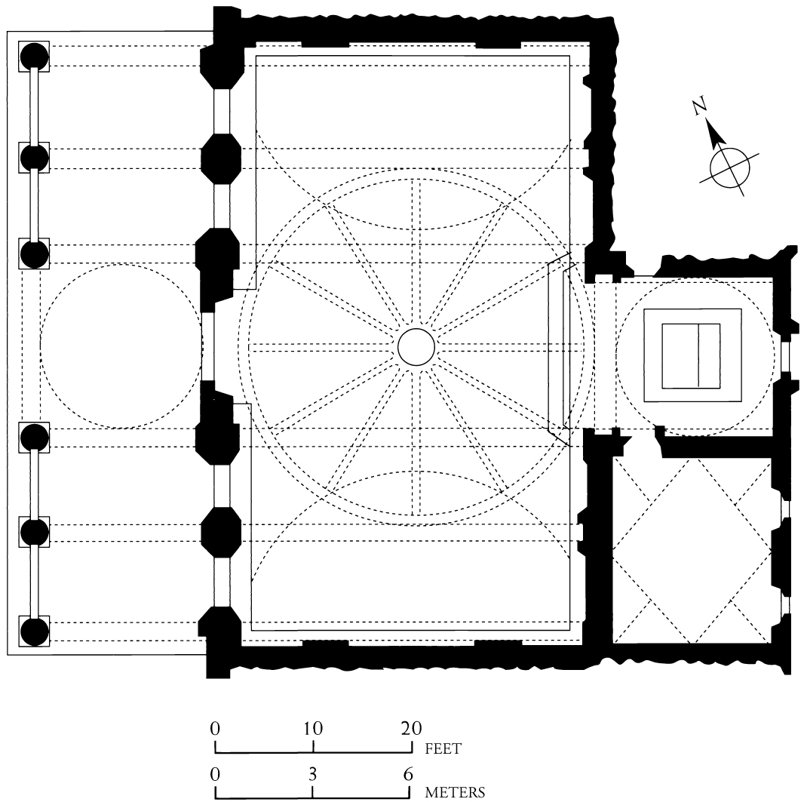
FILIPPO BRUNELLESCHI, interior of the Pazzi Chapel (view facing northeast), Santa Croce, Florence, Italy, begun ca. 1440.

Slide 15
LEON BATTISTA ALBERTI Palazzo rucellai
Builds on the humanist architecture of Brunelleschi
Private dwelling rather than public building
Alberti-wrote “On Painting and On Architecture” which established the guidelines for the creation of paintings and buildings that would be followed for centuries
Wanted to design a building completely divorced from the medieval style and be considered quintessentially Renaissance
Medici wanted more “low profile palace” to be politically wise
Divided into three tiers divided by horizontal entablatures
First tier uses rusticated stone- rough, unfinished masonry; also uses large stone blocks, and post-and-lintel construction with square windows
Tiers decrease in height from bottom to top
Used smaller stones to give the feeling of lightness, enhanced by the round arches
Different types of pilasters-Tuscan on botton, Ionic in middle, Corinthian on top
Called “trabeated” thought by Alberti to be fitting for homes of the nobility
Each tier uses pilasters (flattened, engaged columns) to visually support the entablature
Heavy cornice is like a lid for the structure

Slide 16
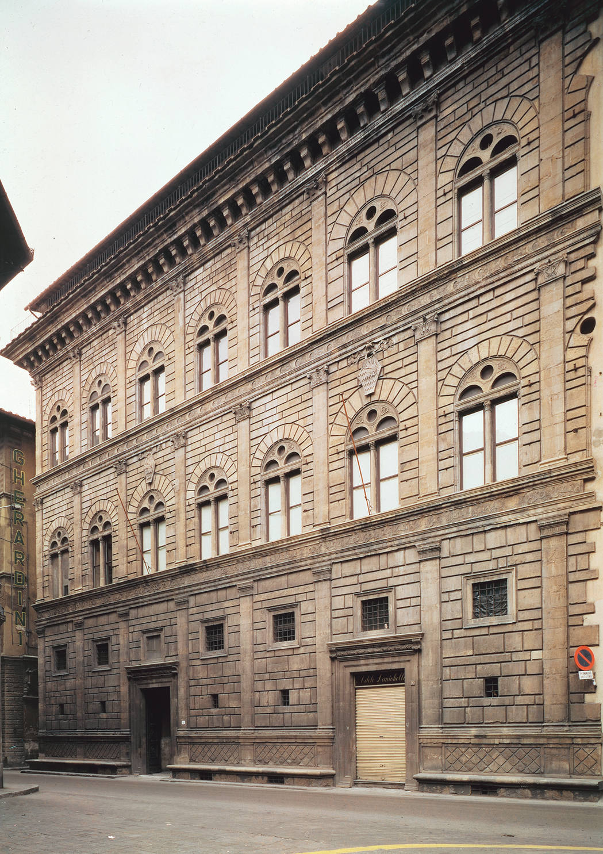
Palazzo Rucellai
Palazzo=palace, shows the stability of the Florentine economy and affluence of its citizens
Made for the Rucellai family
Actually had four floors
First-where the family conducted their business
Second- piano nobile, where they received their guests
Third-family’s private apartments
Fourth-hidden, which had few windows and was not visible from the streets, where the servants lived
Influence of ancient Rome
Similar to the Colosseum, exterior was divided into tiers
Uses architectural features for decoration rather than support
Order of the column changes, from least to most decorative

Slide 17
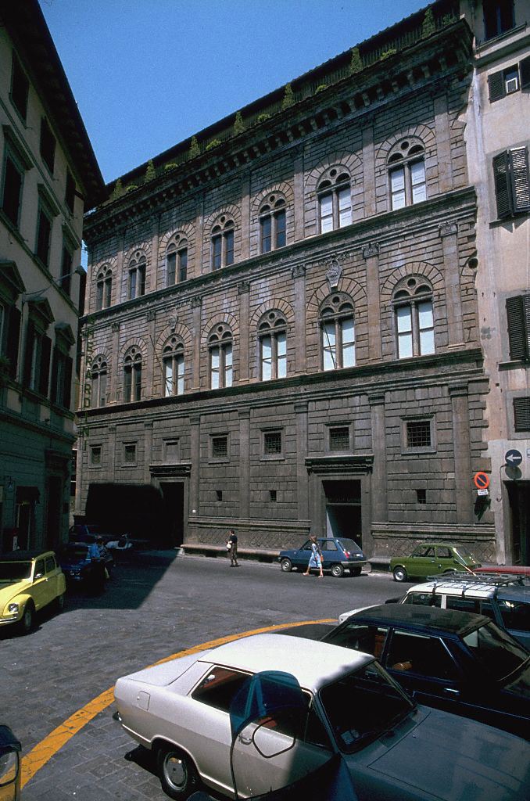
Alternate View General view of facade on Via della Cigna Nuova
© 2005 Saskia Cultural Documentation, Ltd.

Slide 18
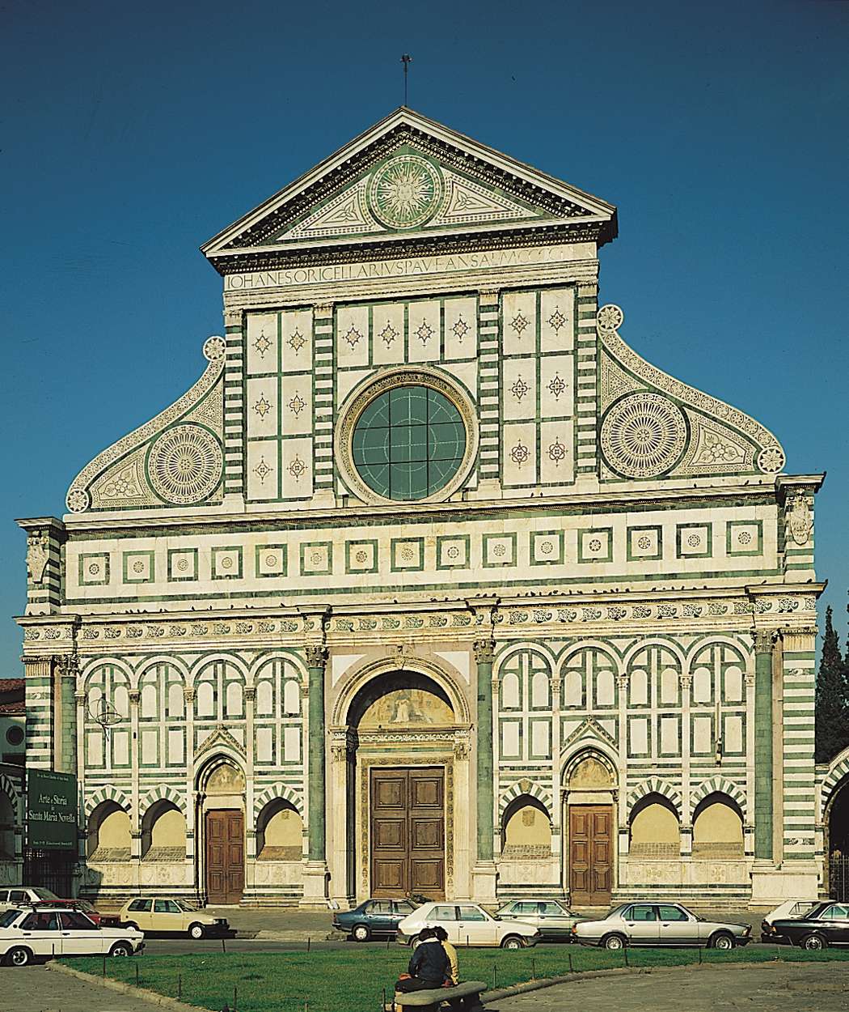
west facade of Santa Maria Novella, Florence, Italy, ca. 1458–1470.
LEON BATTISTA ALBERTI,

Slide 19
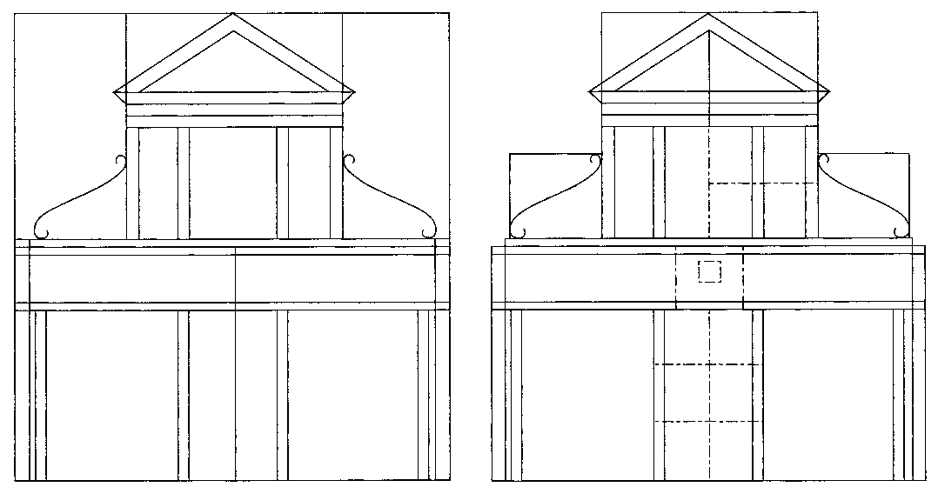
LEON BATTISTA ALBERTI, diagrams of west facade, Santa Maria Novella, Florence, Italy.

Slide 20
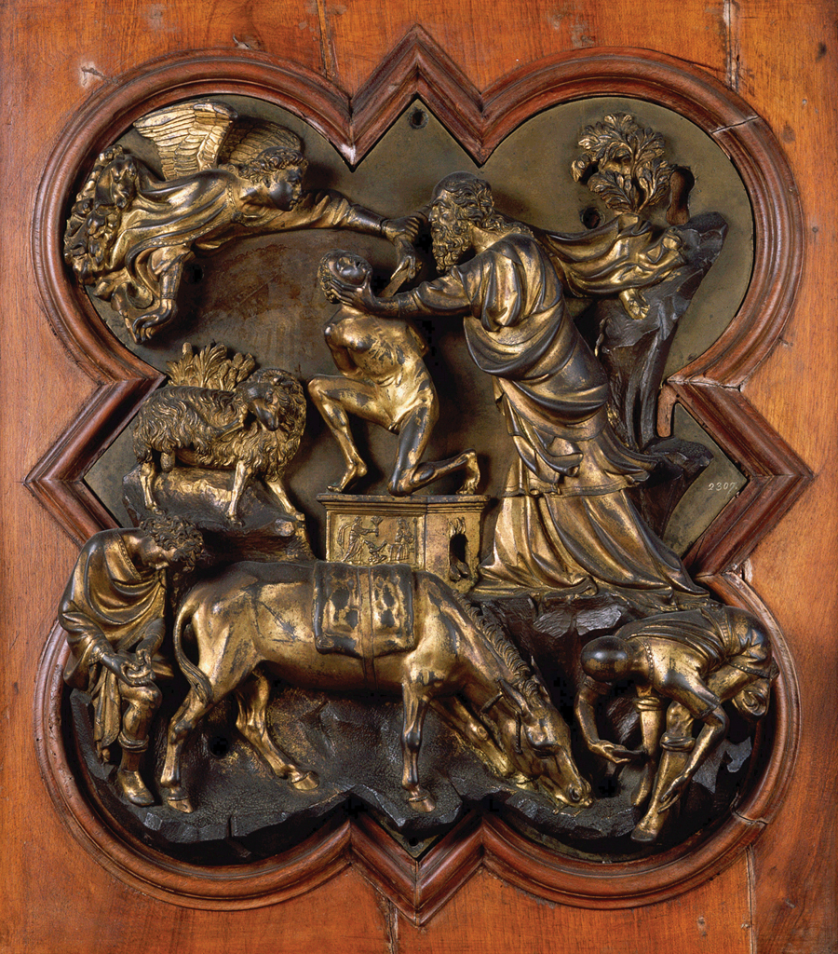
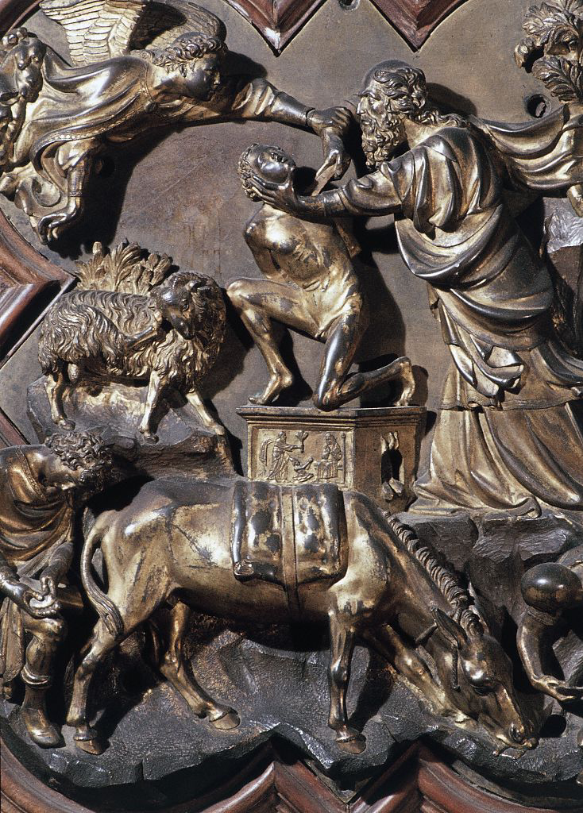
Sacrifice of Isaac, competition panel for east doors, baptistery of Florence Cathedral, Florence, Italy, 1401–1402. Gilded bronze relief, 1’ 9” x 1’ 5”. Museo Nazionale del Bargello, Florence.
FILIPPO BRUNELLESCHI

Slide 21
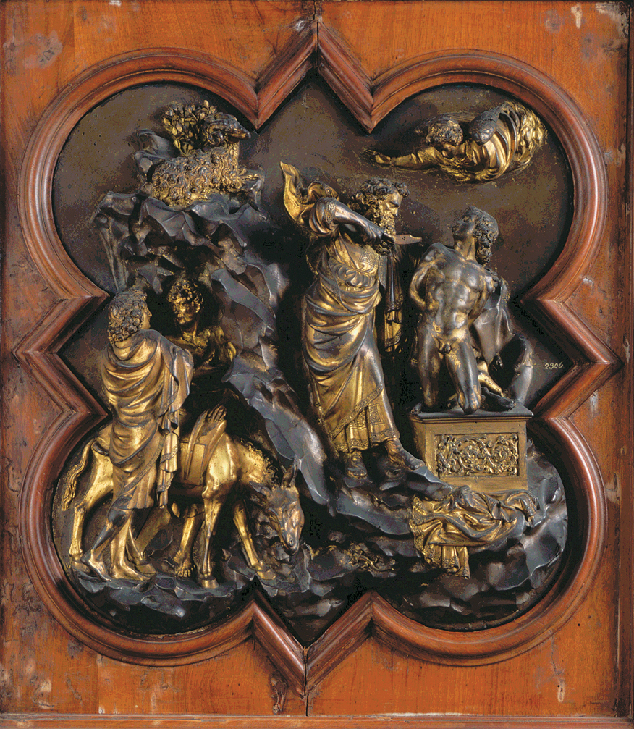
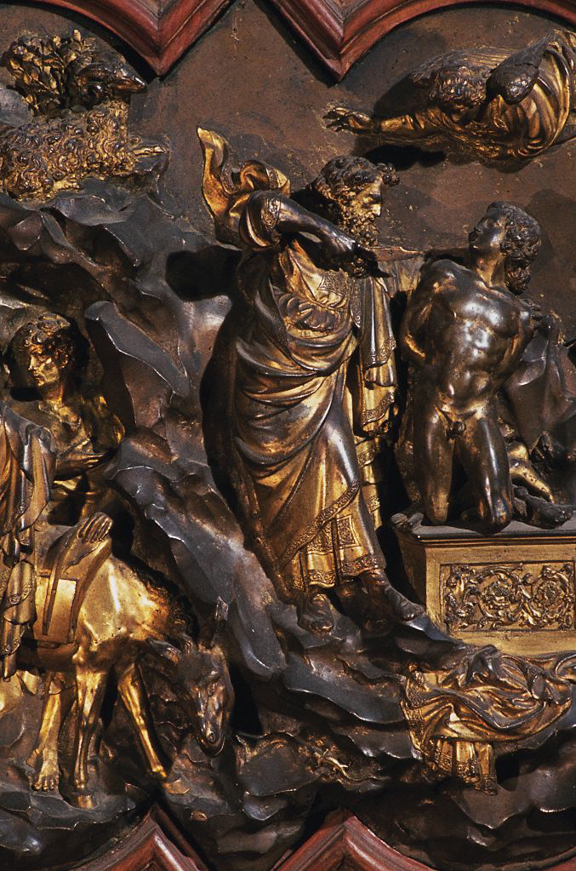
Sacrifice of Isaac, competition panel for east doors, baptistery of Florence Cathedral, Florence, Italy, 1401–1402. Gilded bronze relief, 1’ 9” x 1’ 5”. Museo Nazionale del Bargello, Florence.
LORENZO GHIBERTI

Slide 23
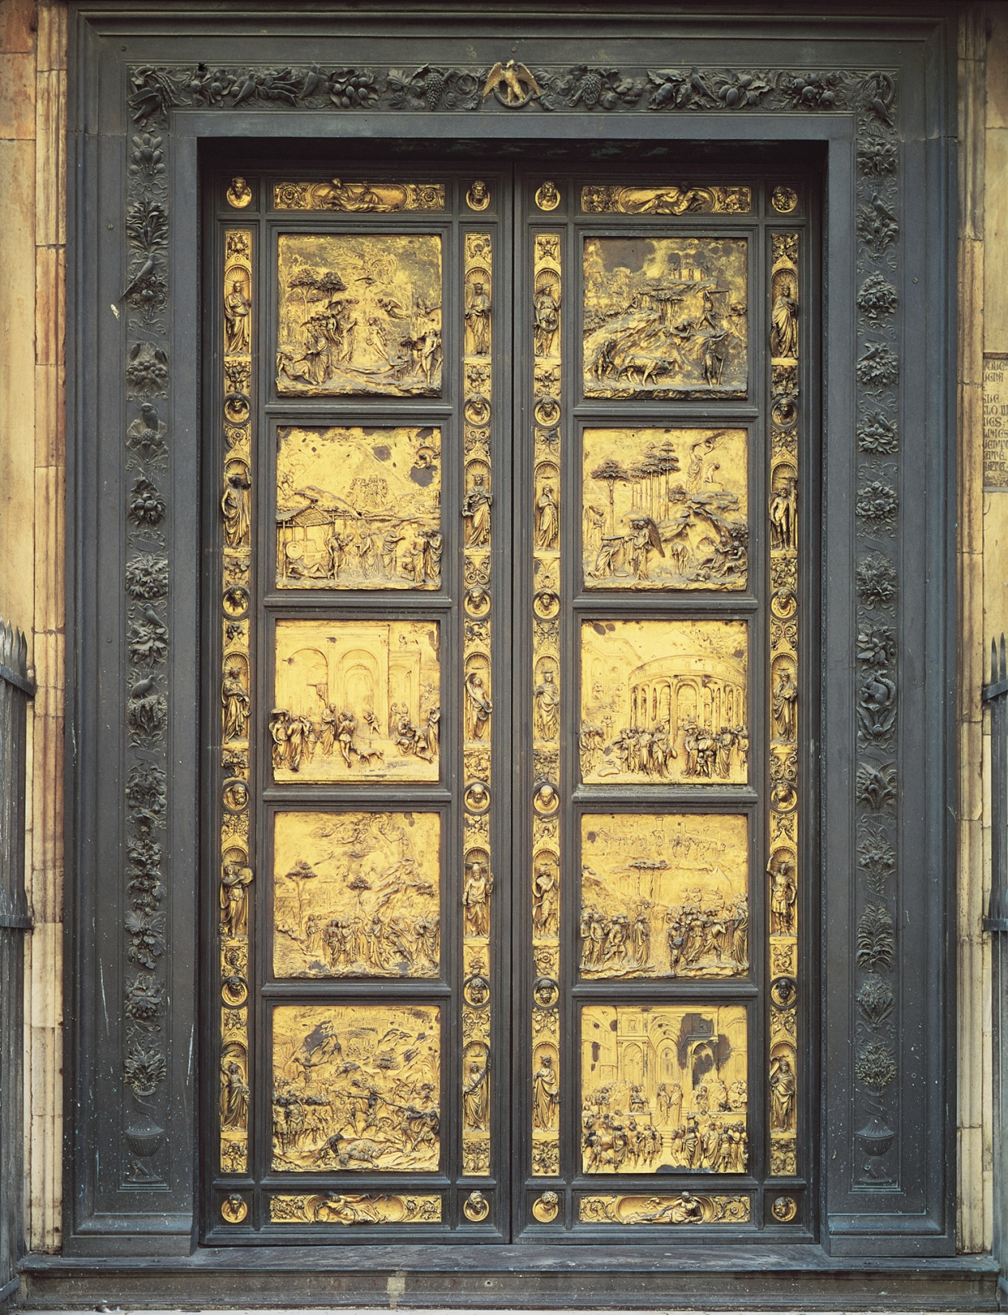
LORENZO GHIBERTI, east doors (“Gates of Paradise”), baptistery, Florence Cathedral, Florence, Italy, 1425–1452. Gilded bronze relief, approx. 17’ high. Modern copy, ca. 1980. Original panels in Museo dell’Opera del Duomo, Florence.

Slide 24
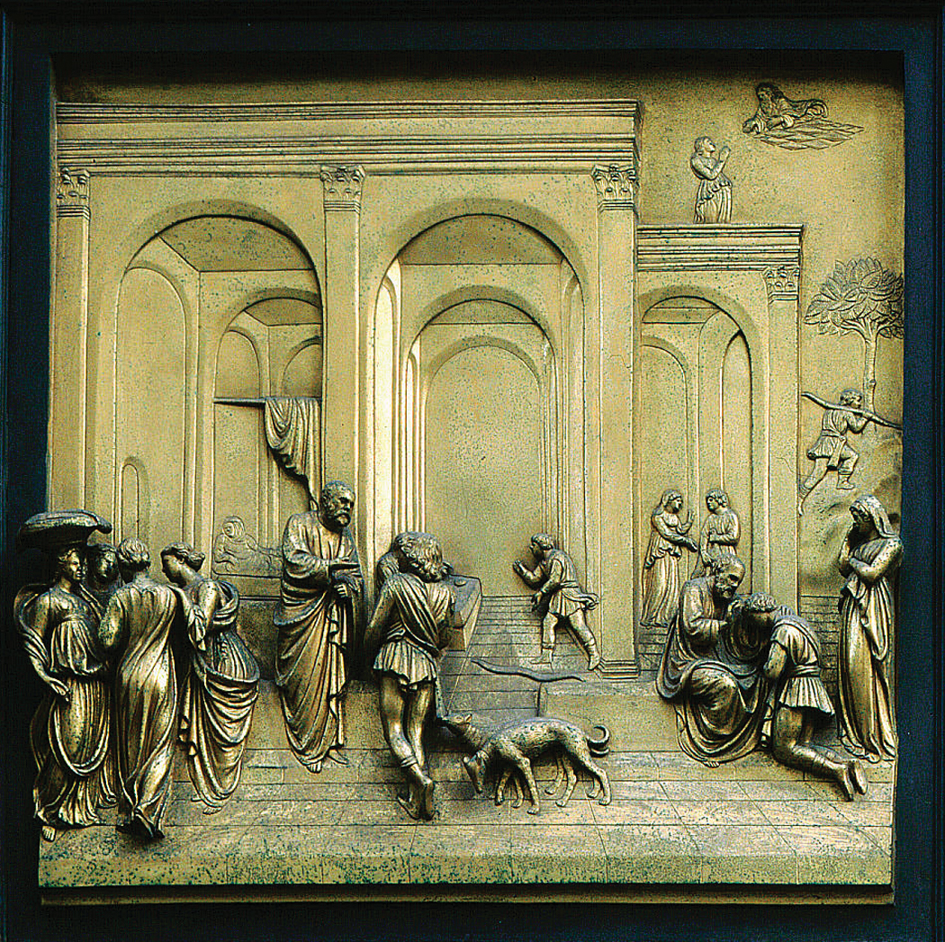
LORENZO GHIBERTI, (detail), east doors, baptistery, Florence Cathedral, Florence, Italy, 1425–1452. Gilded bronze relief, approx. 2’ 7 1/2” x 2’ 7 1/2”. Museo dell’Opera del Duomo, Florence.
Isaac and His Sons

Slide 25
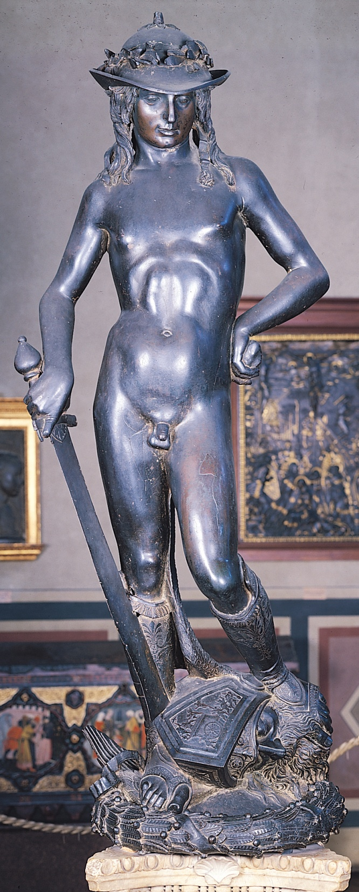
Figure 21-23 DONATELLO, David, late 1420s – late 1450s. Bronze, 5’ 2 1/4” high. Museo Nazionale del Bargello, Florence.
DONATELLO
Revival of free-standing classical nudes (first Renaissance sculptor to do so), was displayed in the Medici courtyard
Subject is young slayer of Goliath, not pagan hero, became a symbol of the Florentine republic
Was produced during the time of the threat of invasion of King Ladislaus
Small, warm bronze color

Slide 26
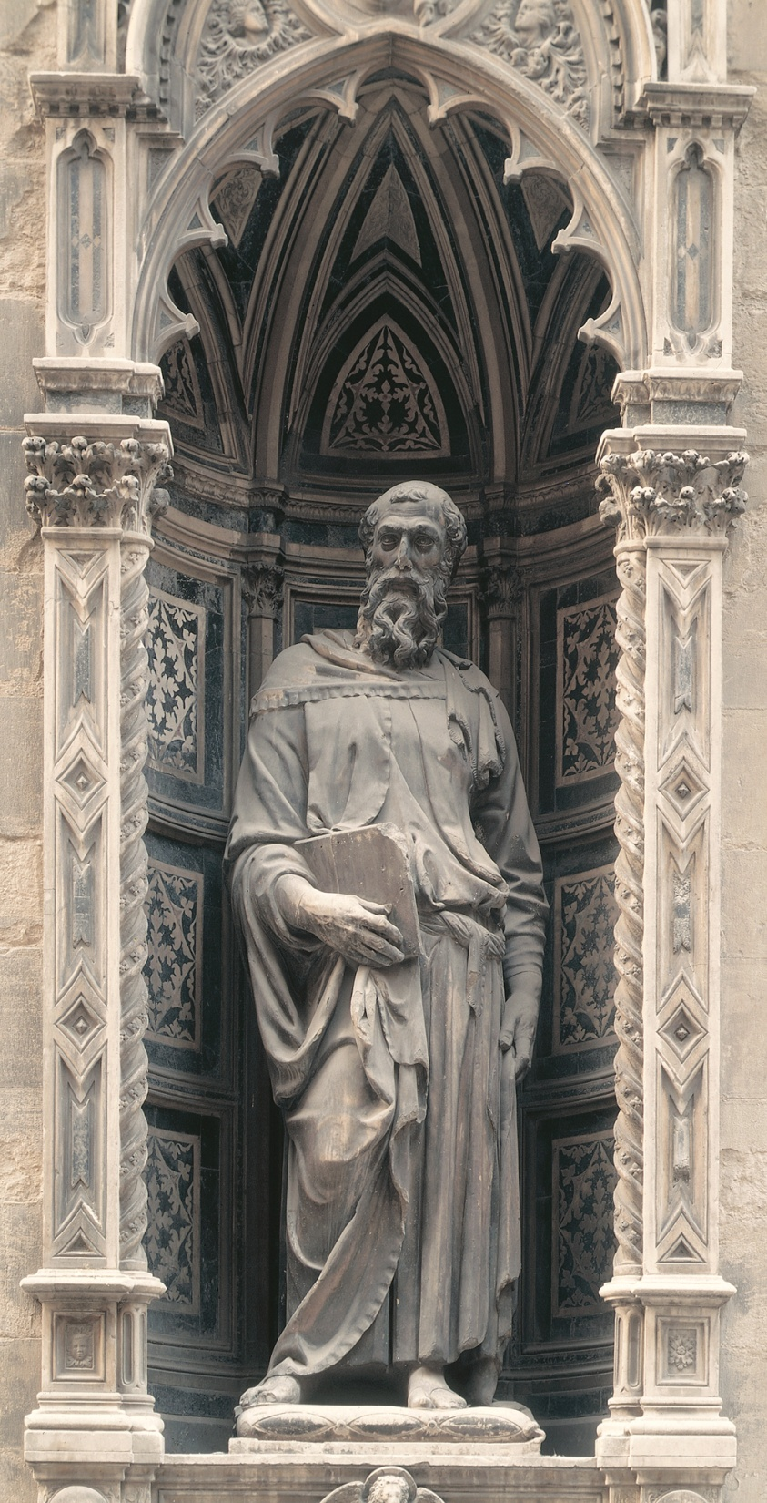
Florence, Italy, 1411–1413. Marble, approx. 7’ 9” high. Modern copy in exterior niche. Original sculpture in museum on second floor of Or San Michele.
Saint Mark, Or San Michele
DONATELLO

Slide 27
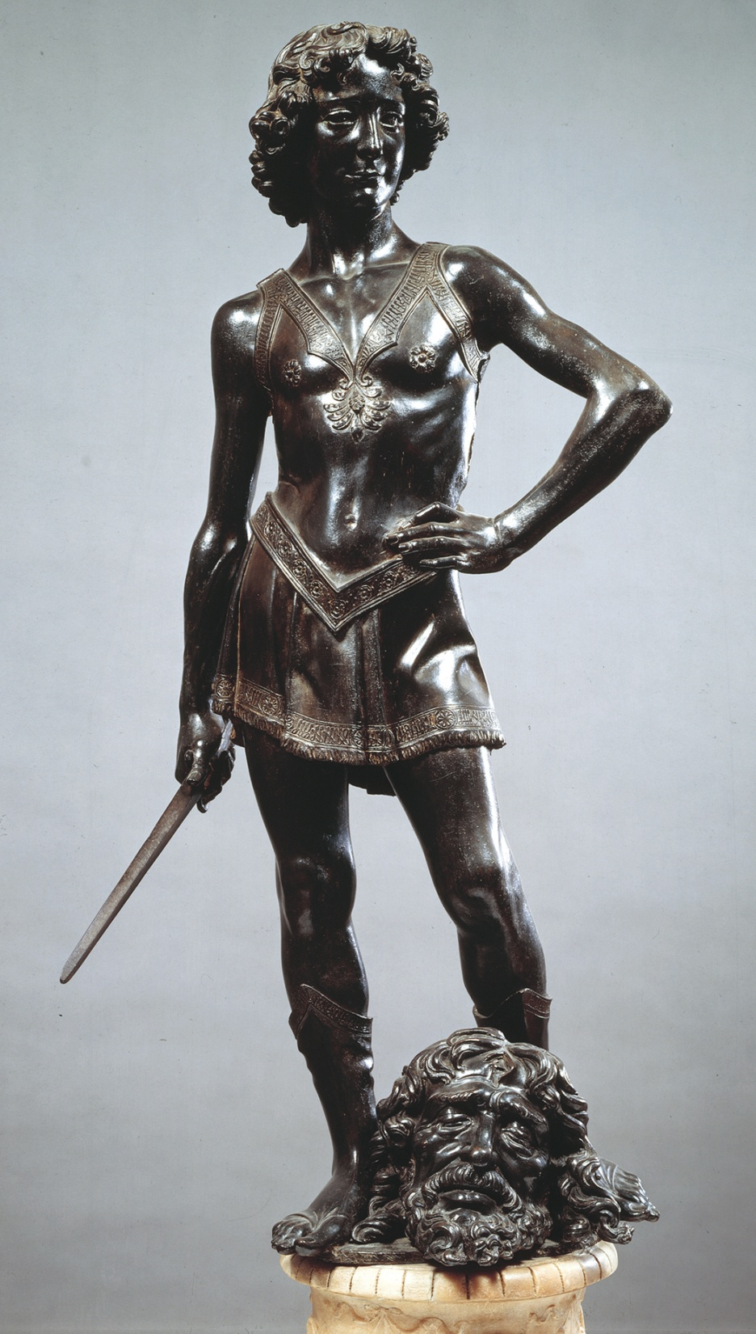
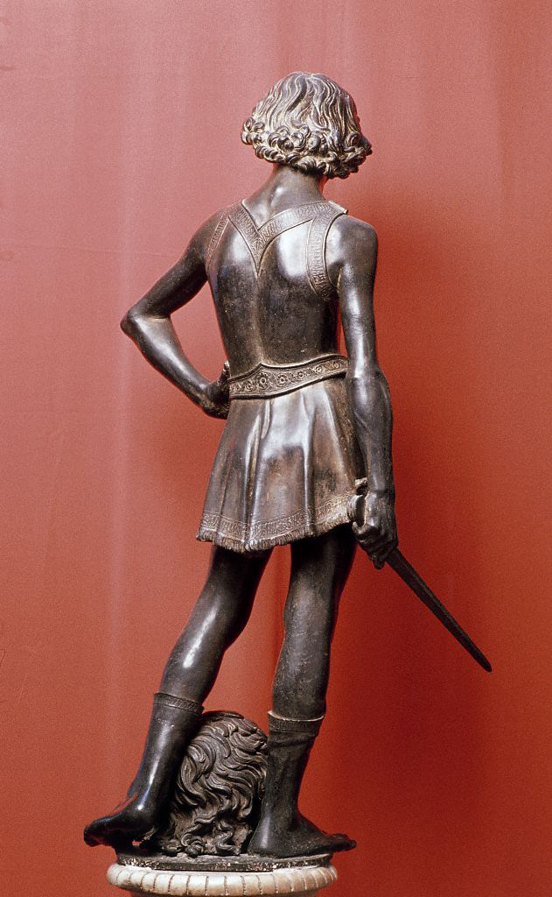
David, ca. 1465–1470. Bronze, approx. 4’ 1 1/2” high. Museo Nazionale del Bargello, Florence.
ANDREA DEL VERROCCHIO

Slide 29
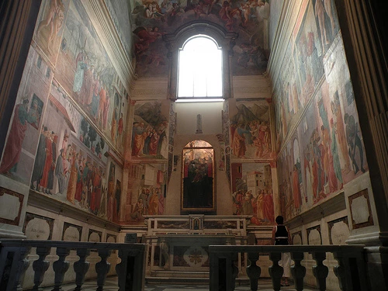
Brancacci CHAPEL
MASACCIO
Santa Maria del Carmine, Florence, Italy, ca. 1427

Slide 30
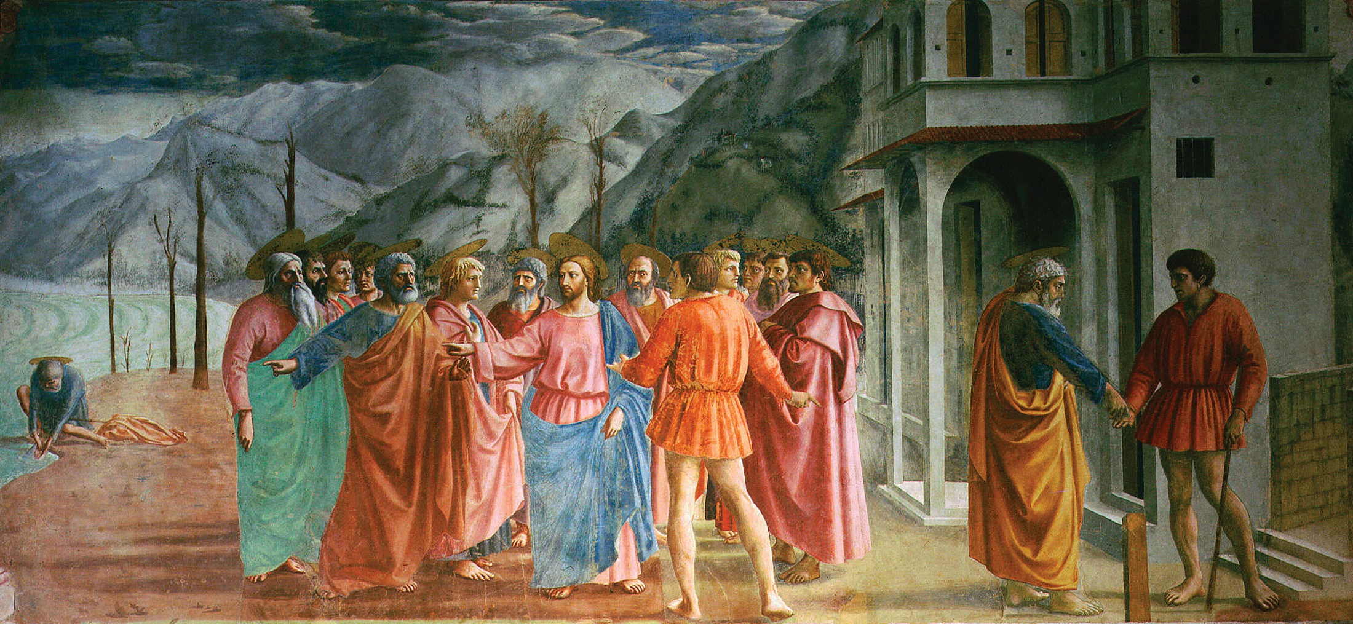
MASACCIO, Tribute Money, Brancacci Chapel, Santa Maria del Carmine, Florence, Italy, ca. 1427. Fresco, 8’ 1” x 19’ 7”.

Slide 31
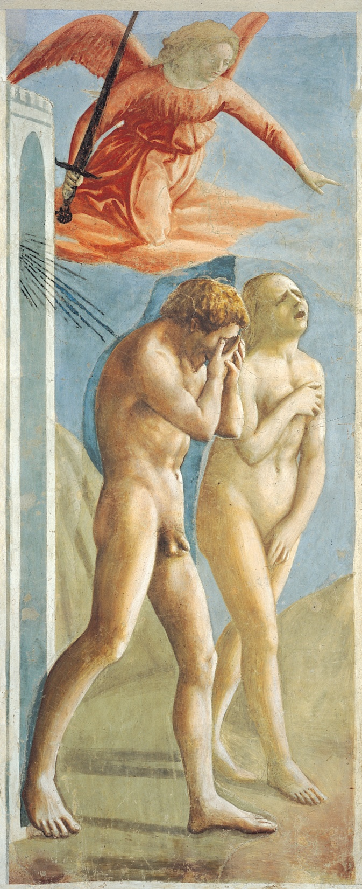
MASACCIO, Expulsion of Adam and Eve from Eden, Brancacci Chapel, Santa Maria del Carmine, Florence, Italy, ca. 1425. Fresco, 7’ x 2’ 11”.

Slide 32
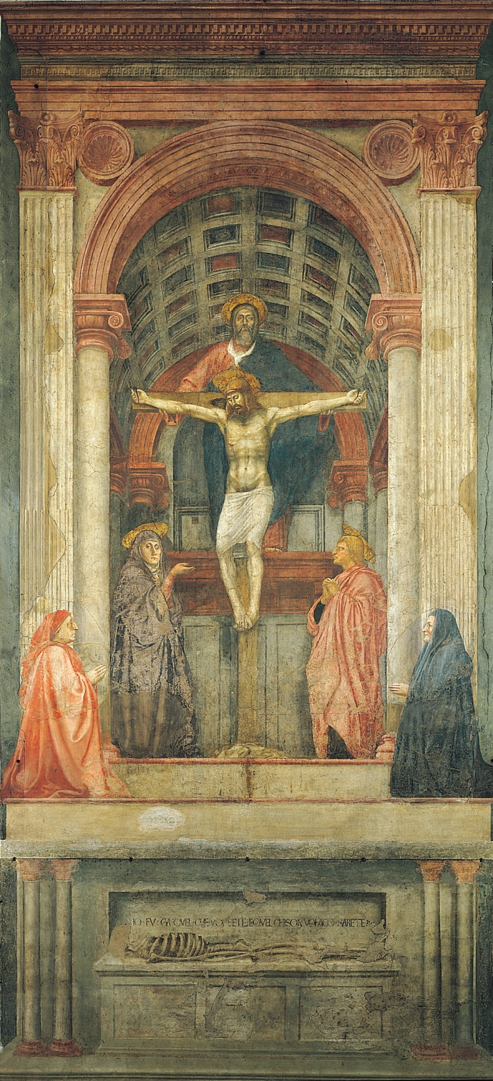
MASACCIO, Santa Maria Novella, Florence, Italy, ca. 1428. Fresco, 21’ x 10’ 5”.
Holy Trinity

Slide 33
SANDRO BOTTICELLI

Slide 34
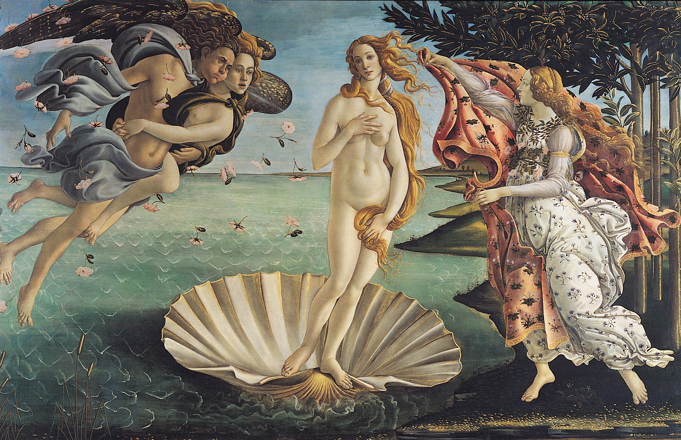
SANDRO BOTTICELLI, Birth of Venus, ca. 1482. Tempera on canvas, approx. 5’ 8” x 9’ 1”. Galleria degli Uffizi, Florence.

Slide 35
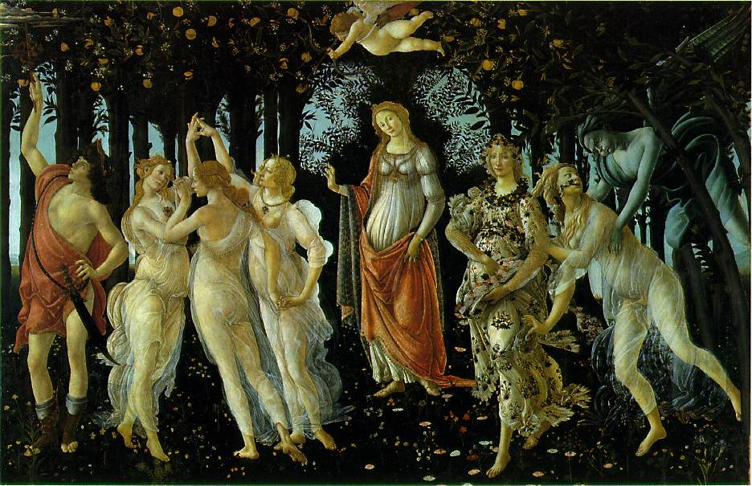

Slide 36
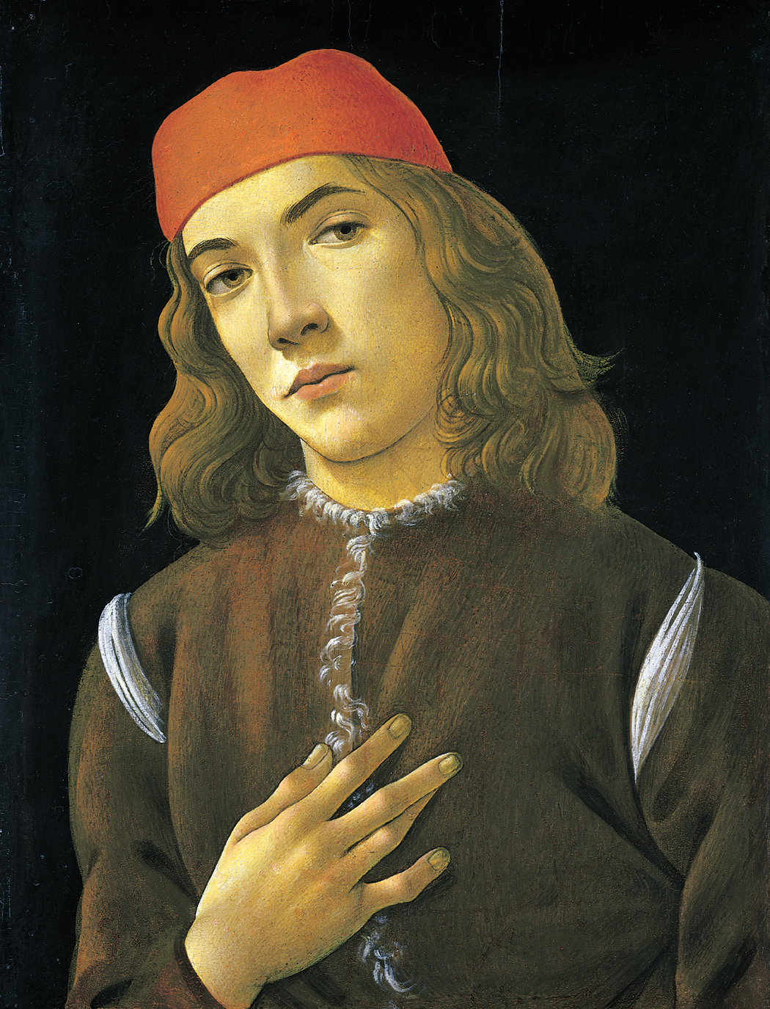
SANDRO BOTTICELLI, Portrait of a Youth, early 1480s. Tempera on panel, 1’ 4” x 1’. National Gallery of Art, Washington (Andrew W. Mellon Collection).

Slide 37
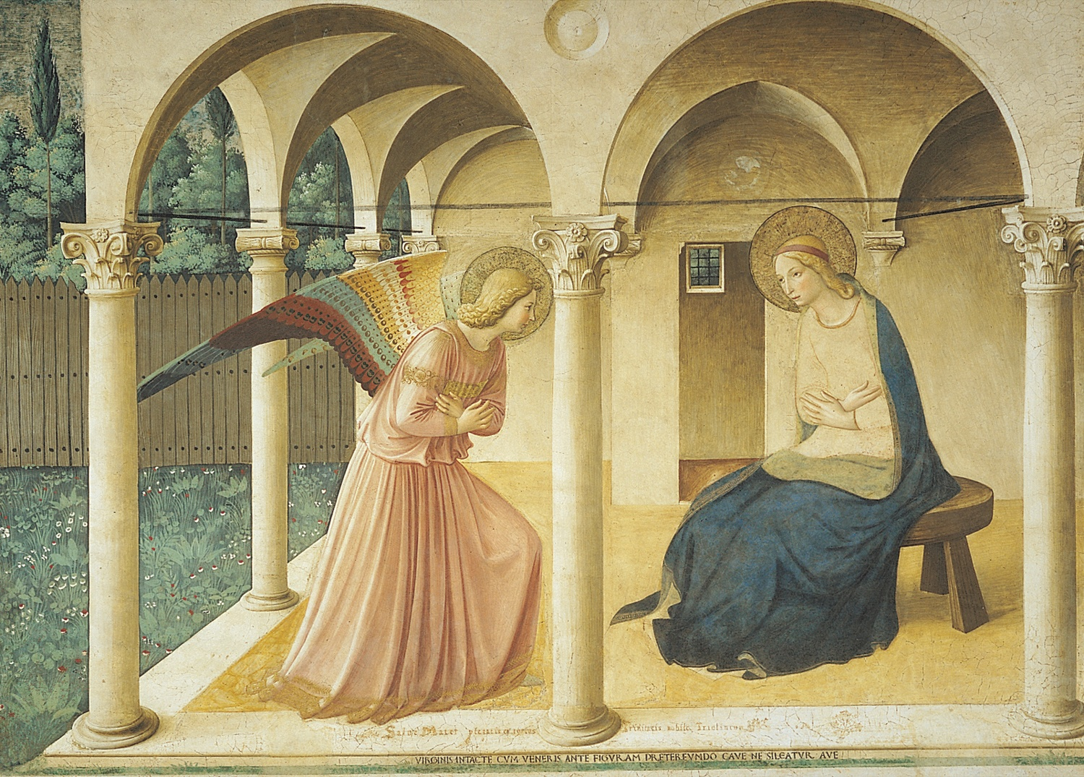
FRA ANGELICO, Annunciation, San Marco, Florence, Italy, ca. 1440–1445. Fresco, 7’ 1” x 10’ 6”.

Slide 38
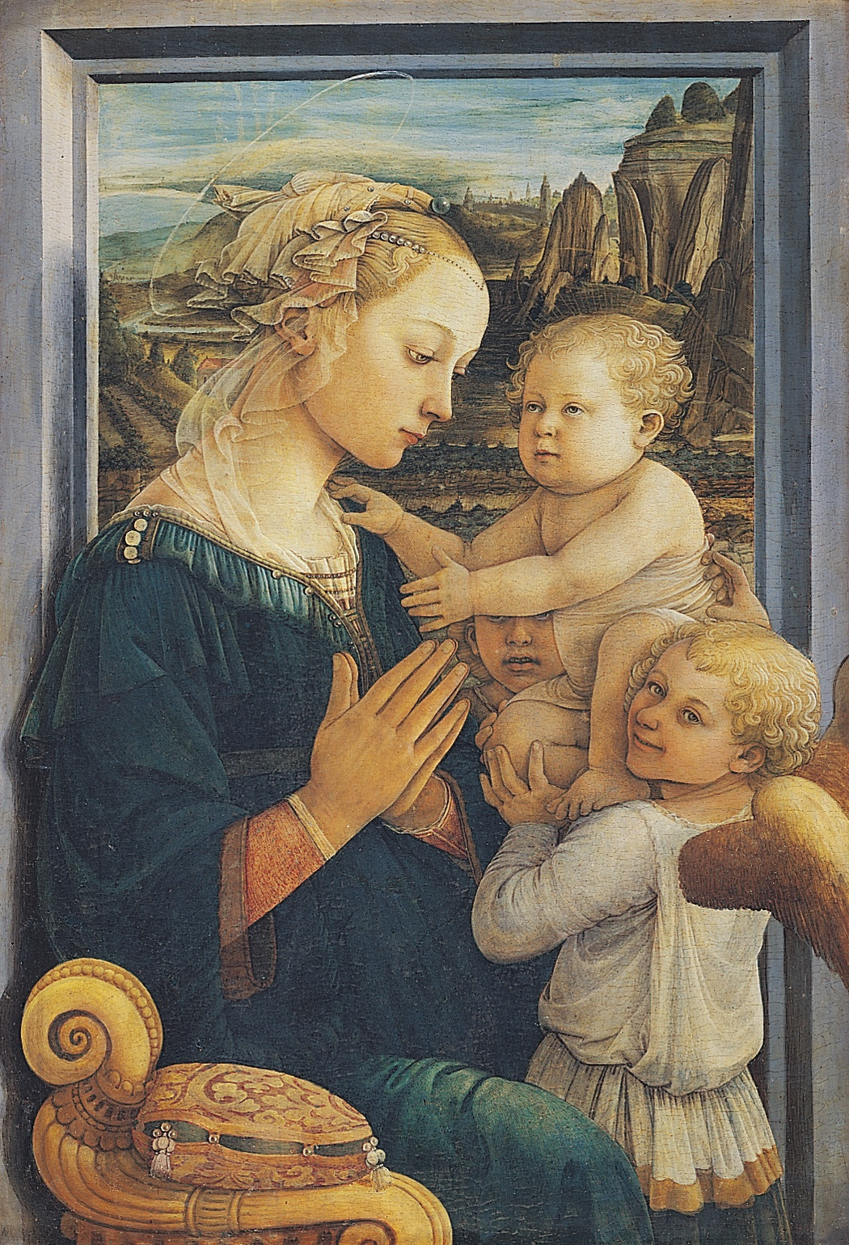
Madonna and Child with Angels, ca. 1455. Tempera on wood, approx. 3’ x 2’ 1”. Galleria degli Uffizi, Florence.
FRA FILIPPO LIPPI
Met and was influenced by Masaccio, as well as Donatello and Ghiberti
Excellent use of line, madonna is not spiritual or fragile, nor is Christ child, held up by two angels, one has a mischievous grin, not behaving for pious occasion
Importance of realism and natural landscape
Humanization of religious theme

Slide 39
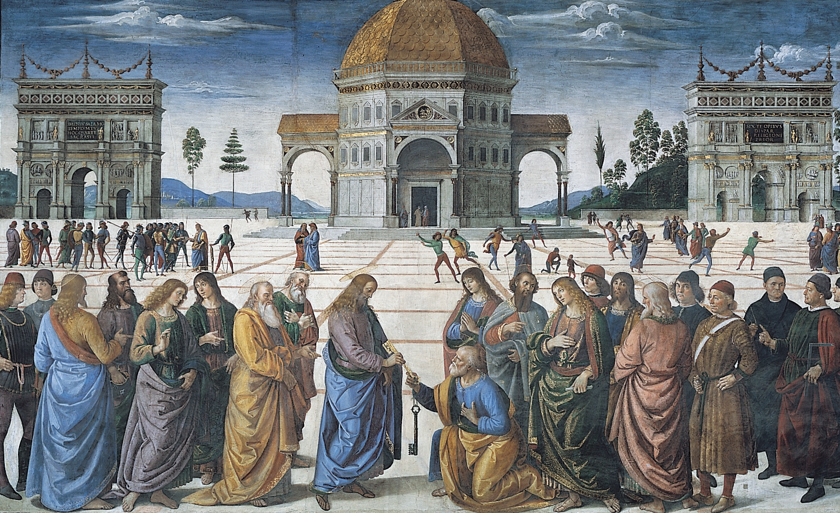
PERUGINO, Christ Delivering the Keys of the Kingdom to Saint Peter, Sistine Chapel, Vatican, Rome, Italy, 1481–1483. Fresco, 11’ 5 1/2” x 18’ 8 1/2”.

