Slide 1
Migratory
Merovingian, Christian Art of the British Isles

Slide 2
The Dark Ages, the Middle Ages, or the Medieval Period: All are names for the era between Classical antiquity and its rebirth (the Renaissance).
650-750- the center of civilization moved northward into Northern and Western Europe.
Artwork was portable and personal, at first due to the nomadic movements of the people.
Decorative animal motifs were popular.
Metalwork was the principle medium, and other small objects translated into wood, stone and manuscript illustration.

Slide 3
Context
Fall of the Roman Empire
Roman traditions diminish in importance as northern European ethnic groups reassert themselves and conflicts emerge between national groups
Impermanence/mobility
Nomadic traditions of northern European peoples and Viking marauders threaten stability of northern Europe
No significant architecture or large-scale sculpture
Craft Traditions
Portable art objects that have value and “currency”, especially jewelry, gold, leather goods, and wood carvings
Rise of Monasticism and the Benedictine order
Founded in 529, with an emphasis on work (manual labor and religious study)
Irish monks (missionaries to the “barbarian” north) were known for copying the gospels and Bible by hand in scriptoria in monasteries on the islands of Lindisfarne and Iona

Slide 4
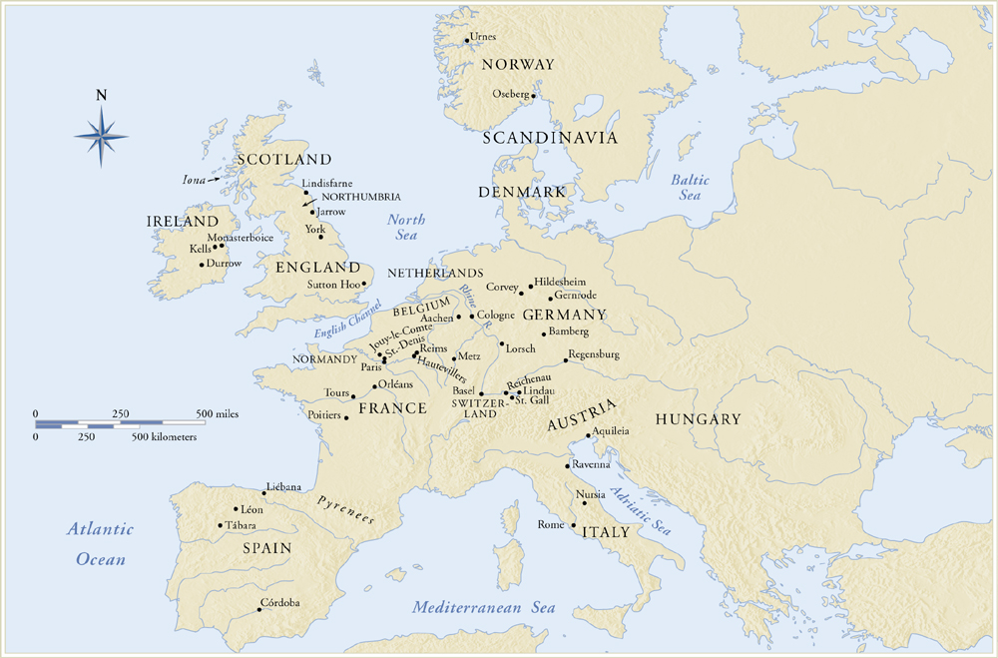
Early Medieval Sites in Europe

Slide 5
Merovingian Art
From 500 CE
One of the barbarian groups who moved into the Western Roman world was the Franks who settled in Belgium and northern France
Dynasty-Merovingian, after its legendary founder Merovech
Established a powerful kingdom
Conversion of Clovis I (496) to Christianity brought the kingdom into a larger Christian network
Created an alliance between French rules and the Pope
Christianity and pagan beliefs developed side-by-side
Kings and nobles defended the claims of the Roman church and the pope validated their authority

Slide 6
Status symbols –weapons and items of personal adornment (bracelets, pendants, belt buckles) are all we have of non-Roman people
Show high degree of technical and stylistic sophistication, and enhanced the prestige of those who owned them and were buried with them
Fibula-decorative pin favored by the Romans, used to fasten garments of men and women, usually inlaid with precious or semi-precious stones
Resemble the fibulae used in the mosaic of Justinian at San Vitale
Covered with decorative patterns adjusted to the basic shape of the object, therefore they amplify the form and structure, becoming a part of the object itself
Zoomorphic elements are so successfully integrated into this they almost become unrecognizable

Slide 7
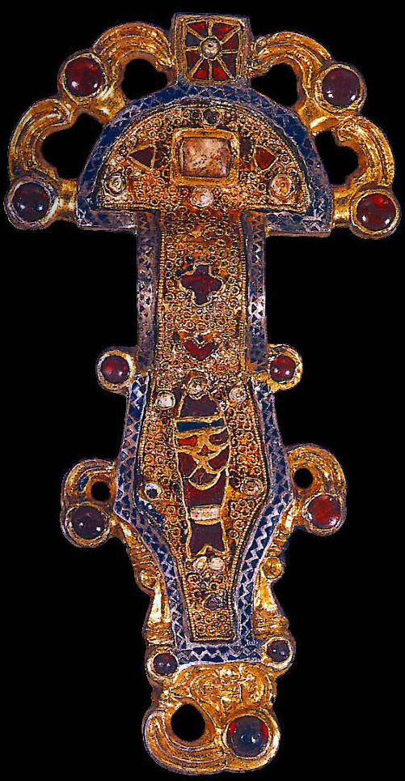
Stylized abstracted animal forms – often with interlaced patterns
Justinian is depicted wearing a Fibula clasp in the apse mosaic at San Vitale, Ravenna, Italy.
Can you find the animal motifs?
Frankish Looped Fibula
France
6th or 7th Century silver gilt worked in filigree with inlays of garnets and other stones 4 in. long
Notes:
Slide concept by William V. Ganis, PhD FOR EDUCATIONAL USE ONLY For publication, reproduction or transmission of images, please contact individual artists, estates, photographers and exhibiting institutions for permissions and rights.

Slide 8
Anglo-Saxon/Hiberno-Saxon Art
Anglo-Saxon-England
Hiberno-Saxon-Ireland
Ireland was never part of the Roman Empire-readily accepted isolation
Christianity survived in these areas, despite the local populations retaining their own gods and myths
Cut off from Rome, they developed their own liturgical practices, church calendar, and distinctive artistic traditions
Pope Gregory (ruled 590-604) sent missionaries from Rome to King Ethelbert of Kent
St. Augustine of Canterbury became the first Archbishop of Canterbury
Had different practices, but eventually Church of Rome aligned Christian Britain’s practices with their own
Insular Gospel books- books written and illustrated in Ireland and Britain (islands)
Christianity dominated by monasteries which were learned and artistic communities with scriptoria
Irish monks became missionaries throughout the European continent
Vocabulary: manuscript illumination, carpet page, folio, interlacing, initial page, vellum, scriptoria

Slide 9
Purse cover from the Sutton Hoo ship burial, 620 CE, Anglo-Saxon, England, gold, glass, and jewels **NOT IN 250
Cloissone technique, from as early as the New Kingdom in Egypt was favored during the early Medival times, cloisons are partitions that were soldered into a metal background with semi-precious stones or glass meant to resemble jewels
Edges are important part of the design
Cross between mosaics and stained glass
Four symmetrical figures make up lower row, on the ends is a man standing with two beasts, he faces the front, they are in profile—history of kings fighting monsters
Above are interlacing abstract patterns, the most prominent form of art in the medieval world
http://smarthistory.khanacademy.org/sutton-hoo-ship-burial.html

Slide 10
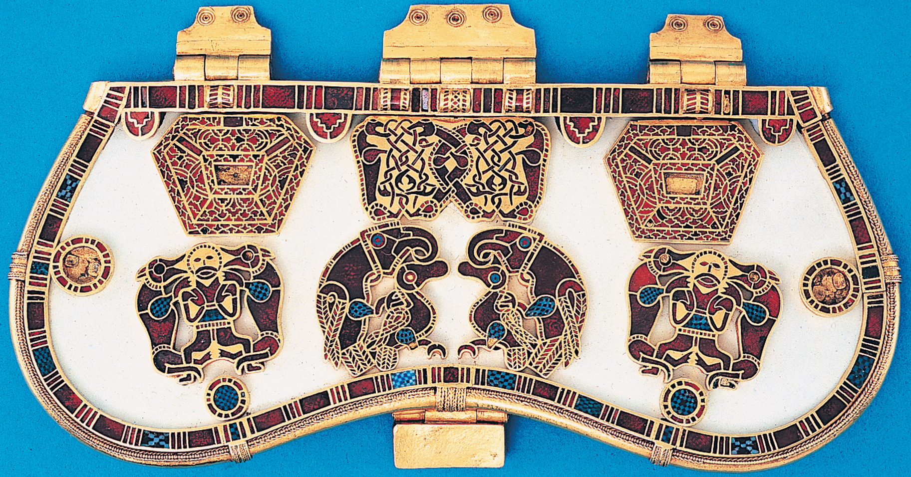
The Art of the Warrior Lords:
The Sutton Hoo Purse cover was a Celtic/Germanic Style Cloisonne purse cover found in a ship burial off Suffolk England.
Animal style: Germanic tribes that entered Western Europe during the declining years of the Roman Empire brought artistic traditions with them, from the East.
The symmetrical motifs on the lower sides are called “heraldic groupings” – seen before in the ancient Near East (remember the Sumerian Bull headed Lyre).
A man between fighting animals – was a popular motif in early Christian Art.
Note the abstracted and interlaced animal figures in the top middle.
The Sutton Hoo Purse Cover, 625-33 CE, gold and enamel, 7.5” long

Slide 11
Book of Durrow (St. Matthew), 700 CE, Hiberno-Saxon, Scotland, ink and tempera on parchment** NOT IN 250
Among the earliest illuminated manuscripts is the Book of Durrow, may have been written and decorated at a scriptorium in Iona (Scotland), later was housed in Durrow, Ireland
Full pages devoted to neither text nor illustration instead pure embellishment
Carpet pages-resembling textiles made of up of decorative panels of abstract and zoomorphic forms
This has no precedent in classical art
Each of the four gospels has a carpet page dedicated to the symbol of the evangelist
Symbol of St. Matthew is a man; only human parts are a schematic frontal head and two profile feet, body is enveloped by a large checkerboard cloak
Cloak resembles the cloissone decoration
Used by Christian missionaries for converting “barbarians” from the north

Slide 12
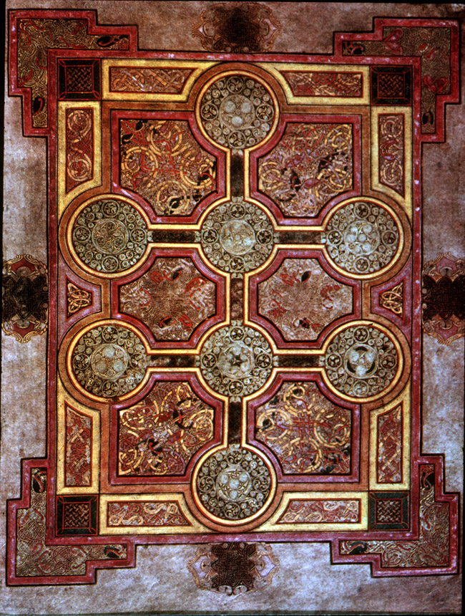
Hiberno (Hibernia) is the Roman name for Ireland.
A Saxon is an English person. This specifically refers to ancient Germanic tribes, who in the 5th and 6th centuries invaded and occupied parts of Britain.
Hiberno-Saxon = a style that has both Irish and English characteristics (especially referring to illuminated manuscripts).
The Hiberno-Saxon region is simply the British Islands.
Book of Kells
Carpet Page, ca. 800 CE

Slide 14
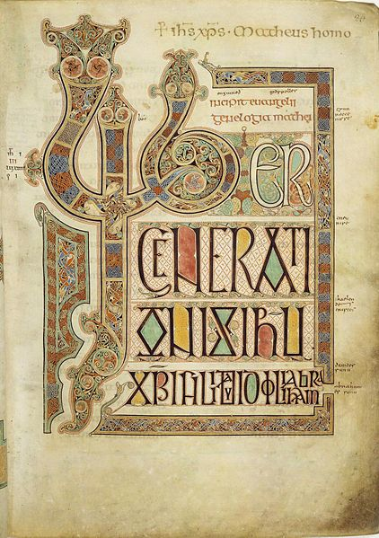
Hiberno-Saxon Art
In 432 CE, Saint Patrick established a church in Ireland and began the Christianization of the Celts.
Illuminated Manuscripts were used to spread the Gospel. Monks produced them.
They were the “primary vehicle” used in the effort to Christianize the British Isles.
The word of God was looked upon as a sacred object with visual beauty - more decorative than narrative.
folio 27r from Lindisfarne Gospels
Incription page for the Gospel of Matthew ca. 700 CE

Slide 15
Lindisfarne Gospels
Made in a scriptorium on the island of Lindisfarne, off the coast of England
Copy the gospels of Matthew, Mark, Luke, and John in Latin
Gospels recount the life of Jesus and his teachings which form the foundations of the Christian faith
These four were authorized by the Council of Nicea in 325 CE
Took approximately 6 years
Was read from by monks during rituals at the Lindisfarne Priory on Holy Island, a Christian community that safeguarded the shrine of St. Cuthbert, a bishop who died in 687 and whose relics were thought to have curative and miracle-working powers
Originally began by bishop Eadfrith
Cross carpet page- features a large cross set against a background of ordered ornamentation
Initial page-Decorated initial
In 793 Vikings attacked and ransacked the monastery on the Scottish isle of Iona
Survivors were able to transport the Gospels to L

Slide 16
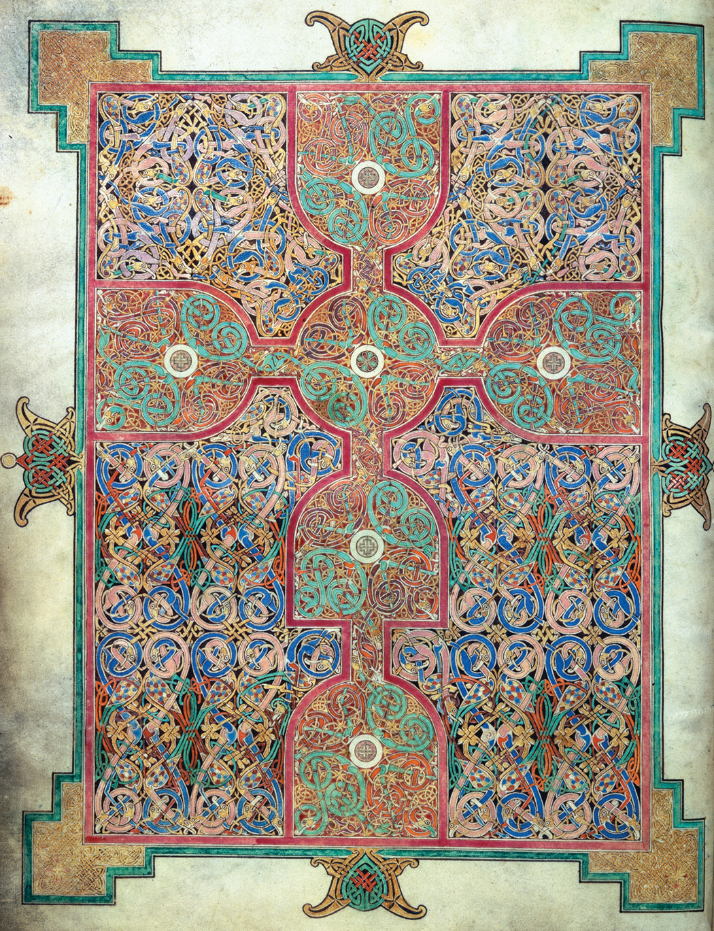
Lindisfarne Gospels, Cross Carpet Page, 700 CE, Hiberno-Saxon, England, tempera on vellum
Mesmerizing knots and spirals dominated by a central cross
Stacked wine glasses horizontally and vertically
Closer inspection of the knots reveal snake-like creatures in tubular forms, and also change color
Serpentine interlacements of fantastic animals devour each other, curving lines show motion and change, but held in check by the regular design and the dominating motif of the cross
Zoomorphic forms intermingle with clusters and knots of line and the color is rich and cool which creates an even surface

Slide 17
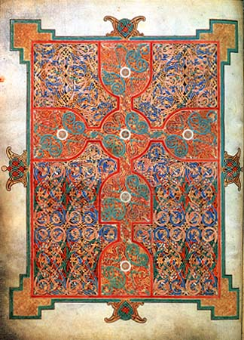
Hiberno-Saxon Art
These are the earliest Christian works made north of the Alps.
Irish (Hiberians) assumed the spiritual and cultural leadership in Western Europe.
“The Golden Age of Ireland”- Ireland never became part of the Roman Empire.
The Irish were converted to Christianity by missionaries but were never Rome-centered.
Hermits living in the countryside formed the first monastaries. These became centers of learning and the arts, missionaries spread Christianity over Scotland, France and the Netherlands.
Designs were precise and maze-like, the interlacing patterns followed strict rules.
Cross Page from
Lindisfarne Gospels
ca. 700 CE

Slide 18
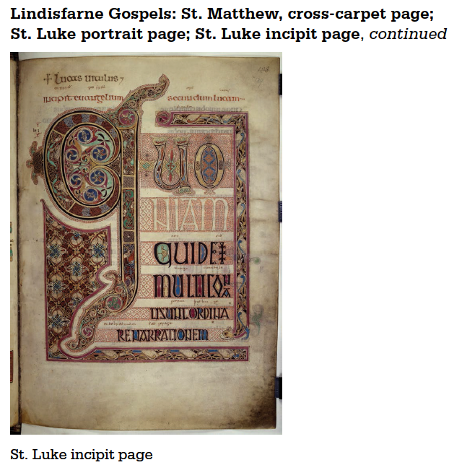
Incipit-it begins
Shows animal life, spiraled forms and swirling vortexes
Knots become snakes along the letter’s boundaries
Blue pin-wheel shapes in the letter Q that begins the first word of the Gospel of Luke
“Quoniam quidem multi conati sunt ordinare narrationem. “As many have taken it in hand to set forth in order”
Birds turn into cats, comma becomes a cat’s forepaw

Slide 19
Some northern artists based their compositions on classical pictures, probably modeled after an author portrait from a Greek or Latin book, which usually featured seated philosophers or poets reading or writing
Luke sits on red cushion with unornamented background, writing on a scroll, feet hover above a tray and wears a robe streaked with purple and red
Golden halo indicates his divinity
Above is a blue-winged calf with body in profile and two eyes facing the viewer
Clasps a green book between legs, reference to the gospel
Calf or ox symbolizes Christ’s sacrifice on the cross
Contains both Greek and Latin language (Greek is from Old Testament, Latin from Church of Rome)
Not concerned with volume, shading, or perspective, only line and color
Matthew’s symbol- winged man, suggesting the human aspect of Christ
Mark’s symbol-lion, symbolizing the triumphant and divine Christ of the Resurrection
John’s symbol-Eagle, symbolizing Christ’s second coming

Slide 20
Lindisfarne Gospels
Decoration includes miniatures of the four Evangelists, intricate cross-carpet pages and full-page initials.
Saint Matthew, and Saint Mark of the Lindisfarne Gospels, from Northumbria, England, ca. 698–721.
The Lindisfarne Gospels were written and illuminated “for God and St Cuthbert” by Eadfrith, Bishop of Lindisfarne (698-721).
Notes:
We know that precious manuscripts were brought to monasteries in order to be copied, for we have a record that the Codex Aminatinus was one of three copies made at the English monastary of Jarrow from a manuscript brought to the monastery by the Bishop of Jarrow. The original manuscript came from Rome.

Slide 21
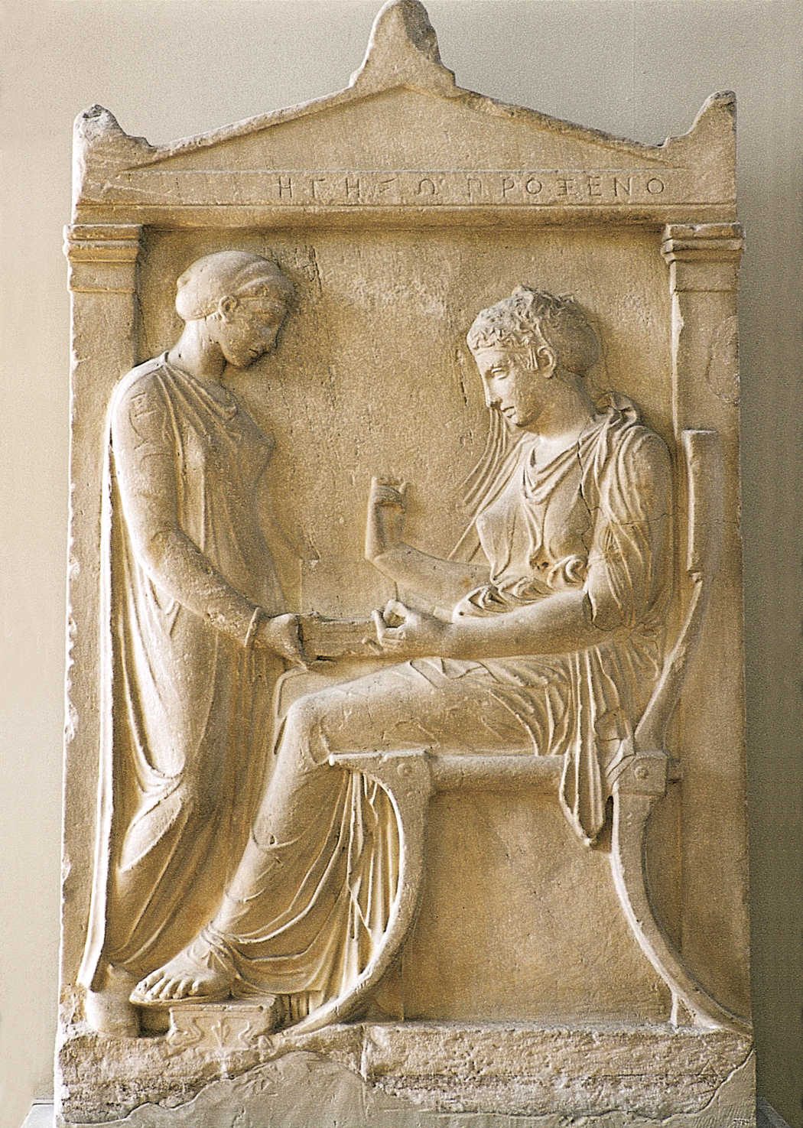
Notice:
Matthew’s symbol – the winged man (angel)
Matthew’s open book – symbolizes the New Testament
Moses’ closed book – symbolizes the Old Testament
– This was a common juxtapostion in Medieval Art.
Classical influences combined with Medieval sensibilities:
Compare the classical presentation of St. Matthew to Greek and Roman images of Philosophers and Poets. →
But notice the Medieval artist’s complete lack of interest in shading. The drapery forms are shown with schematic contour lines and color fills.
Saint Matthew, from the Lindisfarne Gospels, ca. 698–721
Grave stele of Hegeso, from the Dipylon cemetery, Athens, Greece, ca. 400 BCE. Marble
Notes:
We know that precious manuscripts were brought to monasteries in order to be copied, for we have a record that the Codex Aminatinus was one of three copies made at the English monastary of Jarrow from a manuscript brought to the monastery by the Bishop of Jarrow. The original manuscript came from Rome.

Slide 22
Migratory (N. Europe) | Byzantine (E. Mediterranean)
Ornament Art→ Decorative | Iconic Art → Symbolic
Interlacing pattern & complex design | Icon is image symbolic of an idea
Visual experience of the work of art | Conceptual experience of the work of art
Complex pattern composed of a single line which overlaps and intertwines | Simplification of an image into the easily recognizable
Organic and animal forms simplified and abstracted into geometric patterns | Move toward realism but not exactly a representation of visual reality
Decorative elements can dominate, geometric organization with extreme complexity in design and elements | Clarity of purpose-unambiguous image, decorative elements secondary to central image or icon
Miniaturist sensibility-extremely fine work | Simplification and stylization

Slide 23
In terms of cultural influence:
As Europe moved into the Medieval period, WHY did art styles shift so dramatically away from classical naturalism?
Notes:
Slide concept by William V. Ganis, PhD FOR EDUCATIONAL USE ONLY For publication, reproduction or transmission of images, please contact individual artists, estates, photographers and exhibiting institutions for permissions and rights.

Slide 24
Tertullian asks: Can artists be Christians?
“Tertullian, an influential early Christian author living in the second and third centuries, wrote a treatise titled On Idolatry in which he asks if artists could, in fact, be Christians. In this text, he argues that all illusionary art, or all art that seeks to look like something or someone in nature, has the potential to be worshiped as an idol.
Arguing fervently against artists as Christians, he acknowledges that there are many artists who are Christians and indeed some who are even priests. In the end, Tertullian asks artists to quit their work and become craftsmen.”
– Dr. Nancy Ross, A New Pictorial Language: The Image in Early Medieval Art,
Khan Academy
(Tertullian’s writings were ca. 2nd and 3rd centuries CE)
Notes:
Slide concept by William V. Ganis, PhD FOR EDUCATIONAL USE ONLY For publication, reproduction or transmission of images, please contact individual artists, estates, photographers and exhibiting institutions for permissions and rights.

Slide 25
St. Augustine: Illusionary Images are Lies
“Another influential early Christian writer, St. Augustine of Hippo, was also concerned about images, but for different reasons. In his Soliloquies (386-87), Augustine observes that illusionary images, like actors, are lying. An actor on a stage lies because he is playing a part, trying to convince you that he is a character in the script when in truth he is not. An image lies because it is not the thing it claims to be. A painting of a cat is not a cat, but the artist tries to convince the viewer that it is. Augustine cannot reconcile these lies with patterns of divine truth and therefore does not see a place for images in Christian practice.*”
“*There is some irony here since Augustine's position echoes, to some extent, the writing of the ancient Greek philosopher Plato. In book X of The Republic (c. 360 BCE), Plato describes a true thing as having been made by God, while in the earthly sphere, a carpenter, for example, can only build a replica of this truth (Plato uses a bed to illustrate his point). Plato states that a painter who renders the carpenter's bed creates an illusion that is two steps from the truth of God.”
– Dr. Nancy Ross, A New Pictorial Language: The Image in Early Medieval Art,
Khan Academy
(St. Augustine’s writings were ca. 4th century CE)
Notes:
Slide concept by William V. Ganis, PhD FOR EDUCATIONAL USE ONLY For publication, reproduction or transmission of images, please contact individual artists, estates, photographers and exhibiting institutions for permissions and rights.

Slide 26
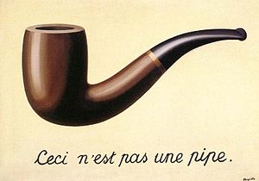
“Two steps from the truth of God”
– Plato
Notes:
Slide concept by William V. Ganis, PhD FOR EDUCATIONAL USE ONLY For publication, reproduction or transmission of images, please contact individual artists, estates, photographers and exhibiting institutions for permissions and rights.

Slide 27
Abstraction “removed at least some of the temptations for idolatry. This new (Medieval) style, adopted over several generations, created a comfortable distance between the new Christian empire and its pagan past.”
– Dr. Nancy Ross, A New Pictorial Language: The Image in Early Medieval Art,
Khan Academy
http://smarthistory.khanacademy.org/The-Evolution-of-the-Medieval-Style.html
Notes:
Slide concept by William V. Ganis, PhD FOR EDUCATIONAL USE ONLY For publication, reproduction or transmission of images, please contact individual artists, estates, photographers and exhibiting institutions for permissions and rights.

