Slide 2
Romanesque Sculpture

Slide 3
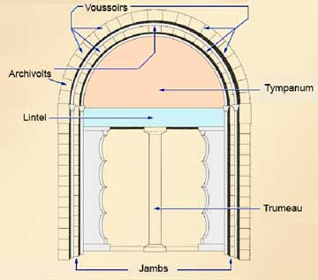
Parts of a Romanesque Portal
Tympanum- the prominent semicircular lunette above the doorway proper, comparable in importance to the triangular pediment of a Greco-Roman temple
Archivolt: the molding frame an arch. In Romanesque and Gothic architecture, each one of a series of arches framing the tympanum of a portal.
Voussoirs- the wedge-shaped blocks that together form the archivolts of the arch framing the tympanum
Lintel- the horizontal beam above the doorway
Trumeau- the center post supporting the lintel in the middle of the doorway
Jambs- the side posts of the doorway or window frame. The jambs of the portals of Romanesque and Gothic churches are frequently decorated with figure sculpture.

Slide 4
Influences on Romanesque Sculpture Style
Sculptors and stone masons are influenced by:
Illuminated manuscript designs: Carolingian, Hiberno-Saxon, Ottonian
Anglo-Saxon metal work and other decorative arts
Early frescoes and mosaics
Revival of stone sculpture carving techniques is slow, after centuries of neglect and disinterest- no local tradition of large scale stone sculpture
Sculptural decoration is first in high relief (rather than sculpture in the round) in areas surrounding main doorways and in column capitals
Sculptors and stone masons look to non-Greco Roman models for inspiration

Slide 5
Function/Content of the Tympanum
Would enter through the west entrance and see the tympanum
Would serve as a reminder to those entering about the joys of heaven and the torments of hell
Called “The Last Judgment”
Christ sits in the center, enthroned, pointing upwards to the saved with his right hand and left hand gestures downward toward the damned
Immediately on his right are Mary, Peter, and possibly the founder of the monastery as well as many other saints

Slide 6
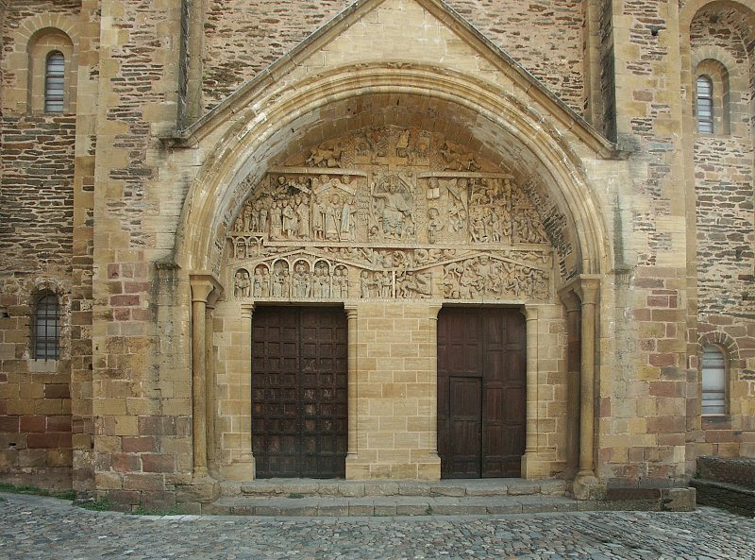
West Portal, Typanum, Last Judgement – Church of Sainte – Foy, Conques, France

Slide 7
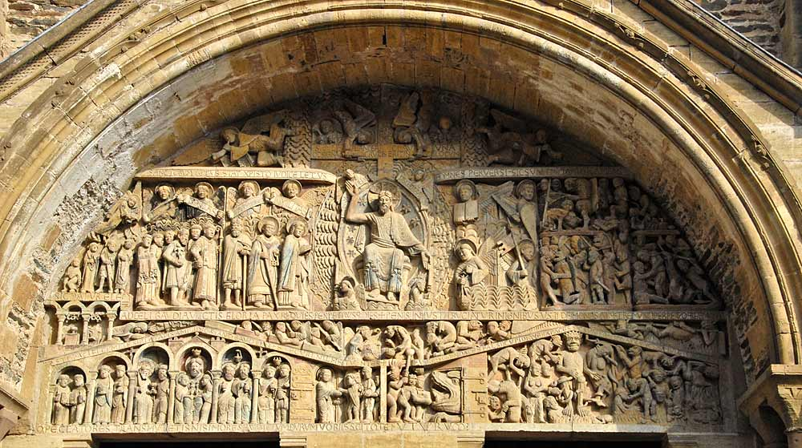
West Portal, Typanum, Last Judgement – Church of Sainte – Foy, Conques, France
Video

Slide 9
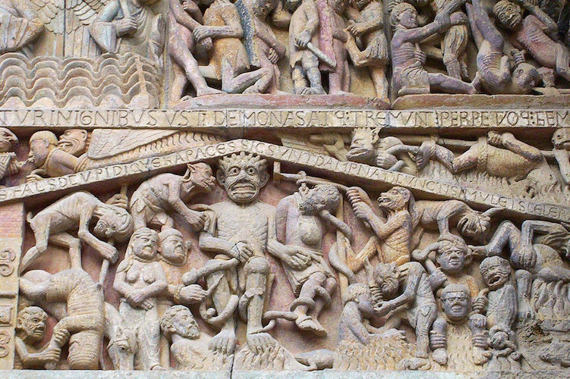
Content of Tympanum
Below the saints is a small arcade (row of arches) covered by a pediment, meant to represent the House of Paradise
Blessed ones who will remain with Christ throughout all eternity
Abraham is at the center and above him is the outstretched hand of God, who beckons the kneeling St. Faith
On the other side are angels opening the graves of the dead
As they rise their souls are weighed and will be admitted to heaven or hell
Clear division of the doorway to paradise and the mouth of Hell
Hell is chaotic and disorderly, reigned over by the devil, like Abraham is on the other side
Devil is enthroned like God determining punishments based on the severity of a person’s sins
Hanged man at the devil’s left references Judas who hanged himself after betraying Christ
Each sinner represents what to avoid: gluttony, adultery, misuse of church offices

Slide 12
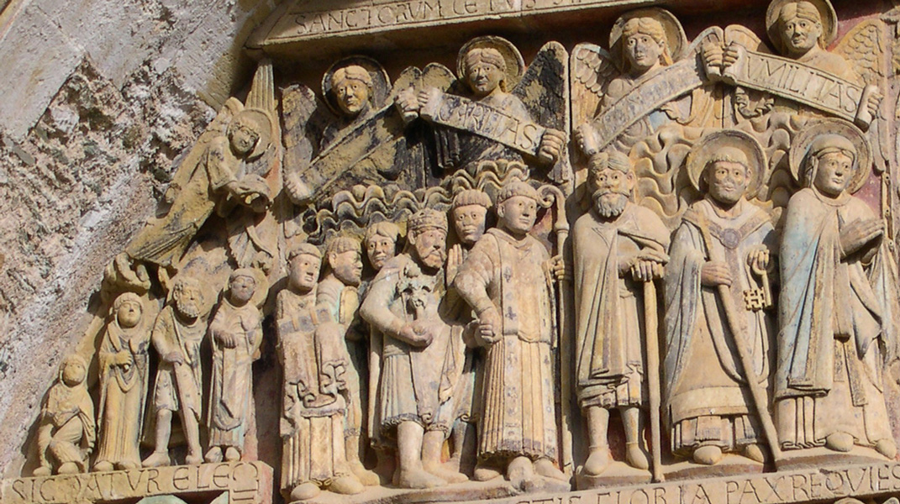
Notes:
Church of Sainte-Foy, tympanum
France, Romanesque
c. 1050-1130 CE
Stone and paint

Slide 13
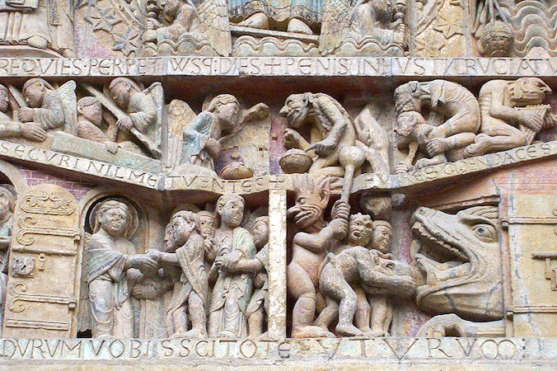
Stylistic Characteristics of Romanesque Sculpture
*Subject matter of tympanums and capitals most often tableaux and narratives from the bible especially the Last Judgment
1. Crowded composition with figures of different sizes in limited space
2. Hieratic organization-that which is most important is largest and usually placed in the center of the composition
3. Extreme distortion of figures, often to fit available space within the composition
Representation of the human figure
Extreme elongation of anatomy
Angularity of form-awkward poses with feet pointing down
Linear perspective of details, especially in drapery and hair
Simplification of drapery and related details- stylization
Frontal presentation of the body
Broad and generalized features in the face
4. Fantastic creatures of the imagination- love of medieval bestiary, grotesques of half animal and half human beings presented in illogical scale and proportion

Slide 14
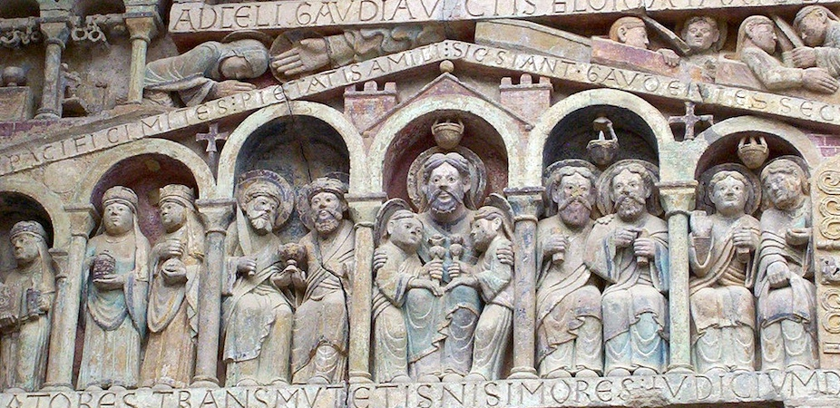
Christ at center
Notes:
Church of Sainte-Foy, tympanum with Christ at center
France, Romanesque
c. 1050-1130 CE
Stone and paint

Slide 15
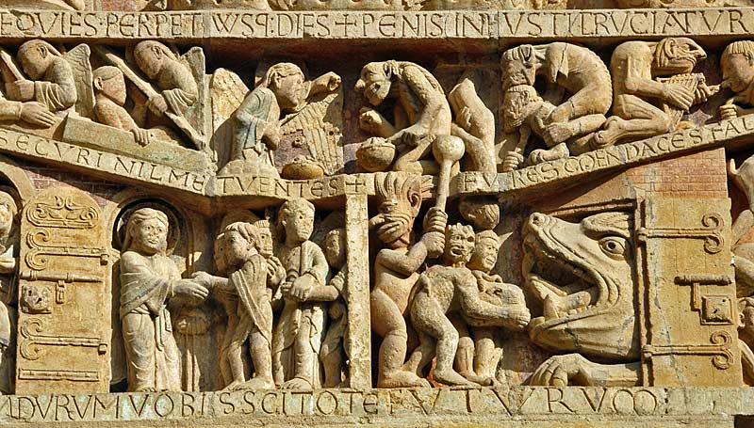
GATES OF HEAVEN AND MOUTH OF HELL
Notes:
Church of Sainte-Foy, tympanum with gates of heaven and mouth of hell
France, Romanesque
c. 1050-1130 CE
Stone and paint

Slide 16
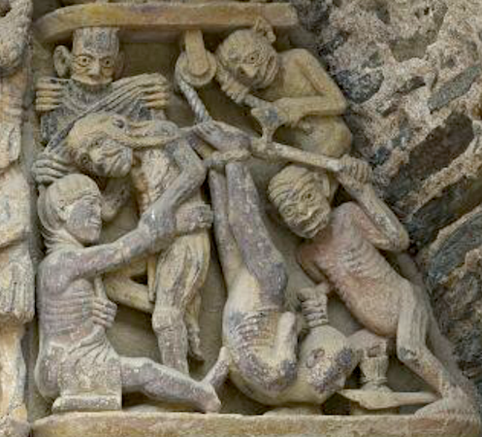
As the dead rise from the tomb, their souls will be weighed and they will be admitted to heaven or hell. Hell is chaotic, disorderly scenes where the Devil, just opposite to Abraham, reigns over his terrifying kingdom.
Notes:
Church of Sainte-Foy, tympanum
France, Romanesque
c. 1050-1130 CE
Stone and paint

Slide 17
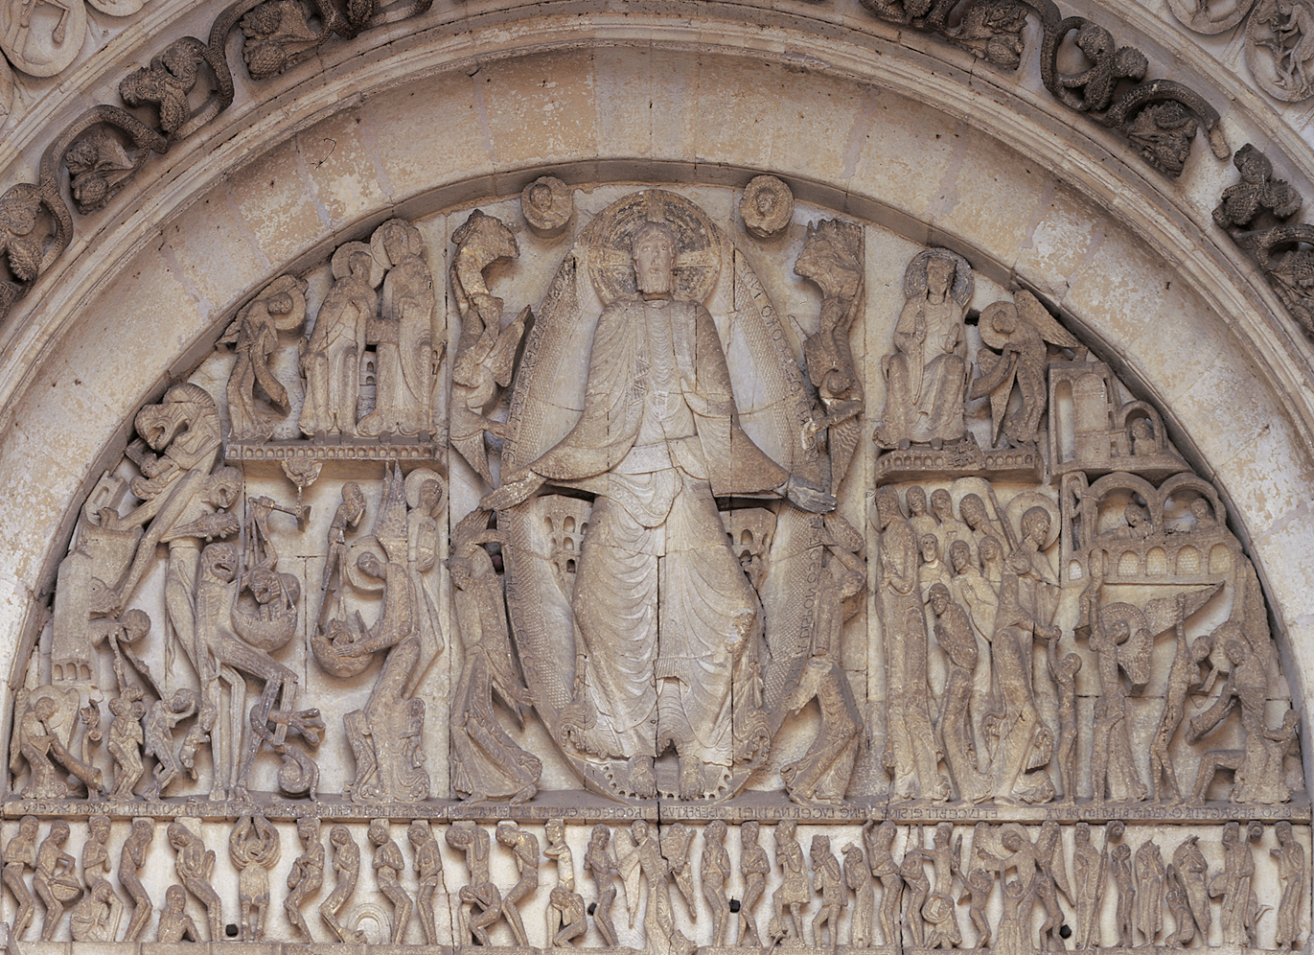
GISLEBERTUS, Last Judgment, west tympanum of Saint-Lazare, Autun, France, ca. 1120–1135. Marble, approx. 21’ wide at base.

Slide 18
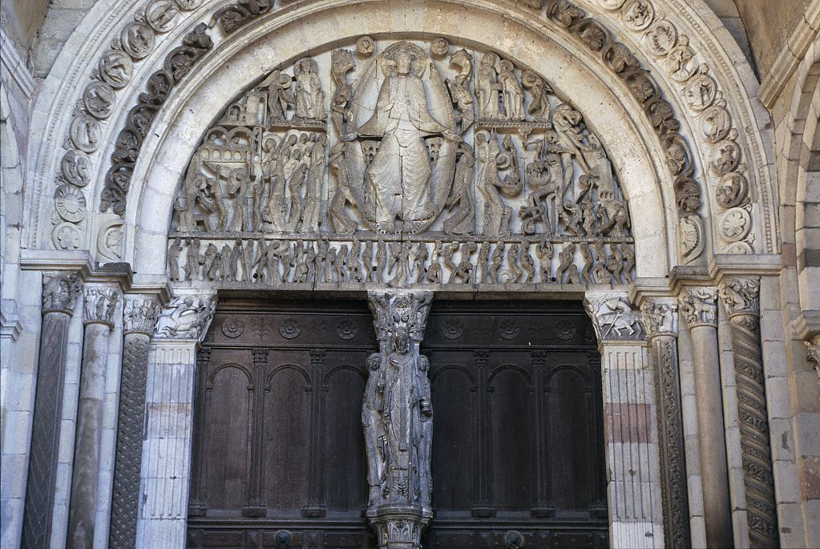
Alternate View General view of Portal with Tympanum

Slide 19
SmART Video

Slide 20
Sculpture in Wood & Metal

Slide 21
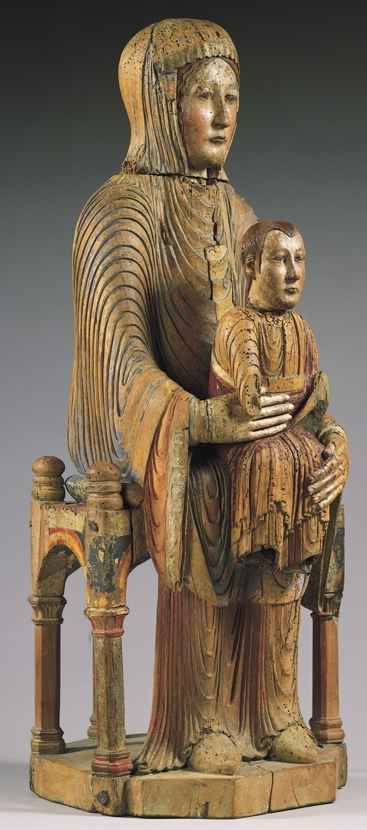
Virgin and Child (Morgan Madonna), from the Auvergne, France, second half of twelfth century. Painted wood, 2’ 7” high. Metropolitan Museum of Art, New York (gift of J. Pierpont Morgan, 1916).

Slide 22
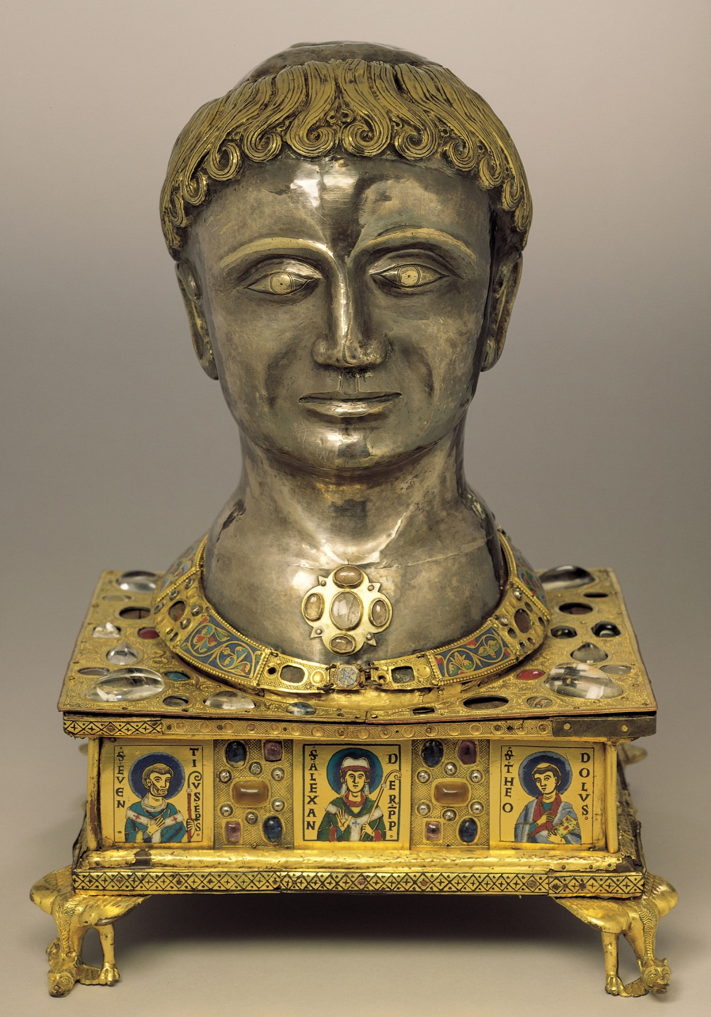
Head reliquary of Saint Alexander, from Stavelot Abbey, Belgium, 1145. Silver repoussé (partly gilt), gilt bronze, gems, pearls, and enamel, approx. 1’ 5 1/2” high. Musées Royaux, Brussels.

Slide 23
Reliquary of Sainte-Foy, gold, silver, gemstones, and enamel over wood
Date: ca. 1050-1130 CE
Sainte-Foy, Conques, France

Slide 24
Reliquary
Contains the remains of St. Foy
Saint Faith (Saint Foi or Foy in French) was a early fourth century child martyr (age of 12) who refused to pay homage to the Roman gods
A monk from the abbey church in Conques stole the skull from a nearby abbey, claiming that St. Faith wanted to move
Silver and gold gilt over a wooden core with inset jewels and cameos, provide a place to hold the skull
Mostly paid for by pilgrims who donated gemstones
Rear of the throne bears an image of the Crucifixion further paralleling Christ’s martyrdom with St. Faith’s

Slide 25
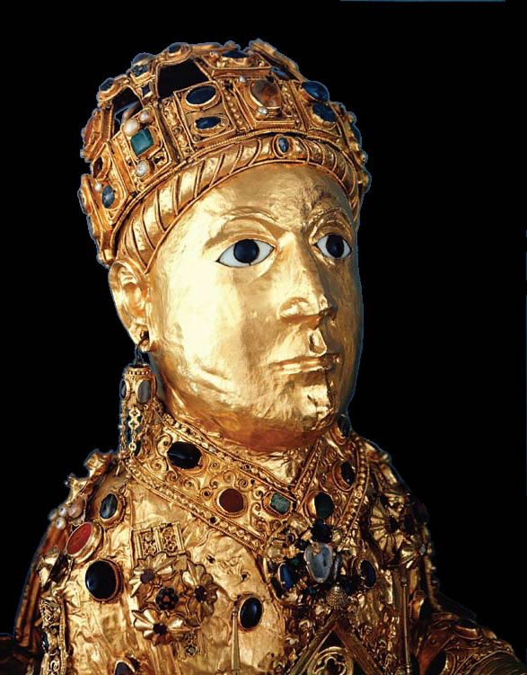
Detail, Sainte-Foy, Conques, France

Slide 27
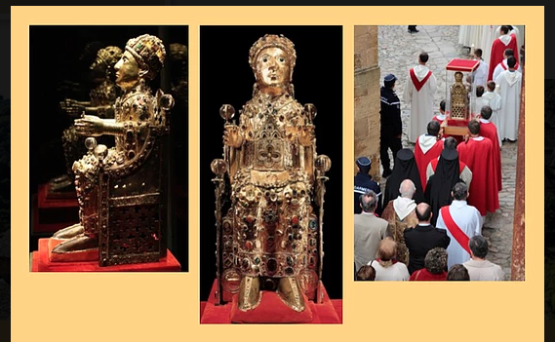

Slide 28
TAPESTRY

Slide 29
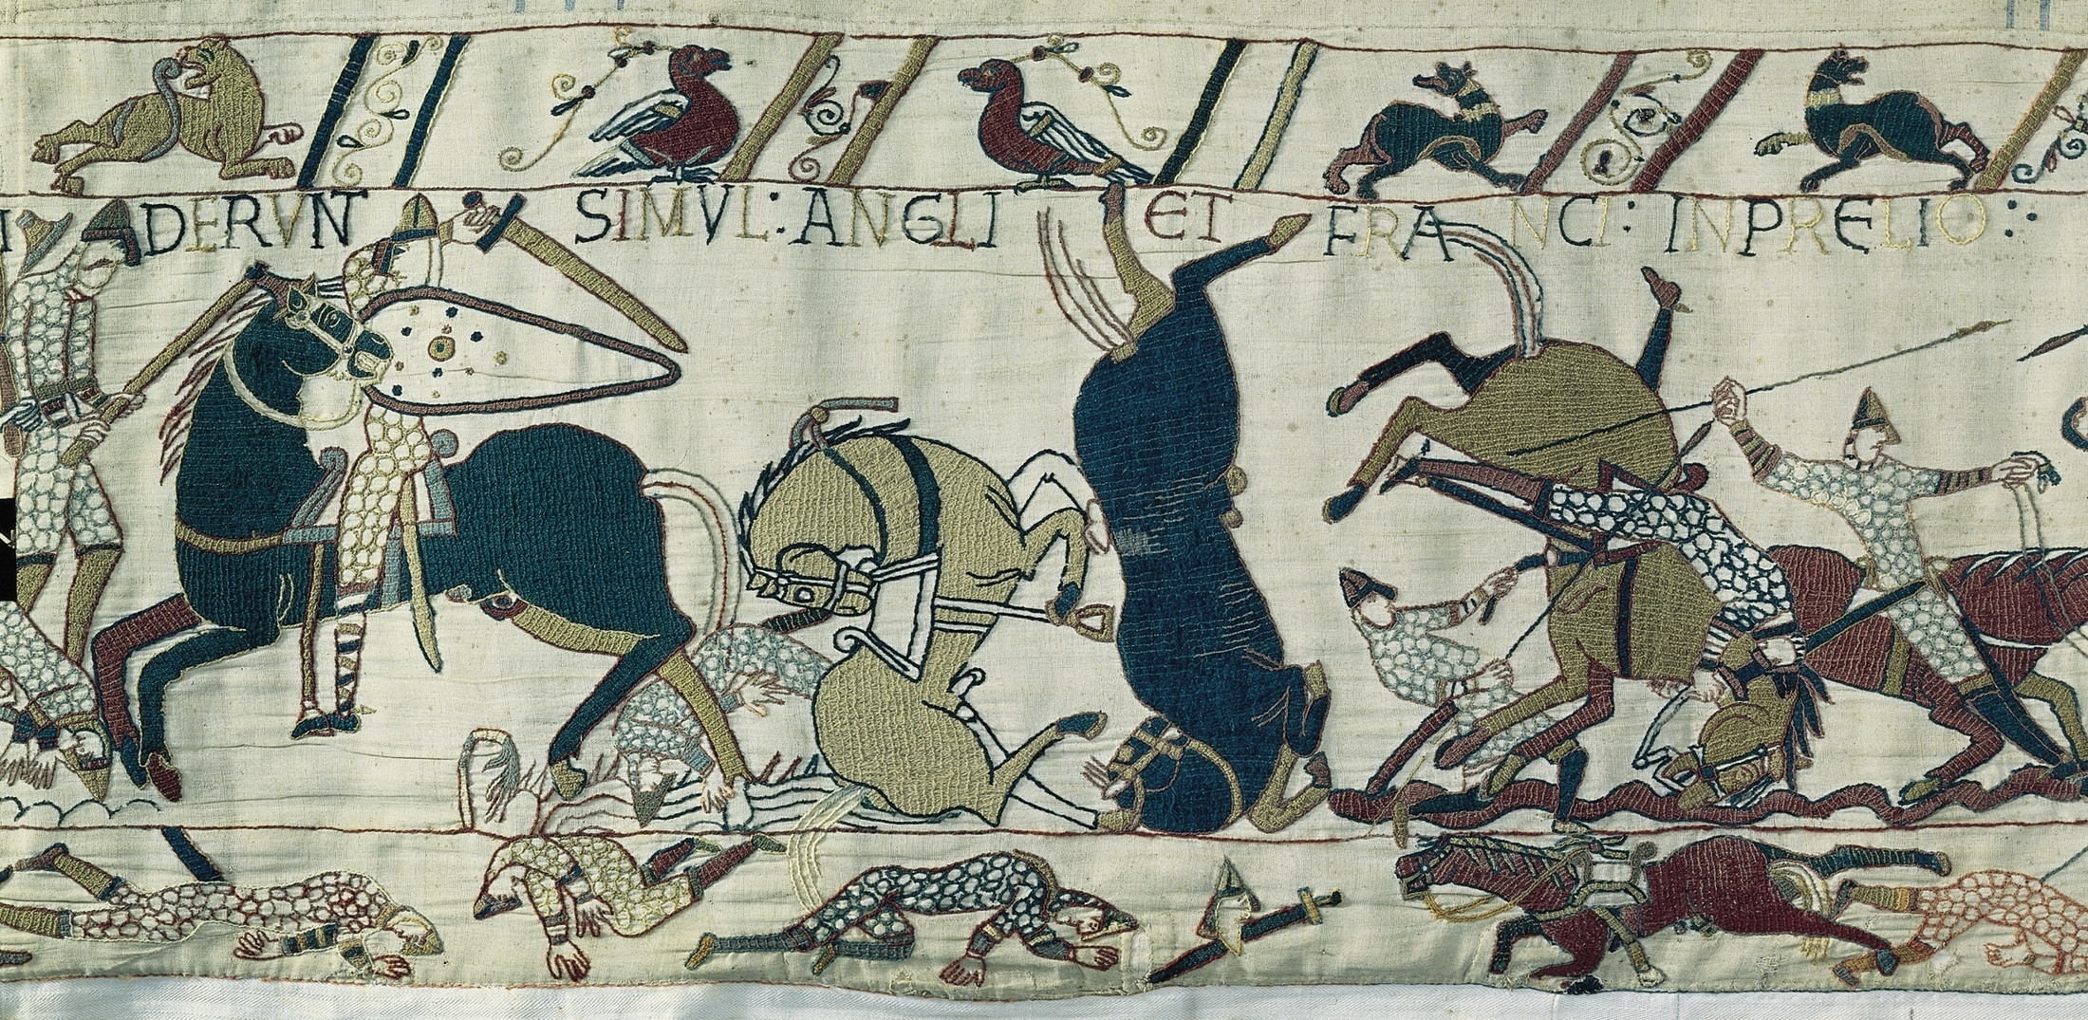
Battle of Hastings, detail of the Bayeux Tapestry, from Bayeux Cathedral, Bayeux, France, ca. 1070–1080. Embroidered wool on linen, 1’ 8” high (entire length of fabric 229’ 8”). Centre Guillaume le Conquérant, Bayeux.

Slide 30
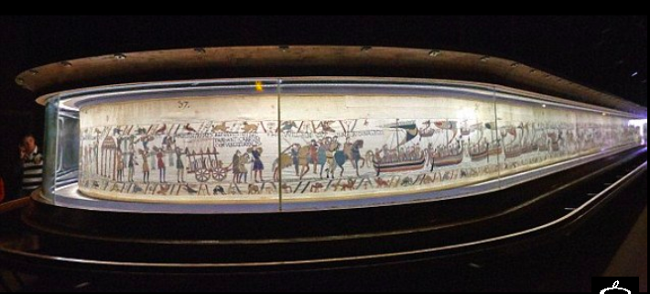
Notes:
Medieval, Romanesque pd, Bayeux Tapestry, 1070-80 display

Slide 31
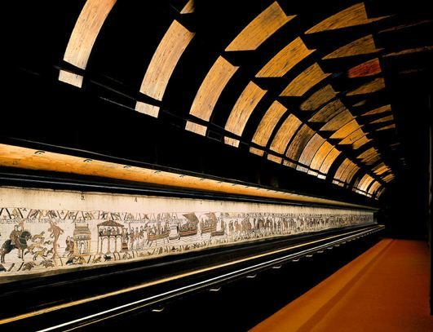
Notes:
Medieval, Romanesque pd, Bayeux Tapestry, 1070-80 display

Slide 34
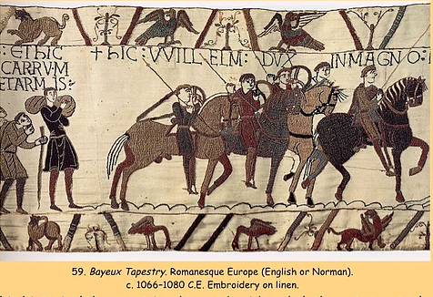

Slide 35
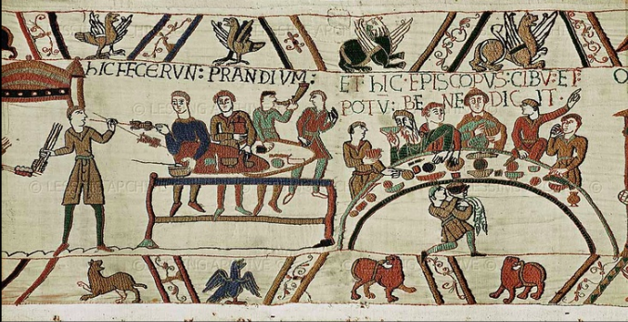
The Bayeux tapestry is considered to be the best historical record of medieval warfare, clothing and customs. The embroiderers’ attention to detail provides important sources for scenes of 11th century life as well as objects that no longer survive.

Slide 36
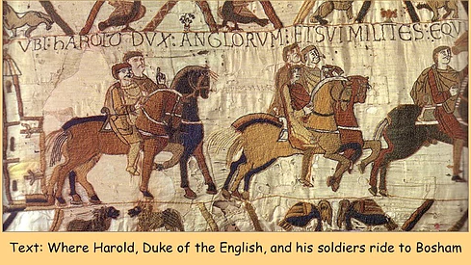

Slide 37
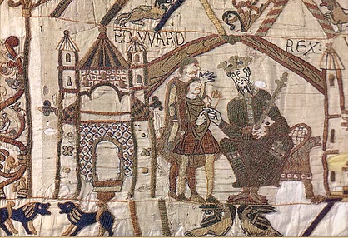

Slide 49
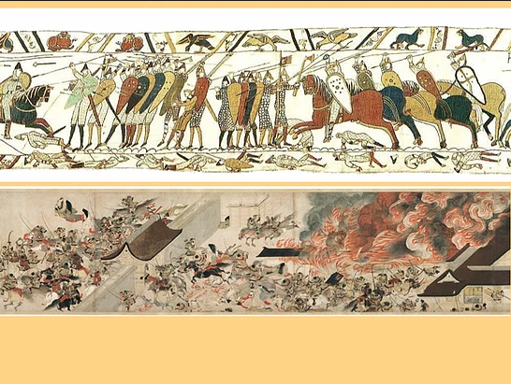
SmART Video - 1
SmART Video - 2

Slide 50
Illuminated Manuscripts

Slide 51
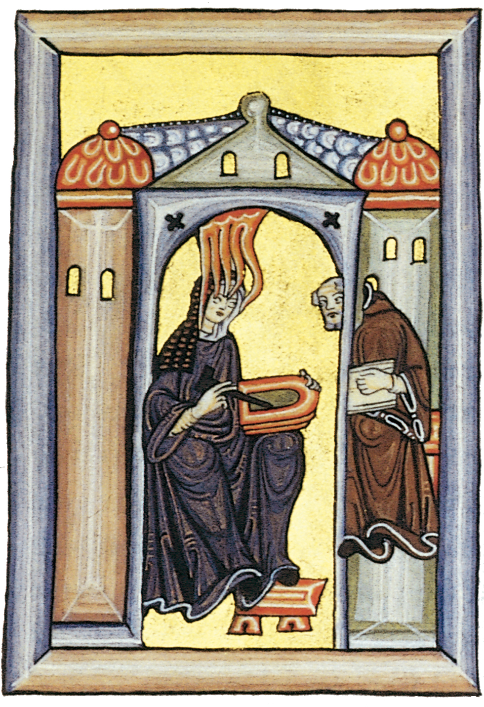
The vision of Hildegard of Bingen, detail of a facsimile of a lost folio in the Scivias by Hildegard of Bingen, from Trier or Bingen, Germany, ca. 1050–1079. Formerly in Hessische Landesbibliothek, Wiesbaden.

Slide 52
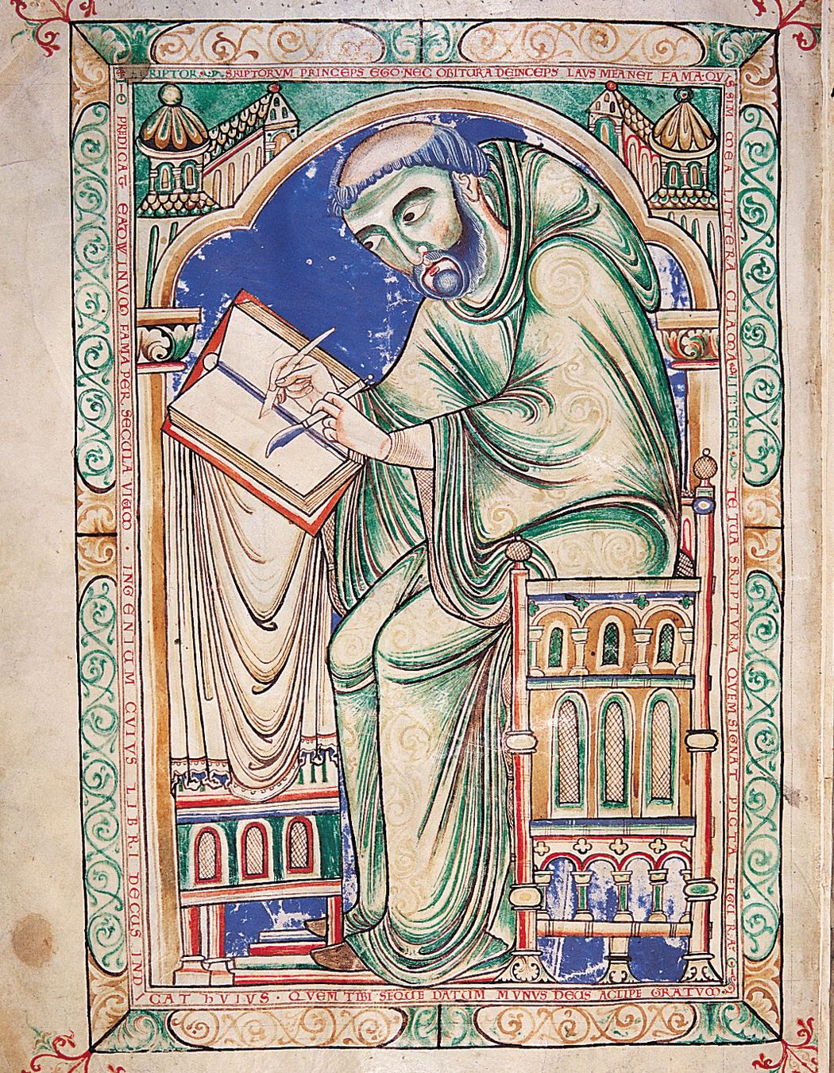
EADWINE THE SCRIBE(?), Eadwine the scribe at work, folio 283 verso of the Eadwine Psalter, ca. 1160–1170. Ink and tempera on vellum. Trinity College, Cambridge.

Slide 53
Romanesque Painting and Other Artistic Expressions In the Romanesque

Slide 54
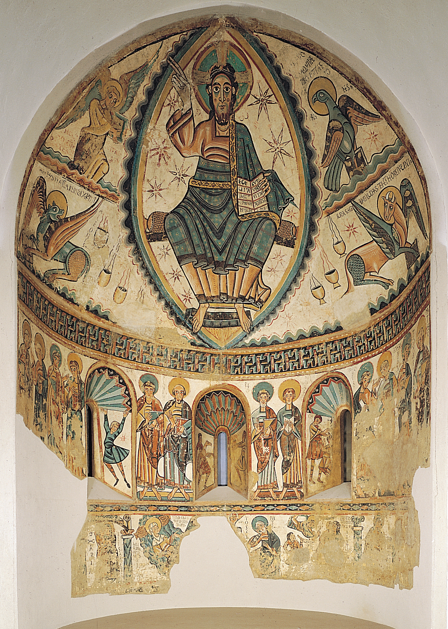
Christ in Majesty, apse fresco from Santa María de Mur, near Lérida, Spain, mid-twelfth century. 22’ X 24’. Museum of Fine Arts, Boston.

Slide 55
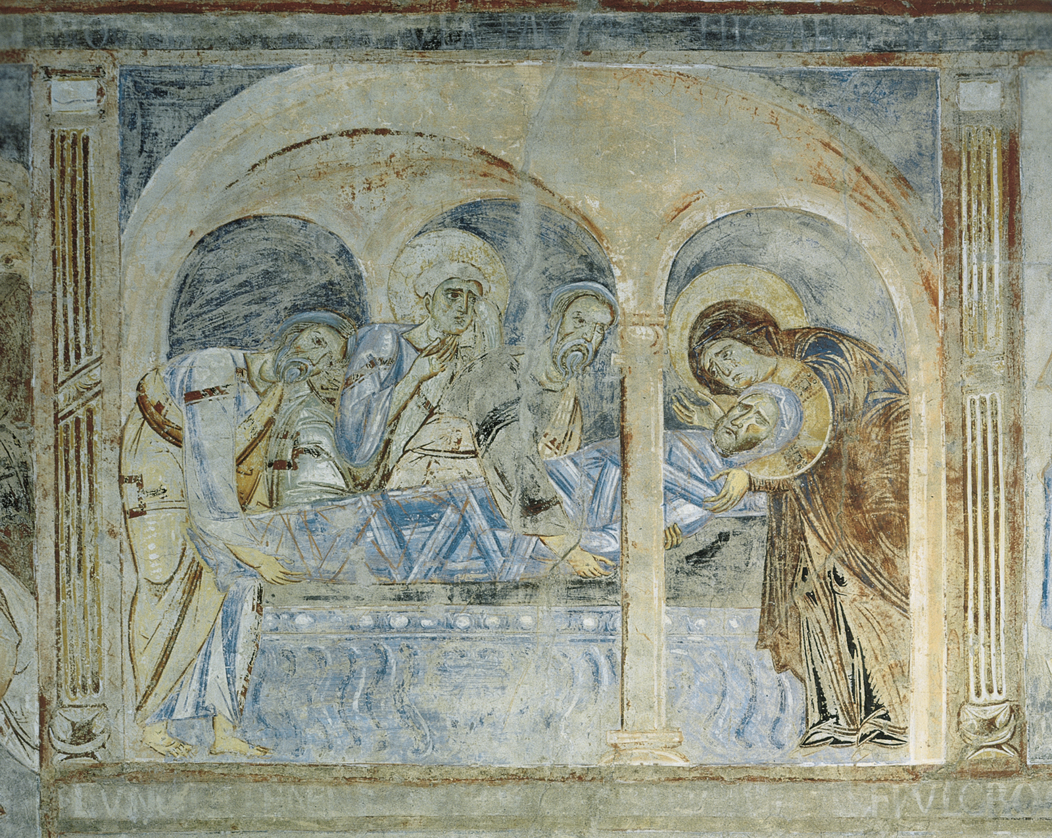
Entombment of Christ, fresco above the nave arcade, Sant’Angelo in Formis, near Capua, Italy, ca. 1085.

