Slide 1
Content Area 4 - Early modernism
REALISM
PHOTOGRAPHY
19TH CENTURY ARCHITECTURE

Slide 2
Required Content Area Works
Realism
113. Courbet, The Stone Breakers
115. Manet, Olympia
119. Rodin, The Burghers of Calais
Photography
110. Daguerre, Still Life in Studio
114. Daumier, Nadar Raising Photography to the Height of Art
117. Muybridge, The Horse in Motion
127. Alfred Stieglitz, The Steerage
Early Modern Architecture
124. Carson, Pirie, Scott and Company Building

Slide 3
Context: Late 19th Century Europe
Industrial Revolution
Urbanization, massive movements to cities and resulting in social unrest
Franco-Prussian War (1870)
France at war and in turmoil
Science=progress
New materials, new knowledge
Darwin and dramatic medical advancements
Invention of photography (1839)
By Daguerre/Talbot, by 1850 it is well-known
Maybridge exhibition in 1881
Lithography (beginning in 1850s)
Resulted in wider distribution of art and other printing techniques

Slide 4
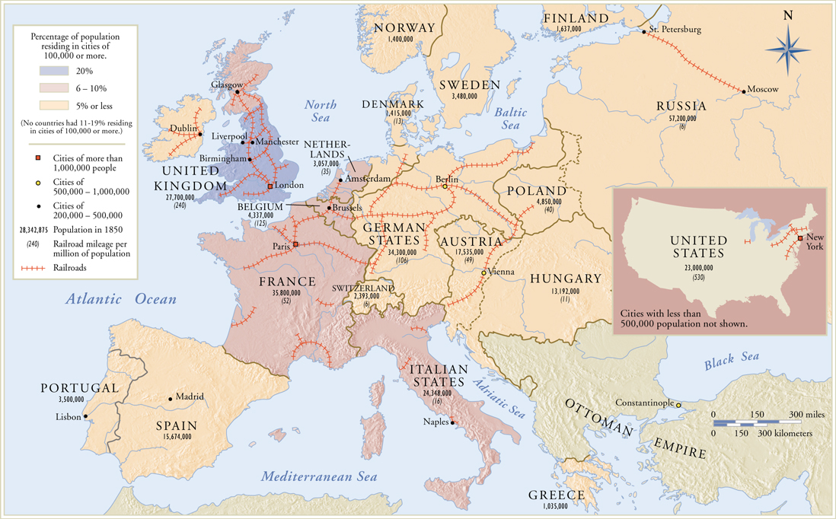
Industrialization of Europe and U.S. about 1850

Slide 5
Context: Late 19th Century Europe
Great Exhibition of all Nations (England) 1851
Cast iron, a new building material for architects results in mass production of complicated decorative devices and prefabrication of building units off site
Colonization by European powers continues/Admiral Perry opens Japan (1853)
Forced trade with Europe, influx of Japanese prints/other objects
Art for art’s sake
Examination of the definition of art and the role of art
Art that is done for the sake of doing, without historicism or histrionics, without symbolism and metaphor

Slide 6
Realism: Context
Realism is a rejection of Romanticism and the Salon
Common day occurrences and subjects of humble origins doing mundane activities
Shocked the public and the salon by rejecting traditional “history” paintings and mythological subjects
Artist’s alliance with radical politics of the time
Socialism and the working (under-class) laborers
“Art for art’s sake”
Direct and “honest” (objective) presentation of subject matter
Invention of photography
Painting begins to move away from being a “window into another world” and starts to become an object on the wall
Cast iron
International Exhibitions
Exposure to new ideas and non-European cultures
Franco-Prussian war

Slide 7
Realism: Concepts
Reaction to Romanticism (which was seen as an escape from everyday life)
Often an alliance with radical politics of the time
Subject matter of art drawn from real life
Genre scenes (the ordinary) elevated to the position of history painting
Simple, direct observation and recording of reality
Objective: a sense of detachment in regard to the representation of subject matter
An optical approach to the visible world and art making
Painting as object: paint surface often textural, paint applied in impasto
Seen by contemporary critics of the time as “crude” and “primitive”

Slide 8
Daumier, Third Class Carriage, 1862, Realism, France** Not in 250
-Power of art to serve political ends, political and social agitation accompanied the violent and social agitation
-Artists started to become suspects of subversive intentions, people began to be arrested for making bold statements
-Daumier defended the working classes, confronted authority with social criticism
-Produced lithographs, reached a large audience
-View into the cramped railway cars of the 1860s
-Depicted in unposed attitudes and unplanned arrangements
-Anonymous and insignificant, faces vague, blank, impersonal
-Random collection of details from ordinary life

Slide 9
Courbet, Burial at Ornans, 1850, Realism, France, oil on canvas** Not in 250
-Small funeral set in bleak landscape
-Clergyman reads, others are gathered around
-Monumental scale of burial paintings, it is stark and unheroic
-Three groups: somberly clad women, similarly clad men by the open grave, and assorted churchmen on the left.
-Faces are portraits, Courbet’s sisters and friends
-Dark sky and pit below in the foreground
-Ordinary rhythms of daily existence
-Realists call attention to painting by pictorial construction: intentionally simple and direct methods of composition and technique

Slide 10
Courbet, Stone Breakers, 1850, Realism, France, oil on canvas
-Glimpse into real life of rural menial laborers, 2 men, one old and one young
-Common rural town in the background
-Lowest job in French society
-Juxtaposing youth and age, remain poor their entire lives
-Not romanticized or idealized
-Isolated physically and economically
-Colors and angles suggest dismal nature and mechanism
-1848 laborers rebelled against bourgeois leaders, demanding better working conditions. Put down in days, but many died
-Original was destroyed during WWII when a transport vehicle moving it in Dresden was bombed by Allied Forces

Slide 11
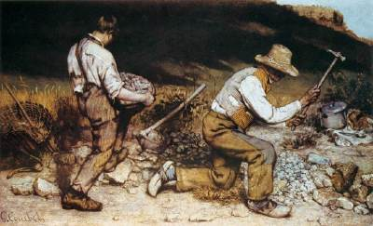
On top, Millet’s The Gleaners, hard-working but un-idealized peasants
Hard working but not depicted as harshly
Aerial perspective is calming, close up and low perspective is uncomfortable
Brush strokes are rough and choppy in Stone Breakers
Rejection of Neoclassicist style
No attention given to faces in either work

Slide 12
Millet, The Gleaners, 1857, Realism, France, oil on canvas** Not in 250
-Subjects in occupations of the everyday world
-Millet was part of a group of painters who settled in the countryside to paint (Barbizon School)
-Millet was also from a peasant family and identified with the country poor
-Three peasant women finding the scraps of grain, allowed to do this by wealthy landowners
-Monumental figures against a large sky
-Sentimental, unlike Courbet
-Disliked by public, especially rich middle and upper classes
-Influenced socialist movements and thinkers like Marx

Slide 13
Manet, Le Dejeneur sur l’herbe, 1860s, Realism, France, oil on canvas**Not in 250
-Important in the development of Impressionism
-Two women and two men enjoying a picnic
-Consistent with Realist principles, all foreground figures are based on real people. Woman is his favorite muse at the time, his brother has a cane, and the other man is a famous sculptor
-Unidealized nude, but comfortable in surroundings, gazing at the viewer
-Outraged the public
-Called attention to the act of making art, stark lighting, soft brushstrokes contrasted with hard lines of the figures
-Moving away from illusionism and toward an open acknowledgement of painting’s properties

Slide 14
Manet, Olympia 1860s, Realism, France, oil on canvas
-Young, white prostitute (Olympia was a common name for prostitutes at this time)
-At ease and gazes at the viewer
-Horrified critics and the public: shamelessness of her gaze
-Depiction of a black woman was not new, but with a white prostitute it evoked moral depravity, inferiority, and animalistic sexuality
-Made references to racial divisions
-Also departed from accepted art practices: rough brush strokes, and abrupt shifts in tonality

Slide 15
Bonheur, The Horse Fair, 1850s, Realism, France, oil on canvas** not in 250
-Most celebrated female artist of the 19th century
-Received training from her father (socialist who championed the education and enfranchisement of women)
-Realist passion for accuracy in paintings, but resisted the depictions of problematic social/political situations
-Turned attention to French countryside and animals
-Studied anatomy at the fairs and the slaughterhouses
-Also inspired by the Parthenon frieze
-Dramatic lighting, loose brushwork, rolling sky
-Different movement but based on reality

Slide 16
Eakins, The Gross Clinic, 1875, Realism, America, oil on canvas**not in 250
-Increasing emphasis on science
-Connection between progress and science. Science was mankind’s highest achievement
-Eakins studied both painting and medical anatomy
-American way of painting, combining admiration for the accurate with a hunger for the truth
-Presents renowned surgeon in operating amphitheater
-Lecturing about his surgery with bloody hands
-Watching is the patient’s mother, an anesthetist holds cloth over his face
-Eakins believed that knowledge was a pre-requisite of art
-Participated in scientific observation for his painting and insistence on accurate scientific fact

Slide 17
Sargent, Daughters of Edward Darley Bolt, 1882, America, oil on canvas** Not in 250
-Looser Realist style, influenced by Velasquez’s “Las Meninas
-Four girls in the drawing room, friend of their parents
-Informal, eccentric arrangement
-Captured naïve openness of child in foreground, self conscious adolescents
-Shows that it was the Realist artist’s business to record modern people in modern contexts

Slide 18
Tanner, The Thankful Poor, 1890, Realism, America, oil on canvas** not in 250
-Depict lives of ordinary people
-Studied with Eakin
-Careful study from nature with a desire to portray with dignity the life of the ordinary people he had been raised among, as the son of an African-American minister
-Grandfather and grandson are clear and their surroundings dissolve into color and light
-Deep sense of sanctity in everyday experience, was important for Tanner

Slide 19
Millais, Ophelia, 1850, Realism, England**not in 250
-Part of the Pre-Raphaelite Brotherhood, group of artists who chose to portray fictional, historical, and fanciful subjects. Wanted to create art free of “tired and artificial manner of the academies”
-Careful in study of visual facts
-From Shakespeare’s “Hamlet”, the drowning of Ophelia
-Faithful to every detail, even though story is fictitious
-Set by a river in Surrey and had a model lay in the bath for hours as he painted.

Slide 20
Rodin, Burghers of Calais, 1900, Realism, France, bronze
-Fascinated by the human body in motion, profound knowledge of the anatomy
-Nude and draped figures, life-size group
-Commemorating a heroic episode during the Hundred Years War-in 1347 six leading citizens offered their lives to the King of England if he would stop attacking the city
-Bedraggled looking men, wandering instead of clustered together
-Roughly textured surfaces add to the pathos and interest of the viewers
-Hoped it would inspire viewers, but the city didn’t like it and removed it to an isolated location

Slide 21
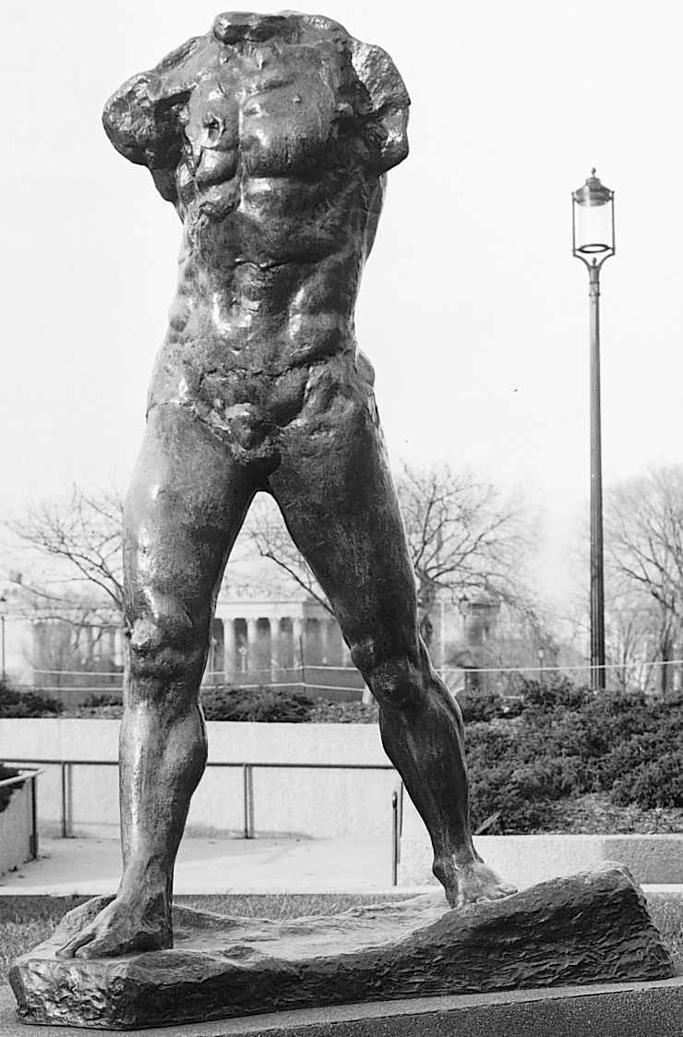
AUGUSTE RODIN, Walking Man, 1905, cast 1962. Bronze, 6’ 11 3/4” high. Hirshhorn Museum and Sculpture Garden, Smithsonian Institution, Washington (gift of Joseph H. Hirshhorn, 1966).

Slide 22
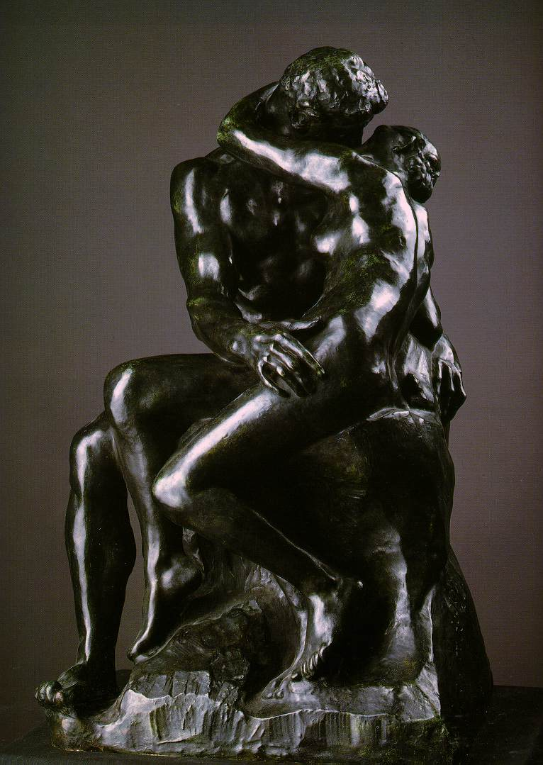
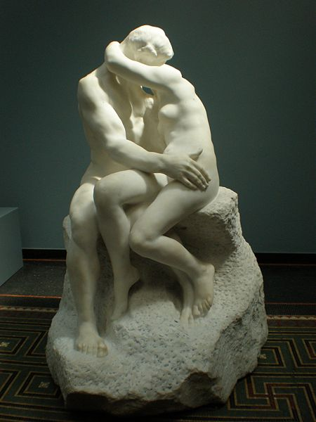

Slide 23
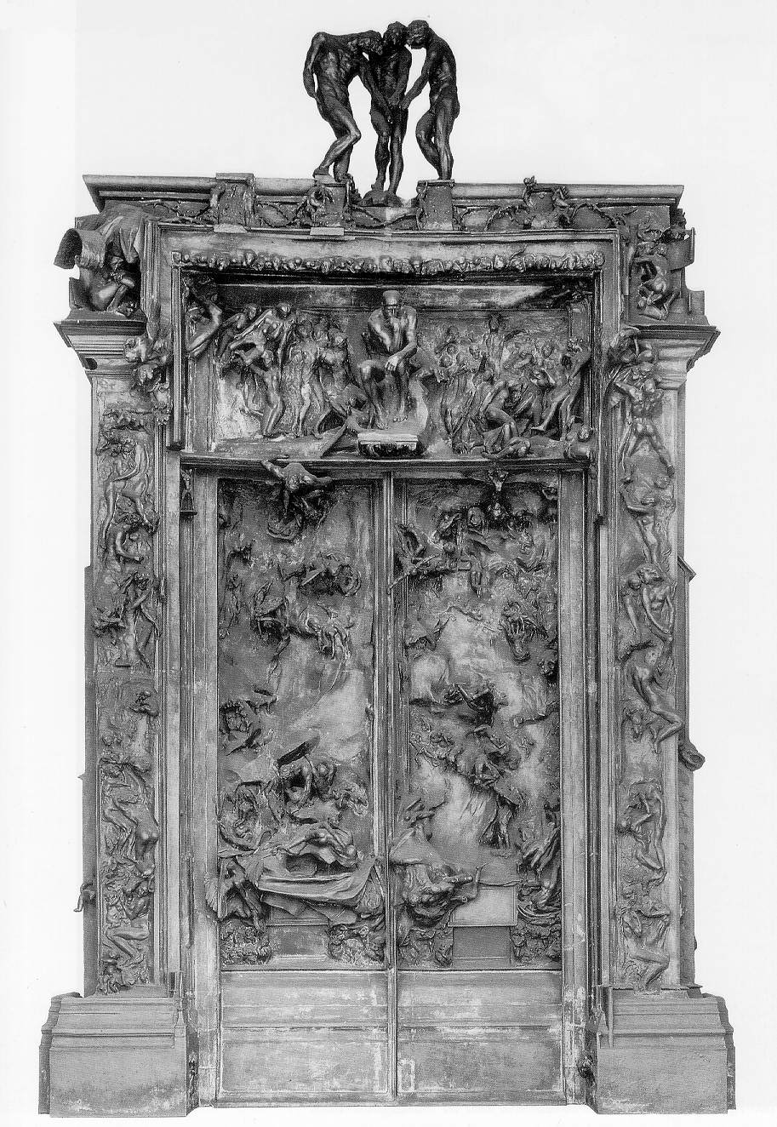
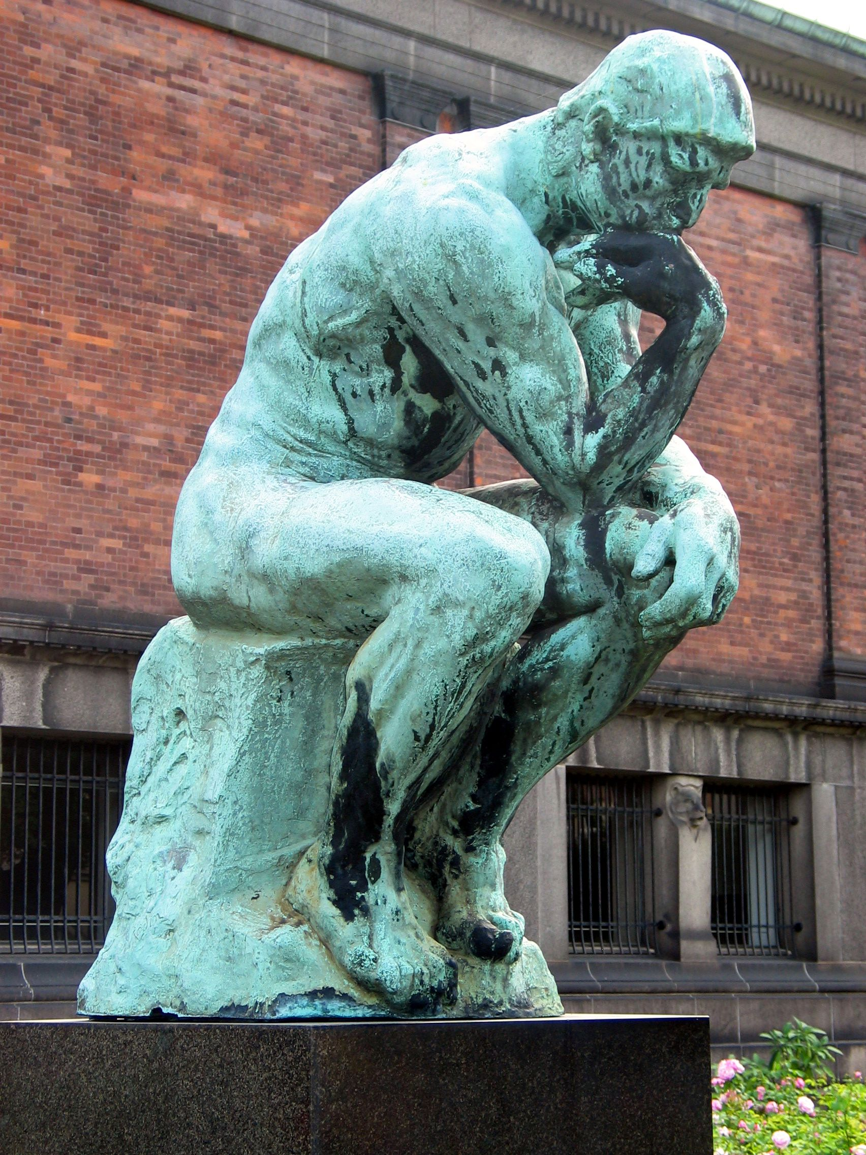

Slide 24
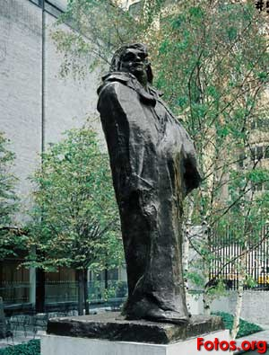
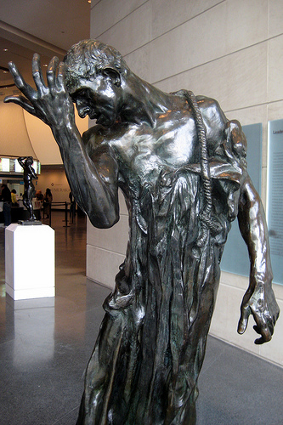

Slide 25
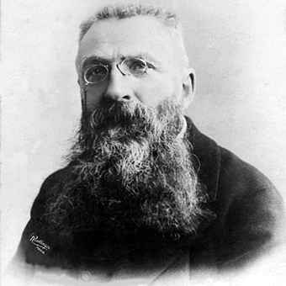
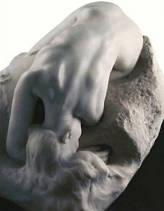
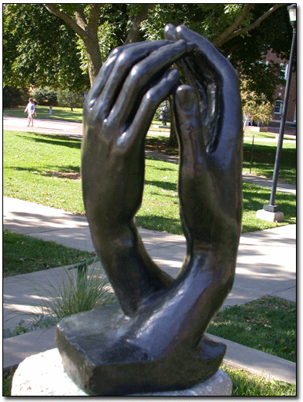
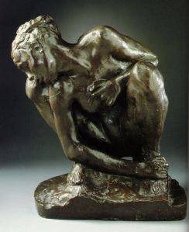
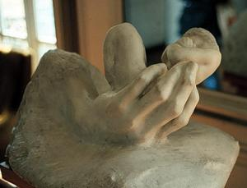

Slide 26
Paxton, Crystal Palace, 1850, Realism, England, glass and metal**not in 250
-Completely “undraped” construction became popular in the conservatories of English country estates
-Submitted the winning design to house the Great Exhibition of 1851 to house “works of industry of all nations”
-Constructed with pre-fabricated parts, put together in 6 months
-Flat roofed nave, barrel-vaulted transept
-Provided ample interior space for display
-Replica was later made, but burned down in 1936

Slide 27
Eiffel, Eiffel Tower, 1889, Realism, France** not in 250
-Originally seen as a symbol of modern Paris
-Was designed for the Great Exhibition in Paris in 1889
-984 ft tall
-Tower rests of four supports, arches that hide its bulk
-Blurs the distinction between interior and exterior, important to 20th century art and architecture
-Showed that modern materials and processes could create a whole new style and innovative approach to design

Slide 28
Richardson, Marshall Field Building, 1887, Realism, America**Not in 250
-Desire for greater speed and economy in buildings, and reduction of fire hazards
-Use of cast-iron architecture inside masonry to strengthen its fire resistance
-Favored Romanesque architecture, round arches and heavy masonry walls
-Occupied a city block
-Tripartite elevation of Roman aqueduct or Renaissance palace
-Horizontal windows, broken courses, large windows that transformed them into screens

Slide 29
Early Modern Architecture
Innovations/Concepts
Steel frame replaces cast-iron (more heat tolerant)
Skyscraper-new verticality possible with the use of new materials
Elimination of ornament and sculptural decoration
Rigid symmetry with no strong central axis
Internal skeletal construction of steel with masonry facades
First skyscraper was built during this period
Interaction between architecture and commerce

Slide 30
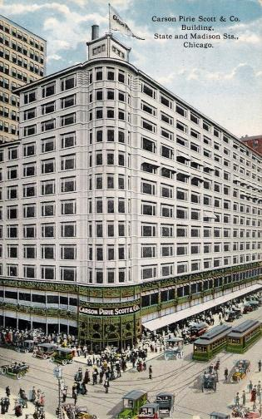
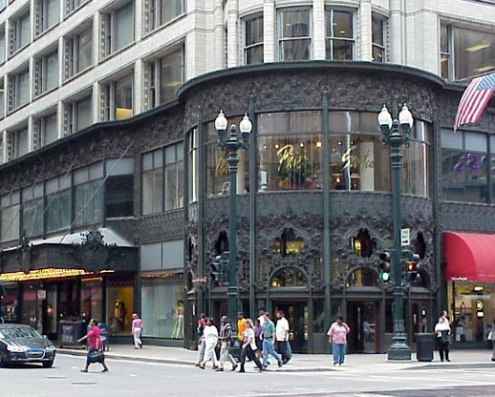
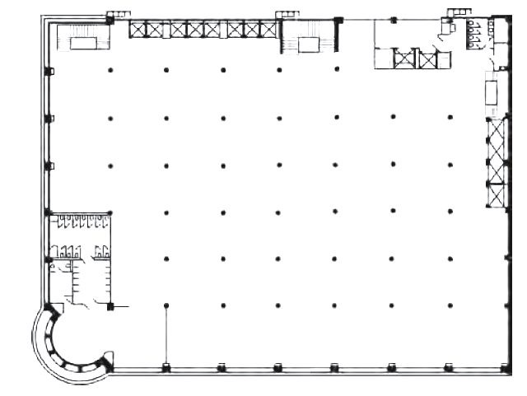
Carson, Pirie, Scott and Company Building. Chicago, Illinois, U.S. Louis Sullivan (architect). 1899–1903 C.E. Iron, steel, glass, and terra cotta. (3 images)

Slide 31
Sullivan wrote a treatise “The Tall Office Building Artistically Considered”
Analyzed the problem of high-rise commercial architecture
“Form must follow function” his most famous phrase
Design must reflect the social purpose of a particular space
Describes the ideal skyscraper
Ground floor-easy public access, light, open
Second floor-also open and accessible by stairways
Floors after should follow the same as the second floor, with offices, looking the same because they have the same function
Should be topped with an attic story and distinct cornice line to mark the end point and to set it apart from other buildings in the cityscape
Purpose of a skyscraper was to be tall, so the design should serve that upward momentum

Slide 32
Was adapted for a department store purchased by Carson, Pirie, and Scott
Highlighted the lower street-level section and entryway to draw shoppers into the store
Windows on the ground floor, displaying store’s products, are larger than those above
Three entrance doors are placed in rounded bay on the corner of the site so they are visible from all directions approaching the building

Slide 33
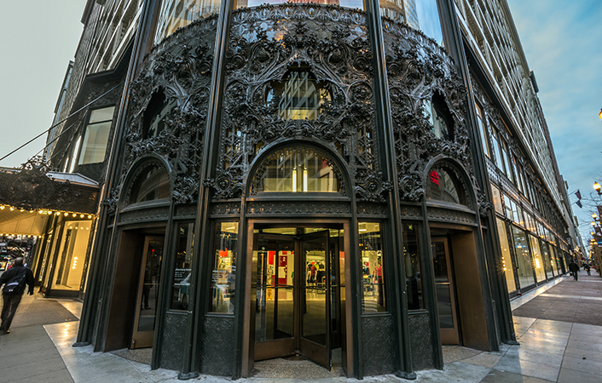
Corner entryway and the entire base section are differentiated from the bare upper stories by a unified system of extreme decoration
Cast-iron ornament contains highly complicated, delicate, organic, and floral motifs that had become the hallmark of Sullivan’s aesthetic design
Decorative program served overall function: to distinguish itself from the buildings around it and to make the store attractive to potential customers

Slide 34
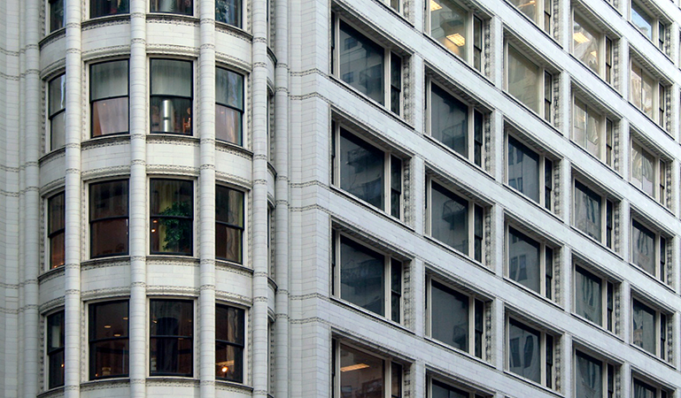
Upper floors show an adaptation of the skyscraper theory
Each floor contains successive, identical windows on a white terra-cotta façade
Overhanging cornice at the top ends the building’s ascent
Makes the attic level distinct from the broad mid-section and the cast-iron decoration of the base level
Primary thrust is horizontal rather than vertical, emphasizes the long uninterrupted lines that run around the building toward the entrance and flow seamlessly around the corner
The window shapes were a requirement of the department building so that shoppers could see the merchandise, not offices

Slide 35
Early Photography
Struggle to define photography
Art or science?
Chemistry needed to register an image was created during the 19th century
Camera obscura was used before
Light was passed through a small hole that reflected an image in reverse
Joseph Nicephore Niepce invented a light-sensitive surface
Development of photography was largely related to technological improvements
Speed-the length of the exposure period
Resolution- longer the exposure, the more grainy the image
Permanence-how to stop any further chemical reaction, once the desired exposure had been achieved
Was solved by the invention of hypo in 1839 that reversed the light sensitivity of paper

Slide 36
Daguerre invented a new process in 1839 called “daguerreotype” which significantly reduced exposure time and created a lasting result, but only a single image could be produced
Was a one-of-a-kind image on a highly-polished, silver-plated sheet of copper
His methods were championed at the Academy of Sciences in Paris
Process was explained step-by-step in front of a joint session of the Academy of Sciences and Academy of Arts
Still Life in Studio. Louis-Jacques-Mandé Daguerre. 1837 C.E. Photograph.

Slide 37
Still Life in Studio. Louis-Jacques-Mandé Daguerre. 1837 C.E. Photograph.
Promoted his invention as both science and art
Still-life compositions of plaster casts of antique sculptures, ideal because white reflects light well and were immobile for long periods of time
His invention caused millions of people to want their portraits recorded for posterity

Slide 38
After Daguerre
Others tinkered with the chemistry to make it practical for portraiture, reducing exposure time to minutes
Devices were created to help sitters remain motionless
Portraiture accounted for the vast majority of daguerrotypes
Portrait studios were set up where middle class could feel like upper class
Did not care about looking artistic, rather that they were recorded accurately
Some men (mostly with money and time) took more intimate photos of family and friends on their own
Artists and scientists also used daguerrotypes
Some artists resisted the change
Others embraced it as a means of new expression
Could exactly record what was seen
Modern audiences were also fascinated with the images that were brought back from other lands
People wanted to travel as a result
Paper photography began to supersede the daguerreotype in the 1850s
Lacked clarity but could make multiple prints

Slide 39
Nadar Raising Photography to the Height of Art. Honoré Daumier. 1862 C.E. Lithograph.
Collodion method was invented in 1851
Process involved fixing a substance, gun cotton, onto a glass plate, allowing for a shorter exposure time (3-5 minutes) as well as clearer image
Disadvantage was that it needed to be exposed and developed while the chemical coating was still wet
Meant that photographers had to carry portable darkrooms to develop images immediately after exposure
Difficulty in method and uncertainty of growing status was publically criticized in works like this one

Slide 40
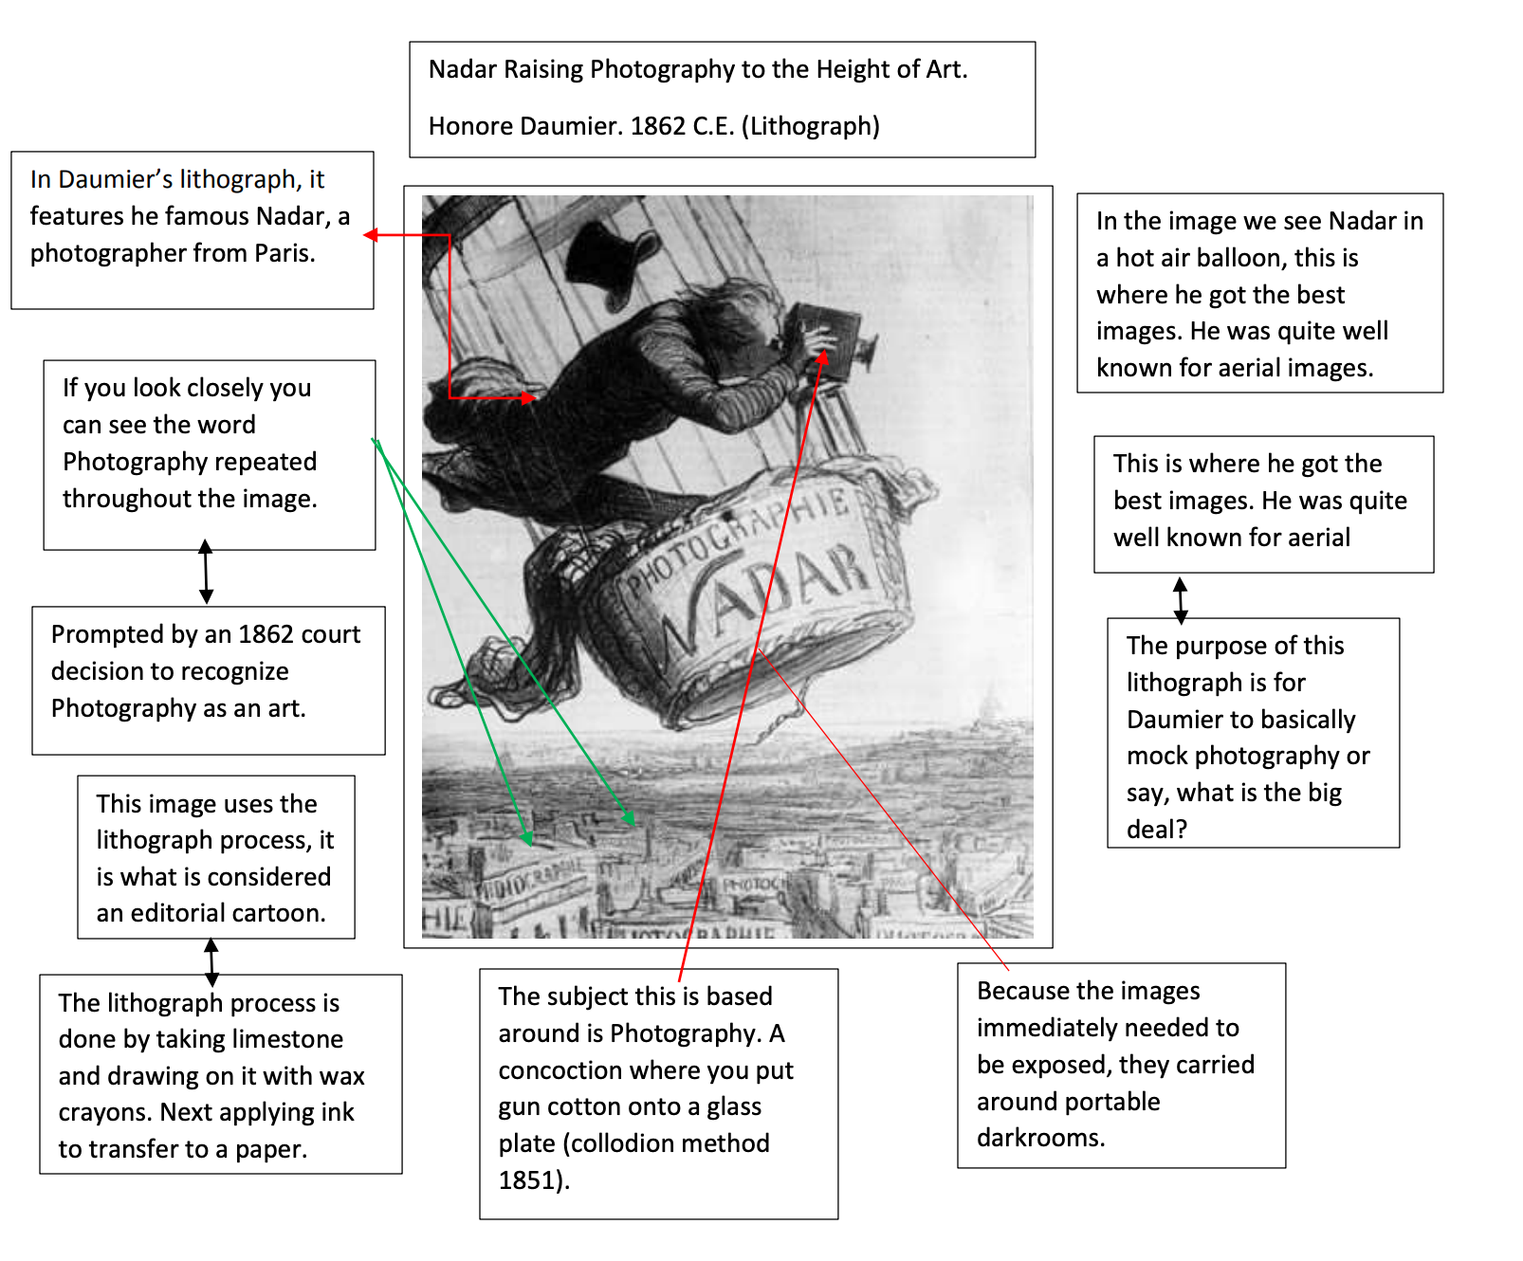

Slide 41
Nadar was one of the most prominent photographers in Paris at the time
Pseudonym of Gaspard-Felix Tournachon
Studied as a caricaturist
Was known for making caricatures of prominent figures in Paris
Was known for capturing the first aerial photographs from the basket of a hot air balloon

Slide 42
Daumier began satirical works in 1830
Made portrait busts criticizing certain types of contemporary men
Was hired by the paper La Caricature
Was later seized by Louis Philippe
Daumier was sent to prison
Made around 4,000 images
Transfer lithography
Drawing is made on paper rather than stone
Drawing is transferred to stone
Ink is applied to grease-treated surface on flat surface
Non-image, blank areas, repel ink
Then printed onto paper
114. Nadar Raising Photography to the Height of Art. Honoré Daumier. 1862 C.E. Lithograph.

Slide 43
Eadweard Muybridge, the horse in motion. Courbet, 1878, Photograph
Further advances were made to make photography less labor intensive
1867-dry glass plate was invented
Reduced the inconvenience of the wet collodion method
Prepared glass plates could be purchased eliminating the need to mess with chemicals
Exposure time was now 1/25 of a second
Allowed moving objects to be photographed and lessening the need for a tripod
Development is celebrated in Eadweard Muybridge’s The Horse in Motion
Was done to settle the question of whether or not a horse has all four feet off the ground when galloping
Also showed that new photographic methods were capable of nearly instantaneous exposure

Slide 44
Muybridge considered himself an artist but was encouraged by scientific investigation
Example of collotype
Invented by William Henry Fox Talbot
Patented in 1841
Creation of the paper negative that transformed a negative image into a positive image, allowing for more than one copy of the picture

Slide 45
Was taken from the first class deck by Stieglitz on a transatlantic journey from New York to Paris on May 14, 1907
Was married a status-conscious woman
Was uncomfortable with the upper class passengers and felt out of place
Walked to the front of the ship to escape the nouveau riches and looked down to see the women and children of the lower classes
Wanted to be with them, rather than above him
When describing this in an essay he also says that it encapsulated his mission to elevate photography to the status of fine art, by engaging in the same dialogues about abstraction that European artists were engaged with
Looked at the shapes and composition of the hats, the mast, the machinery
Alfred Stieglitz, The Steerage, 1907, photogravure

Slide 46
Photography is not only documentary but can also convey abstraction
Not only about significant forms of shapes forms and textures, but also a message about its subject
The immigrants who were rejected at Ellis Island and returning to their country
Or returning to see relatives and encourage them to come back to the USA with them
Stieglitz was familiar with the debates about immigration reform and the terrible conditions passengers in steerage were subjected to
His father had immigrated from Germany between 1845 and 1855; exemplified the American dream
However, he did not approve of admitting the uneducated and marginal to the US
This was a statement about photography, not immigration
Alfred Stieglitz, The Steerage, 1907, photogravure

