Slide 1
PART 2
NORTHERN RENAISSANCE ART + PAINTING + PRINTMAKING
1400-1650

Slide 2
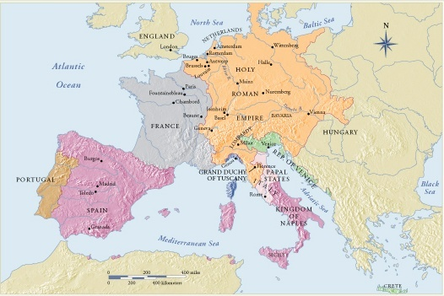

Slide 3
Terms and Techniques:
OIL PAINTING
pigment, glazes
PRINTMAKING
relief process
Woodcuts - wood block prints
intaglio process
etching - acid baths / bite /tar
engraving - incising, burin

Slide 4
15th Century Northern Renaissance-Context
Secularization culture causes a variety of subject matter in painting and the humanization of religious themes
Capitalization/banking/urbanization (growth of market economies) causes new patrons for the arts
“Sanctification of sight” causes intense detail and the miniaturist traditions with expanded subjects
Invention of the oil painting technique (changes the look of painting in 3 ways)
More detail possible because of slow drying time of oil
More attention to surface textures and reflected light effects
Intense, saturated color and subtle value gradations possible
1337-1435: 100 Years War, France and England at war, with Flanders caught in the middle
1305-1417: The Great Schism, two popes claim authority, one in Avignon and the other in Rome, pitting France against Italy
C. 1400: Emerging power of Royal Houses throughout Europe, but especially England and France
C. 1400: Court of Burgundy (northeastern France and the Netherlands, with capitals in Bruges, Antwerp, and Bourges), powerful financial and trading center. Dukes of Burgundy were the most powerful rulers in northern Europe
1456: Gutenberg develops printing press and publishes the Bible

Slide 5
“Sanctification of Sight”
“The exaltation of sight to divine status and the astonishing assertion that the essence of God is sight-not being, as St. Thomas tells us- are entirely in harmony with the new vision in painting. As sight and being in God are essentially the same, so the painter’s sight, which is instrumental in making likenesses, brings them into being…God sees everything, great and small alike…God [is] present in the greatest and in the smallest, in the macrocosm and the microcosm, in the whole earth and in a drop of water…[the] sanctification of the faculty of sight provides Flemish painters with a religious warrant to apply sight in the investigation of the given world.”
Glorification of the faculty of sight
Artist’s approach to subject matter reflects an analytical approach to the world
Every object and details of each object is treated with equal emphasis

Slide 6
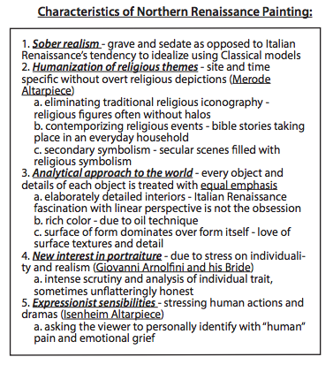

Slide 7
Northern
Renaissance
Altarpieces

Slide 8
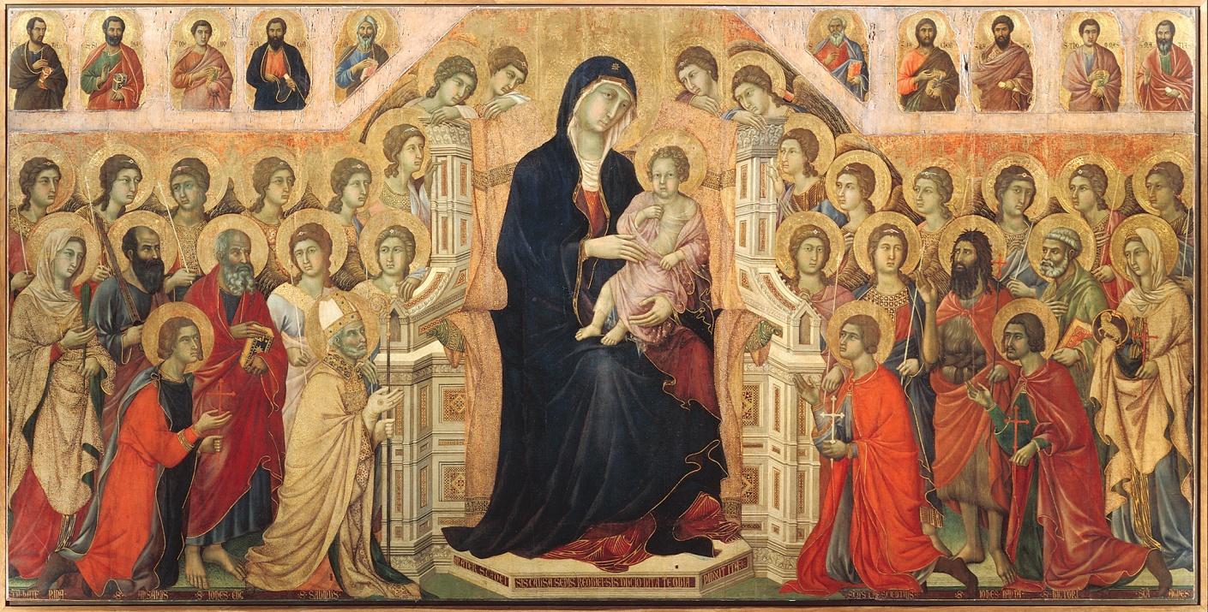
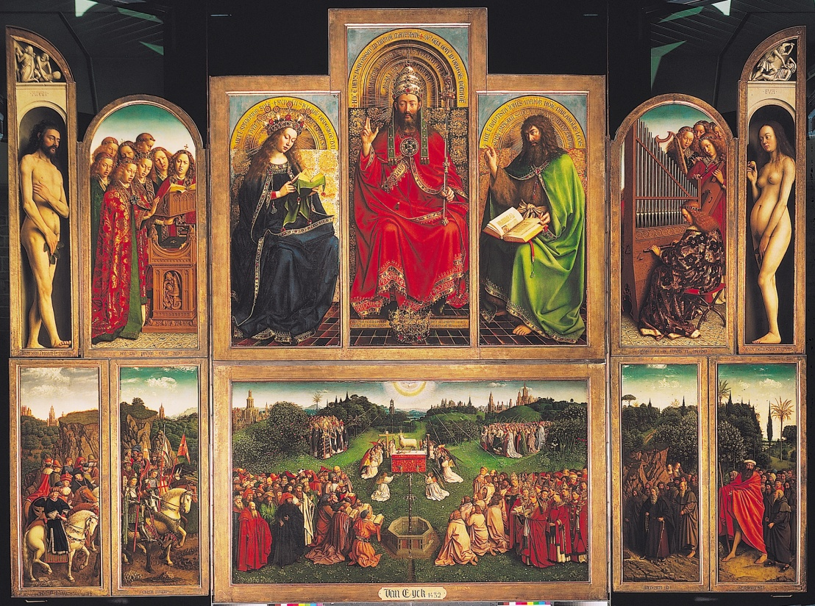
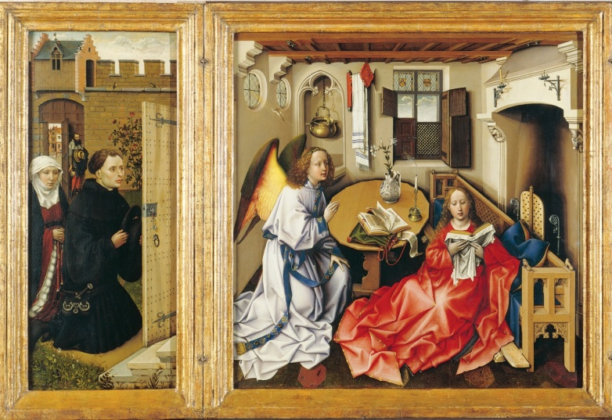
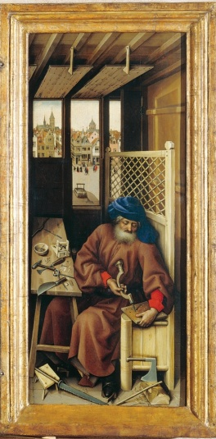
Italian Altarpieces
Northern European

Slide 9
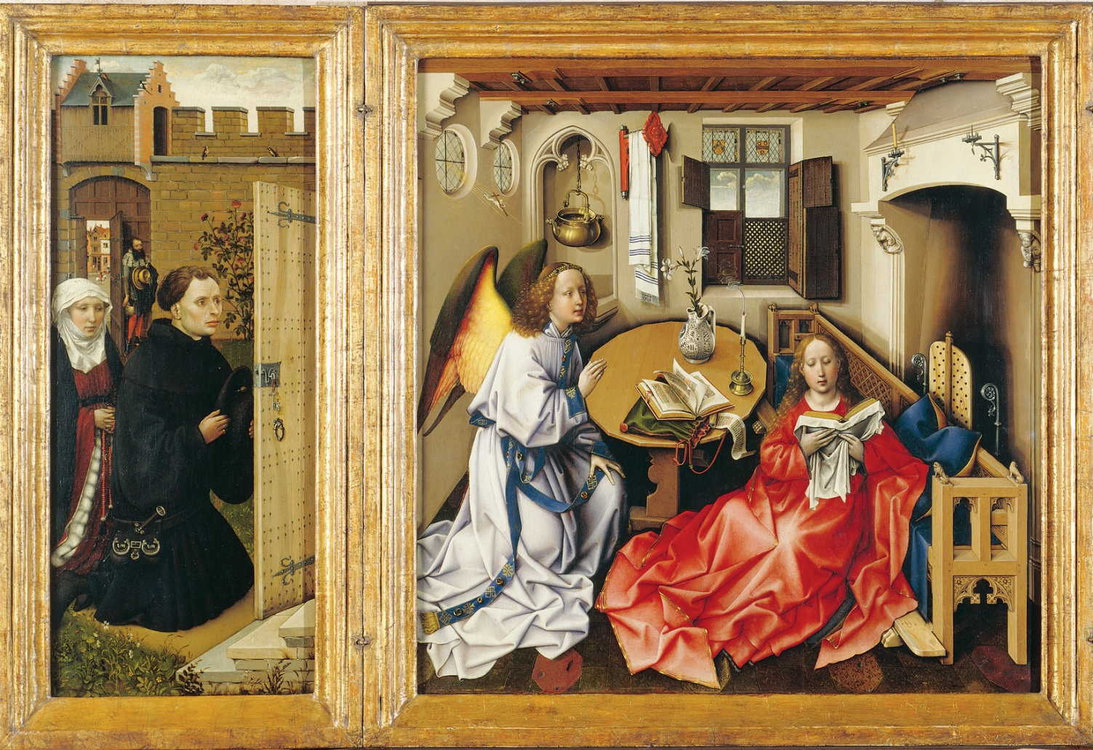
ROBERT CAMPIN (Master of Flémalle), Mérode Altarpiece (open), The Annunciation (center panel), ca. 1425–1428. Oil on wood, center panel approx. 2’ 1” x 2’ 1”. Metropolitan Museum of Art, New York (The Cloisters Collection, 1956).

Slide 10
Was originally known as the Merode Altarpiece
Now called the Annunciation
Was originally thought to be painted by Robert Campin,
Now known to be from his workshop
Part of Netherlands, place where luxury goods were being produced
Newfound prosperity
Commissioned for private worship
Only 25 3/8 inches
Tripytch that can be folded and carried

Slide 11
Annunciation in a recognizable setting and modern context
To make the figures closer to us and closer to God
Paying attention to everything equally
Painted first, with hopes that someone would want to buy it, the patrons were added later, after it was bought
Trade-oriented culture
Patrons are shown kneeling
Set within walled garden-often refers to Mary’s virginity
According to Christian tradition, Jesus was conceived miraculously and Mary remained a Virgin
A lot of detail, nature and the body
Showing extreme detail
Interest in light
Due to oil paints
Paint light reflecting on objects
Unavailable to Italian Renaissance because they didn’t have oil paints

Slide 12
Space doesn’t make sense
Linear perspective has just been invented in the south by Brunelleschi and has not made it to the north
Not rational or mathematical
Creates a closeness to the forms
Aid in private devotion, spend time focusing on these things
Interest in naturalism and realism that is expressed differently
Joseph
Act of making, surrounded by his tools
Object out the window and next to him are mousetraps
Refers to the cross, considered the Devil’s mousetrap, the bait by which he was caught, the Lord’s death (St. Augustine)
Refernces to Christ’s death
Wood that references the cross,
Boring holes reminds us of holes in Christ’s hands and feet
Also references the artist as a maker
Open doorway, shadow with odd shape
See prosperous city through the windows
Mousetrap is out of the window because its for sale
Used for sale and for devotion

Slide 13
Annunciation theme
Drapery is complex, not necessarily realistic
Many things in the small room, all with detail
Would have been seen over and over again, to develop someone’s focus
Would have led viewer from contemplation of physical objects to spiritual ideas
Each object has a meaning, but a lot of the information is lost
Shiny pot reflects light, represents the purity of the Virgin Mary, without sin
Double shadow because double light source
Small figure holding a cross gliding down rays-heading down towards Mary, Holy Spirit
When God is made flesh, possible for humans to be saved
Incarnation of God and Mary’s virginity
High level of realism

Slide 14
Northern
Renaissance
Painting
Private
Devotional
Use

Slide 15
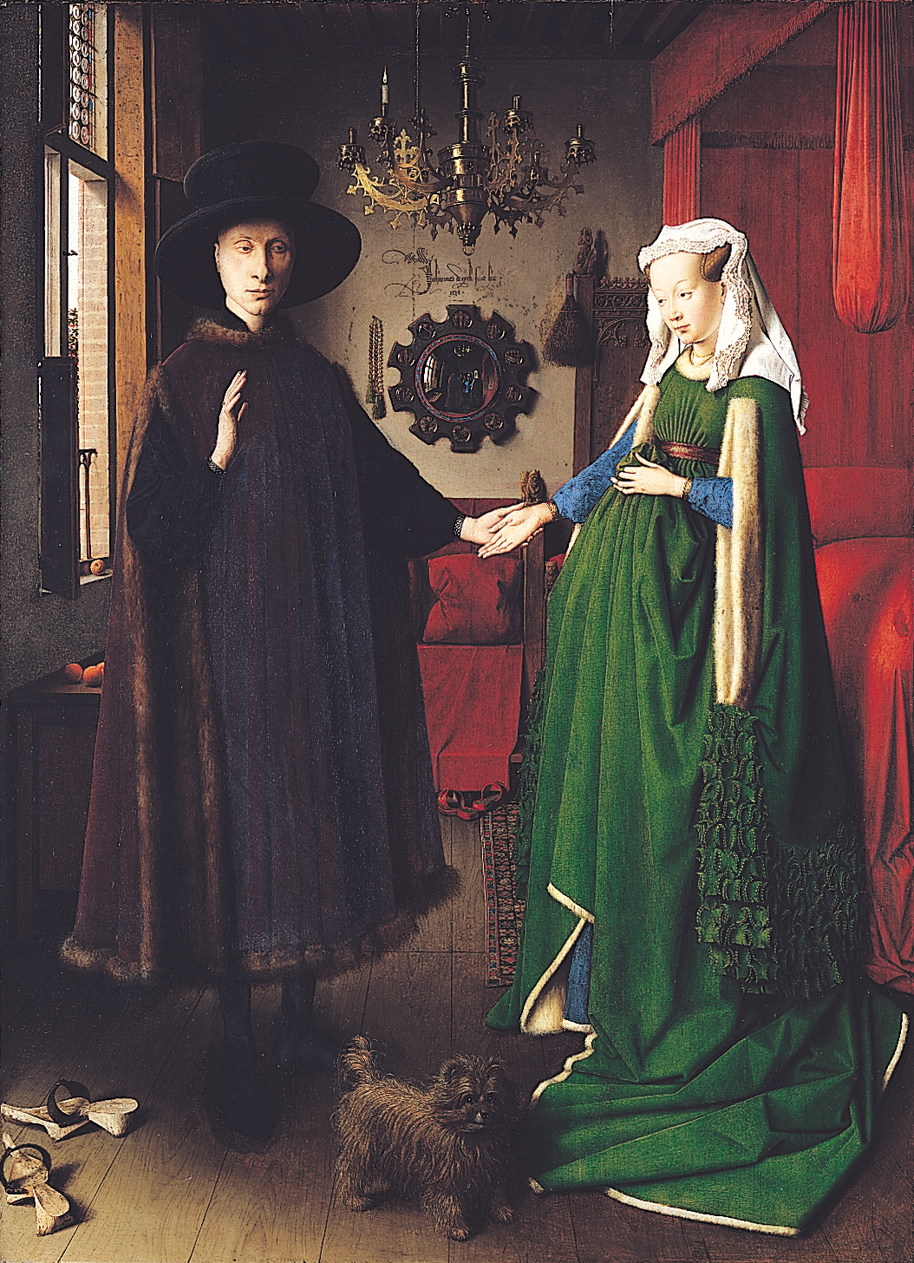
JAN VAN EYCK, Giovanni Arnolfini and His Bride, 1434. Oil on wood, approx. 2’ 8" x 1’ 11 1/2". National Gallery, London.
Increase in secularization of culture and urban prosperity (money) led to a desire for private art objects
Objects are symbolic., Flemish viewers would have been familiar with these symbols.Clogs=event is taking place on holy ground, dog=fidelity (“Fido”-latin), finial is of St. Margaret (patron saint of childbirth), whisk broom=domestic care, candle=all seeing eye of God
Each object is distinguished, difference in textures and light, convex mirror shows a reflection that adds to the scene’s realism, may be himself in the reflection
Self-portrait underscores Van Eyck’s desire to be known and remembered

Slide 16
Disagreement over what it represents
Widely accepted-not wedding portrait, but a double portrait of a couple already married
Woman may have passed away
Something important is happening, unclear what
Italian merchant working in Bruges
Shows and emphasizes his wealth
Clothing and furniture
Male giving authority to female

Slide 17
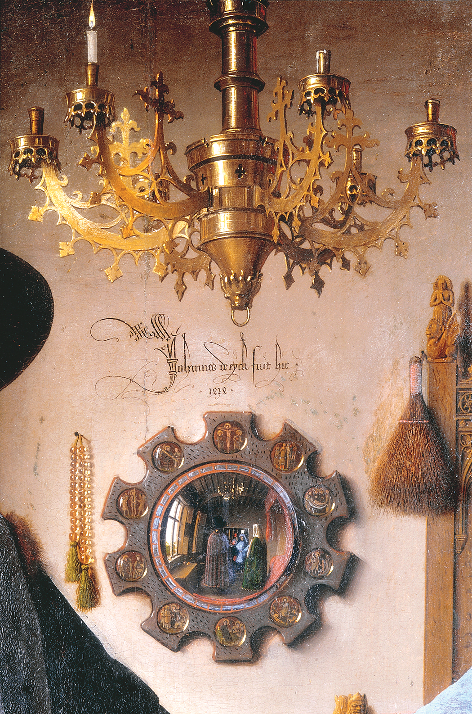
JAN VAN EYCK, detail of Giovanni Arnolfini and His Bride, 1434.
Symbolism very important during this period
Shoes-sacred event is taking place
Single candle in chandelier- presence of God
Dog-fidelity
Two people in the doorway, where we would be standing if in the painting
Witnessing taking place
Reinforced by the signature
“Jan Van Eyck was here.”

Slide 18
Mirror
Adds to realism
In the roundels next to it, are scenes from the Passion of Christ, ½ inch
Glass panels set into wooden frame
Can see what story it is, very clear
Dog
Wouldn’t expect to see a dog in a formal wedding portrait
But common in couples, indicates fidelity
Clothing
Fur-lined clothing but fruit on the tree outside
Detailed and fashionable
Crisp lace
Fruit
Sign of wealth, oranges were expensive
Arnolfinis may have imported oranges, so also a reference to their wealth
Carpet
Symbol of taste and wealth

Slide 19
Looks like bedroom
Thought to be private
But actually a place to receive visitors in this time period
Not pregnant
Just the fashion at the time
Used oil paint
Luminous and rich quality
Applying thin, multiple layers or glazes, each layer is translucent
Produce subtle light
From window onto the objects
Picks up the colors on the objects
Lack of interest in human anatomy and perspectivally-correct
Places it in the Northern Renaissanace

Slide 20
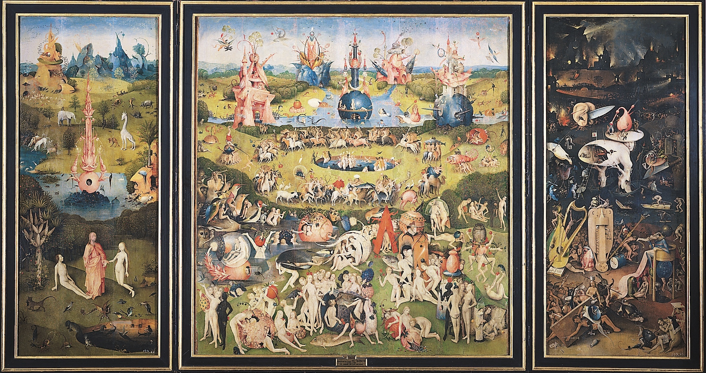
HIERONYMUS BOSCH, Garden of Earthly Delights. Creation of Eve (left wing), Garden of Earthly Delights (central panel), Hell (right wing), 1505–1510. Oil on wood, center panel 7’ 2 5/8" x 6’ 4 3/4". Museo del Prado, Madrid.

Slide 21
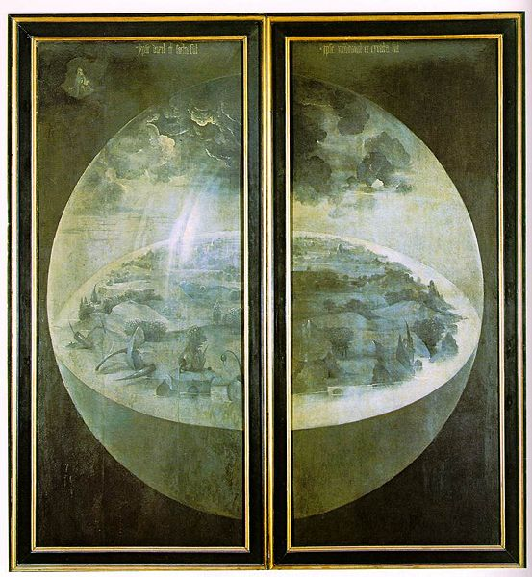

Slide 22
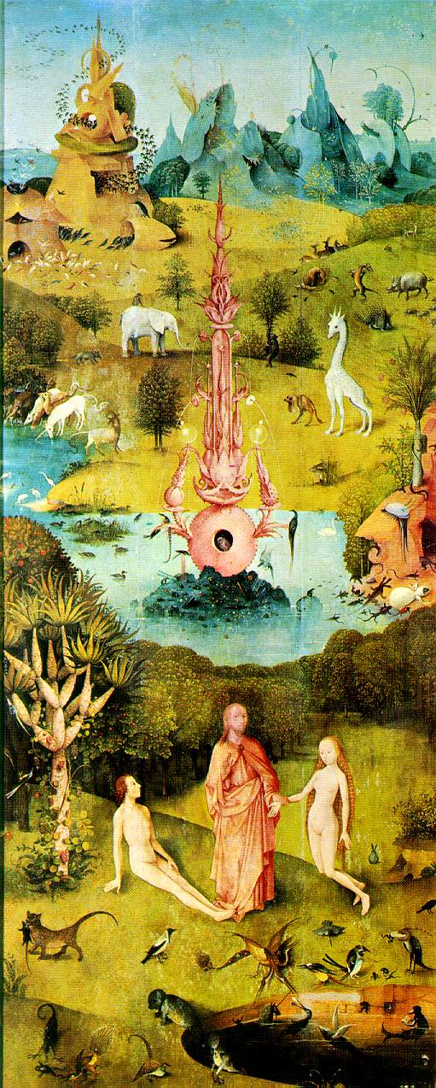
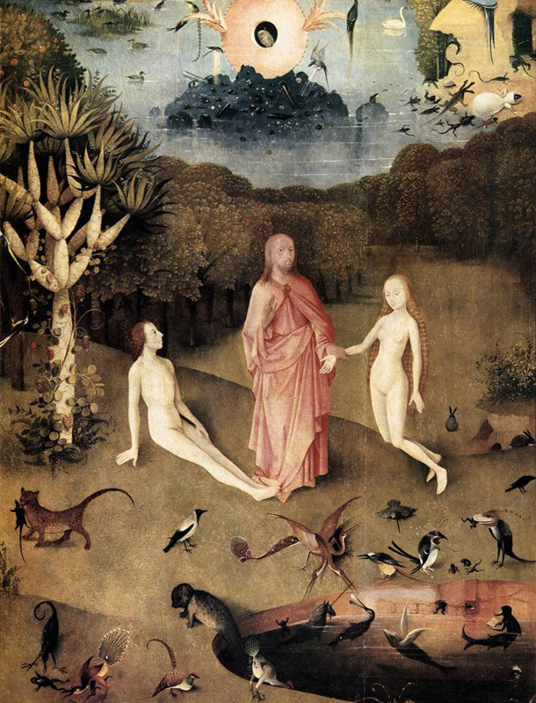

Slide 23
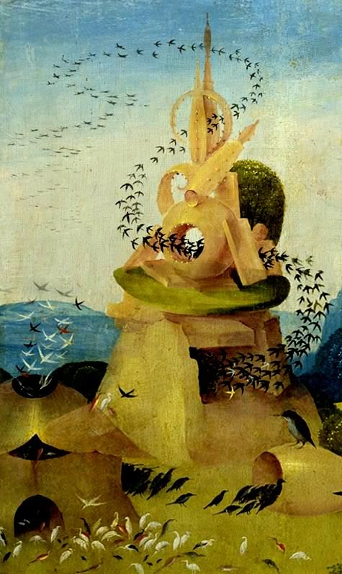
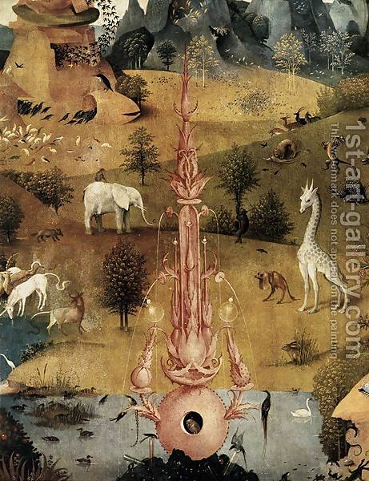

Slide 24
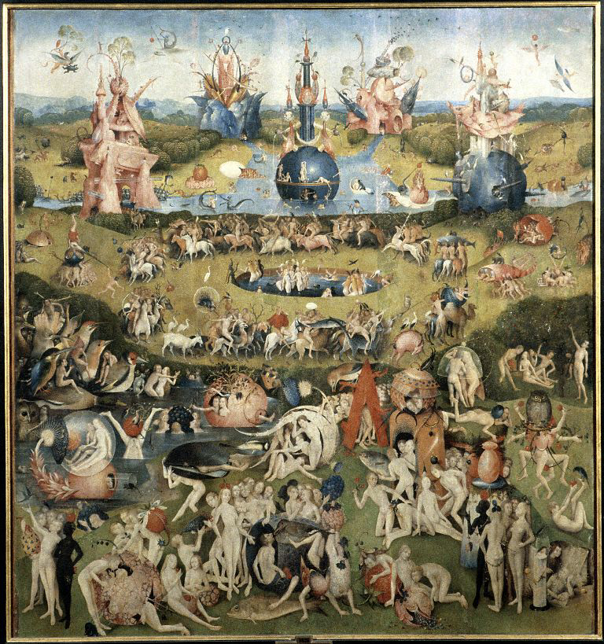
Center Panel Total, center panel
© 2005 Saskia Cultural Documentation, Ltd.

Slide 25
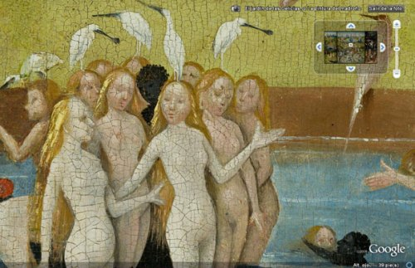
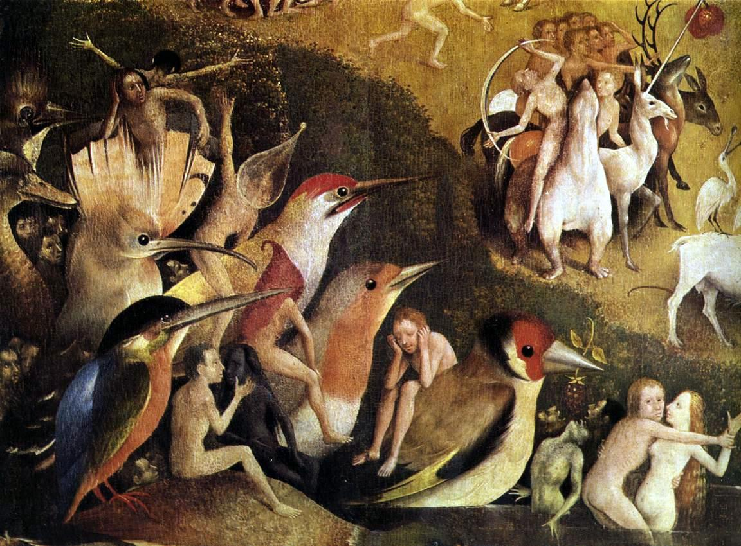
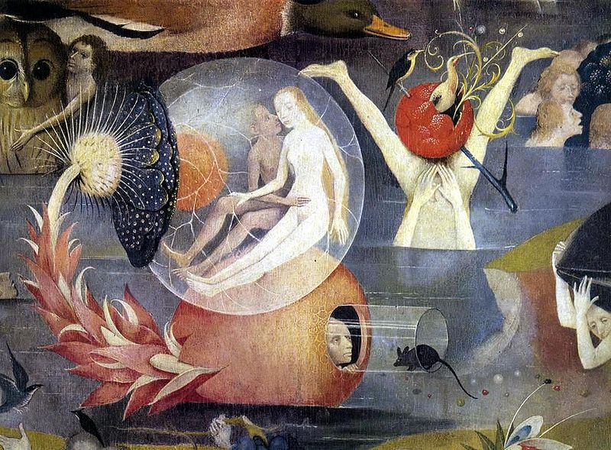

Slide 26
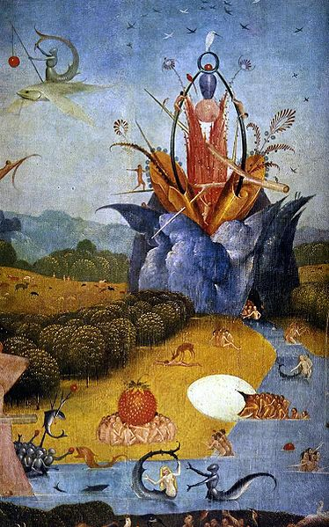
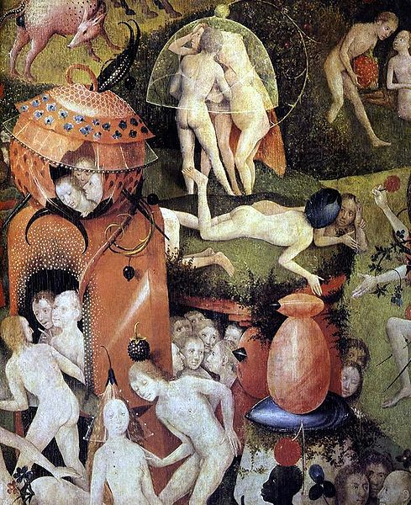

Slide 27
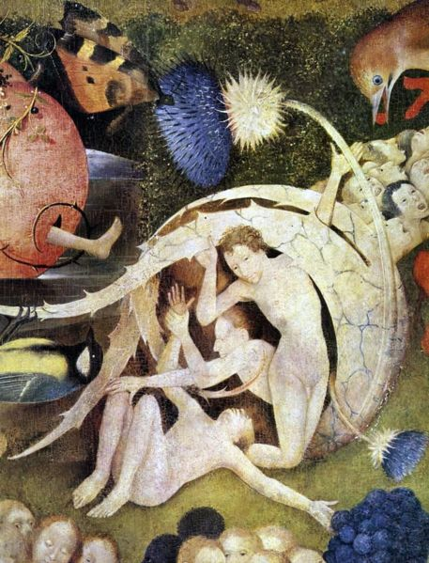
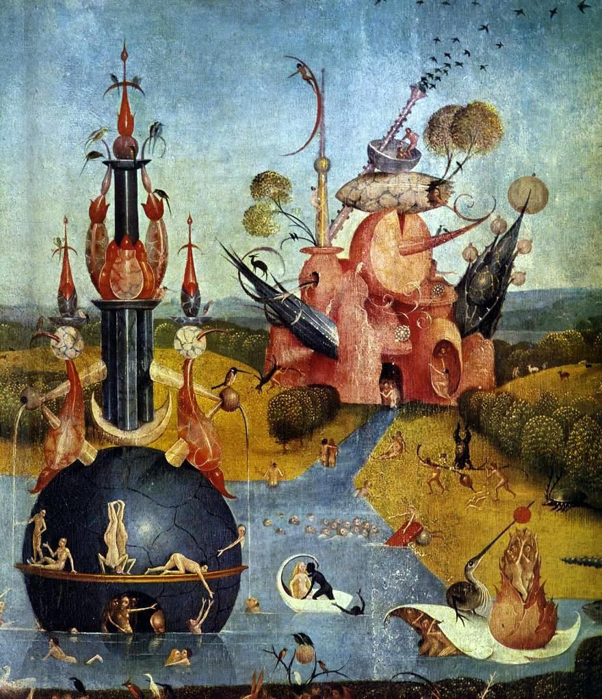

Slide 28
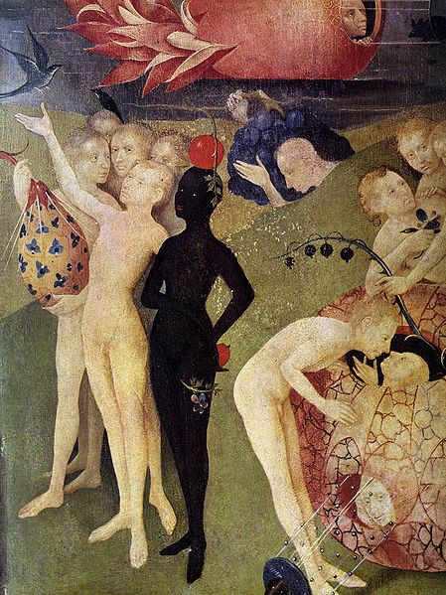
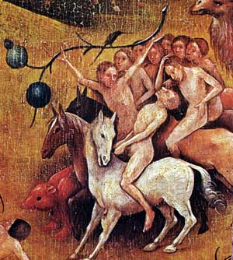

Slide 29
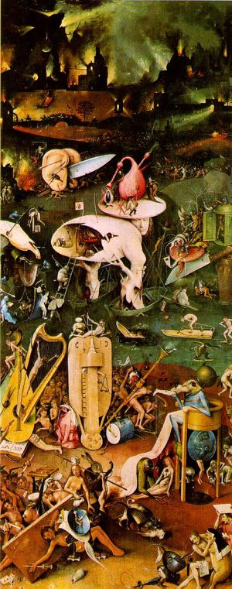
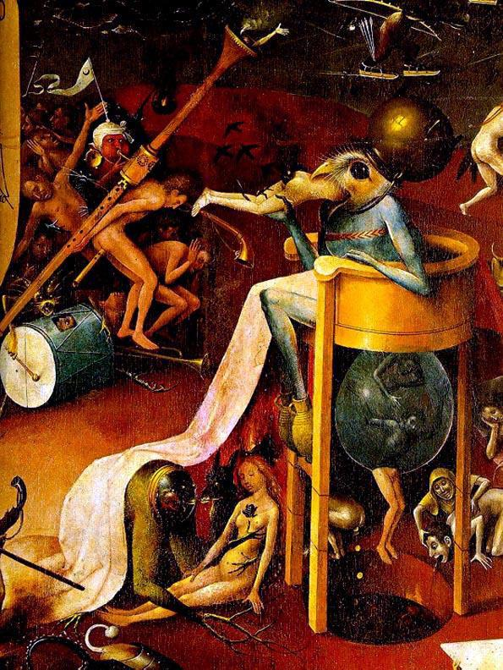

Slide 30
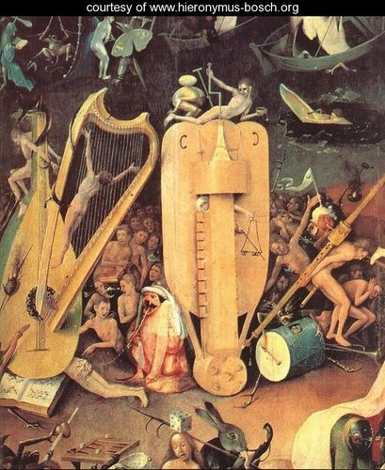
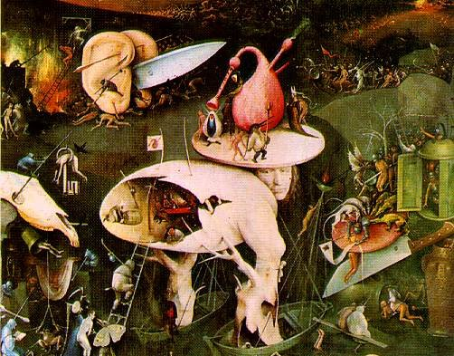

Slide 31
16th Century
Painting
&
Sculpture

Slide 32
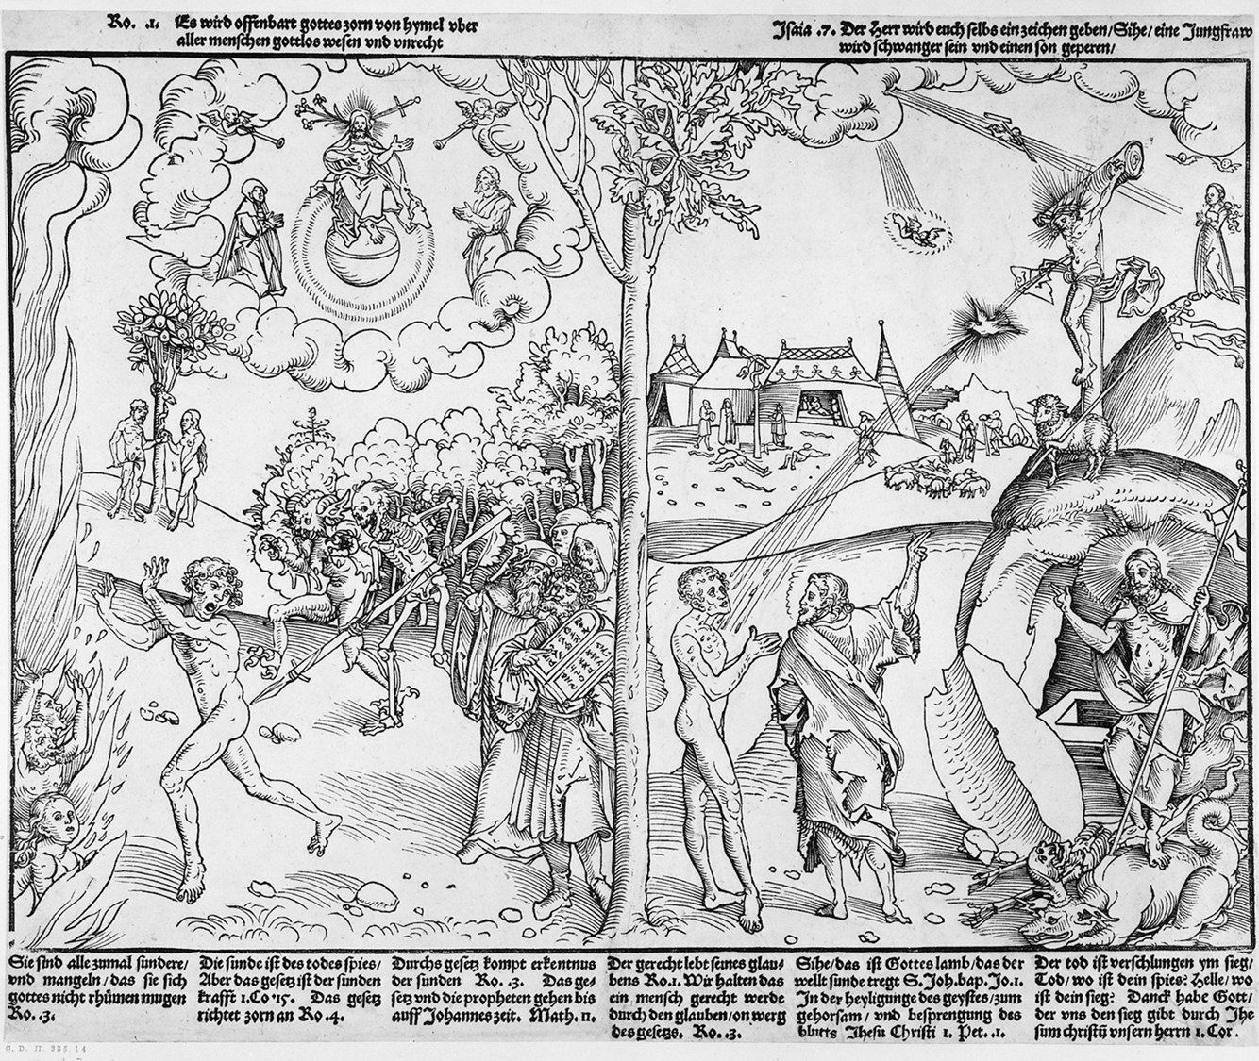
LUCAS CRANACH THE ELDER, Allegory of Law and Grace, ca. 1530. Woodcut, 10 5/8” x 1’ 3/4”. British Museum, London.

Slide 33
Was originally painted by the artist
Examines the questions of how does one get to heaven? Good deeds? Divine allowance?
Most influential image in the Lutheran Reformation
What came from questioning the Catholic church
Catholic church believed in good deeds and donations to get to heaven, and especially pay for art in the church
Luther believed that all people had to do was have faith
Led to rebellion against the church
This work was made in consultation with Martin Luther
Explains Luther’s ideas in visual form: basically that heaven is reached through faith and God’s grace, and rejects “good works”

Slide 34
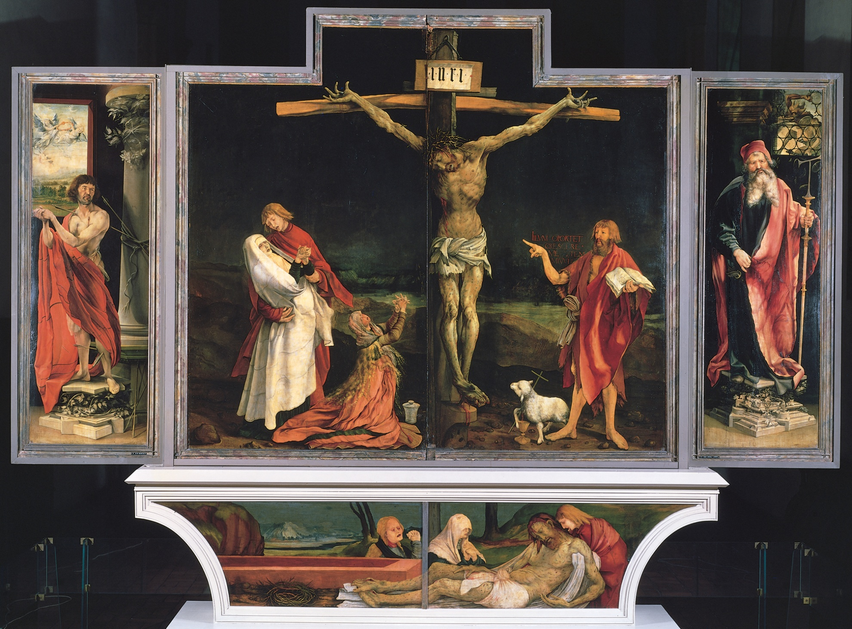
MATTHIAS GRÜNEWALD, Isenheim Altarpiece (closed), Crucifixion (center panel), from the chapel of the Hospital of Saint Anthony, Isenheim, Germany, ca. 1510–1515. Oil on panel, center panel 9' 9 1/2” x 10’ 9”, each wing 8’ 2 1/2” x 3’ 1/2”, predella 2’ 5 1/2” x 11’ 2”. Musée d’Unterlinden, Colmar.

Slide 35
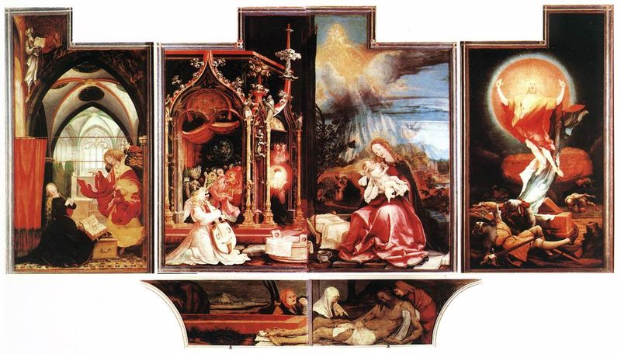

Slide 36
Was created to serve as a central object of devotion at Isenheim hospital built by the Brothers of St. Anthony
Patron saint of those suffering from skin disease
Usually depicted with a pig as reference to the use of pig fat to heal skin infections
By extension he became the saint of swineherds
Also saint of healing, basket-weavers, brushmakers, and grave-diggers
Hospital was for sick and dying peasants suffering from ergotism
Disease caused by eating rye grain infected with fungus
Called St. Anthony’s fire, caused hallucinations, skin infections, and attacked the central nervous system
LSD was later developed from this same fungus

Slide 37
Created for a monastic hospital, consists of a wooden shrine, with two removable panels
Crucifixion in the center, Saint Sebastian on the left and St. Anthony on the right, Lamentation on the predella
Saints associated with plagues, diseases, and miraculous cures are prominent
Addresses the themes of dire illness and miraculous healing to emphasize the patron saint, Saint Anthony. Served as warnings, and encouraged devotion from monks and hospital patients
Legend of St. Anthony was both dispenser of justice (by inflicting disease) and benevolent healer
Uses color to contrast horror and hope

Slide 38
Crucifixion
Show different visions
Hell on earth
Physical and psychological torments of Christ
Saints presented in dissonant psychedelic color
Distorted figures: men, women, demons, angels
Other-worldly landscapes
Painted panels fold out to reveal three distinct ensembles
Closed it shows a horrific, night-time crucifixion
Christ is splayed on the cross, in agony, marked with disease
Mary swoons into arms of young St. John the Evangelist
John the Baptist on the other side gestures toward Christ and holds a scroll “he must increase, but I must decrease”
Altarpiece opens at Christ’s arm, appearing to sever it
Physical suffering was supposed to be miracle-performing and a point for people at the hospital to identify with
Flanking panels of St. Sebastian-plague saint that has been pock-marked by arrows and St. Anthony

Slide 39
Predella
Lamentation
Horrifying and punctured body of Christ
Presented as an invitation to contemplate mortality and resurrection
Division in the predella refers to amputation which was a common treatment for gangrene, which was treated at this hospital

Slide 40
Reads like a narrative of Christ’s life
Annunciation on the left, Virgin and Child with angels in the center, and the Resurrection on the right
Lamentation below
All three scenes are highly idiosyncratic (specific, specialized, individual interpretations)
Eerie light, Gothic bandstand, fiery and atmospheric clouds
Resurrection panels are most strange
Christ is wreathed in orange, red, and yellow body halos and rises like a fireball over the tomb and sleeping soldiers
Combines the Transfiguration, Resurrection, and Ascension

Slide 41
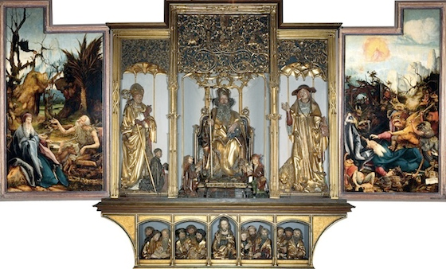
Sculpted altars were popular in Germany
Center holds Nicholas of Hagenau’s central carved and gilded ensemble consists of solid and unimaginative representations of three saints important to the Antonine order
St. Anthony in the center, St. Jerome and St. Augustine on the side
Below, in the carved predella, carved Christ stands at the center of the seated apostles, six on each side, in groups of three
Symmetrical, rational, mathematical, and numerical proportions

Slide 42
Completely open
Carefully selected iconography to be particularly meaningful to viewers in the hospital
Balanced the horrors of disease and the punishments that awaited those who did not repent
Foreground is a grotesque image of a man with oozing boils, withered arm and distended stomach—suggests ergotism (disease caused by fungus on rye bread). Was referred to as St. Anthony’s Fire and was treated frequently at this hospital
Also caused gangrene, which was usually treated by amputation, when the panel is opened, Christ’s arm is severed

Slide 43
16th Century Northern Renaissance-Context
1456-Gutenberg develops the printing press and publishes the Bible
Two great printing innovations of this period of civilization
The printed word-printing press (Aldine Press-1495 and Gutenberg Bible 1456) creates the dissemination of information and opinion and mass printings of the Bible
The illustrated book/wood cut (Durer’s Treatise on Human Proportions c. 1510) creates the fame of the artist
1517-Martin Luther posts the 95 Theses condemning the Church’s practices
1534-Henry VIII founds Church of England
Reasons for Northern Europe being more fertile ground for protest within the established church than in the south (Italy)
Vital merchant class
Stronger guilds
Major tenets of Luther and the Reformation
“Justification by faith”-every person had to find God for themselves
Individual conscience was the ultimate moral authority-a priesthood of all believers
Through prayer, each person could address God directly without priestly/saintly intercession
Translation of scriptures into native languages so that people could interpret the Bible for themselves
Learning to read and understand became the necessary prelude to faith and salvation
Psychological impact of Lutheranism lay in shifting the burden of thinking to the individual

Slide 44
Art and Ideas
The idea of Christian Humanism (which laid the ground work for Luther’s Reformation) takes hold in Northern Europe early than in Italy.
Scholars could view the church and social abuses with more independence and objectivity
Native tendency to look more at nature and the world aobut them
The road to Reformation was paved by the northern humanists whose articulation and advocacy of reason in human affairs pruned away so much medieval superstition
Thomas More, Utopia- a disguised expose of the social absurdities and injustices of his time. His utopian society was founded on reason, equality, tolerance, democracy, and dullness
Rabelais- Gargantua- liberate men and women from their foolishness, so that they could realize their higher potentialities as human beings
Erasmus- In Praise of Folly-criticism of the pretensions and hypocrisies of his time, especially the church (pilgrimages, power of the clergy, literal interpretation of the Bible, Papal indulgences, meditation of saints and the sacramental system)

Slide 45
How the Reformation impacted art
Architecture
Patronage diminishes from the Church for architectural projects/decorations
Churches become much simpler in decoration and design (focus on pulpit)
Sculpture
Less three-dimensional sculpture, thought to be too close to idol worship
Wholesale destruction of church art during the 16th century
Printmaking
Artist’s prints allow for artistic ideas to be more accessible to more people further away and results in dissemination of ideas and the fame of the artist
Painting
New themes and new iconographic traditions emerge (before, an emphasis on historical paintings, mainly biblical and mythological subjects)
New categories of subject matter develop (from the universal to the particular)
Portraiture-Luther’s reorientation of religion toward subjective, personal and individual
Genre- telling of everyday experiences, personal feelings and reactions
Landscape- nature as expression of God’s creation/confirmation of a rational universe
Still life- middle class life with moral message-subject matter has symbolic meaning

Slide 46
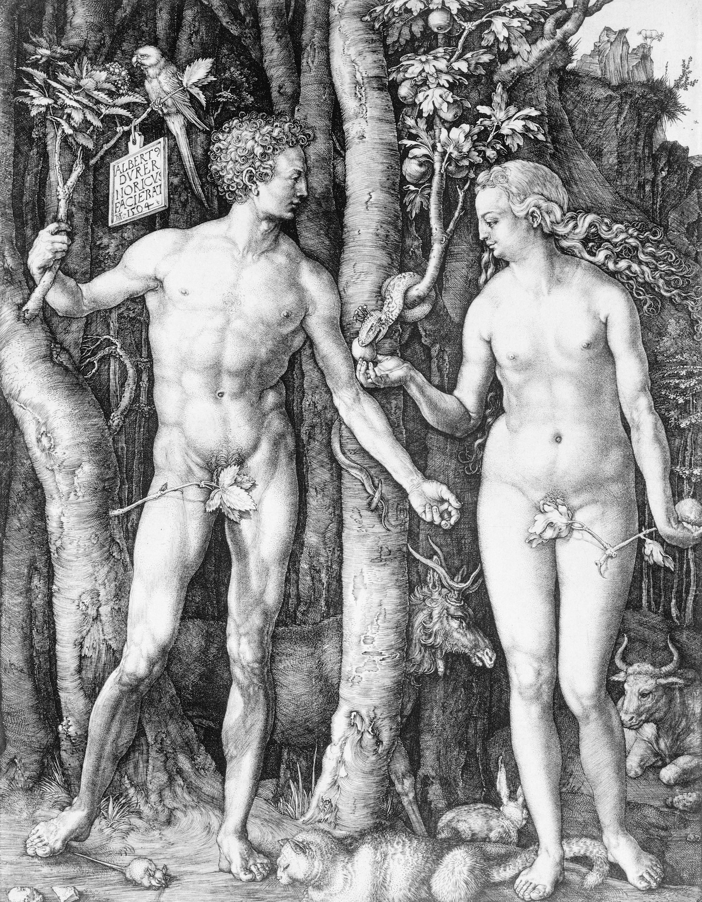
ALBRECHT DÜRER, The Fall of Man (Adam and Eve), 1504. Engraving, approx. 9 7/8” x 7 5/8”. Museum of Fine Arts, Boston (centennial gift of Landon T. Clay).

Slide 47
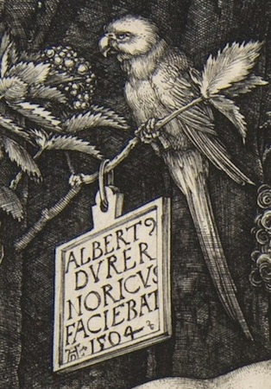
Adam and Eve stand together in dense, dark forest
Forest is unlike any Eden, but rather a German forest
Dark with animals all around
Frontal, nude bodies, standing contrapposto
Heads turn to the sides to face each other
Twisting is artificial
Contradictions throughout the engraving
Eve plucks an apple from a tree with fig leaves
Tropical parrot perches on a branch
Other animals stand about or stroll through
Small sign or cartelino on a branch held by Adam
Identifies Albrecht Durer of Nuremberg (Norcius) made this
But in Latin, language of Mediterranean, and Rome

Slide 48
Figures are supposed to show the German artist’s knowledge of Classical Greco-Roman proportions
Based on Roman architect Vitruvius, the proportions of the face are used to determine the proportions of the body
Shows his interest and love for the style
Perfection of bodies
Symbols
Tropical parrots-collector’s items in Germany, call sounded like “Eve-Ava” (Eve and Ava Maria, “Hail Mary”) Mary is the antidote for Eve’s sin
Animals that correlate to specific fluids in the body
Elk-black bile, melancholic-analytical and quiet
Ox- phlegm, phlegmatic- relaxed and peaceful
Rabbit-blood, sanguine-optimistic and social
Cat-yellow bile, choleric- short-tempered and irritable
Adam and Eve were at perfect balance internally, after the Fall, one humor predominates in everyone, throwing our temperaments off balance
Perfection of bodies and harmony of humors
Durer’s animals signify this moment of perfection
The cat does not yet chase the mouse
The goat is still standing on the mountain perch (scapegoat)

Slide 49
Engravings allowed for ideas and designs to be known in other regions and countries and by many people
German artists could learn about classical art without travelling to Italy
Art was more affordable
Art had been for one person at one time, now could be seen and interpreted in multiple and unknown ways

Slide 50
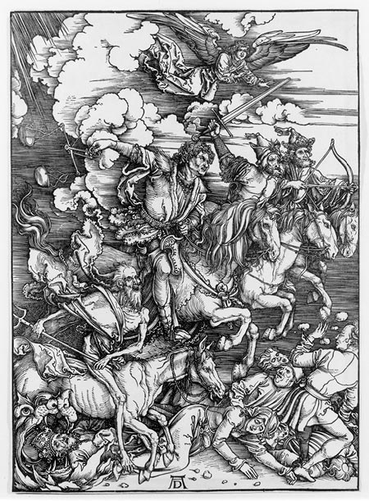
ALBRECHT DÜRER, Four horsemen
of the apocalypse,
1498, woodcut

Slide 51
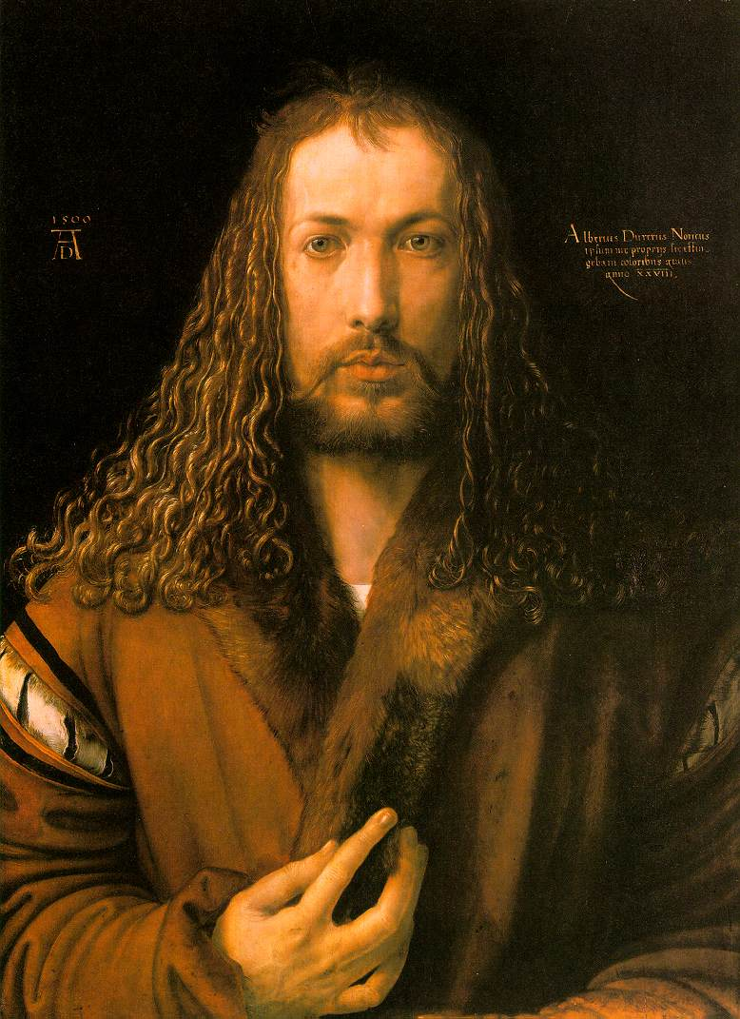
ALBRECHT DÜRER, Self Portrait, 1500, oil on wood panel, Alte Pinalothek, Munich

Slide 52
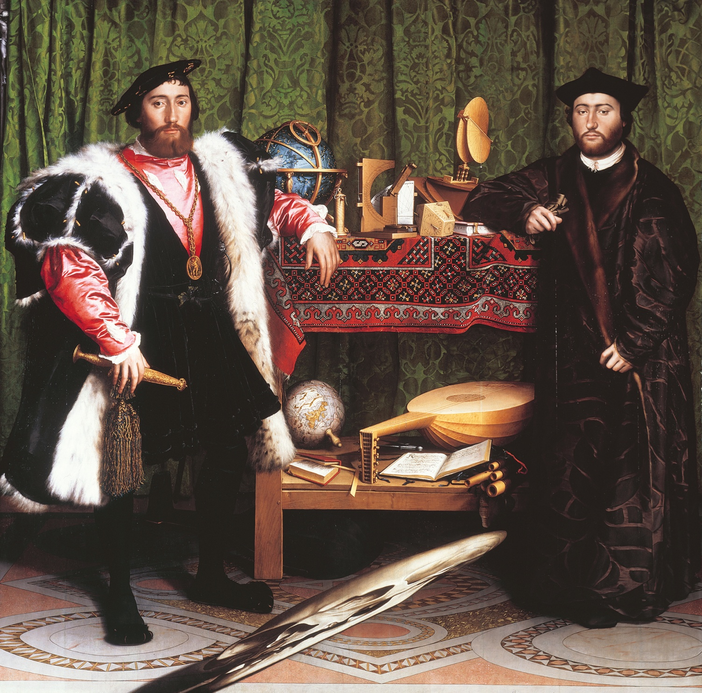
HANS HOLBEIN THE YOUNGER, The French Ambassadors, 1533. Oil and tempera on panel, approx. 6’ 8” x 6’ 9 1/2”. National Gallery, London.

Slide 53
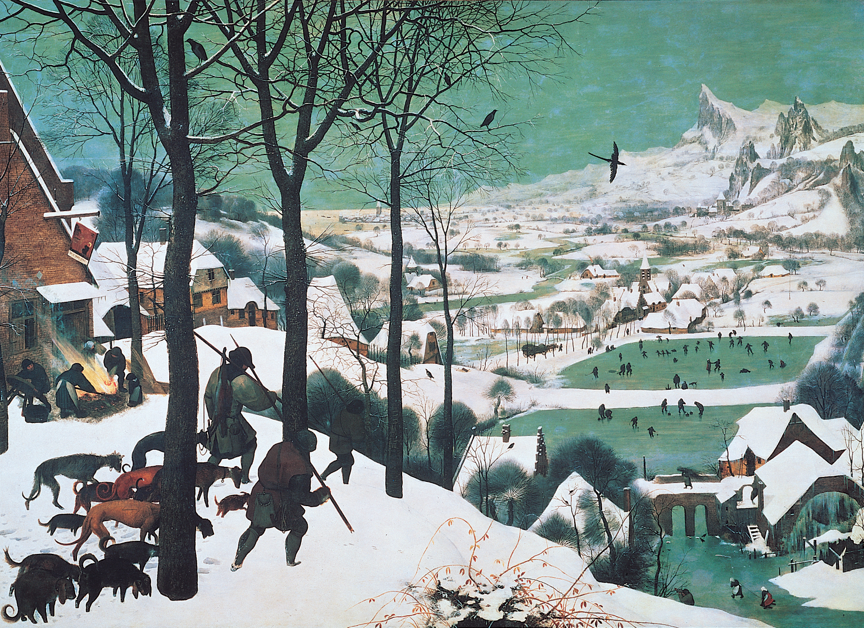
PIETER BRUEGEL THE ELDER, Hunters in the Snow, 1565. Oil on panel, approx. 3’ 10” x 5’ 4”. Kunsthistorisches Museum, Vienna.

Slide 54
Interested in the interrelationship between human beings and nature, however human activities remain the dominant theme
Studied in Italy but chose not to include classic elements in his paintings
One in a series of six paintings illustrating the seasonal changes in the year
Refers back to older traditions of depicting seasons and peasants in Books of Hours
Reflects the particularly bad winter of 1565, the year Bruegel painted this
Landscape is rendered in optically accurate way, develops smoothly from the foreground into the background and draws the viewer in

Slide 55
Panel painting from Flanders
Made for a merchant in Antwerp
Asked for six paintings looking at the labors of the month
References illuminated manuscripts that did the same thing
Represent different times of year
Hunters returning
Not a big catch
Stresses of winter
Footprints in snow
Melancholy
Heads down, dogs follow
Moves down the hill quickly

Slide 56
Full of action and activities of winter
Different side of winter
Comes from Virgil
Painting landscape that is given meaning by the labor of the people within it
Visual rhythm made by the trees and landscape
People in action
Work and play
Giving a lot of visual information and narrative
In Italy
Attempt to perfect
In North
Meaning comes from the multiplicity of human activities

Slide 57
Had been to Italy
Still focused on landscape, rather than bodies
Impressed with the Alps and includes large mountain range here that would not have been in Flanders
Not an actual northern landscape
Composite landscape activated by human figures
Both cold and warmed by human inhabitants

