Slide 1
Impressionism

Slide 2
Works
Impressionism
116. Monet, The Saint-Lazare Station
121. Cassat, The Coiffure
Post-Impressionism
120. Van Gogh, The Starry Night
123. Gaugin, Where Do We Come From? Who Are We? Where are We Going?
125. Cezanne, Mont Sainte Victoire

Slide 3
Context
First Impressionist Exhibit held in Paris in 1874
Science of optics and color theory
Analysis of perception (especially of color)
Japan is opened by Admiral Perry 1853
Forces trade with Europe
Results in influx of Japanese prints
Emergence of an urban middle class
New patrons of art, new subject matter of painting
Synthetic chemicals for pigments
Produced brilliant colors
Pre-mixed oil paint in lead tubes
Portability/painting outdoors
Photography continues to influence painting
Especially in terms of composition
Increased use of lithography and commercial artists
Wide distribution of art

Slide 4
Characteristics of impressionist style
Rendering the visual world as it appears to the eye, not as it physically exists
Emphasis on optical sensations
Impressionist subject matter is the experience of looking
The surface of the painting asserts itself
Texture, brush stroke, lack of modeling, thick paint
Painters minimize the effects of modeling and perspective, forcing the viewer to look at the painted surface and to recognize it as a flat pane covered with pigment
Often short, choppy brush strokes
Worked out of doors, directly from nature
Trying to capture the transitory light/color effects
Portable pigments in tubes, make possible working outdoors using intense contrasting colors
Representation of atmosphere, climate, and light effects
Artists work rapidly (or in sequence) to capture the changing light
Forms bathed in light create the illusion
Worked directly on white canvas
Not neutralized by brown or green as before

Slide 5
Influences on the impressionist style
Impressionist Color Theory (based on scientific and medical discoveries)
Light is the source of our experience of color, white light is made up of colored light
Local color (the actual color of an object) is modified by the quality of the light in which reflections from other objects effect
Shadows are not black/grey but composed of colors modified by reflections, or other conditions
Two complementary colors in small amounts placed right next to each other, blend in the eye to neutral tones
Juxtaposition of colors on canvas for the eye to fuse at a distance produces a more intense hue than the mixing of the same colors on the artist’s palette

Slide 6
Modernism
Many developments in early 19th century: industrialization, urbanization, and increased economic and political interaction worldwide
Foundation for development in plastics, machinery, building construction and automobile manufacturing
Urbanization: migration from rural regions
Marxism and Darwinism
Marx and Engels wrote the Communist Manifesto, called for the working class to overthrow the working elite. Scientific, rational law governed nature and human history. People who control the means of production exploit those who labor
Darwin’s theory of natural selection. Evolution is based on laws, rather than random chance or God’s plan. Only the fittest of humans will survive, this contrasted with the biblical narrative of creation

Slide 7
Modernism
Combination of extensive technological changes and increased exposure to other cultures: western world’s impermanence
Darwin and Marx pointed to an awareness of a constantly shifting reality
Modernist artists seek to capture the images and sensibilities of their age
Modernism implies concerns of art and aesthetics that are internal to art production

Slide 8
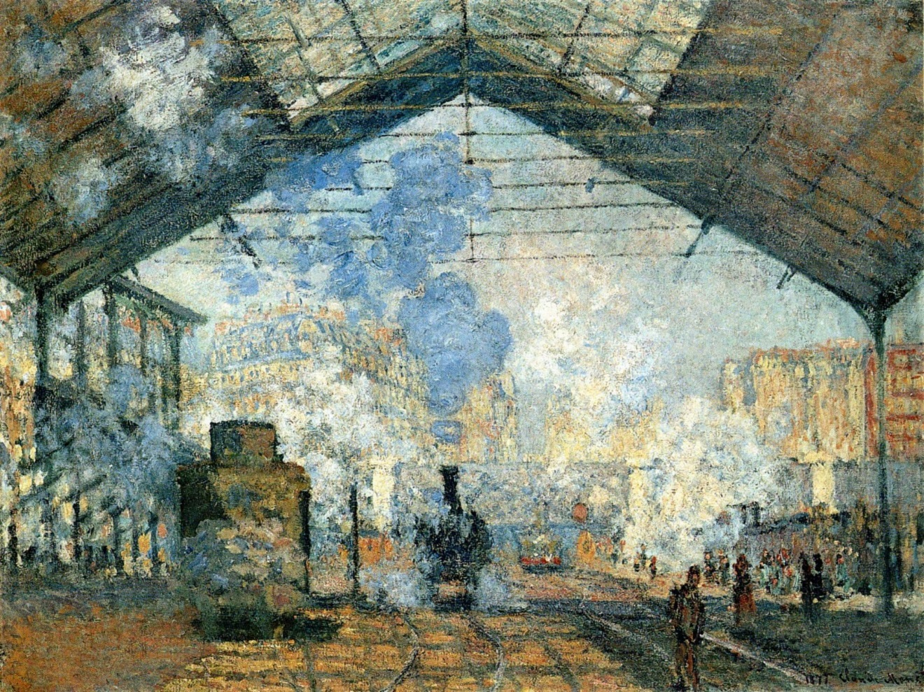
CLAUDE MONET. THE SAINT-LAZARE STATION. 1877 C.E. OIL ON CANVAS. Musee d’Orsay

Slide 9
Series of 6 or more canvasses depicting the train station in Paris
Few years after First Impressionist exhibition
Monet had been living in a rural suburb of Paris
Commuter railways and visiting the city was a very modern idea
Paris had been recently renovated by Haussman
Train stations and boulevards were new
Industrial

Slide 10
Usually painted landscapes
Did have elements of modern life
Not different from traditional landscape painting
Framing by the top and sides
Diagonal movement into the background
Flat, because of an emphasis on surface texture
Iron locomotive should be substantial, but seems to dissolve
To focus on the play of light and color
Light that shines through the droplets of water
Changes of color on the surface of things
No real lines or contours to the object
Showing modern life

Slide 12
Monet, Impression: Sunrise, 1875, Impressionism, France, oil on canvas**Not in 250
-Exhibited at the first Impressionist show in 1874
-Called “impressionist” as a derogatory term, but was later embraced
-Incorporate the quality of sketches: abbreviation, speed, spontanaeity
-No attempt to disguise brushstrokes and blend pigment to create smooth, tonal gradations and an optically accurate scene
-Sense of “impressions”, what the artists recorded were not objective descriptions or solely subjective, but the interaction between the two; their personal responses to nature
-Painted outdoors, showed the importance of light and color play

Slide 13
Monet, Rouen Cathedral, 1890, Impressionism, France, oil on canvas ** Not in 250
-Most intensive study of the phenomena of light and color
-One in a series of 40 at Rouen Cathedral, north of Paris
-Observed the cathedral from nearly the same viewpoint but at different times of day or under various climatic conditions
-Church depicted bathed in bright light
-Created an unparalleled record of the passing of time as seen in the movement of light over identical forms
-The subject of the painting is not the cathedral
-Was criticized for destroying form and order for fleeting atmospheric effects
-Focused on light to reach a greater understanding of form

Slide 14
Pissaro, La Place du Theatre Francais, 1898, Impressionism, France, oil on canvas ** Not in 250
-One of the many panoramic scenes of Paris at this time
-Recorded the blurred dark accents on the light background: appears as a busy street would look from high above
-Moment is capture by deliberate casualness of the arrangement of figures to capture the moment
-Sometimes used photography to record the places he wished to paint
-Connections between photography and Impressionist painting: arbitrary cutting off of figures at the frame’s edge and flattening spatial effect produced by the high viewpoint

Slide 15
Renoir, Le Moulin de la Galette, 1875, Impressionism, France, oil on canvas**not in 250
-Leisure activities of the inhabitants of Paris: dining, dancing, opera, ballet
-Industrialization is the cause of these pursuits, regimented hours of work lead to regimented hours of leisure
-Popular dance hall, people talking and dancing
-Dappled in light and shade, figures are blurred, effect of floating and fleeting light
-Casual placement of figures, suggests continuity of space
-Viewer as participant
-Opposite of classical art (universal and timelessness), instead incidental, momentary, and passing aspects

Slide 16
Manet, Bar at the Folies-Bergere, 1882, Impressionism**NOT in 250
-France, oil on canvas
-Career bridges Realism and Impressionism
-Folies-Bergere was a fashionable gathering place for Impressionist artists
-Centrally placed barmaid, looking uninterested
-Rough brushstrokes, minimal use of modeling or perspective, causes the viewer to scrutinize the scene
-Woman on the right the reflection of the woman in the foreground?
-Reveal Manet’s insistence on calling attention to the pictorial structure of the painting

Slide 17
Degas, Ballet Rehearsal, 1875, Impressionism, France, oil on canvas**not in 250
-Formal leisure activities, Degas was fascinated (obsessed?) with movement
-Devices used to bring the viewer into the pictorial space: frame cuts the spiral stair, and group of figures in the foreground
-Not classically balanced, arranged in random
-Diagonals of floor and wall bases, carry the viewer into the diagonal lines of the dancer
-Arbitrarily cut off figures, light splotches, and blurriness of images indicate the artist’s interest in reproducing single movements -Was influenced by Japanese woodblock prints
-Asymmetry
-dramatic cropping of the picture plane
-use of flat areas of color/pattern
-stacking up object in picture plane to
create space/depth
-leaving large areas “empty” in a
composition

Slide 18
Morisot, Villa at the Seaside, 1875, Impressionism, France, oil on canvas** not in 250
-Many Impressionist paintings depict scenes from resort areas, importance of transportation
-Manet’s sister-in-law
-Focus on domestic subjects, a realm of Parisian life that an upper-class woman had access to
-Shaded veranda in the summer, elegantly dressed woman with child
-Used open brush work and plein air (outdoor) lighting characteristics
-Sketchy brush strokes
-Filmly soft, does not linger contours or precise details
-Escaped criticism directed at most other Impressionists, and was praised for her sensibility, grace, and delicacy

Slide 19
Cassat, The Bath, 1892, Impressionism, France, oil on canvas
-American female artist
-Influenced and befriended by Degas
-Trained in America
-Could not frequent cafes like other Impressionist artists, and had responsibility of caring for aging parents
-Subjects were women and children
-Combination of objectivity and sentiment
-Solidity of woman and child contrasts with flattened wallpaper and rug
-Influenced by Degas and Japanese prints

Slide 20
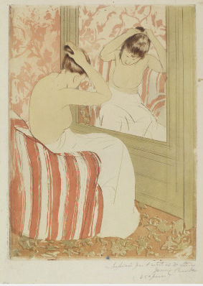
The Coiffure. Mary Cassatt. 1890–1891 C.E. Drypoint and aquatint on laid paper.
National Gallery of Art, Washington DC

Slide 21
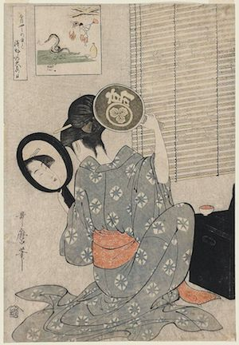
April of 1890, the École des Beaux-Arts (School of Fine Arts) in Paris showcased an exhibition of Japanese woodblock prints.
Ukiyo-e images, “pictures of the floating world,”
scenes of urban bourgeois pleasure—geishas, beautiful women, sumo wrestlers, kabuki actors—and pictures of the natural beauty around Edo (present day Tokyo)—
the mists of Mount Fuji, cherry blossoms, rain showers, and surging waves along the port of Kanagawa.

Slide 22
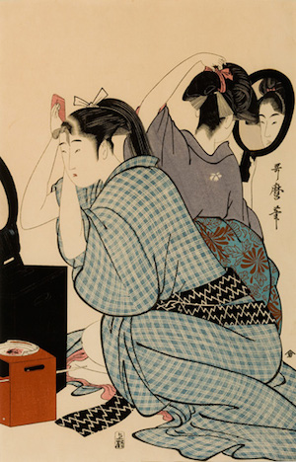
Opening of imperial Japan by Matthew Perry in 1853
Interested artists like Degas, Pissaro, Monet, van Gogh, and Cassat
Cassat was an American expat and visited the exhibition with her friend Edgar Degas
One of the hundreds made by Cassat in her home studio in 1890-1
Inspired by her personal woodblock collection
“Takashima Ohisa Using Two Mirrors to Observe Her Coiffure”

Slide 23
Coiffure evokes a precise image-wealthy women in glamourous settings
Ritual of grooming, dressing, and preparing one’s hair, common of court women during 17th and 18th century
Typically a maid would do this, Cassat has her woman doing it alone
Ironic tension
Voyeuristic scene takes cues from Ingres’ Grand Odalisque
Not sexualized
Contours of body are deliberately muted into overall structure

Slide 24
Placed a slight left-angle so we can see her reflection and her looking away from it
Modesty of female subject
Ukiyo-e were made for male dominated market and meant to be enticing
Not a psychological portrait, but more focus on compositional elements
Curve of the woman’s sloping back and neck echoes the curves of the chair which stand in contrast to the vertical lines of the mirror—a compositional counterpoint that further enhances the tension within the tight composition
Limited color palette of shades of rose, brown, and white, enables us to focus closely on the form and clarity of line

Slide 25
Use of intaglio
Carved designs onto a smooth copper plate with a fine metal needle.
Plate would be dusted with a powdered resin and heated until the resin melted in tiny mounds that hardened as they cooled.
Acid was then added on to the metal plate biting the channels along the resin droplets.
The deeper penetration of acid produced richer, darker tones, while a lighter application of acid produced lighter shades of color and a variety of nuanced gradients could be generated within a single print.

Slide 26
Inspired by Degas’ pastels of women grooming
Capture fleeting moments of the working class
Cassat believed art should be accessible to a wide audience

Slide 27
Post-Impressionism

Slide 28
Required Works
Van Gogh, Starry Night
Gaugin, Where Do We Come From? Who Are We? Where are We Going?
Cezanne, Mont Sainte Victoire

Slide 29
Quotes
“The Impressionists study color exclusively, but without freedom…they heed only the eye and neglect the mysterious centers of thought.”-Paul Gaugin
“The Neo-Impressionists were bringing their witness to the great struggle which is taking place between the workers and capitalism.”-Paul Signac
“Gaugin freed us from all the restraints which the idea of copying nature had placed on us. For instance, if it was permissible to use vermilion in painting a tree which seemed reddish…why not stress even to the point of deformation the curve of a beautiful shoulder or conventionalize the symmetry of a bough?”-Maurice Denis

Slide 30
Context
Reaction to Impressionism
Impressionist aesthetic exhausted, optical reality is played out
Personal view of the artist is primary
Move away from naturalism and realism
Stylization of subject matter or images constructed in some “invented order”
Exploring the world of imagination
Political sub-text to work
Working class/lower classes/underworld of industrial revolution’s cities
Alienation of modern cities and societies with disturbing undercurrents to work and society
Fascination with the foreign
Two respects: the primitive “non-urban” and non-western cultures/peoples
Experimentation with primary elements of art, painting style and art techniques
Artists begin to concentrate on formal and stylistic aspects of art-making
Issues of artist’s personal (unique) style and technique become a central occupation
Art for art’s sake
One of the central investigations: how to make truly modern art?

Slide 31
Characteristics of Post-Impressionist painting
*Variety of style-not one style but the emergence of individual styles
Variety of painting techniques
The artist’s individual technique becomes a preoccupation/signature
Paintings become formal exercises rather than records of visual reality
Variety of influences on artists’ styles
Medieval art (Gaugin)
Japanese art-prints (Van Gogh)
Commercial art/ posters (Toulouse-Lautrec)
Exotic cultures of Tahiti (Gaugin)
Varied subject matter of painting
The exotic (Gaugin, Bernard)
The fringes of modern cities (Van Gogh, Seurat)
The fringes of night life (Toulouse-Lautrec)

Slide 32
Vincent Van Gogh
Explored capabilities of colors and distorted forms to express his emotions as he confronted nature
Repeated professional and personal failures, painting was the only way to communicate his experiences
Felt like an outcast from society and from artistic circles
Hostile reception to his work reinforced his perceptions
Sold only one painting during his lifetime
Died at 37 of a self-inflicted gun shot wound
Since his death his reputation and appreciation of his art has grown dramatically

Slide 33
Van Gogh, The Night Café, 1888, Post-Impressionism, France, oil on canvas** not in 250
-Subject is benign
-In a letter to his brother he stated that he wanted the painting to convey an oppressive atmosphere “a place where one can ruin oneself, go mad, or commit a crime”
-Steeply tilted pool table that seems to threaten to slide out
-Communicated his madness by selecting vivid hues whose juxtaposition augmented their intensity
-Expressive color values and expressive color application
-Thick brushstrokes create a tactile counterpart to intense color schemes

Slide 34
Van Gogh, Starry Night, 1889, Post-Impressionism, France, oil on canvas
-”expressionist” method
-Was living in an asylum, where he had committed himself, also the time in which he mutilated his ear
-Does not reflect the sky’s appearance, but rather his feelings about the vastness of the universe, filled with whirling and exploding stars
-Corresponds to a personal vision and to the view available from his window, placement of cypress trees and placement of constellations
-Dark, deep blue, turbulent brush strokes
-Work has become iconic of individualized expression in modern landscape painting
- Technical challenges he wished to confront—namely the use of contrasting color and the complications of painting en plein air (outdoors) at night

Slide 35
Van Gogh, Starry Night, 1889, Post-Impressionism, France, oil on canvas
-Was given a small studio for painting
-Was encouraged to paint while in the asylum, had a view of the gardens
-Some aspects come from his imagination and memory, church spire from the time he spent in the Netherlands
-Exercise in deliberate stylization, experiments that were inspired by medieval woodcuts, thick outlines and simplified forms
-Contemplation of the night sky without the modern world

Slide 36
Toulouse-Lautrec, At the Moulin Rouge, 1895, Post-Impression, France, oil on canvas** Not in 250
-Admired Degas and shared the Impressionist’s interest in capturing the sensibility of modern life
-Satirical edge that borders on caricature
-Was crippled and removed himself from the high society his name allowed him into
-Became close with entertainers, prostitutes, and other social outcasts
-Reveals influences of Degas, the Japanese print, and photography
-Oblique and asymmetrical , spatial diagonals, strong lines, dissonant colors
-Scenes from real life were already familiar to people, so he exaggerated or emphasized each element
-Glaring artificial light, corrupt, cruel, mask-like faces
-Included himself in the background
-Anticipates Expressionism

Slide 37
Georges Seurat
Depicted Impressionist subjects but in an intellectual way
-Devised a disciplined and painstaking system of painting that focused on color analysis
-Less concerned with the recording of immediate color sensation than he was with their careful and systematic organization of a new kind of pictorial order
-Pointilism or divisionism, carefully observing color and separating it into its component parts. This is applied to the canvas in tiny dots (points) or daubs, thus the shapes and images become totally comprehensible only from a distance

Slide 38
Seurat, A Sunday on La Grande Jatte, 1885, France, Post-Impressionism, oil on canvas**not in 250
-Was on display at the eighth and last Impressionist exhibit in 1886
-Consistent with Impressionist recreational themes
-La Grande Jatte (The Big Bowl) is an island near Paris’s rapidly growing suburbs
-Shows congregation of people from different classes, most wear their Sunday best, which blurs class distinctions
-Also shows interest in analyzing light and color
-Rigid and remote, unlike spontaneous representations
-Played on motifs to create flat patterns and suggest spatial depth
-Light is not broken down into patches of color
-Line, color, value, and shape cohere in a precise and tightly controlled organization
-7x10 ft canvas

Slide 39
Paul Gauguin
-Took lessons from Pissaro
-Like Van Gogh, rejected objective expression in favor of subjective expression
Broke with Impressionist studies of minutely contrasting hues, he felt color should be expressive
Colors appear flatter, dissolving into abstract patches or patterns
Lived in Brittany and admired the “natural” men and women, perfectly at ease in their unspoiled environment
-Admired Japanese prints, stained glass, cloissone metal work
Also lived in Tahiti, removed from materialistic life of Europe, especially in the countryside
Fascinated with primitive life
Attempted to take his own life in 1857, later died in 1903

Slide 40
Gauguin, Vision after the Sermon, 1888, Post-Impressionism, France, oil on canvas** not in 250
-Rejects Realism and Impressionism
-Breton women wearing starched white caps and black dresses, visualizing the sermon they have just heard about Jacob’s encounter with the Holy Spirit
-Women pray devoutly before the apparition
-Departed from optical realism and composed the picture elements to focus the viewers attention on the idea and intensify its message
-Memory recalled and imagination modified
-Twisted the perspective, space emphasizes faith of women
-Reduced Jacob and angel to the size of wrestling roosters
-Event was often held after high mass, and women were most often the spectators
-Not unified with horizontal perspective, light and shade, or naturalistic color
-Shapes are angular and harsh, suggest peasant life and ritual

Slide 41
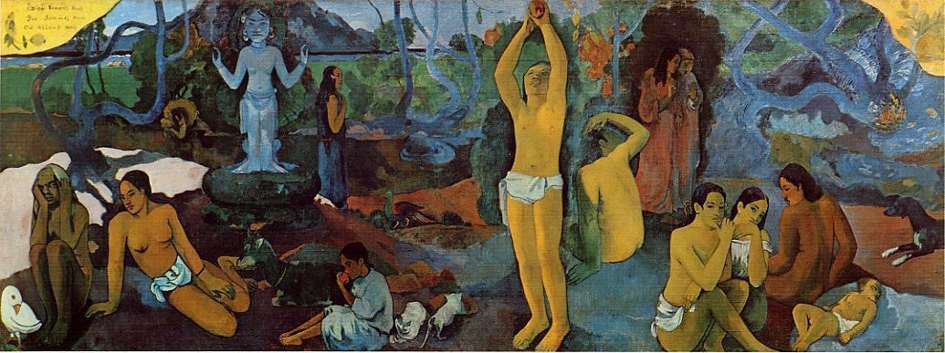
Where Do We Come From? What Are We? Where Are We Going? Paul Gauguin. 1897–1898 C.E. Oil on canvas.
MFA Boston

Slide 42
Gauguin, Where Do We Come From? What Are We? Where Are We Going?, 1897, France, Post-Impressionism, oil on canvas
-Summary of his artistic methods and his views on life
-Based indirectly on native motifs
-Tropical landscape, populated with native men and women
-Broad areas of flat color
-Where are we going? Near to death an old woman. . . .What are we? Day to day existence. . . .Where do we come from? Source. Child. Life begins. . . . Behind a tree two sinister figures, cloaked in garments of somber color, introduce, near the tree of knowledge, their note of
anguish caused by that very knowledge in contrast to some simple beings in a virgin nature, which might be paradise as conceived byhumanity, who give themselves up to the happiness of living.-Gaugin

Slide 43
Gauguin, Where Do We Come From? What Are We? Where Are We Going?, 1897, France, Post-Impressionism, oil on canvas
-Huge, brilliantly-colored work painted on heavy sack cloth
-Numerous human, animal, and symbolic figures arranged across an island landscape
-Gaugin’s largest painting and his finest work
-Represents his manifesto while living on the island of Tahiti; lived there from 1891-3, returned in 1895, 1897, and eventually died in 1903
-Believed it was the best painting he had ever made, and tried to commit suicide after completing it

Slide 44
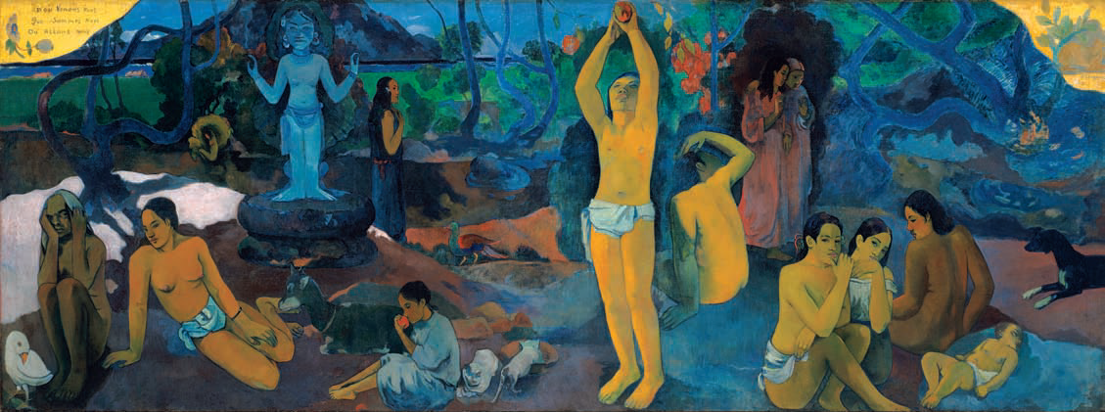
“Two upper corners are chrome yellow, with an inscription on the left and my name on the right, like a fresco whose corners are spoiled with age, which are appliqued to a golden wall. To the right lower end, a sleeping child and three crouching women. Two figures dressed in purple confide their thoughts to one another.
“An enormous crouching figure, out of all proportion and intentionally so, raises its arms and stares in astonishment upon these two, who dare to think of their destiny. A figure in the center is picking fruit. Two cats near a child. A white goat. An idol, its arms mysteriously raised in a sort of rhythm, seems to indicate the Beyond. Then lastly, an old woman nearing death appears to accept everything, to resign herself to her thoughts. She completes the story! At her feet a strange white bird, holding a lizard in its claws, represents the futility of words….So I have finished a philosophical work on a theme comparable to that of the Gospel.”-Gauguin

Slide 45
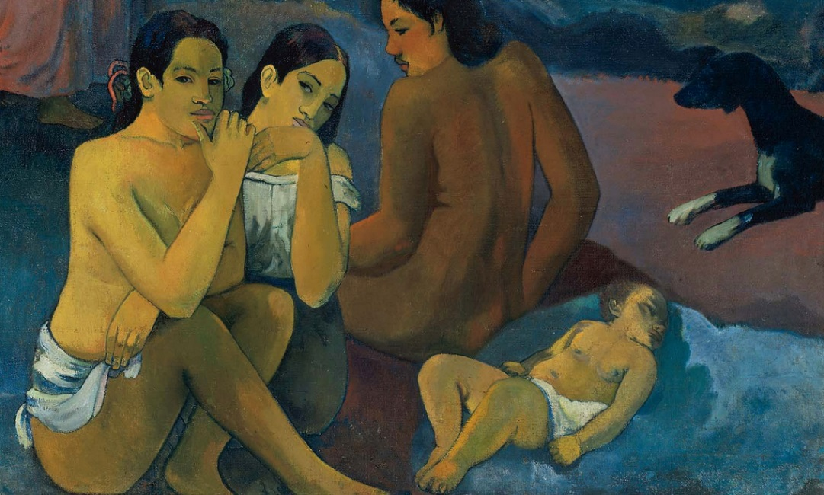
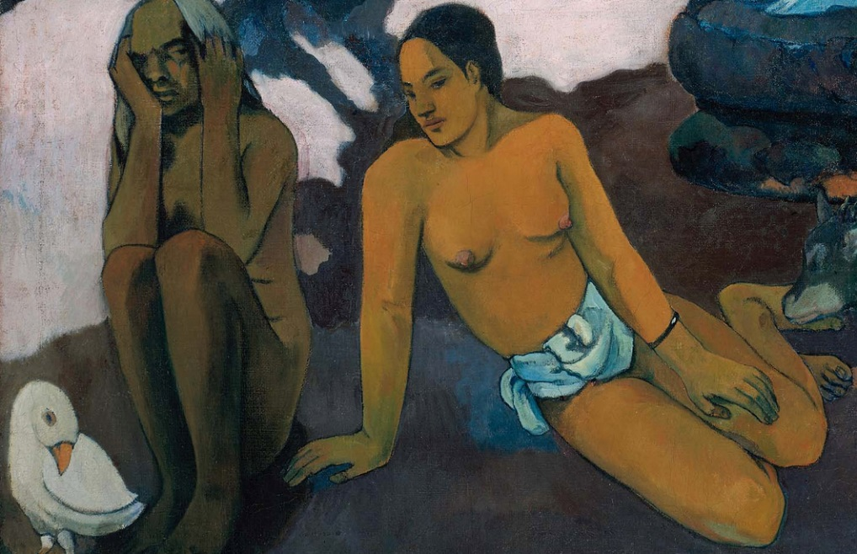
Gaugin, Where Do We Come From? What Are We? Where Are We Going?, 1897, France, Post-Impressionism, oil on canvas
-To be read from right to left, like a sacred scroll written in ancient language
-Sleeping infant-where we come from; standing figure in the middle-what we are; ending in a crouching old women-where we are going
-Mixture of universal meaning and ambiguous, personal meaning
-Was sent to Paris after completion with specific instructions on how it should be exhibited and who should be invited
-Shows his awareness of the market, even as he has exiled himself in Tahiti

Slide 46
Paul Cezanne
Admirer of Delacroix, allied himself early in his career, especially with Pissaro
Studies persuaded him that Impressionism lacked form and structure
Wanted to make Impressionism “something solid and durable like the art of the museums”

Slide 47
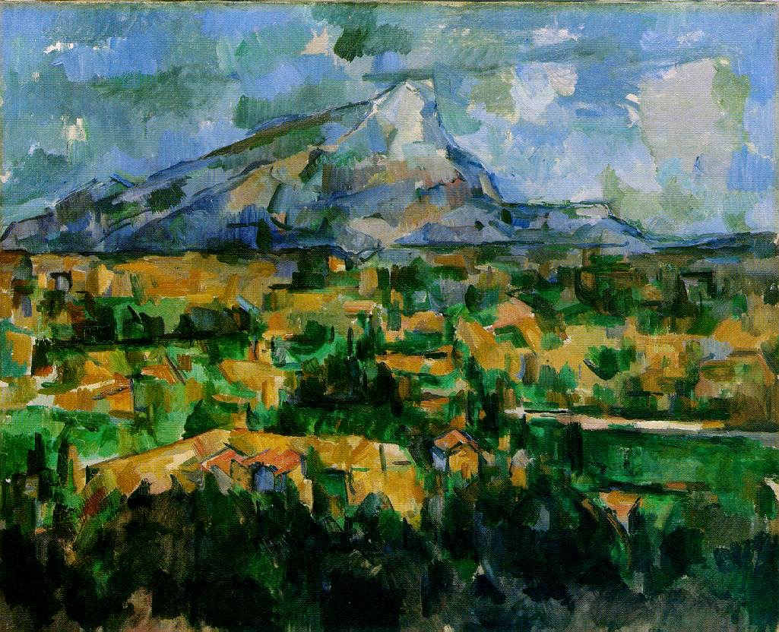
Cezanne, Mont Sainte-Victoire, 1902, Post-Impressionism, France, oil on canvas
Philadelphia Museum of Art

Slide 48
Cezanne, Mont Sainte-Victoire, 1902, Post-Impressionism, France, oil on canvas
-Unique study of nature
-Mont Saint-Victoire was a mountain near his house
-Not trying to find truth in the appearance
-Sought a lasting structure behind the formless and fleeting visual information the eye absorbs
-Analytical style, sought to order lines, planes, colors that comprised nature
-Wanted to achieve Poussin’s effects of distance, depth, structure, and solidity not by using traditional perspective and chiaroscuro, but by recording the color patterns with the optical analysis nature provides
-Studied the effect of line in every direction, focused on carefully selecting colors (to create 3D structure)
-Each part is seen from a slightly different viewpoint
-Stressing background and foreground contours=being simultaneously near and far away

Slide 49
Cezanne, Mont Sainte-Victoire, 1902, Post-Impressionism, France, oil on canvas
-Dominates the landscape over Aix-en-Provence, hometown of Cezanne
-Was an important theme in his work, especially after he adopted Impressionism in the 1880s
-Returned the motif during his career, showed from many different points of view and in a constantly changing relationship to other elements (trees, bushes, buildings and bridges, fields and quarries)
-Built a studio on an acre of land in 1901

Slide 50
Cezanne, Mont Sainte-Victoire, 1902, Post-Impressionism, France, oil on canvas
-Divided into three horizontal sections
-Viewpoint is elevated; closest to us is a band of houses and foliage; next rough patches of yellow, emerald, and lighter green suggest the expansive middle plain, extending the foreground into the middle ground
-Above is the contrasting blues, violets, and greys, with the craggy mountain with touches of green
-Introduced subtle adjustments: peak is inclined to the right of center and horizon line inclines gently upward from left to right
-Diagonals are found in all three sections which lead the eye back
-Flat painting with an awareness of the surface

Slide 51
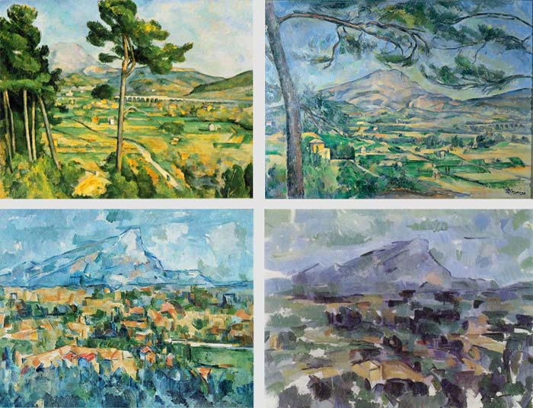

Slide 52
Cezanne, Basket of Apples, 1895, Post-Impressionism, France, oil on canvas**not in 250
-Good vehicle for Cezanne’s experiments, could arrange a limited number of objects for a point of departure
-So intent on preparation he could not use real fruit because it would rot
-Objects have lost their individual character, almost like cylinders and spheres
-Solidity is found by juxtaposing color patches
-Table edges are discontinuous, objects seem to be seen from different vantage points
-Integrity of the painting surface, never disregard the two-dimensionality of the picture plane
-Both three dimensional and two dimensional

