Slide 1
Europe 200 – 1325CE
Content Area #3
Early Europe
Judaism, Early Christian, Byzantine, Migratory, Romanesque & Gothic

Slide 2
Early Christian
Medieval Art

Slide 3
Timeline of Early Christianity
Crucifixion of Christ ca. 29
Crucifixion of St. Peter ca. 64
Persecution of Christians Trajan Decius 249-251
Diocletian 303-305
Edict of Milan 313
(Constantine granted religious toleration)
Foundation of Constantinople 324
Christianity becomes state religion 390
(under Theodosius I)
Ban on Pagan worship 391
Olympic games abolished 394
Fall of Rome to Alaric the Visigoth 410

Slide 4
Context
Constantine legalizes Christianity in 313 with the Edict of Milan
Allowed churches to be built over catacombs and people could worship in public
C. 600 Pope Gregory establishes papacy as political power
Fall of Rome/Roman Empire
410 Visigoths sack Rome
Ravenna becomes the capital of Western Roman Empire, under Honorius (Emperor of the East), his brother Arcadius with Emperor of the East
476, fall of Western Roman Empire by Odoacer (sets up his rule in Ravenna)
Ravenna becomes capital of Ostragothic kingdom
Appropriation
Appropriated Greek and Roman forms for architecture, painting, and mosaics for purposes of illustrating the characteristics of Christianity
http://smarthistory.khanacademy.org/church-architecture-an-overview.html

Slide 5
Pre-Constantinian Period
THE WORLD OF LATE ANTIQUITY
The new monotheistic religion of Christianity that grew out of Judaism during the Roman Imperial period adapted imagery and architectural forms from other religious cults and secular sources.
Christian adherents were creating new visual icons and architectural structures for expressing and practicing their religion.
Pagans, Jews, and Christians in the Desert:
Murals depicting biblical scenes were painted in a private house converted into a synagogue.
Another house was converted for use by Christians.

Slide 6
INTRODUCTION TO CHRISTIANITY
Son of carpenter, Jewish
Rebelled against the Roman Empire in the area now known as Palestine
Was crucified for upsetting the social order and challenging the authority of the Romans and their local Jewish leaders
Romans crucified Jesus, which was typical of those accused of crimes against the government
His followers claim that three days later he rose from the grave and later ascended into heaven
His original followers, disciples or apostles, travelled and spread his message
His life is recorded in the Gospels of Matthew, Mark, Luke, and John
Christ means messiah or savior
This belief in a savior is a traditional part of Jewish theology

Slide 7
OLD AND NEW TESTAMENT
Christianity was practiced and understood in many different ways
Wasn’t until the 2nd century that Christianity began to be understood as a religion distinct from Judaism
4th century-Roman emperor Constantine converted and made Christianity legally acceptable
Less than 100 years later, it was made the official state religion by the Roman emperor Theodosius
The first Christians were Jews, and the Old Testament is referred to as the Hebrew bible
Christians saw the predictions of the prophets in the Old Testament come to fulfillment in the life of Jesus Christ
Therefore the “Bible” of the Christians includes the Old and New Testament
Saw parallels in the events of the Hebrew Bible and the New Testament
Called foreshadowing, typology, or prefiguration

Slide 8
DOCTRINES
Christianity holds that God has a three part nature—the Trinity
God the father, the Holy Spirit, and Jesus Christ
There are also non-Trinitarian Christians
It was Jesus’ death on the cross and his sacrifice that allowed for humans to have the possibility of eternal life
Christ is seen as the second Adam, and Mary (Jesus’ mother) is seen as the second Eve
Adam and Eve caused the original sin and were expelled from paradise
Christ and Mary made it possible for humans to have eternal life in heaven (paradise), through Christ’s sacrifice
Eucharist or Communion
Eat blessed bread and wine
Transubstantiation-turns into the body and blood of Christ
Consubstantiation-represents the body and blood of Christ

Slide 9
Distinctive Characteristics of Christianity
Proselytizing- spreading the word of Jesus and trying to convert people
Resulted in rapid growth of religion from humble beginnings
Necessitated didactic art work in sacred spaces (art with a particular message)
Congregational- shared prayer, sermons, sacraments, and confession
Needed large assembly halls for worship
Specific burial requirements (preserving the body, like Jesus)
Catacombs and sarcophagi are necessary
Mysticism and miracles-cornerstones of faith
Didactic art work in sacred spaces that require images and storytelling leading the controversy of iconoclasts (destroyer of images) vs. iconodules (someone who worships images)

Slide 10
Judaism
Monotheistic
God created and rules the universe, hears the prayers of the faithful, made a pact with their ancestors (the Hebrews) and are God’s chosen people
Await the savior or Messiah (Christians believe this was Jesus)
Written records of God’s will
Hebrew Bible or Old Testament
Torah-first five books of the Hebrew Bible
God promised the patriarch Abraham that Canaan would be the homeland for Jewish people
Trace their origins to a Semitic-speaking people called the Hebrews who lived in Canaan
Moses led Hebrews out of slavery in Egypt to the promised land of Canaan in around 2000 BCE; climbed Mt. Sinai and received the Ten Commandments, which were kept in the Ark of the Covenant
Jewish law forbade the worship of idols, especially sculpture-in-the-round
Synagogues
Emphasized religious learning, a place to study the Torah
Can be any large room where the Torah scrolls are kept and read, as well as a place of communal gathering
Some were originally located in private homes or in buildings constructed like homes

Slide 11
Jewish Worship
Described in Jewish Bible, during their exile in Egypt, Israelites made sacrifices to God in the Tabernacle, a huge movable tent
Also made sacrifices in the large outer court and burned incense in the inner chamber, the “Holy of Holies”
Holy of Holies housed the Ark of the Covenant, which contained the Ten Commandments and the manna (substance that miraculously provided food to the Israelites in the wilderness)
Where God revealed His presence
Did not have a permanent place of worship until King Solomon built the Temple in Jerusalem in 10th century BCE
Was destroyed in 586 BCE and replaced by the Second Temple, now the location of the Dome of the Rock
Not much is known about the liturgy except: animal sacrifices, incense burning, chanting of Psalms, blessings, and the making and eating of “showbread” (bread placed on a specifically dedicated table in the Temple as an offering to God)
Roman emperor Titus destroyed the Second Temple in 70 CE and Jews were forced to worship only in their synagogues, where were halls for prayer and study, not sacrifice
Also a place to include readings of scripture and teachings
Included a bema, or platform from which men could read scripture and teach

Slide 12
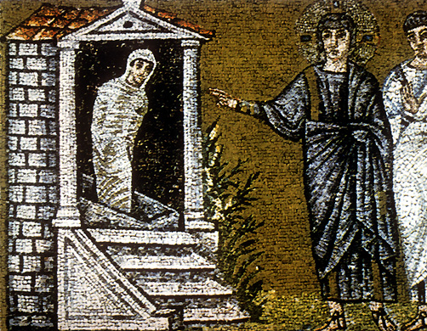
The eventual conversion of the Pagan world to Christianity brought a “new, non-naturalistic, *hieratic aesthetic” to art and design in that era.
How do we identify art from this transitional period?
Look for a mix of traditional classic features, Jewish (or old testament) narratives, and distinctive early Christian motifs.
Detail of Saint Apollinare Nuovo
Ravenna, Italy. 504 CE
*hieratic aesthetic: art style that is set by religious traditions

Slide 13
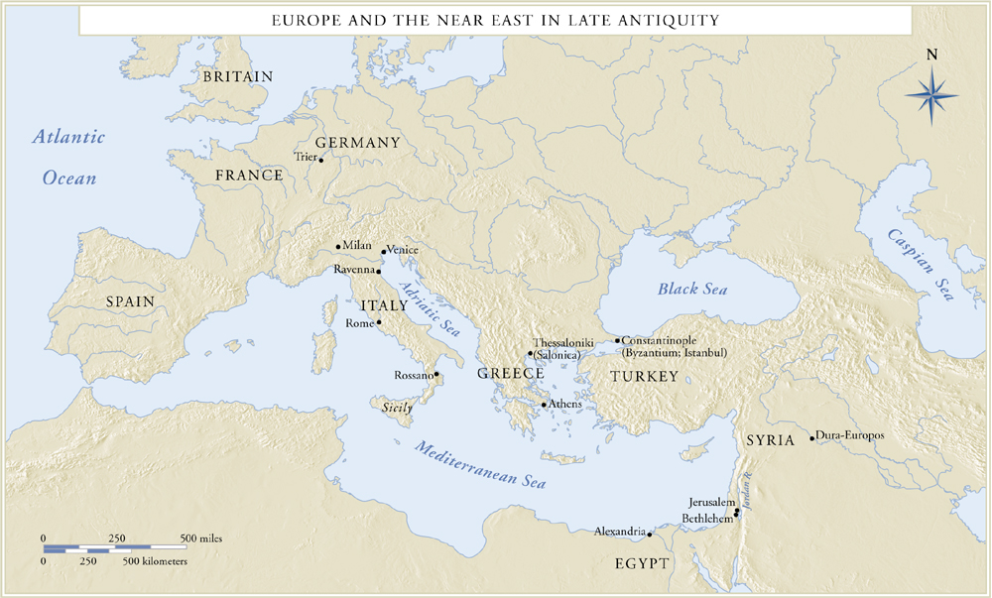
Europe and the Near East in Late Antiquity
2

Slide 14
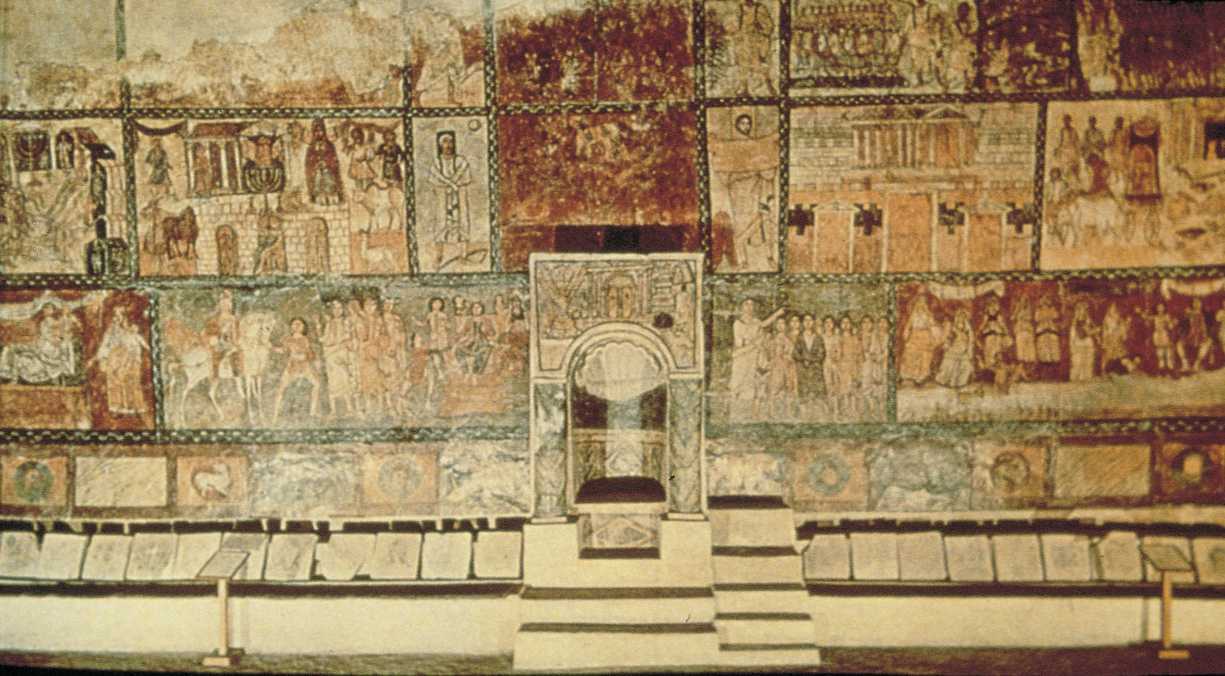
Interior of the synagogue at Dura-Europos, Syria, with wall-paintings of Old Testament themes, ca. 245–256. Tempera on plaster. Reconstruction in National Museum, Damascus.
3

Slide 15
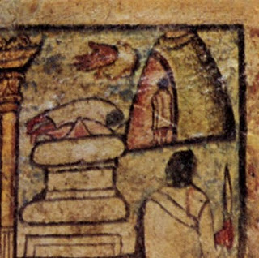
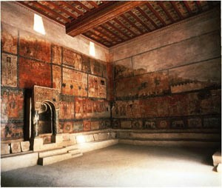
The Dura-Europos Synagogue paintings surprised scholars because they seemed to defy the 2nd commandment (banning the creation of “graven images”).
Jews of the Roman empire did not worship idols, but they did paint biblical stories on the walls of synagogues.
God is only depicted as a hand reaching down from near the top of the picture’s frame.

Slide 16
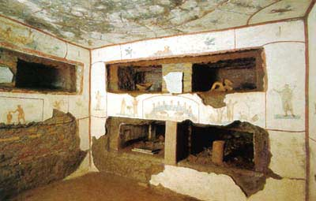
BURIAL PRACTICES
*Early Christian art refers to the earliest preserved works with Christian subjects, not the art of the Christians in the time of Jesus
Most Christian art is found in catacombs (vast subterranean networks of galleries and chambers used for burying the Christian dead)
Catacombs were tunneled out of tufa bedrock (like the Etruscans, but less elaborate) some extend 60-90 miles, could house as many as 4 million bodies
Roman custom required that Christians be buried outside city walls on private property purchased by a confraternity (association of Christian families)
Process: galleries 3-4 feet wide were dug around the perimeter of the burial ground at a convenient level below the surface, then they cut openings (loculi) to receive the bodies, placed on top of each other like shelves
Later they carved out small rooms (cubicula) that served as morturary chapels
Once the galleries were full, they built more at right angles, and then built lower into the ground, and made staircases
loculi

Slide 17
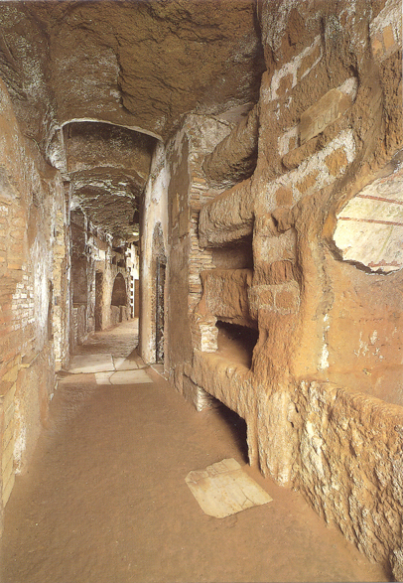
Catacomb showing loculi
Rome
3rd-4th centuries
Notes:
Slide concept by William V. Ganis, PhD FOR EDUCATIONAL USE ONLY For publication, reproduction or transmission of images, please contact individual artists, estates, photographers and exhibiting institutions for permissions and rights.

Slide 18
Frescoes on the Dome of Heaven:
Chambers that served as mortuary chapels adjoining the galleries in catacombs were sometimes painted with Christian symbols and motifs.
Paintings vary in quality from hastily rendered “graffiti” to sensitive and clearly professional painting that rivals any Roman examples known.
Imagery ranges from mere decoration, to simple symbols (fish, anchors, grapes, birds), to figures of the deceased praying (the orantes figures), to scenes from the old and new testaments.
One may safely surmise that the wealthier families provided the richer decorations.

Slide 19
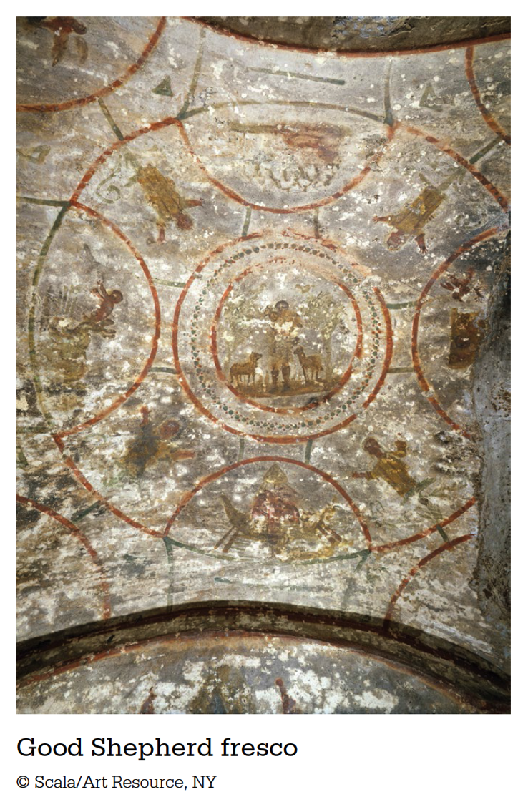

Slide 20
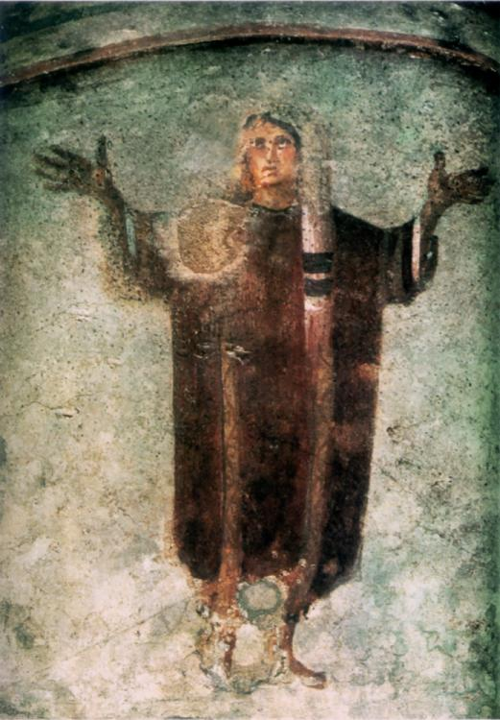
Orant:
figure of the deceased praying
The hands up gesture is a praying posture.
Orant figure
Catacomb of Priscilla, Rome,Italy
3rd century, fresco
Notes:
Slide concept by William V. Ganis, PhD FOR EDUCATIONAL USE ONLY For publication, reproduction or transmission of images, please contact individual artists, estates, photographers and exhibiting institutions for permissions and rights.

Slide 21
Reality vs. Abstraction
Classical art-focused on realism and naturalism, creating an illusion for the viewer
This is a problem for the Christians
One of the ten commandments was to forbid graven images
However-most early Christians were converted pagans who were accustomed to using images in religious worship
If illusionary art looks like something in nature, it can be considered idolatry
Augustine-images are like actors and are “lying,” an image cannot be what it claims to be
Christians favored flat representations of people, animals, and subjects
Removed the “lying” and temptations of idolatry

Slide 22
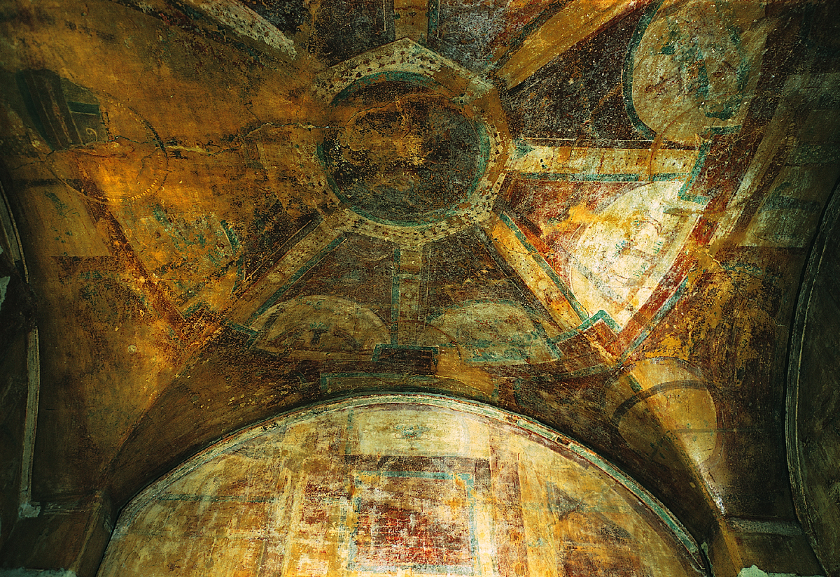
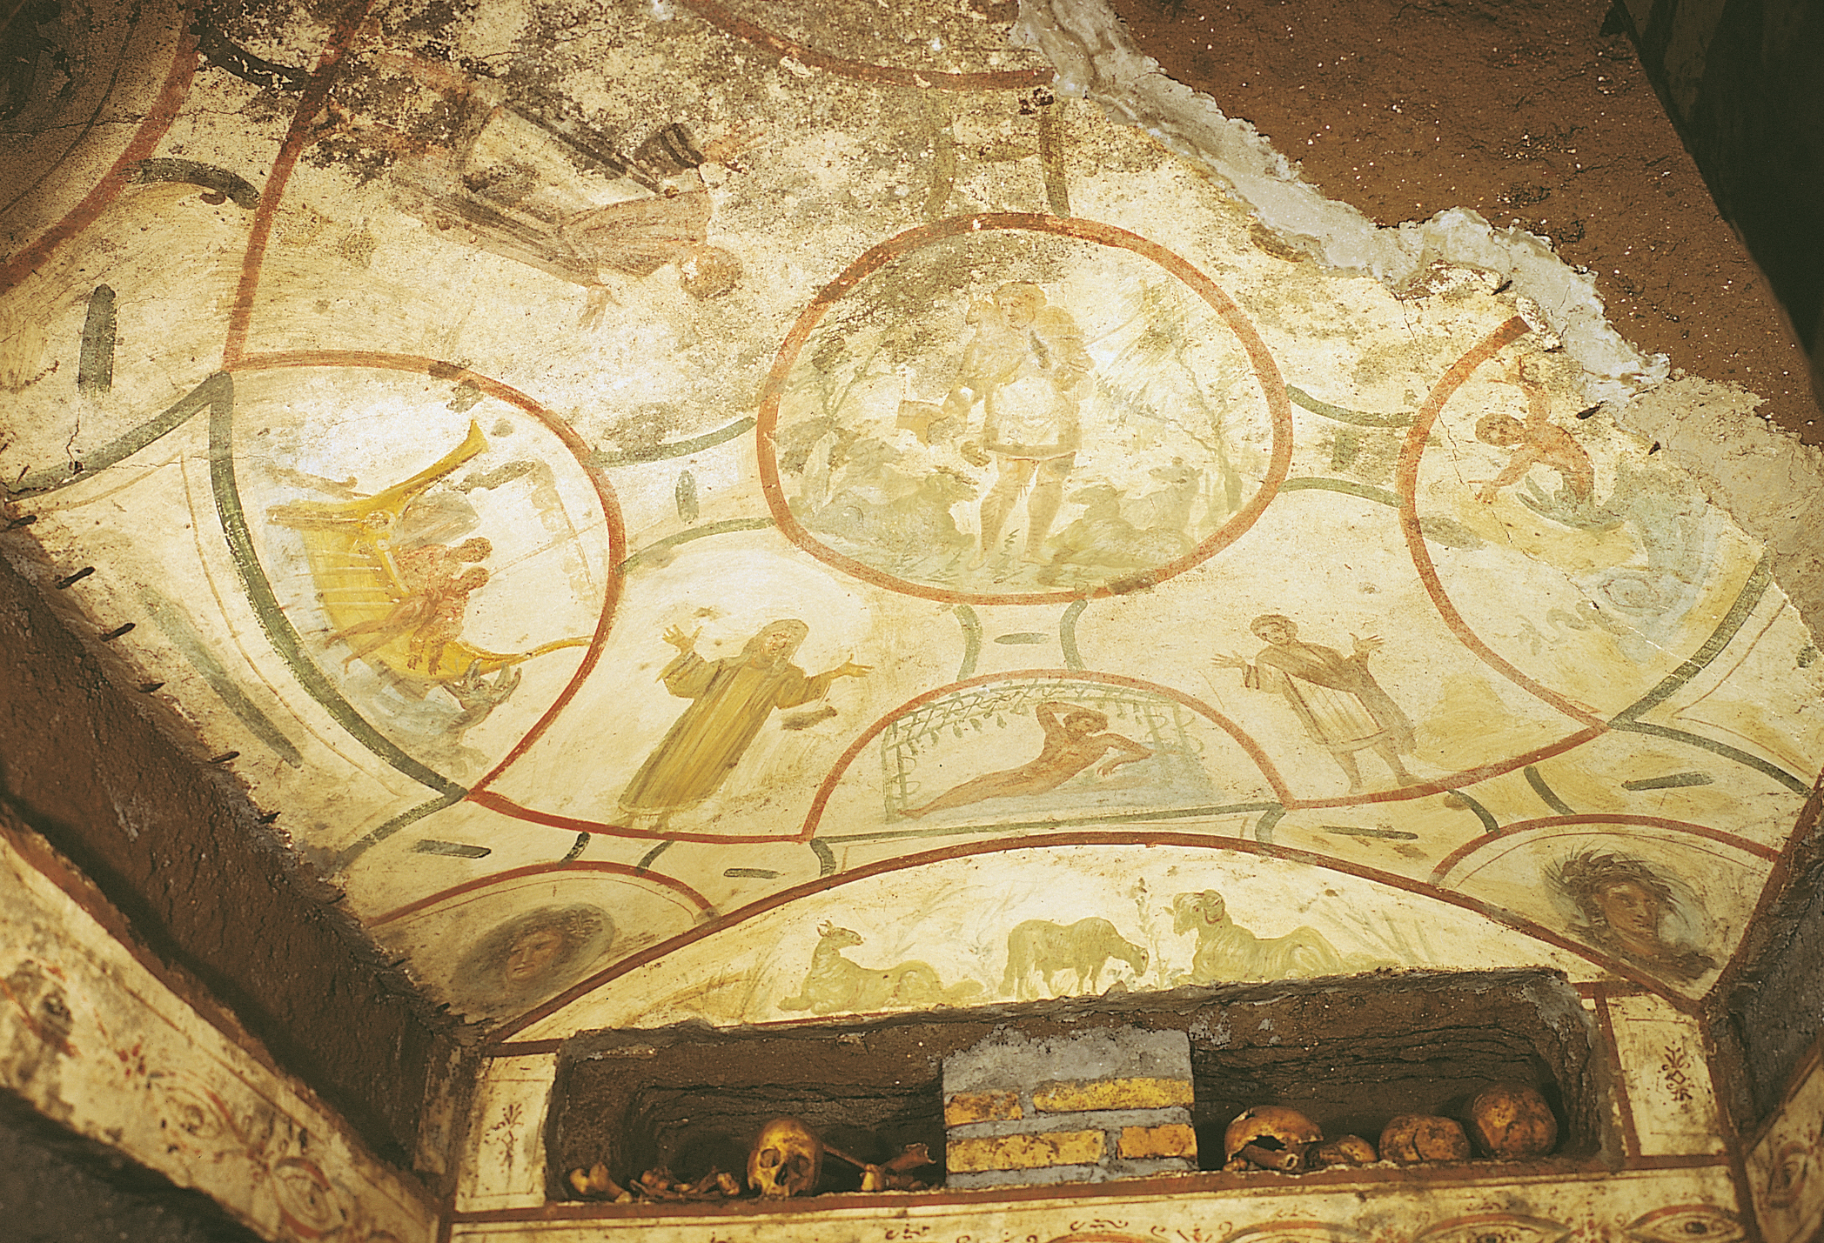
The Good Shepherd, the story of Jonah, and orants, painted ceiling of a cubiculum in the Catacomb of Saints Peter and Marcellinus, Rome, Italy, early fourth century.

Slide 23
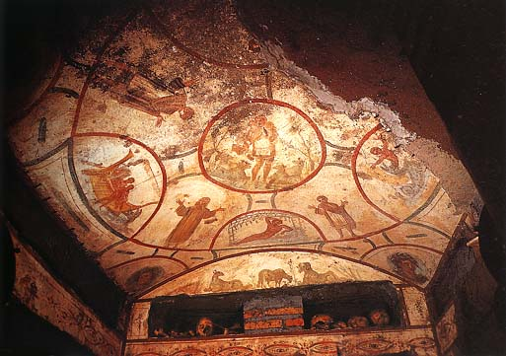
The Good Shepherd, 400 CE, Early Christian, Rome, fresco
Found in the catacomb of Saints Peter and Marcellinus
Lunettes-semi-circular frames
Form the arms of a cross
Orants-praying figures
Story in the lunettes- Jonah and the whale
Jonah is considered a prefiguration (prophetic
forerunner of Christ)
Man, woman and child accompany the story (orants), found in the cross-section of the fresco, are a Christian family seeking the heavenly afterlife
In the center, Christ is depicted as youthful, protector of the flock (common until Christianity was declared an official religion)
Sheep is symbol for lost sinner that Christ brings back to the “flock”
https://www.khanacademy.org/test-prep/ap-art-history/early-europe-and-colonial-americas/medieval-europe-islamic-world/v/catacomb-priscilla
lunettes
Orants

Slide 24
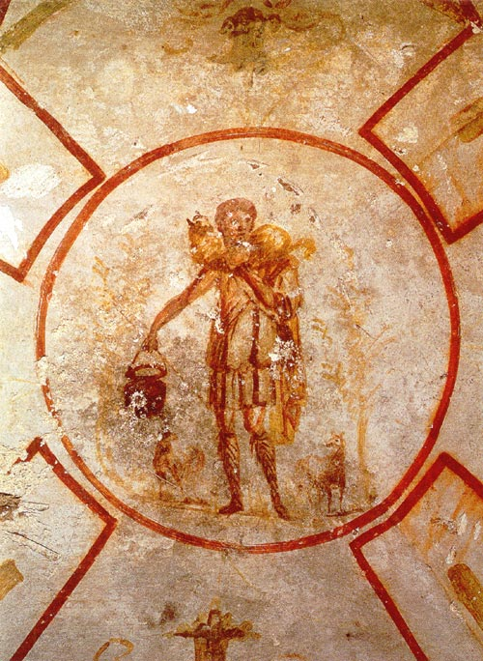
Before the 4th century, artists almost always depicted Christ as either the Good Shepherd or as a young teacher.
Early Christian images depict him as a youth.
After Constantine, depictions of Christ changed – showing a halo, imperial purple robes, a throne, and eventually an older bearded face.
Good Shepherd (detail)
Catacomb of Pietro and Marcellino, Rome, Italy, early 4th century fresco
Notes:
Slide concept by William V. Ganis, PhD FOR EDUCATIONAL USE ONLY For publication, reproduction or transmission of images, please contact individual artists, estates, photographers and exhibiting institutions for permissions and rights.

Slide 25
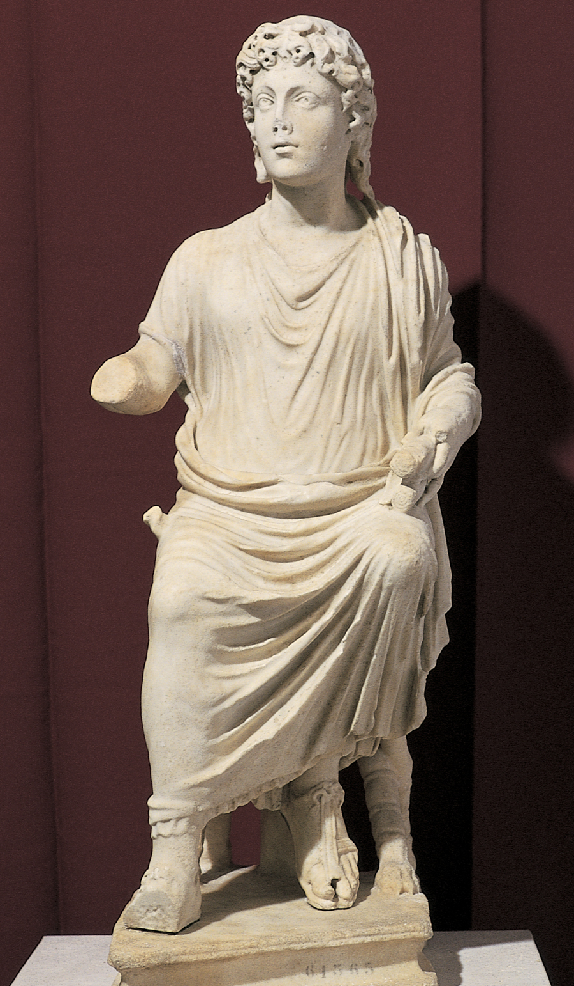
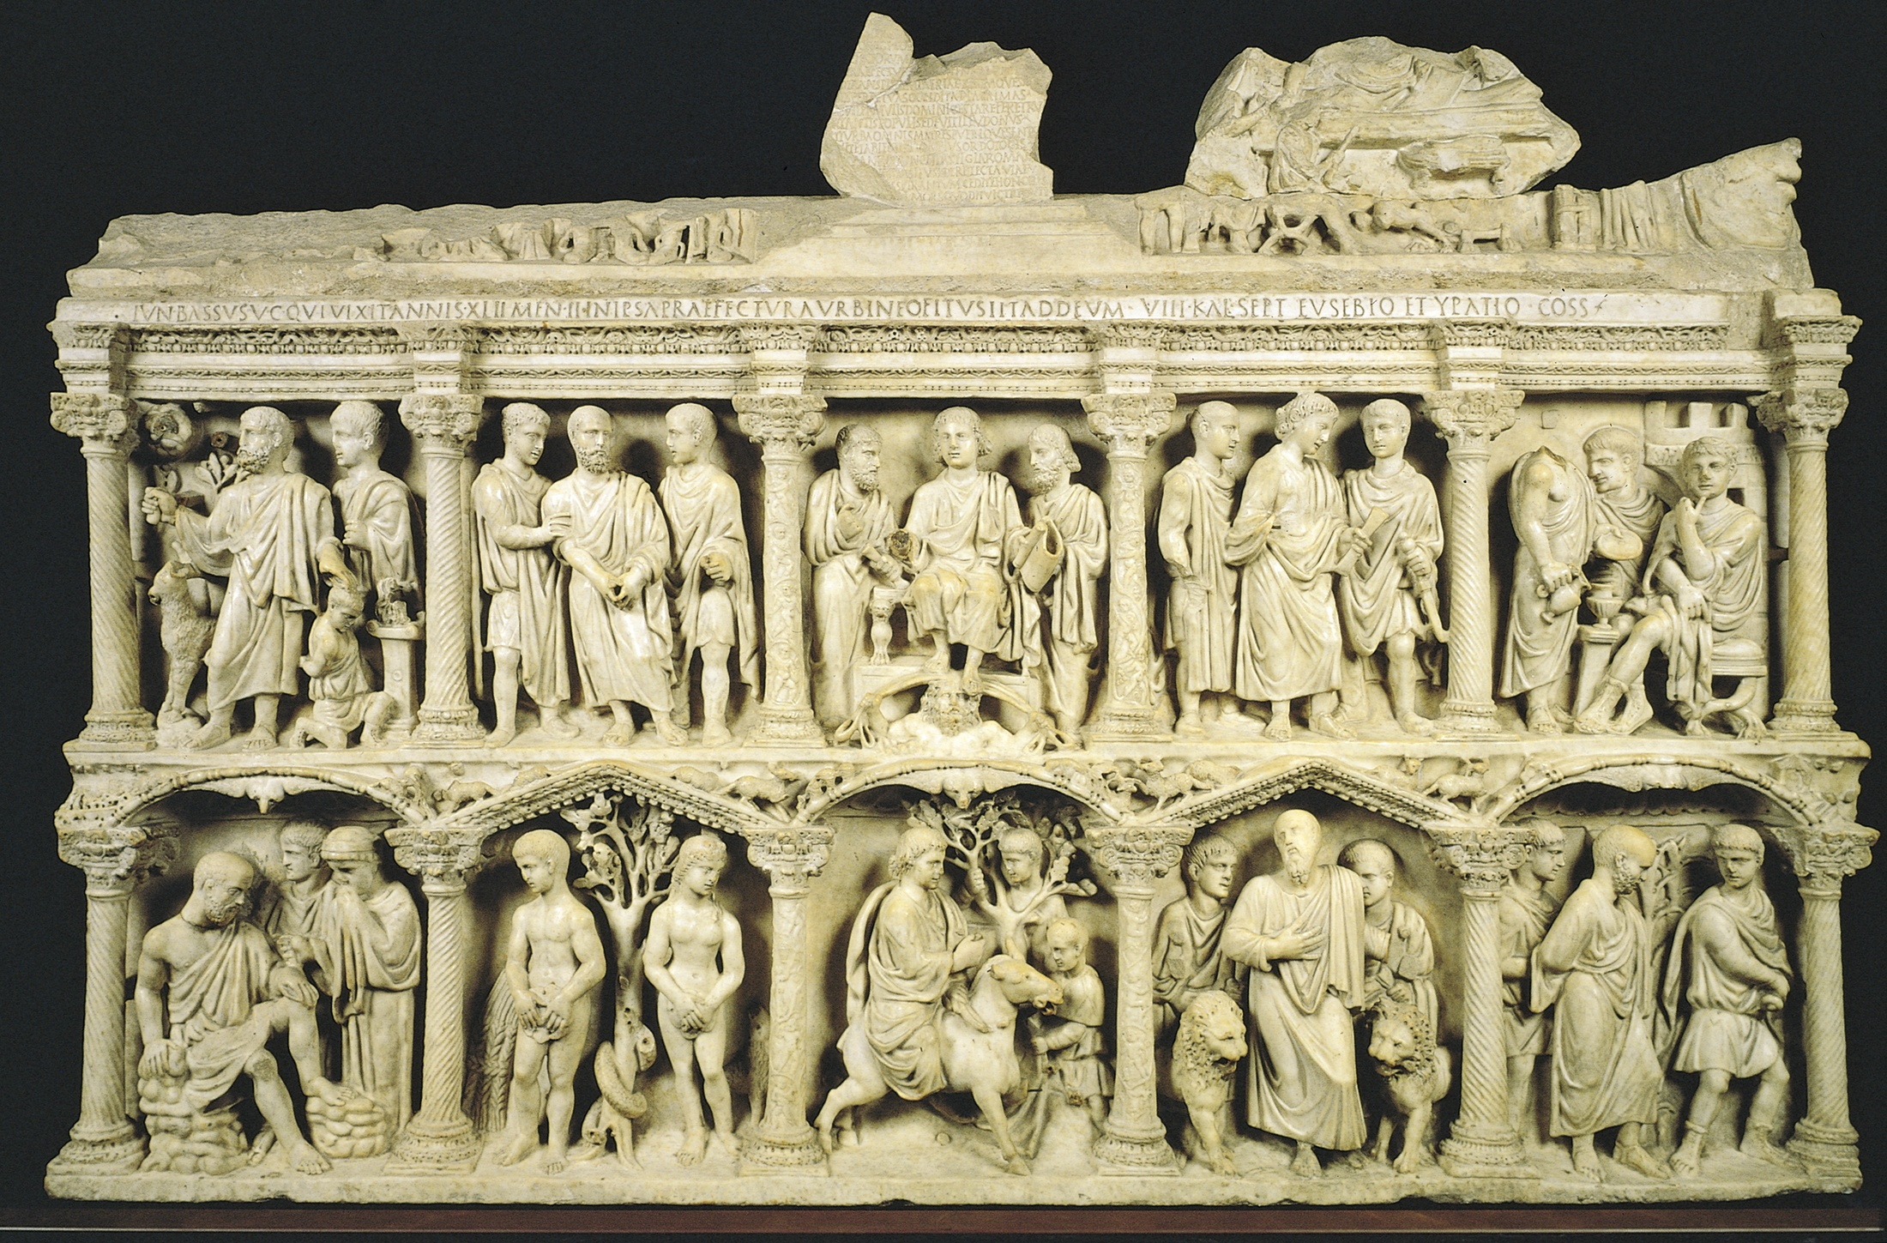

Slide 26
Jewish Subjects in Early Christian Art
Commonly depicted stories, that *prefigured Christ
for early Christians:
Jonah and the “whale” – foretold Christ’s resurrection
Abraham and the 3 angels – prefigured the immaculate conception and the Holy Trinity
Sacrifice of Isaac – a prefiguration of the sacrifice of God’s son Christ
Daniel and the den of lions – a salvation tale, and a triumph over death
Adam and Eve – the “original sin” led to the need for Christ’s sacrifice on the cross
*Prefigure: to picture or imagine beforehand, to foreshadow

Slide 27
Sarcophagus with Philosopher, Orant, Old and New Testament Scenes
from Rome, Italy
ca. 270, marble, 1 ft. 11 1/4 in. x 6 ft. 2 in.
Wealthy Christians continued to favor the sarcophagus for burial but had them carved with Christian themes and biblical subject matter.
Reliefs designs were pre-made, leaving the central figures “unfinished” to add customized portrait faces at the time of burial.
Notes:
Slide concept by William V. Ganis, PhD FOR EDUCATIONAL USE ONLY For publication, reproduction or transmission of images, please contact individual artists, estates, photographers and exhibiting institutions for permissions and rights.

Slide 28
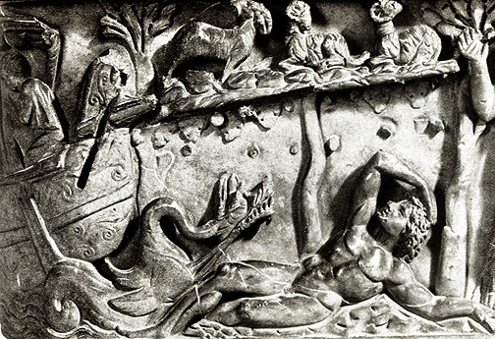
Sarcophagus with Old and New Testament Scenes, detail of Jonah
from Rome, Italy
ca. 270, marble, 1 ft. 11 1/4 in. x 6 ft. 2 in.
Notes:
Slide concept by William V. Ganis, PhD FOR EDUCATIONAL USE ONLY For publication, reproduction or transmission of images, please contact individual artists, estates, photographers and exhibiting institutions for permissions and rights.

Slide 29
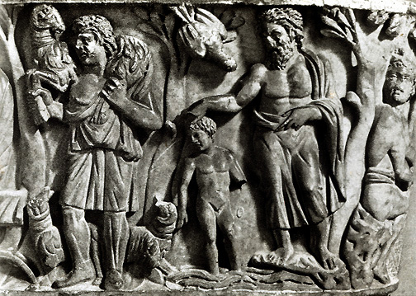
Sarcophagus with Old and New Testament Scenes, detail of Christ as Good Shepherd AND as a Child receiving baptism
from Rome, Italy
ca. 270, marble, 1 ft. 11 1/4 in. x 6 ft. 2 in.
Notes:
Slide concept by William V. Ganis, PhD FOR EDUCATIONAL USE ONLY For publication, reproduction or transmission of images, please contact individual artists, estates, photographers and exhibiting institutions for permissions and rights.

Slide 30
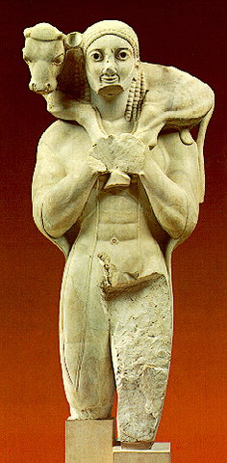
The Archaic Moschophoros
(calf bearer)
6th century BCE
He offers his sheep in
sacrifice to Athena.
Christ as the good shepherd:
When Christ was depicted with a sheep on his shoulder, the animal symbolized a sinner who had strayed from the “flock” and been rescued.

Slide 31
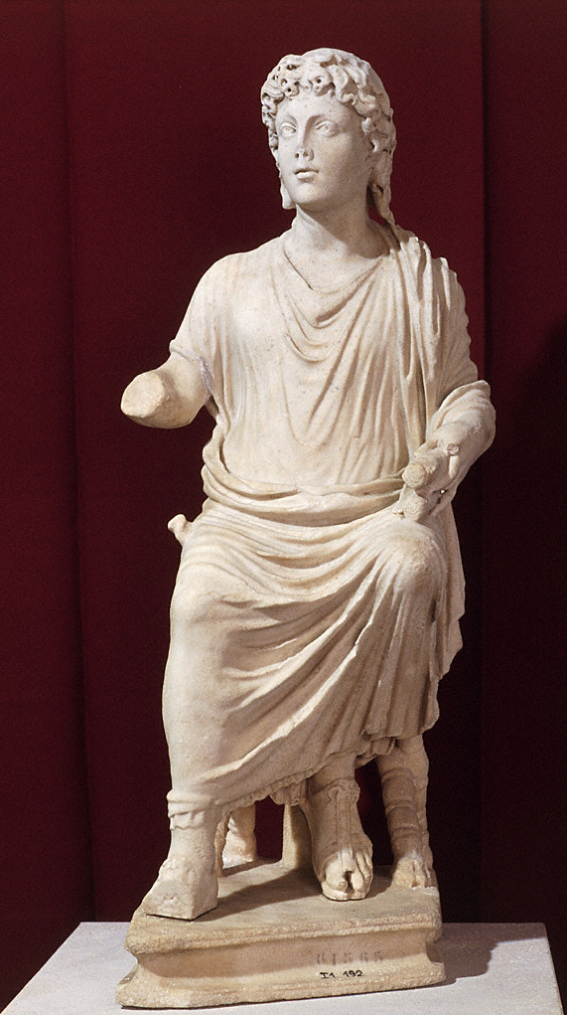
Christ Enthroned ca. 350–375. Marble, approx. 2' 4 1/2" high.
This is a rare early Christian “idol” marble statuette.
Christ is depicted as an “Apollo like” youth, yet he is dressed as an aged Roman philosopher.
Admonishment to Shun Graven Images:
2nd century philosopher Justin Martyr, declared in his writings that Pagans (Romans) worshipped statues as gods.
This influenced early Christian thought, therefore “cult statues” of Christ were rare.
Monumental Christian sculpture did not return until the 12th century!

Slide 32
Sarcophagus of Junius Bassus, from Rome, Italy, ca. 359. Marble, 3’ 10 1/2” X 8’. Museo Storico del Tesoro della Basilica di San Pietro, Rome.
The Old Testament scenes on the Junius Bassus sarcophagus were chosen for their significance in the early Christian Church.
7

Slide 33
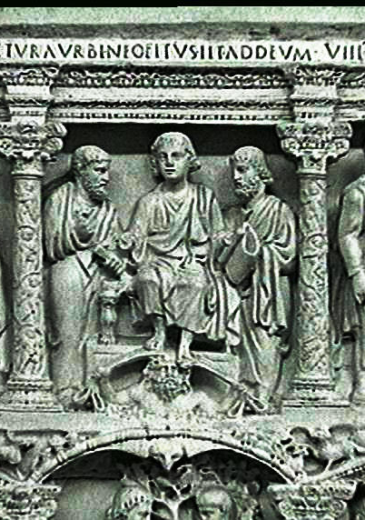
Sarcophagus of Junius Bassus,360 CE, Early Christian, marble **Not on 250
Sarcophagi became popular because Christians rejected cremation, many have survived because of their material
Sculptors often finished sarcophagi before they knew who would buy them, could add portraits at time of burial
Junius Bassus was a convert, this sarcophagus has two registers with 5 compartments that all have Christ in a place of pride, stories from New and Old Testament (teacher, entering Jerusalem on donkey)
Heavenly triumph is above earthly triumph
Appropriation of Roman art- Sits enthroned like an emperor, sky god next to him, showing Christ as ruler of the universe
Also Adam and Eve-created Original Sin and necessitated the sacrifice of Jesus for the salvation of humankind
Also Abraham about to sacrifice Isaac (another prefiguration of Christ)
Crucifixion does not appear but is alluded to by showing Jesus being brought before Pontius Pilate and judgment
SIGNIFICANCE
Appropriation of Roman art
Images of Resurrection on sarcophagus-Junius Bassus hoped for the same

Slide 34
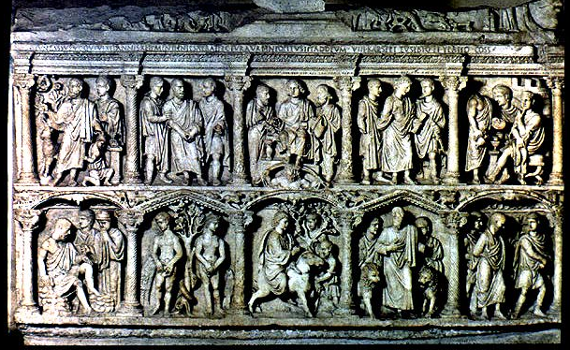
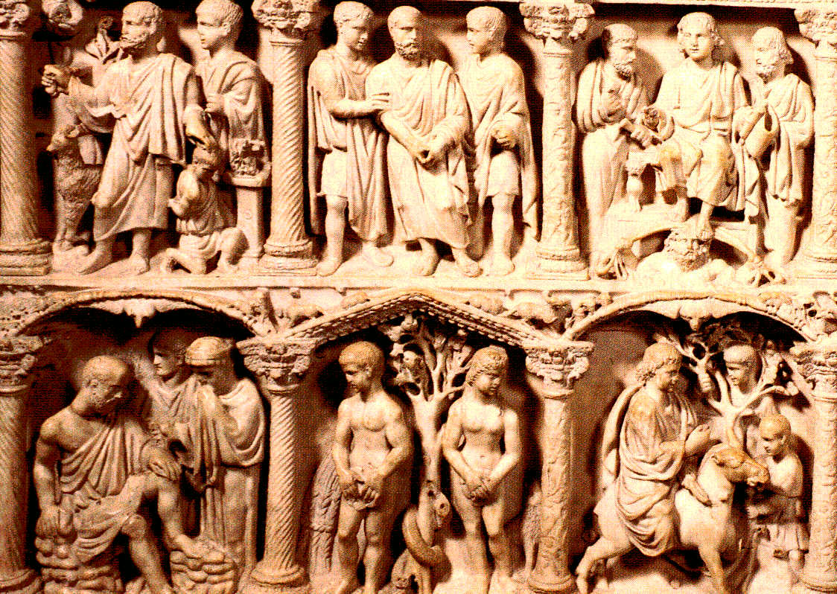
Sarcophagus of Junius Bassus, left side
from Rome, Italy, ca. 359, marble, 3 ft. 10 1/2 in. x 8 ft.
Notes:
Slide concept by William V. Ganis, PhD FOR EDUCATIONAL USE ONLY For publication, reproduction or transmission of images, please contact individual artists, estates, photographers and exhibiting institutions for permissions and rights.

Slide 35
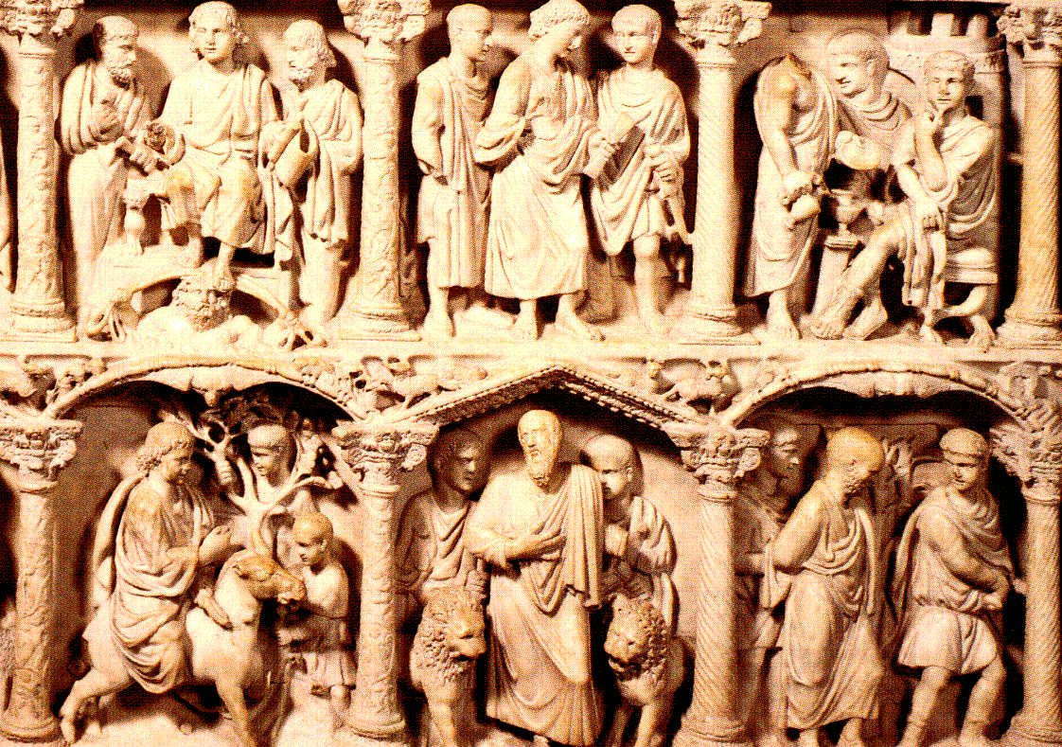
Sarcophagus of Junius Bassus, right side
from Rome, Italy, ca. 359, marble, 3 ft. 10 1/2 in. x 8 ft.
Notes:
Slide concept by William V. Ganis, PhD FOR EDUCATIONAL USE ONLY For publication, reproduction or transmission of images, please contact individual artists, estates, photographers and exhibiting institutions for permissions and rights.

Slide 36
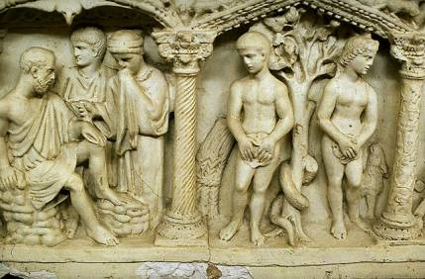
Raising of Lazarus Fall of Adam and Eve
Sarcophagus of Junius Bassus
from Rome, Italy
ca. 359, marble, 3 ft. 10 1/2 in. x 8 ft.
Notes:
Slide concept by William V. Ganis, PhD FOR EDUCATIONAL USE ONLY For publication, reproduction or transmission of images, please contact individual artists, estates, photographers and exhibiting institutions for permissions and rights.

Slide 37
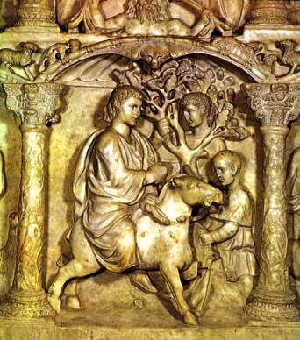
Sarcophagus of Junius Bassus
from Rome, Italy
ca. 359 marble 3 ft. 10 1/2 in. x 8 ft.
Christ Entering Jerusalem
Notes:
Slide concept by William V. Ganis, PhD FOR EDUCATIONAL USE ONLY For publication, reproduction or transmission of images, please contact individual artists, estates, photographers and exhibiting institutions for permissions and rights.

Slide 38
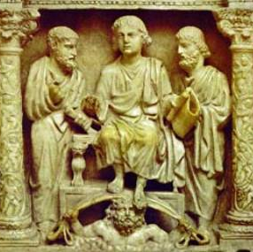
Sarcophagus of Junius Bassus
From Rome, Italy
ca. 359 marble 3 ft. 10 1/2 in. x 8 ft.
Christ Enthroned
Notes:
Slide concept by William V. Ganis, PhD FOR EDUCATIONAL USE ONLY For publication, reproduction or transmission of images, please contact individual artists, estates, photographers and exhibiting institutions for permissions and rights.

Slide 39
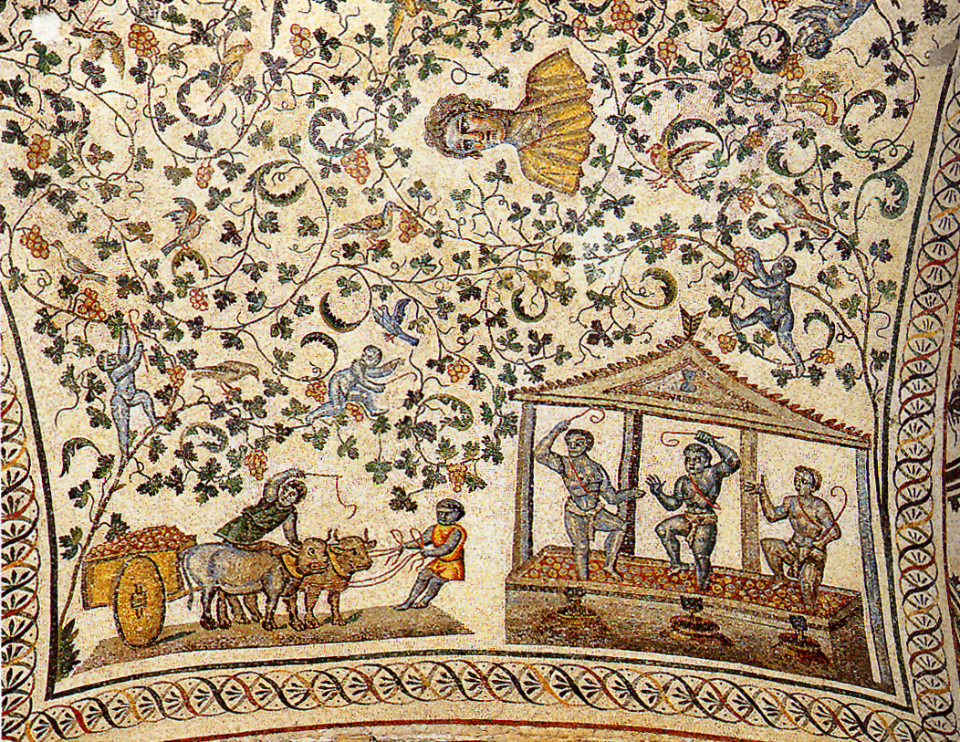
Detail of vault mosaic from ambulatory of Santa Costanza, 350 CE, Early Christian, Rome, Italy, mosaic** NOT IN 250
Found in the ambulatory of Santa Constanza
Roman images, with possible Christian interpretation
Putti (small angels) harvesting grapes and making wine. Wine was associated with Bacchus (cf. Hermes and the Infant Dionysus)
Grapes also signify the wine of the Eucharist, representing the blood of Christ
Portrait bust in the center (cf. Bust of a Roman Patrician)
SIGNIFICANCE
Symbols with pagan and Christian meanings, showing the transition or the appeal of one religion or the other

Slide 40
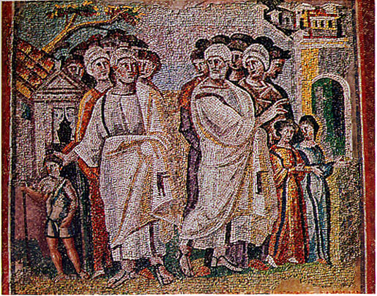
Parting of Lot and Abraham, 430 CE, Early Christian, Rome, Italy, mosaic**NOT IN 250
From Santa Maria Maggiore in Rome (the first major church dedicated to the Virgin Mary)
Each small piece is tesserae
Educating congregation on biblical stories and Christian dogma and provided a beautiful setting
Old Testament theme/story, from Genesis (the Bible’s opening book0
Abraham and nephew Lot part, Lot, to the right, departs to Sodom while Abraham heads to Canaan (church probably represented by the building behind him)
Lot’s is the evil choice, represented by his two daughters in front of him
Abraham’s yet-unborn son Issac, stands in front of him (whom Abraham will almost sacrifice), and is considered another prefiguration of Christ
Head cluster-used to represent each group without bodies, too many heads, not enough bodies—long history in Christian art
Eyes are wide in their sockets, enlarged hands with broad gestures-no ambiguity, clear motion with a simplified message
Similar to Greek and Roman, large figures, explaining a distinct message, light and dark shading to represent depth
SIGNIFICANCE
To decorate and to instruct, clear Christian message, Old Testament story
Appropriation of Greek and Roman styles
Head cluster
Tesserae

Slide 41
Constantinian Period
Christian architecture adapted the Roman basilica and audience hall for use as a church following a design that includes a nave, flanking aisles, transept, and apse.
Also adopted was the central-plan building for use as mausoleums, baptisteries, and private chapels.
Byzantine architects used the central plan design for churches. Byzantine interiors were decorated with mosaics.

Slide 42
Architecture
Once Christianity received imperial sponsorship under Constantine, Christians began constructing churches, in both Rome and Constantinople; as well as sites sacred to Christianity: Bethlehem and Jerusalem
Constantine believed the Christian god had guided him to victory, and so wanted to advance the religion
As emperor, however, he was obliged to safeguard the ancient Roman religion
Was anxious to provide buildings to house rituals and venerated burial places, especially memorials to the early Christian martyrs
Had to meet the requirements of the Christian liturgy (official ritual of public worship), provide a suitably monumental setting for the celebration of the Christian faith, and accommodate a rapidly growing number of worshippers
Most major Constantinian churches stood on sites associated with graves of Christian martyrs, that were on the city’s outskirts
This was according to Roman tradition
But also kept the Christian shrines out of the city center to avoid confrontation between the Christians and those who still worshipped the old gods

Slide 43
Early Christian Worship
Many of the first Christians were Jewish
Continued and re-interpreted their practices
Included a creed or statement, hymns, reading of the Hebrew Bible translated into Greek, teaching, meals, and baptism
Before the legalization of Christianity by Constantine Christians worshipped in their homes and grave sites of loved ones outdoors
Use of the Roman basilica
Constantine began an extensive building campaign to support the new state religion
Used this format to address the spatial needs of Christian liturgy
Had previously only been used as a civic building, usually to hear court cases
Did not have pagan associations like temples did
Interior additions
Bema-platform for teaching and reading scripture, borrowed from Jewish tradition
Altar for the celebration of the Eucharist, right in front or just inside the apse
Were wood at first, then stone
Later, relics of saints were installed inside
Some altars were placed on top of tombs of important martyrs

Slide 44
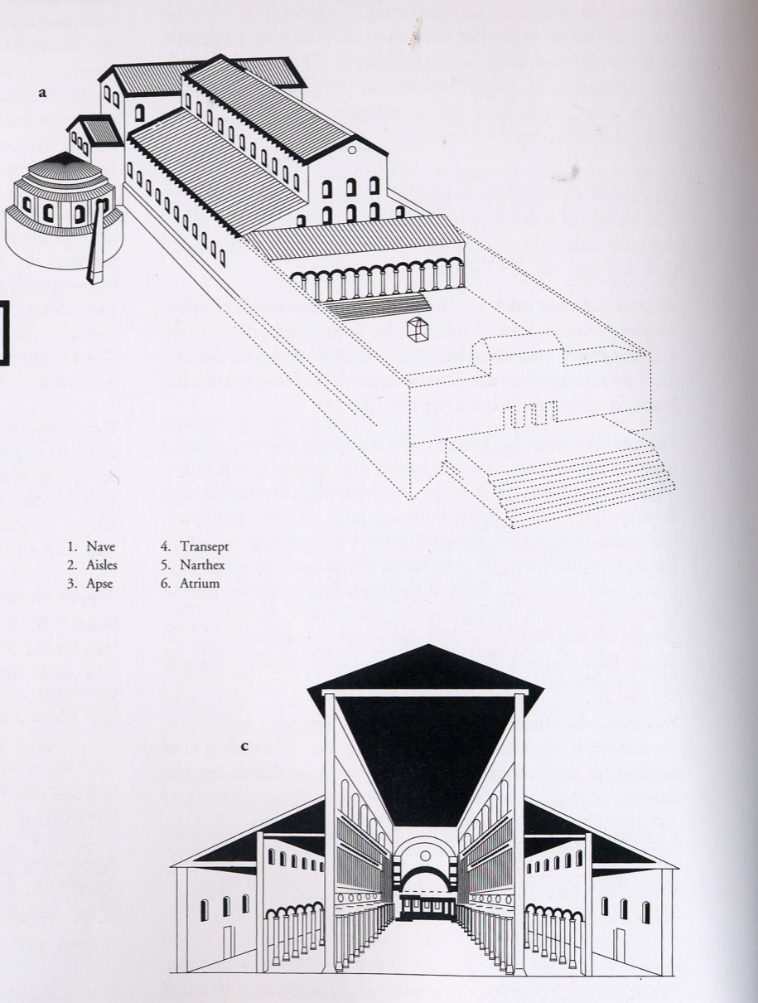
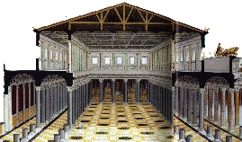
Old Saint Peter’s, 320 CE, Early Christian, Rome, Italy** NOT IN 250
Greatest of Constantine’s churches, began in 319, no longer exists
Located on the slope of the Vatican hill believed to be the burial place of Peter, founder of the Christian community in Rome (modern excavations have shown this likely to be true)
Capable of housing 3,000-4,000 worshipers, one of the most hallowed sites in Christendom (first is the Holy Sepulcher in Jerusalem, the site of Christ’s resurrection)
Also fulfilled the figurative words of Christ “Thou art Peter, and upon this rock I will build my church” Peter was Rome’s first bishop and the head of a long line of popes extending to the present
Huge, marble baldachhino (domical canopy over the altar) marked the spot of Saint Peter’s tomb
Resembles Roman basilicas, specifically the Basilica Ulpia. Did not want to mimic the houses of worship from polytheistic shrines, also Roman/Greek temples were meant to house cult statues and all rituals take place outside, not so in Christian religion
Basilica Ulpia from the Forum of Trajan

Slide 45
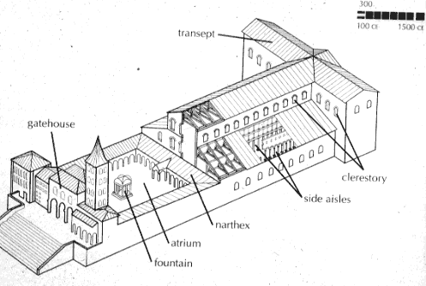
1. Nave
2. Aisles
Has a wide central nave, with flanking aisles and an apse at the end
Had a pronounced longitudinal access
Worshippers entered through a narthex or vestibule
300 ft nave, looking through the chancel arch which divides the nave from the transept
Transept is the transverse aisle that is perpendicular to the nave and between the nave and the apse
It house Saint Peter’s relics (body parts, clothing, objects associated with the saint or Christ himself
3. Apse
4. Transept
5. Narthex
6. Atrium
Old Saint Peter’s Basilica (plan)
Rome, Italy
Notes:
Slide concept by William V. Ganis, PhD FOR EDUCATIONAL USE ONLY For publication, reproduction or transmission of images, please contact individual artists, estates, photographers and exhibiting institutions for permissions and rights.

Slide 46
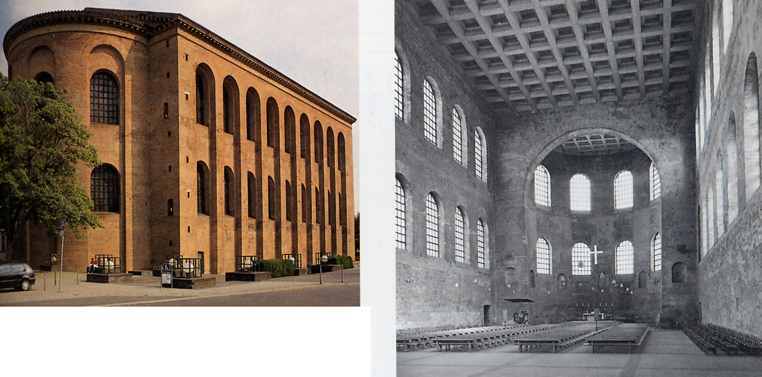
Aula Palatina (basilica)
Trier, Germany
early 4th century
Notes:
Slide concept by William V. Ganis, PhD FOR EDUCATIONAL USE ONLY For publication, reproduction or transmission of images, please contact individual artists, estates, photographers and exhibiting institutions for permissions and rights.

Slide 47
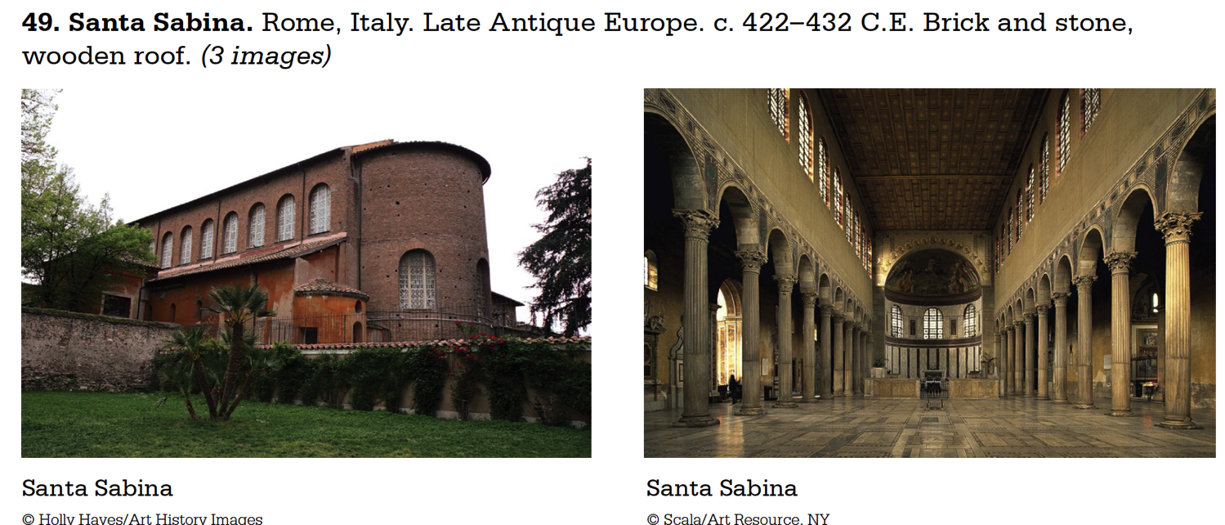
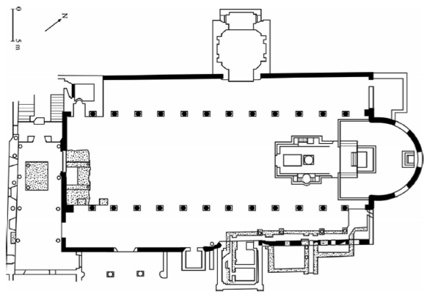
Nave-Center aisle
Narthex-Entrance
Apse- end where the altar is
Side Aisles- extra seating/standing

Slide 48
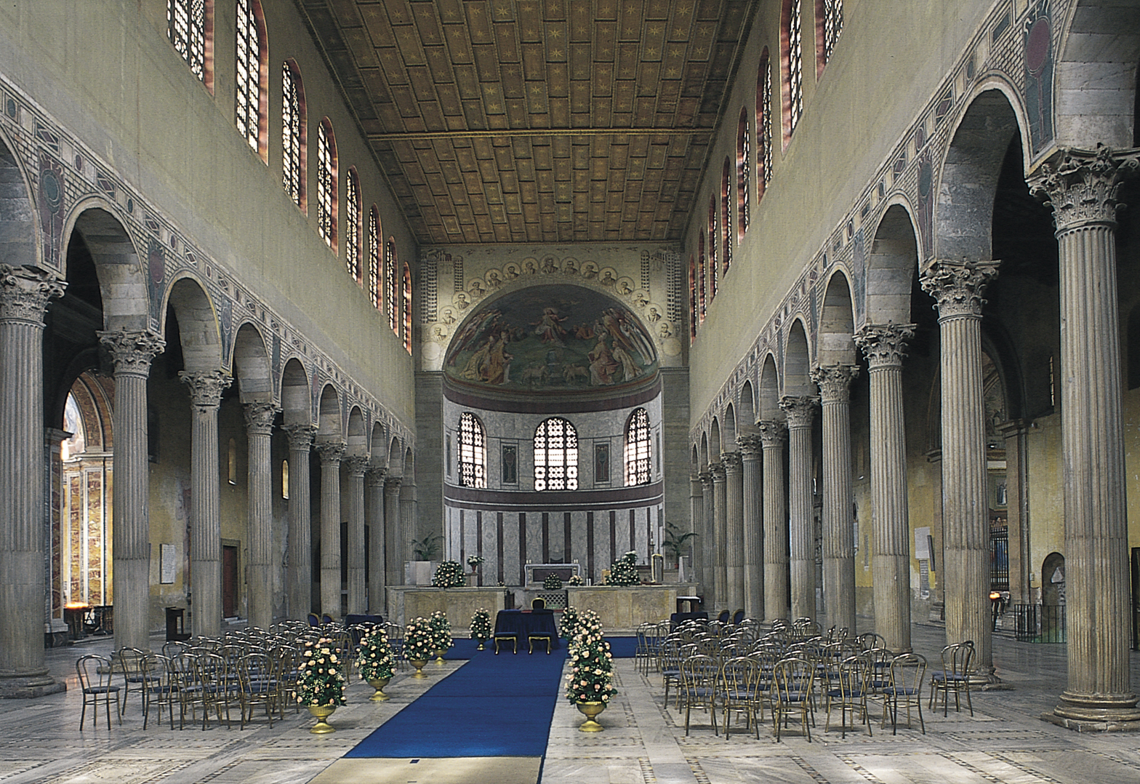
Figure 11-8 Interior of Santa Sabina, Rome, Italy, 422–432.
10

Slide 49
Santa Sabina
Example of a basilica
Was the category of building Constantine used to serve as the basis for new churches
Originals (such as Old St. Peter’s in Rome) are gone, but Santa Sabina shows what these would have looked like
Interior
Nave-central aisle that leads towards the apse, the site of the altar
On each side of the nave are side aisles, columns supported round arches, creating a nave arcade
Decoration in the spandrels were images of a wine cup and bread plate, reference to the Eucharist
Nave features clerestory windows
Walls would have been originally decorated with mosaics
Would have created a shimmering effect
Light is considered the symbol of divinity
Three main areas are ascribed with spiritual meaning: narthex-world, nave-Kingdom of God, apse-heaven
Exterior
Simple brickwork
https://www.khanacademy.org/test-prep/ap-art-history/early-europe-and-colonial-americas/medieval-europe-islamic-world/v/santa-sabina-rome

Slide 50
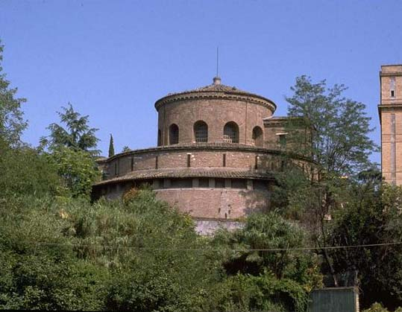
Santa Costanza
Rome, Italy
ca. 337-351
Notes:
Slide concept by William V. Ganis, PhD FOR EDUCATIONAL USE ONLY For publication, reproduction or transmission of images, please contact individual artists, estates, photographers and exhibiting institutions for permissions and rights.

Slide 51
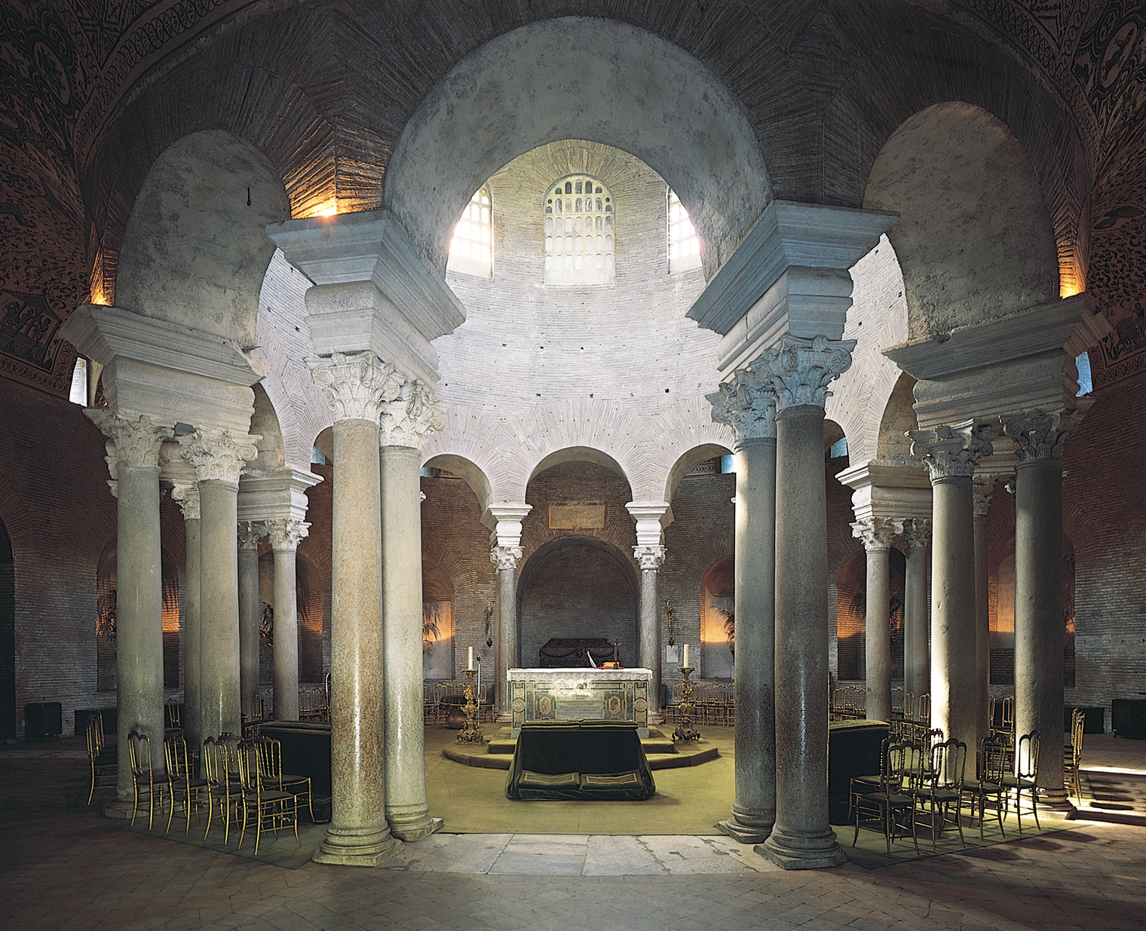
Interior of Santa Costanza, Rome, Italy, ca. 337–351.

Slide 52
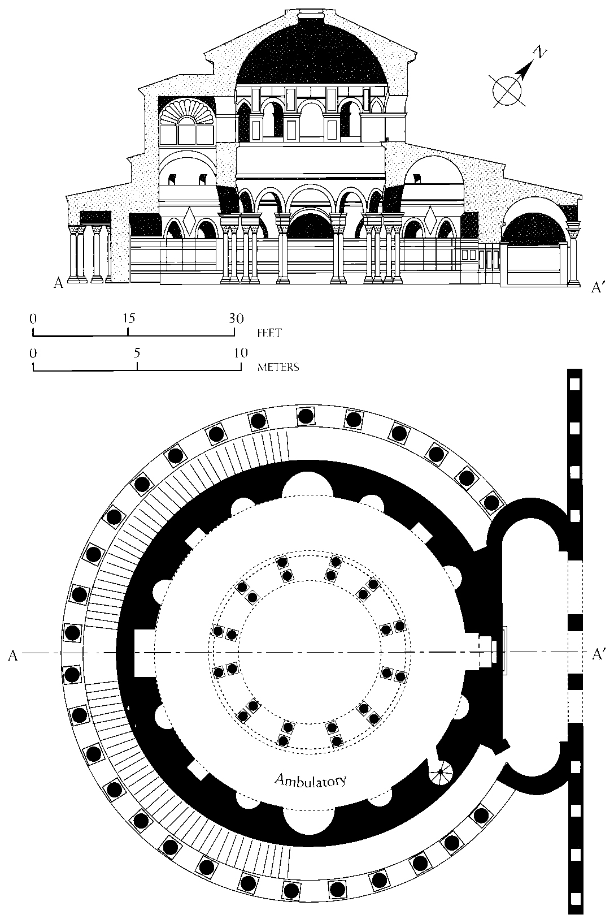
Longitudinal section (top) and plan (bottom) of Santa Costanza, Rome, Italy, ca. 337–351.
12

Slide 53
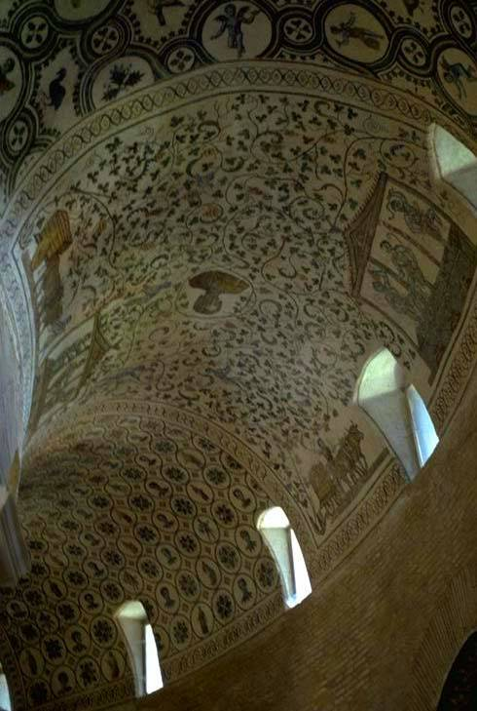
Santa Costanza vault mosaic
Rome, Italy
ca. 337-351 tessera mosaic
Notes:
Slide concept by William V. Ganis, PhD FOR EDUCATIONAL USE ONLY For publication, reproduction or transmission of images, please contact individual artists, estates, photographers and exhibiting institutions for permissions and rights.

Slide 54
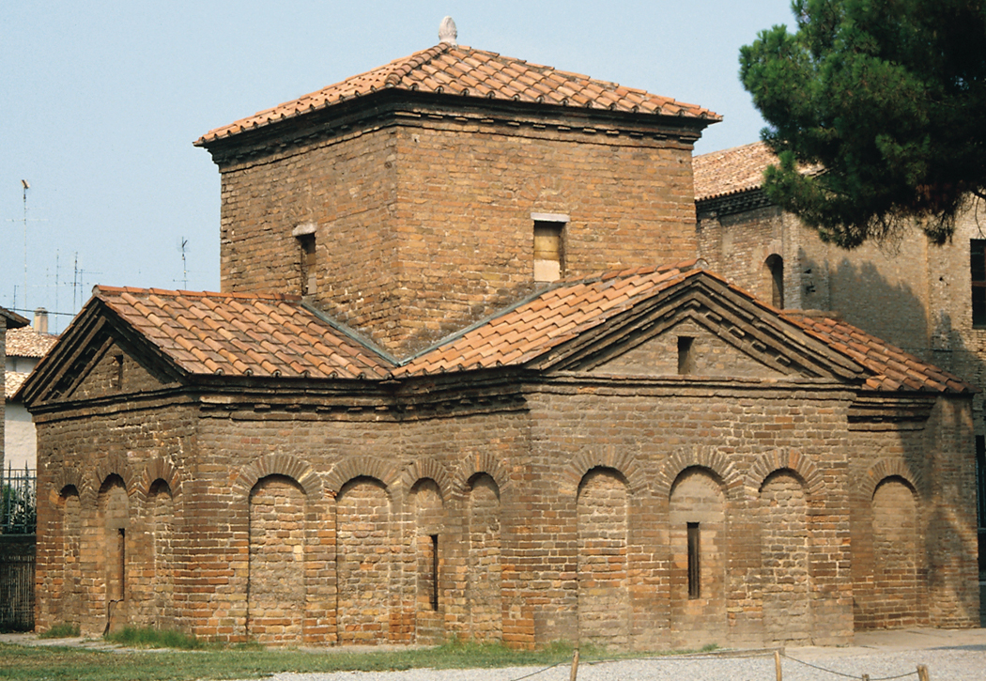
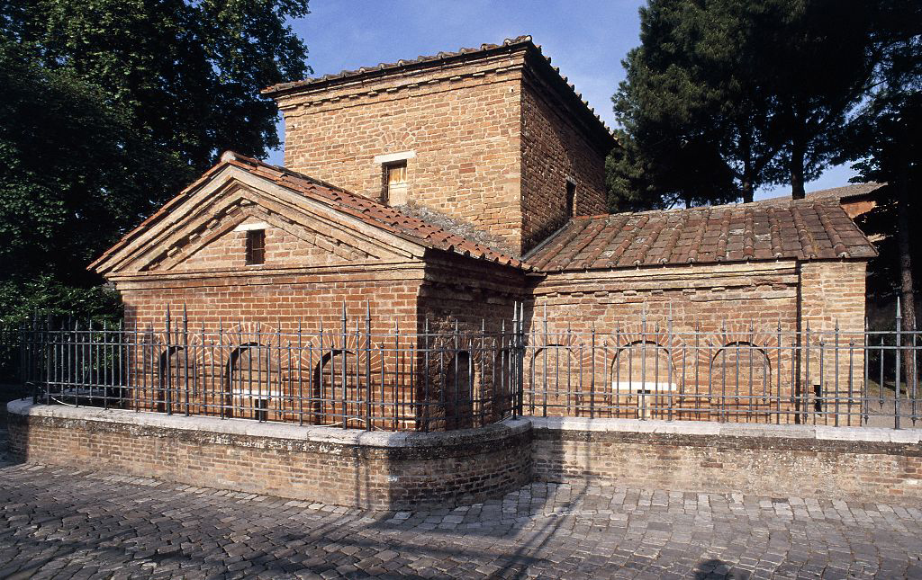
Mausoleum of Galla Placidia, Ravenna, Italy, ca. 425.

Slide 55
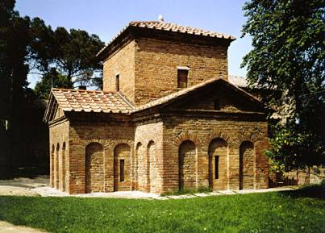
Christ as the Good Shepherd, 425 CE, Early Christian, Ravenna, Italy, mosaic ** NOT IN 250**
From the Mausoleum of Galla Placidia
Subject of a lunette above the entrance
Regal depiction of Christ
Not carrying a lamb on his shoulders, but sitting among his flock, haloed and in gold and purple robes (purple robes symbolized wealth, royalty, high rank, etc) and observes his flock
Sheep are in groups of two and three all facing him
Arrangement is loose and informal and seem to exist on a flat surface with no depth or space
All the forms have 3 dimensional bulk and cast shadows, and are within a carefully rendered landscape space.
Still rooted in classical tradition
SIGNIFICANCE
Depiction of Christ is clearly divine and powerful
Depiction is classical even if subject matter is Christian
Note Christ’s halo and his imperial purple robe.
The Mausoleum of Galla Placidia – SmART History video

Slide 56
Mausoleum of Galla Placidia, 420 CE, Early Christian, Ravenna, Italy ** NOT IN 250**
Galla Placidia was the sister of Honorius, the Emperor of the West
Small, cruciform (cross-shaped) structure with barrel-vaulted arms and a tower at the crossing
Arms are of unequal length, has a longitudinal orientation but the emphasis is on the crossing tower with its vault resembling a dome
Blind arcade-arches with no actual openings on the exterior
The earliest example of the successful fusion of two basic Late Antique plans,--the longitudinal (used for basilican churches) and the central plan (used for baptisteries and mausoleums)
This type of plan was to have along history in church architecture
SIGNIFICANCE
Successful fusion of two basic plans
Influential on later church architecture

Slide 57
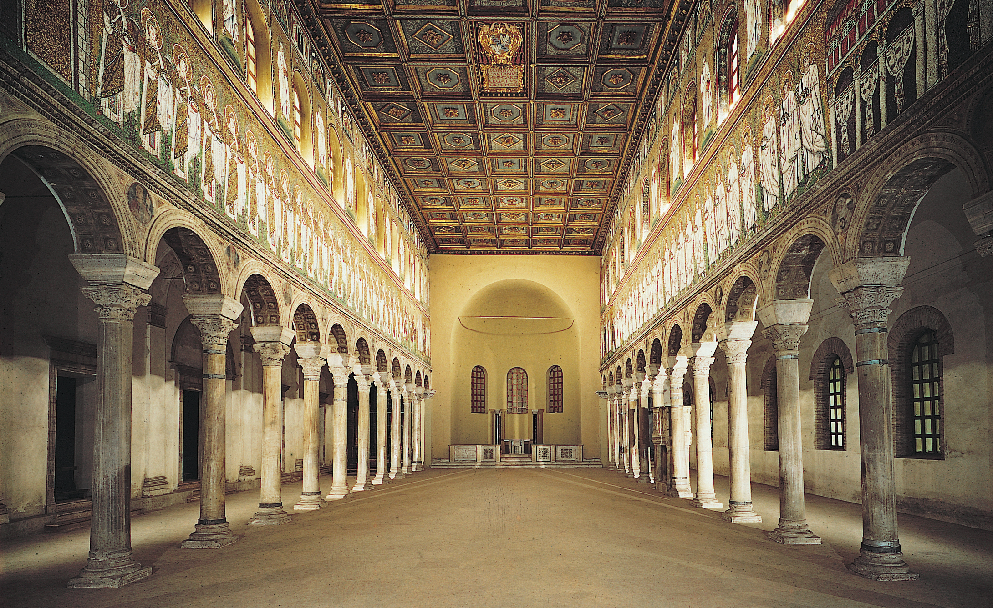
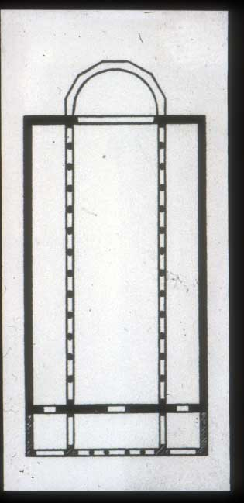
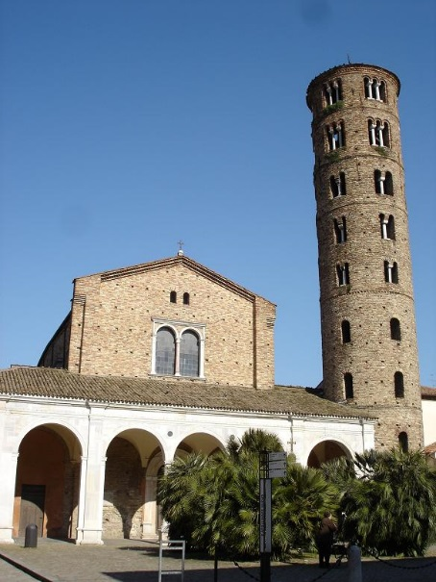
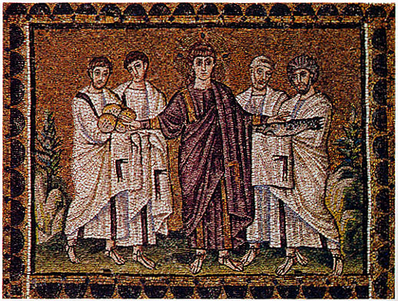
Sant’Apollinare Nuovo, 526 CE, Early Christian, Ravenna, Italy ** NOT IN 250**
Dedicated to Saint Apollinaris, contained his relics
Built by Theodoric who succeeded Odoacer (by killing him)
Was originally dedicated to Jesus Christ but later to Saint Apollinaris
Contains the mosiaic “Miracle of the Bread and Fishes”
Barrel-vaulted, Corinthian columns, clerestory
Apse, aisles, nave, and narthex, no transept

Slide 58
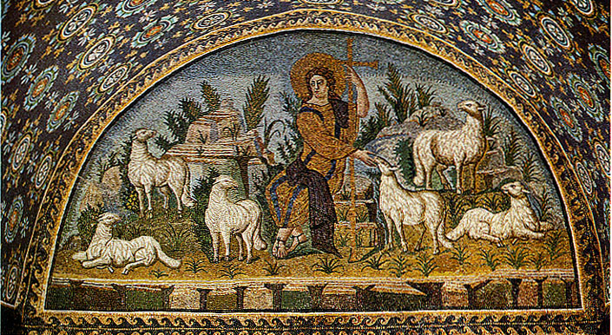
Miracle of the loaves and fishes, 500 CE, Early Christian, Ravenna, Italy, mosaic** NOT IN 250
From Sant’Apollinare Nuovo
Young Jesus with purple and gold robes (compare to Christ as the Good Shepherd, below), now has cross-inscribed nimbus (halo) on his head, signifying his divinity
Faces the viewer with extended arms, directing his disciples to distribute the miraculously created bread and fish to the crowd (of which, presumably, the viewer is a part of)
Mosaicist used least number of figures to tell the story, aligning the figures laterally, moving them close to the foreground, placing them in a shallow picture box
Has a golden background which takes the mosaic out of time and place and emphasizes the spiritual over the physical
Rocks and bushes are the only indication they are outside, sky is blue and gold, feet barely touch the ground
SIGNIFICANCE
Divinity of Jesus is clear
Subject engages with the viewer
Showing advancements in depth and representation of an idea

Slide 59
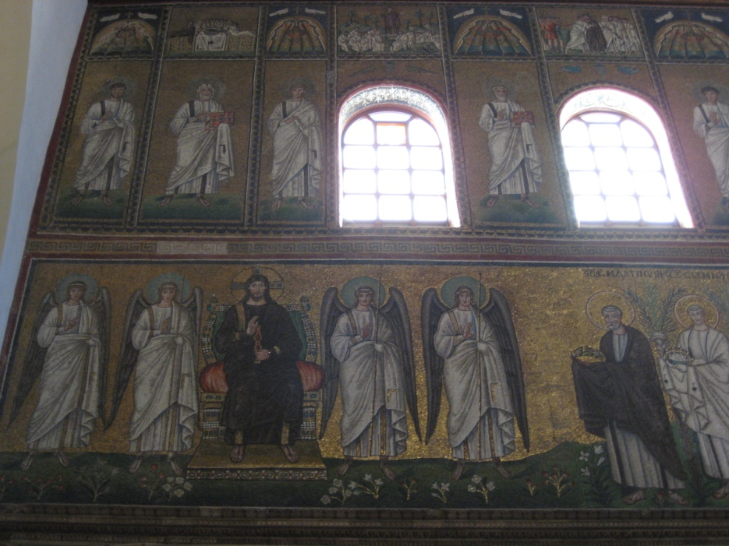
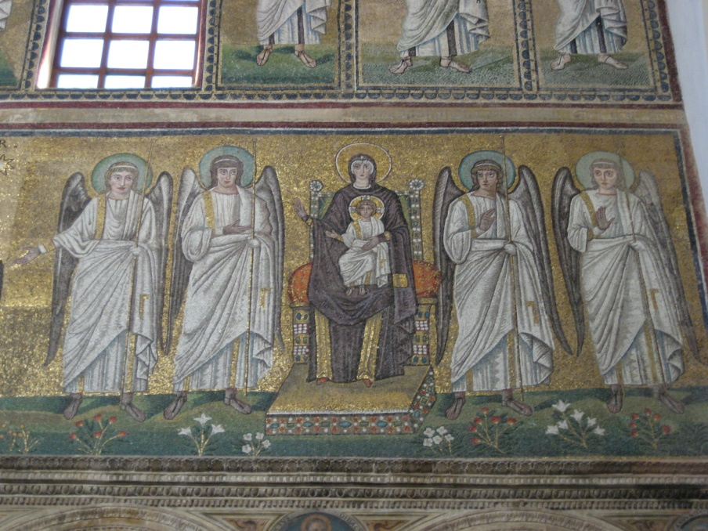
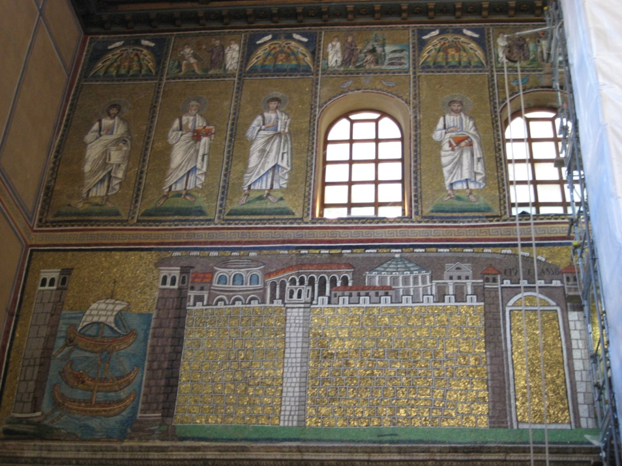
24

Slide 60
Raising of Lazarus
Saint Apollinare Nuovo
Ravenna, Italy
dedicated 504, tesserae mosaic
Notes:
Slide concept by William V. Ganis, PhD FOR EDUCATIONAL USE ONLY For publication, reproduction or transmission of images, please contact individual artists, estates, photographers and exhibiting institutions for permissions and rights.

Slide 61
Saint Apollinare Nuovo
Ravenna, Italy
dedicated 504, tessera mosaic
Christ Foretelling Peter’s Denial
Notes:
Slide concept by William V. Ganis, PhD FOR EDUCATIONAL USE ONLY For publication, reproduction or transmission of images, please contact individual artists, estates, photographers and exhibiting institutions for permissions and rights.

Slide 62
Christ as the Good Shepherd,
Mausoleum or Gallo Placido
Miracle of Loaves and Fishes,
Saint Appolinare Nuovo
The Saint Apollinare Nuovo mosaics illustrate the stylistic change that occurred in the 75 years that had passed since the mosaics of the Mausoleum of Galla Placida were made. (between 424 and 504 CE).
In the Miracle of Loaves and Fishes, notice:
the direct frontal poses
emphasis is on holy character of the event, not on the details.
The presence of an almighty power is stressed, not the narrative.
The blue sky of the physical world is gone, but the “gold of heaven” is in its place (this becomes standard for mosaics).
Drapery folds are more structured, appearing more like abstract patterns.
Notes:
Slide concept by William V. Ganis, PhD FOR EDUCATIONAL USE ONLY For publication, reproduction or transmission of images, please contact individual artists, estates, photographers and exhibiting institutions for permissions and rights.

Slide 63
Images of the Crucifixion were very rare in early Christian art, and before the 5th century, were virtually unknown.
This is the first known Crucifixion image:
ca. 420 CE
The Crucifix would later become an iconic focus in Christian art.
Suicide of Judas and Crucifixion – the earliest known depiction of the crucifixion
from a casket ca. 420 CE ivory 3 x 3 7/8 in.
Notes:
Slide concept by William V. Ganis, PhD FOR EDUCATIONAL USE ONLY For publication, reproduction or transmission of images, please contact individual artists, estates, photographers and exhibiting institutions for permissions and rights.

