Slide 1
Rayonnant Gothic Architecture

Slide 2
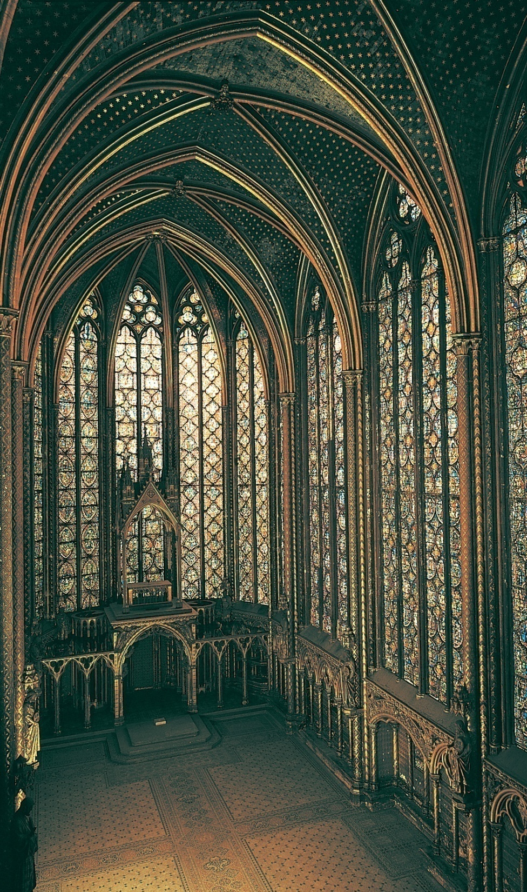
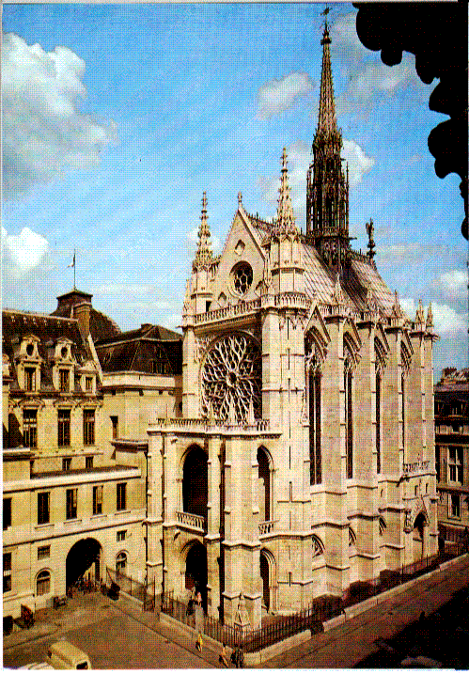
Interior of the upper chapel, Sainte-Chapelle, Paris, France, 1243–1248.

Slide 3
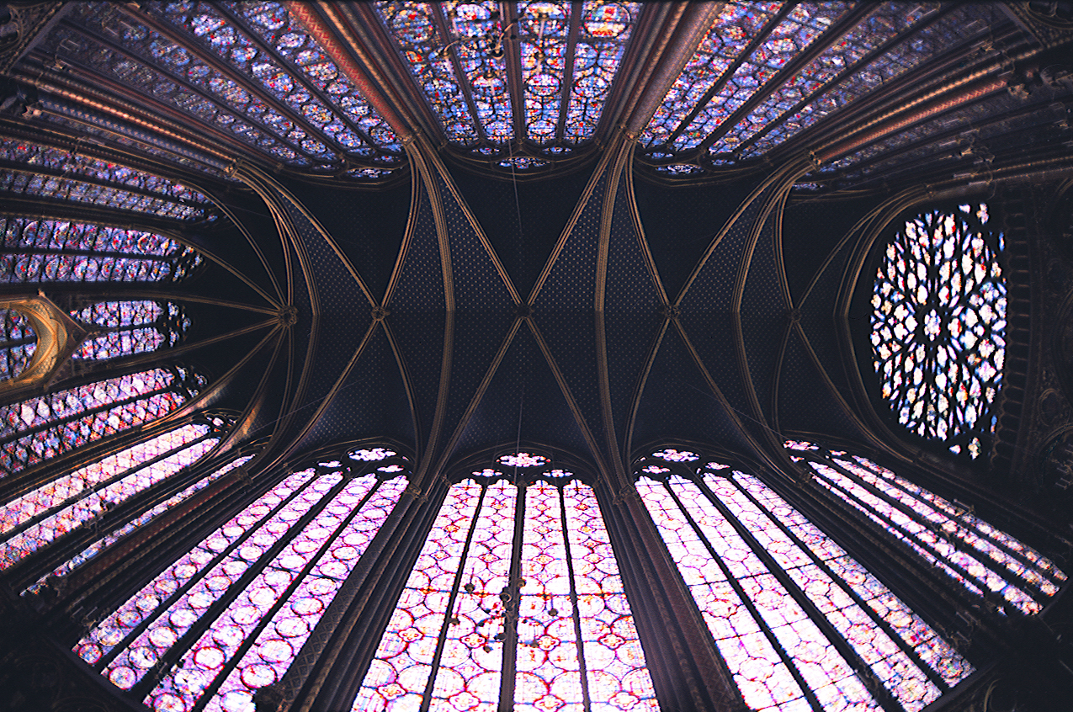

Slide 4
Late/Flamboyant Gothic Architecture

Slide 5
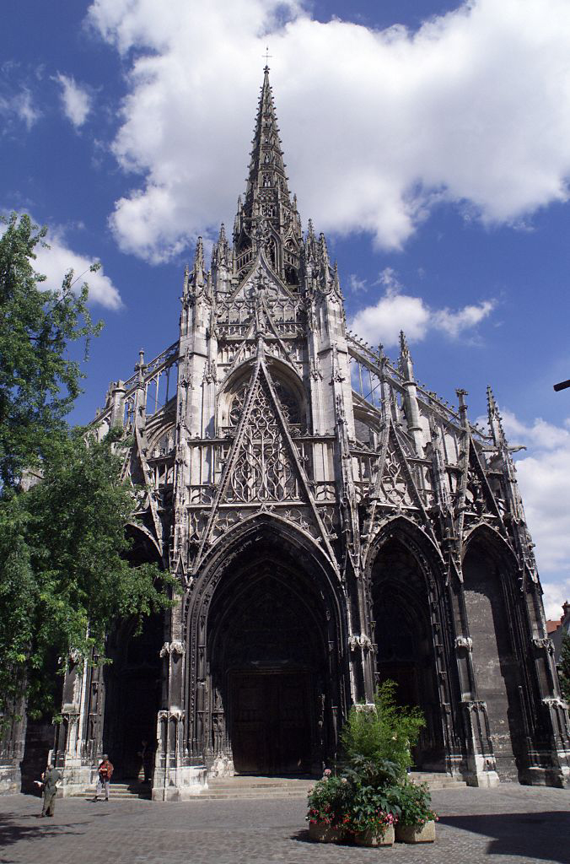
West facade of Saint-Maclou, Rouen, France, ca. 1500–1514.
© 2005 Saskia Cultural Documentation, Ltd.

Slide 6
French Gothic Stained Glass

Slide 7
HOW STAINED GLASS IS MADE

Slide 8
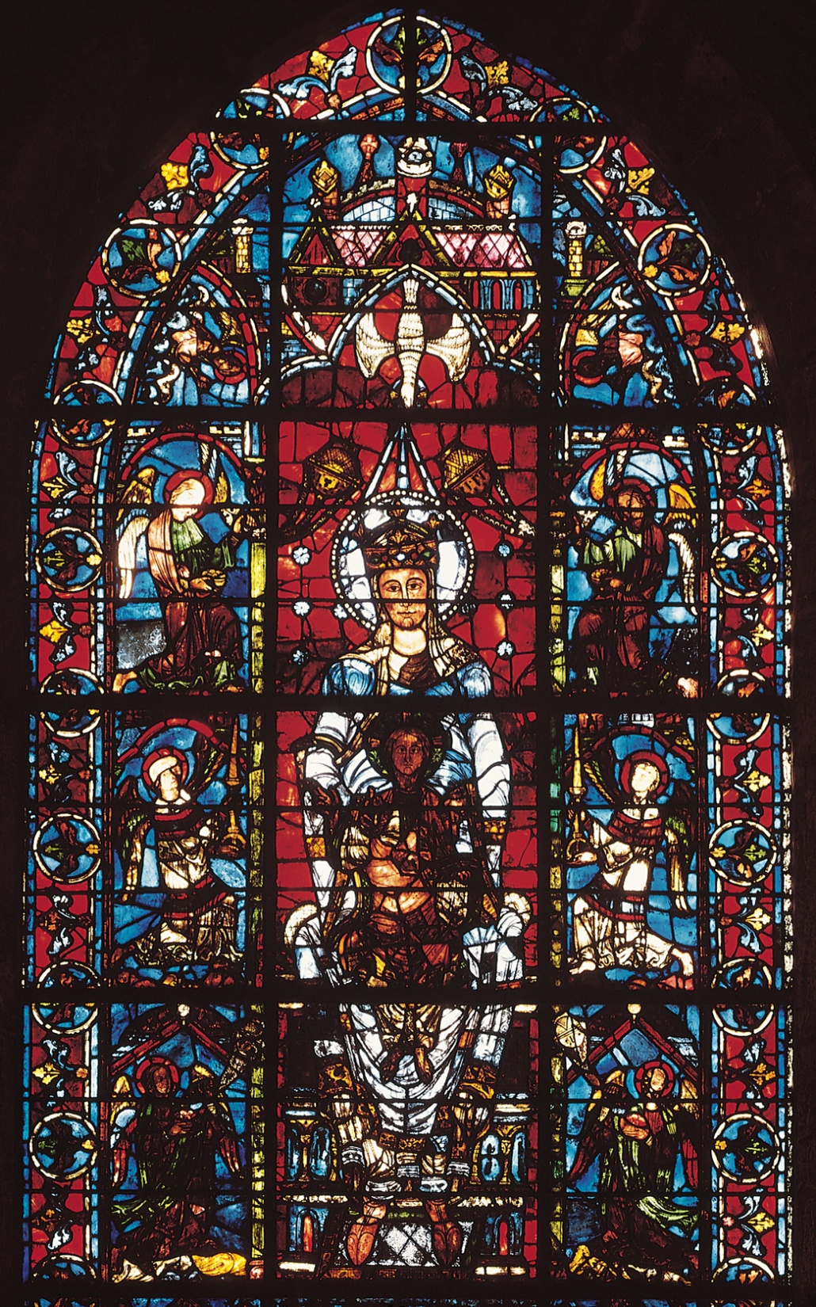
Virgin and Child and angels (Notre Dame de la Belle Verrière), window in the choir of Chartres Cathedral, Chartres, France, ca. 1170, with 13th century side panels. Stained glass, 16’ X 7’ X 8”.

Slide 9
Notre Dame de la Belle Verriere
Stained glass windows replace heavy walls of Romanesque style
Complex and costly process
Made by bringing sand and ash to a molten state under intense heat and “staining” it with color through the addition of metallic oxides
Blown and flattened into sheets
Used a full-scale drawing as a guide, glass painter would cut sheets of individual color
Used different types of paint to show features and facial expressions
Then would be fired and mounted individually into the iron framework
Lux nova- transform the interior light into a mystical wall
Was donated by Louis IX, son of Blanche of Castille
Windows and their corresponding light, was meant to replace walls, not conceal them
Manufacture of windows were costly and labor-intensive
Central section depicts Virgin Mary enthroned with the Christ child in her lap
Frontal composition, but young other-worldy Queen of Heaven, haloed and accompanied by the dove representing the Holy Spirit
https://www.khanacademy.org/test-prep/ap-art-history/early-europe-and-colonial-americas/medieval-europe-islamic-world/v/part-2-cathedral-of-notre-dame-de-chartres-c-1145-and-1194-c-1220

Slide 10
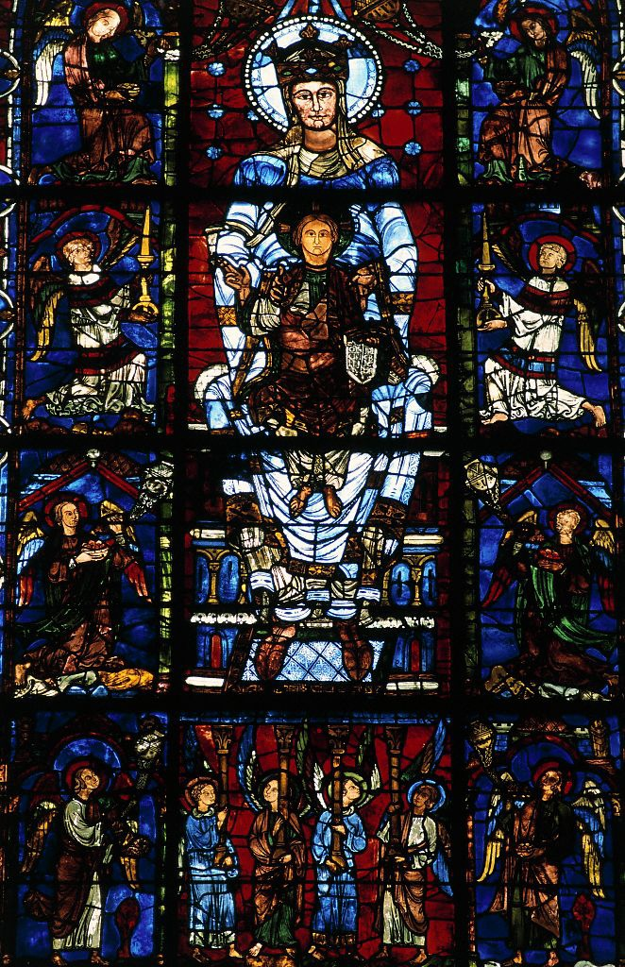
Detail Window 14 (ca 1170 inserted in a larger window of 13th c). Notre Dame de la Belle Verrière or Blue Virgin: 488 cm, upper portion w Blue Virgin
© 2005 Saskia Cultural Documentation, Ltd.

Slide 11
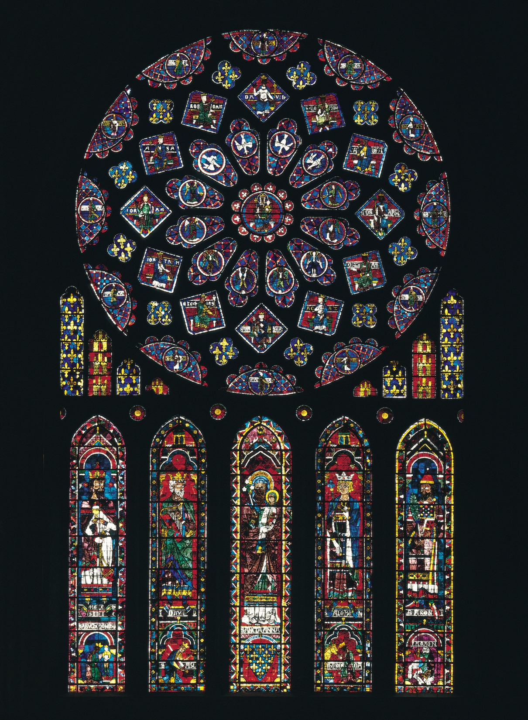
Rose window and lancets, north transept, Chartres Cathedral, Chartres, France, ca. 1220. Stained glass, rose window approx. 43’ in diameter.
SmART Video 2
SmART Video 3

Slide 12
French Early Gothic Sculpture

Slide 13
Contextual Consideration as to the development of Gothic style in sculpture
Re-emergence of the human body as a central subject matter of art
Religious character still within the context of architectural decoration or embellishment, still primarily surrounding the portals of churches
Growing belief that the Christian “soul” must be manifested within the human body
Aristotle’s writings rediscovered—the human body is the form of the soul, a manifestation of it and therefore should be beautiful, to represent God’s creation
Throughout the 12th and 13th centuries, increasing sense of realism in door jamb structure—from iconic to naturalism
Development from early style:
Extreme elongation
“archaic smile”
Linear quality drapery of figures

Slide 14
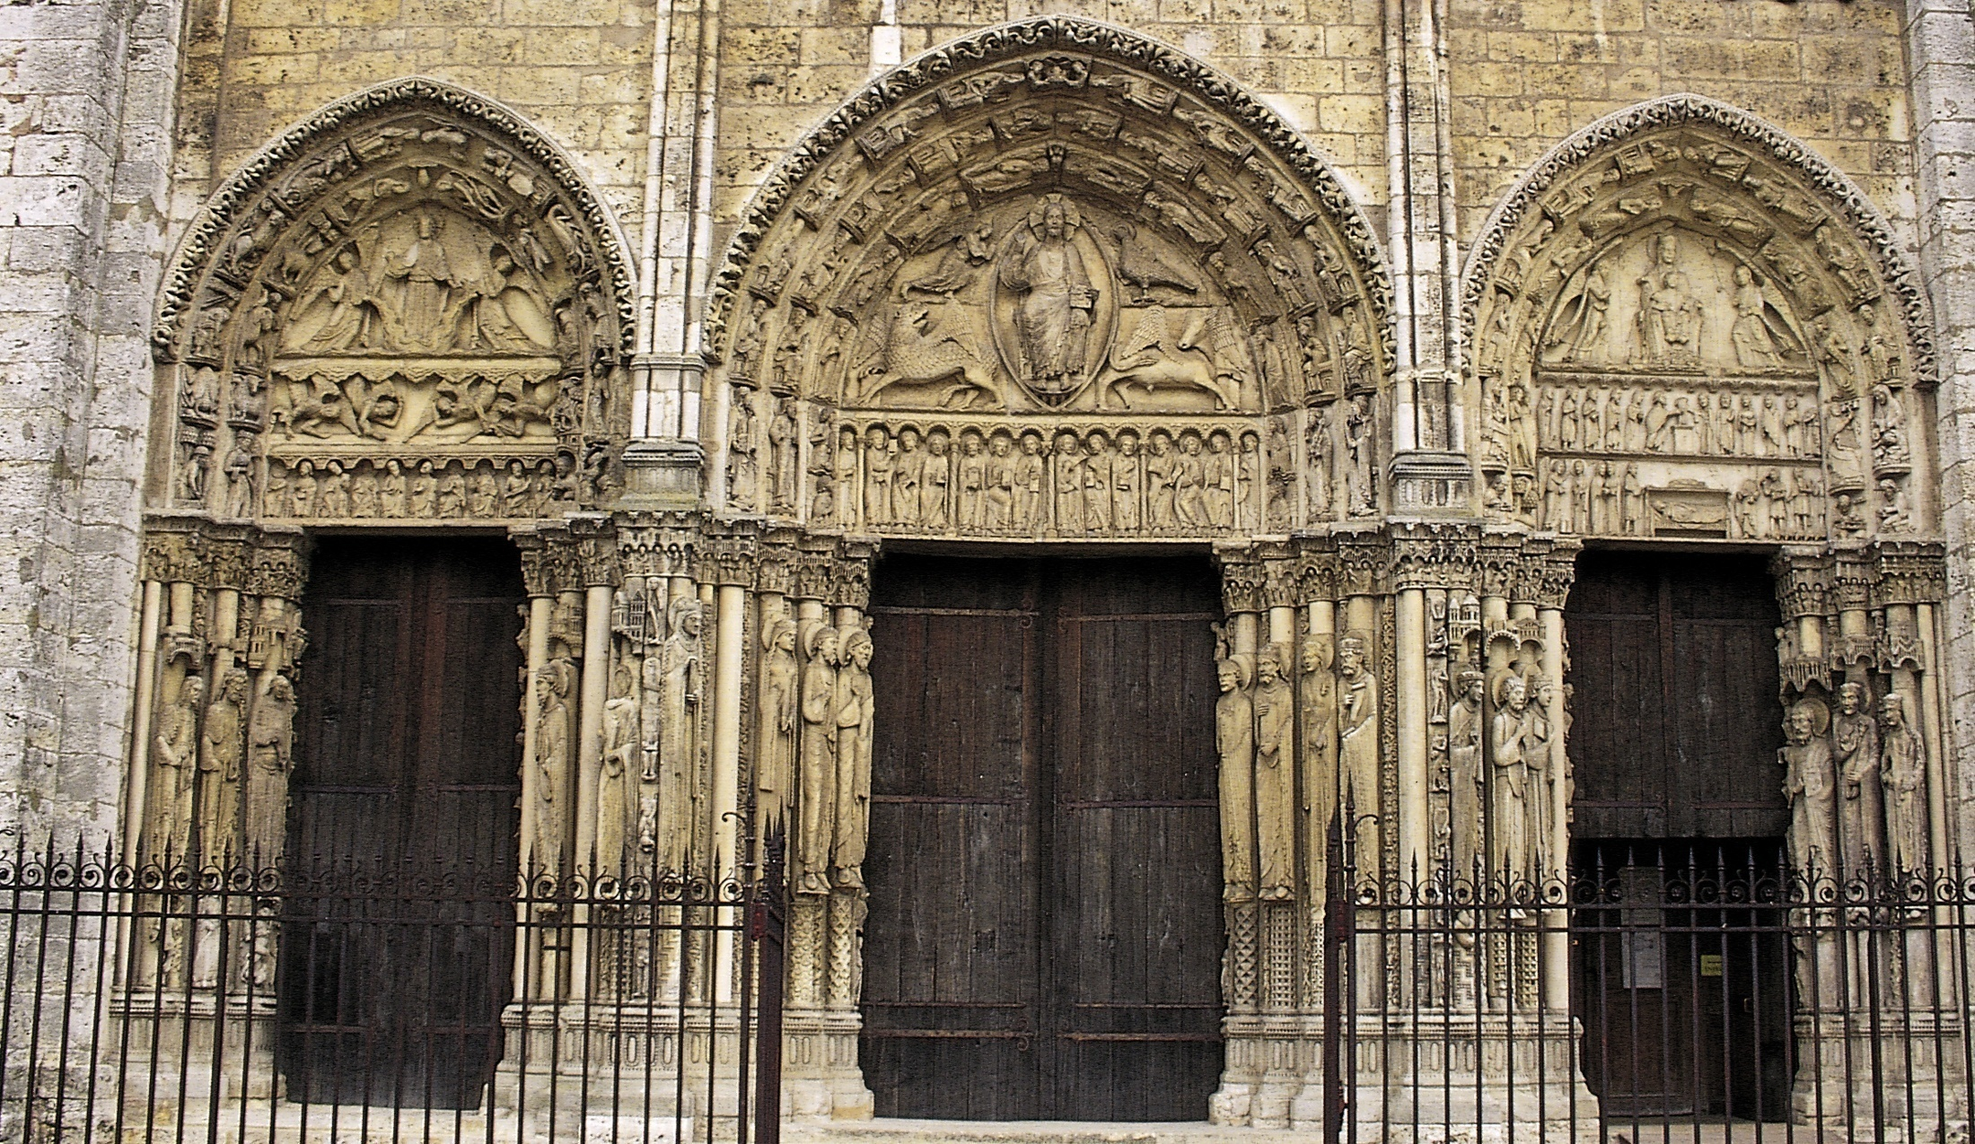
Royal Portal, west facade, Chartres Cathedral, Chartres, France, ca. 1145–1155.

Slide 15
Great or Royal Portal
Called the Royal Portal because of the statue columns of kings and queens flanking the doorways
Would have been used by general public, but also important ceremonial entrances of the bishop
Episodes of Christ’s life on the capitals, that form a kind of frieze, linking one entrance to the next
Right portal: Christ appears on the lap of the Virgin Mary, with scenes of his birth and early life below.
Virgin Mary is prominent, which has not been done before (Cult of the Virgin)
Left portal: Christ’s Ascension into heaven. Symbols of the zodiac and the various labors of the months of the year
Central portal: The Second Coming, symbol of salvation rather than damnation
Surrounded by the four evangelists
More serene and human
Apostles are organized into four groups of three
Statue columns hold up the tympana, a thematic and realistic support of Christ (kings, queens, rich people of France)
Connection between royalty and the church
Elegantly elongated, life-like drapery
Moving toward a new naturalism
-

Slide 16
Central portal: The Second Coming, symbol of salvation rather than damnation

Slide 17
Right portal: Christ appears on the lap of the Virgin Mary, with scenes of his birth and early life below.

Slide 18
Left portal: Christ’s Ascension into heaven. Symbols of the zodiac and the various labors of the months of the year

Slide 19
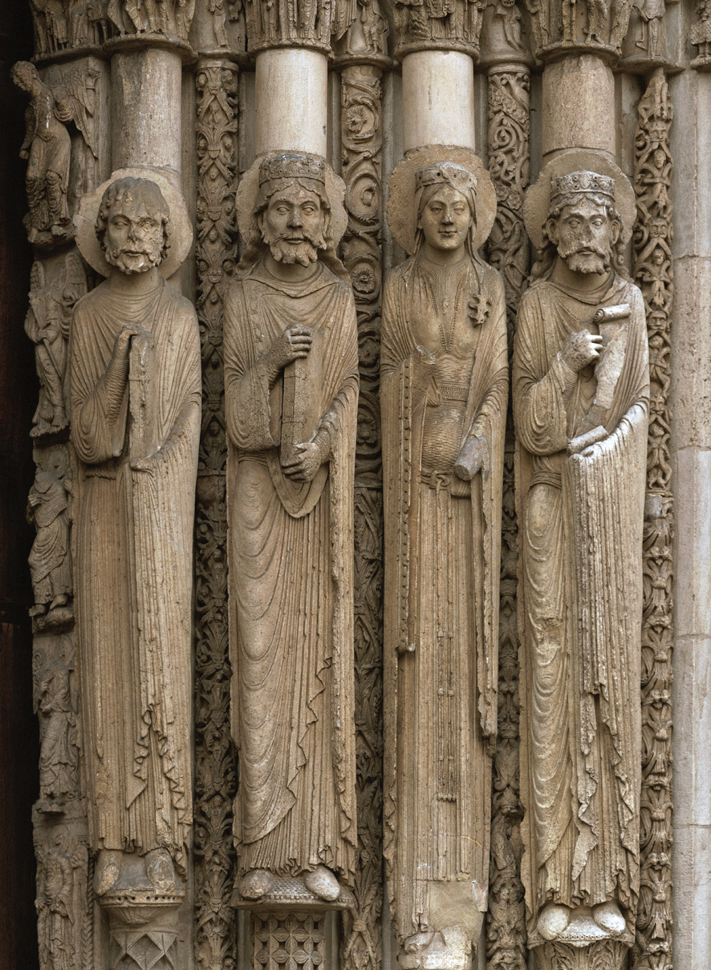
Old Testament kings and queens, jamb statues, central doorway of Royal Portal, Chartres Cathedral, Chartres, France, ca. 1145–1155.

Slide 20
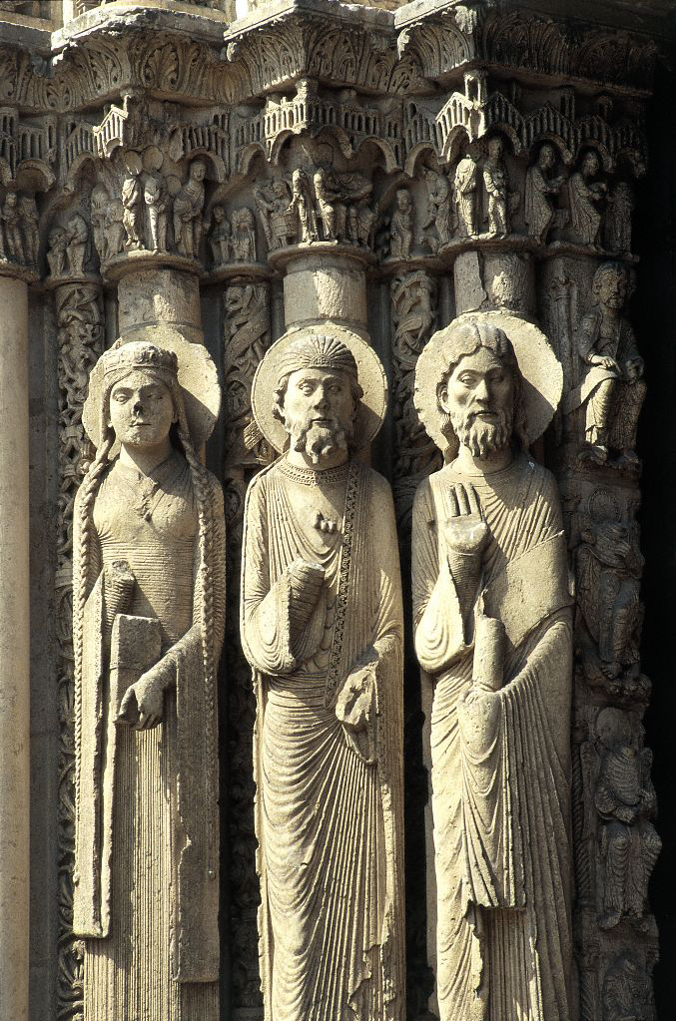
Alternate View Saints from left jamb, central portal (west), braided lady, two male saints
© 2005 Saskia Cultural Documentation, Ltd.

Slide 21
French High Gothic Sculpture

Slide 22
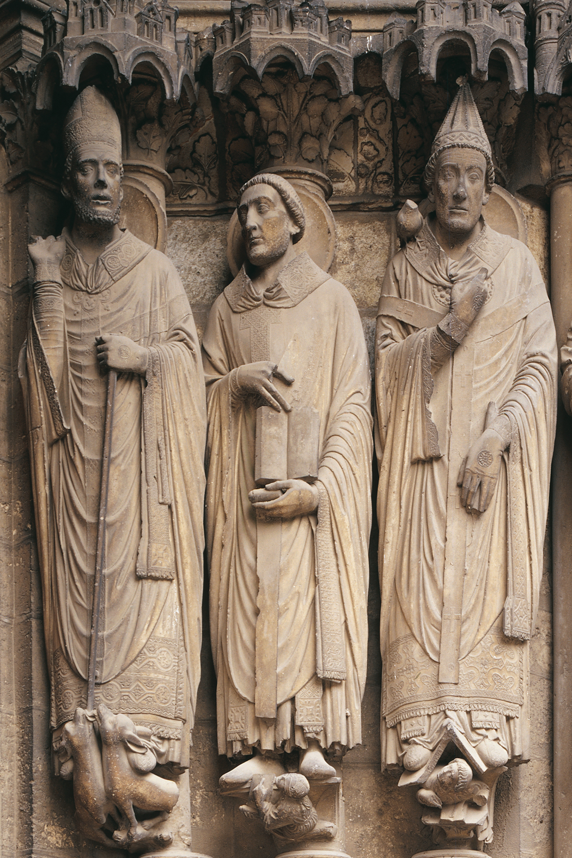
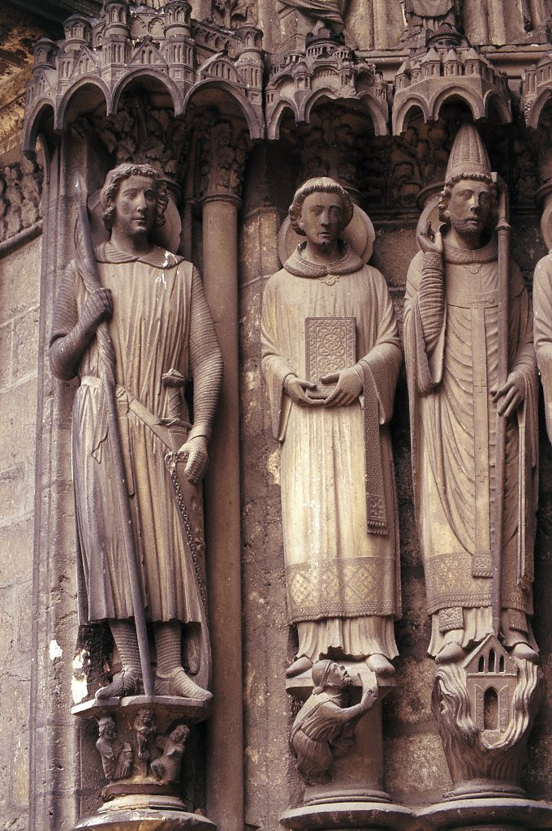
Saints Martin, Jerome, and Gregory, jamb statues, Porch of the Confessors (right doorway), south transept, Chartres Cathedral, Chartres, France, ca. 1220–1230.
S Transept, left portal, left jamb: Sts. Theodore, Stephen & Clement

Slide 23
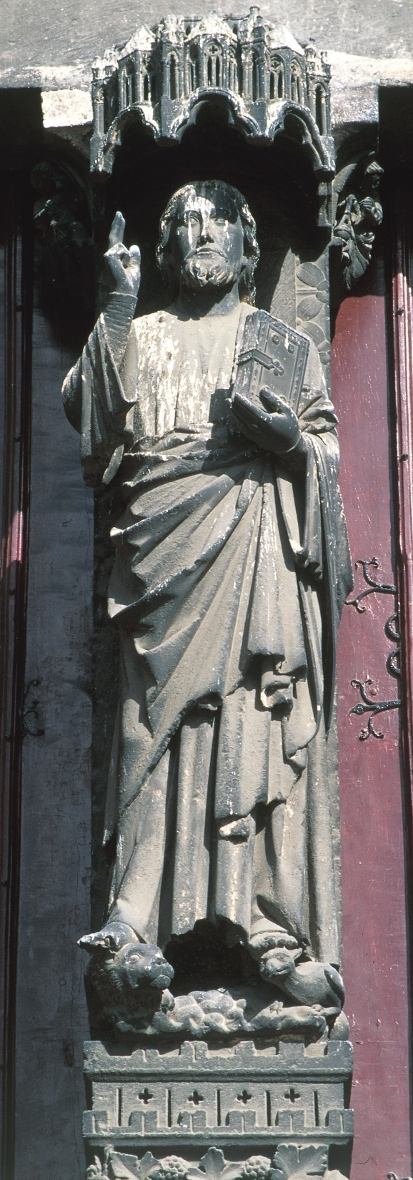
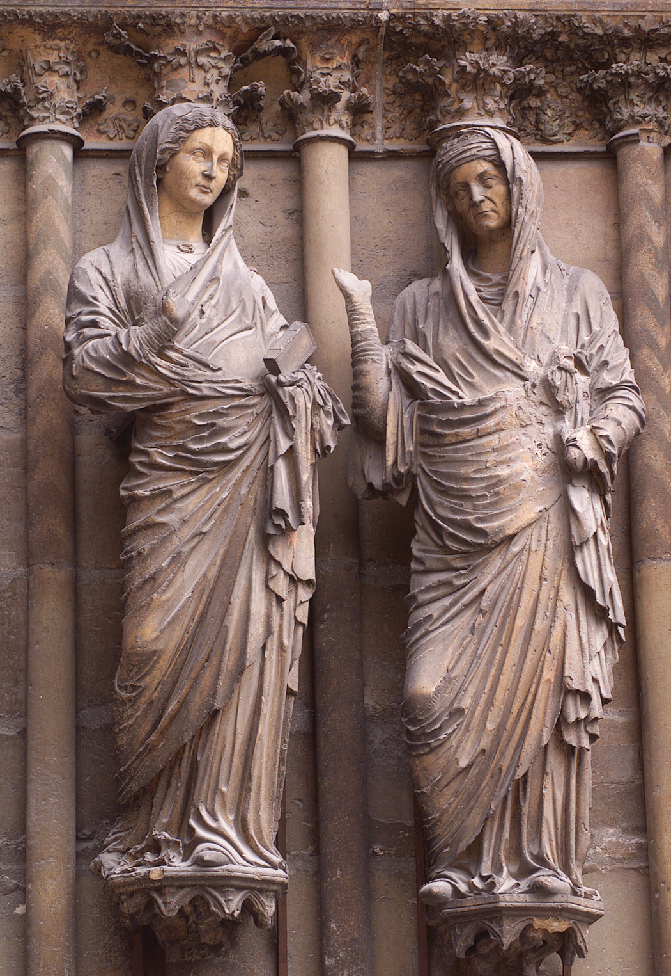
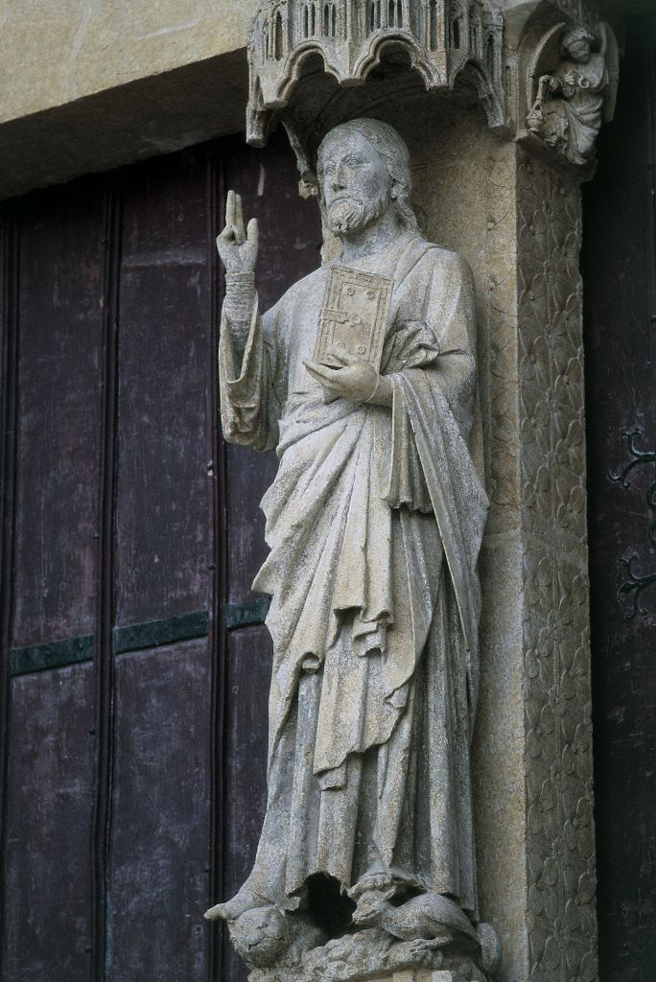
Christ (Beau Dieu), trumeau statue of central doorway, west facade, Amiens Cathedral, Amiens, France, ca. 1220–1235.
Visitation, jamb statues of central doorway, west facade

Slide 24
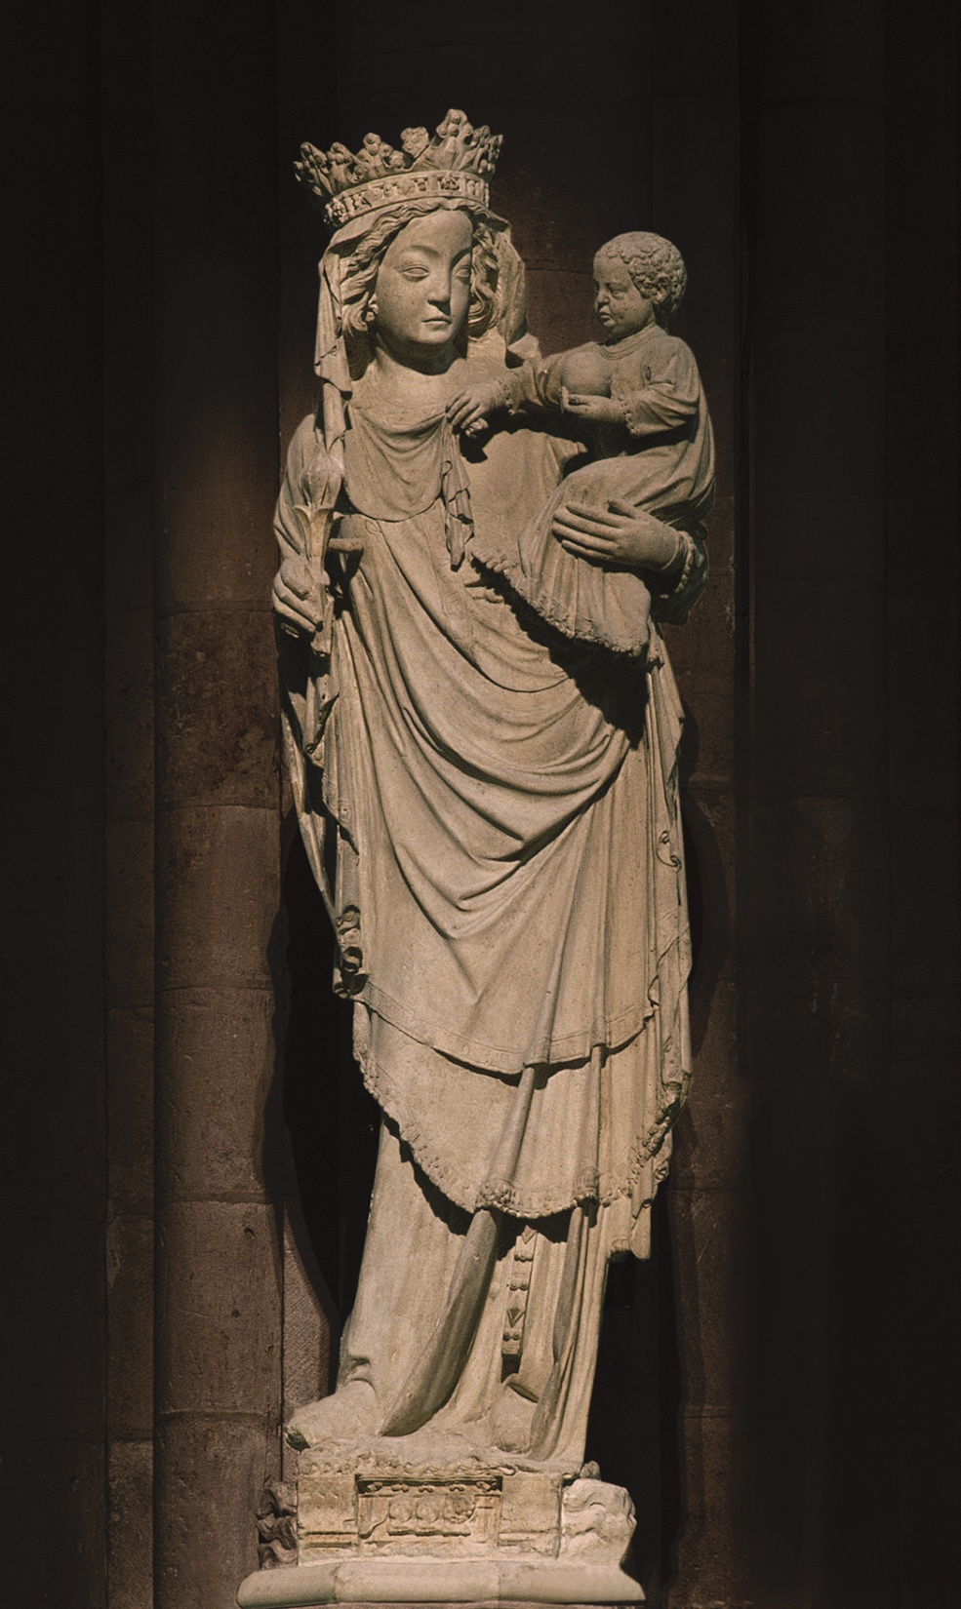
Virgin and Child (Virgin of Paris), Notre-Dame, Paris, France, early fourteenth century.

Slide 25
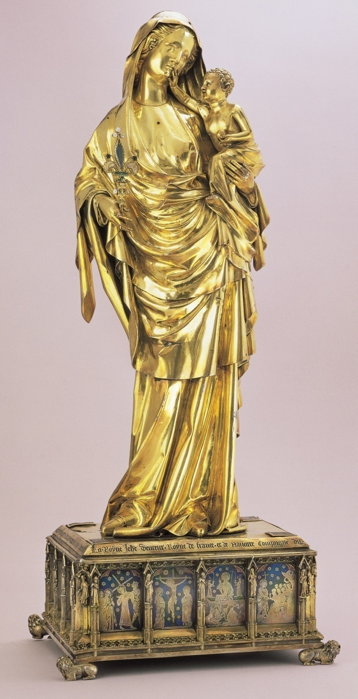
Virgin of Jeanne d’Evreux, from the abbey church of Saint-Denis, France, 1339. Silver gilt and enamel, 2’ 3 1/2” high. Louvre, Paris.

Slide 26
Slow movement to greater realism and naturalism of door jamb sculptures of late Gothic statuary
Figures begin to interact with each other
Move away from the confines of the door jamb space
Proportion more realistic
Individualization of faces
Attempt at contrapposto and more natural stance
Figures reflect a greater understanding of the anatomy
Mary holding dead Christ in her lap
Widespread troubles of the early 14th century: war, plague, famine, brought suffering into awareness
Increase in depictions of the suffering of Christ and Mary to show a connection with the suffering of people
Artists emphasized the traits of human suffering in powerful, expressive exaggeration
“Pieta”=pity or compassion in Italian
Christ is distorted and bleeding, Mary is full of grief
Example of the growing number of humanized religious images
Expression of feeling accompanied by the human body in motion, to express more recognizable human emotions
Virgin with the Dead Christ (Röttgen Pietà), from the Rhineland, Germany, ca. 1300–1325. Painted wood, 2’ 10 1/2” high. Rheinisches Landemuseum, Bonn.

Slide 27
Beauty and drama of Gothic art, to make you feel something
Earlier representations of Christ focused on his divinity
Not his suffering
Earlier art emphasized his divinity and distance from humanity
Many monks stressed his humanity and poverty, or Mary’s thoughts while she held her dead son
Christus patiens-the patient Christ
Spread throughout Europe, was very popular
Many pieta statues appeared in Germany in the late 1200s
Many show reclining Christ with skeletal abdomen
Mary’s response is what is unique to this one
Catholic tradition-Mary knew of Jesus’ death
Here, she appears to be angry and confused
Emotions emphasize her humanity
Intended as a focal point for contemplation and prayer

