Slide 1
Content area 1
Global Pre-History

Slide 2
BIG IDEA 1: Artists manipulate materials and ideas to create an aesthetic object, act, or event.
1. What is art and how is it made?
Materials (Environment/Geography
Art making techniques
Why make art? (Function)
2. Themes:
Power and Authority
Funereal Traditions
Sacred Objects and Spaces
Historical Record
3. Form, function, content, context:
Form and Content = VISUAL
Function and Context = CONTEXTUAL

Slide 3
CONTEXT
Ritual and symbolic works might have encouraged the availability of food sources. The first art-making was associated with activities of food production (hunting, agriculture, etc.), showing status, and burial.
Artifacts show human's awareness of fundamental, stable situations/experiences/ incidents from astrological events to manipulation of materials available.
Art production was used to connect and influence the natural world to human needs - sustaining life, and fertility.
Animal images and female figures seem to be connected to shamanistic rituals.
Due to the absence of written records and other contextual information, there is a lack of certainty regarding prehistoric artifacts. Multiple intrepretations are presented due to archaeological and ethnograhic (study of human cultures) approaches of function and meaning of the works of art.

Slide 4
LATIN TERMS TO KNOW
PALEO
“old”
MESO
“middle / between”
NEO
“new”
LITH
“stone”
POTAMUS
“river” (mesopotamia = between rivers)
corbelling
twisted perspective
nomadic
sculpture in the round relief sculpture
schematic
animism
relative dating corbeling dolmen incising capstones passage grave
mimetic abstraction undulation
abstraction low relief ware modeling post-and-lintel
Henge
shaman/shamanism/shamanistic

Slide 5
TECHNIQUES
Architecture:
post and lintel construction megalith trilithon
Two-dimensional art work:
silhouette vs. frontal contour/contour line aerial view twisted perspective/ “composite view”
Three-dimensional art work:
additive vs. subtractive statuette (figurine) relief (sculpture)

Slide 6
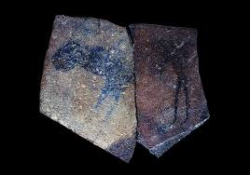
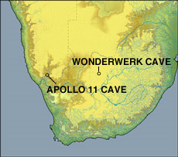
1. Apollo 11 stones. Namibia. c. 25,500–25,300 B.C.E. Charcoal on stone.

Slide 7
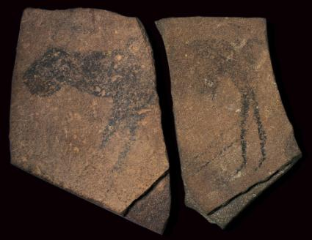
Apollo 11 stones
ca. 25,500–23,500 BC
The seven slabs of rock with traces of animal figures that were found in the Apollo 11 Cave in the Huns Mountains of southwestern Namibia have been dated with unusual precision for ancient rock art. The cave was given its name by a German archaeologist who was working in the cave when he heard of the Apollo 11 crew's successful return to Earth on July 24, 1969. Originally brought to the site from elsewhere, the stones were painted in charcoal, ochre, and white. Until recently, the Apollo 11 stones were the oldest known artwork of any kind from the African continent. More recent discoveries of incised ochre date back almost as far as 100,000 B.C., making Africa home to the oldest images in the world.

Slide 8
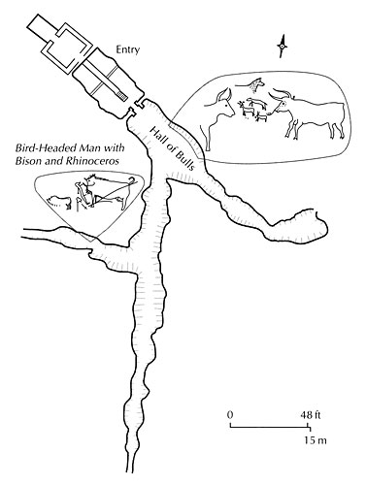
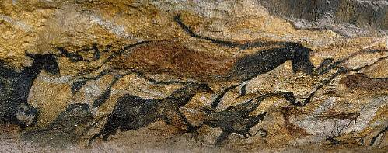
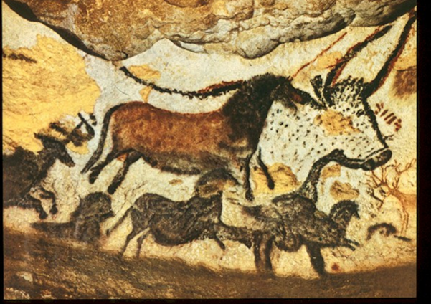
2. Great Hall of the Bulls. Lascaux, France. Paleolithic Europe. 15,000–13,000 B.C.E. Rock painting.
TWISTED PERSPECTIVE – combination of frontal
and side view.
Frontal
Side view
(profile)
faculty.evansville.edu/.../sum04/art105-12.html

Slide 9
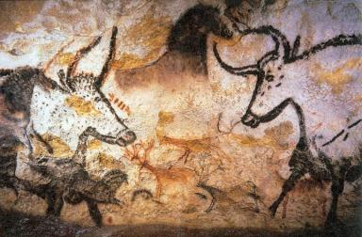
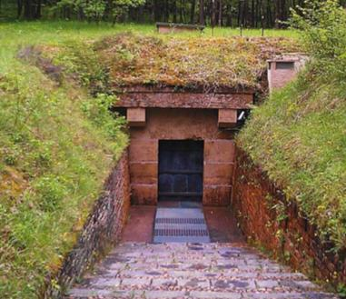
Lascaux Cave Paintings
ca. 17,300 BCE
Lascaux is the setting of a complex of caves in southwestern France famous for its Paleolithic cave paintings. Discovered by young boys in 1940, the cave was opened to the public in 1948. By 1955, the carbon dioxide, heat, humidity, and other contaminants produced by 1,200 visitors per day had visibly damaged the paintings and introduced mold and lichen on the walls.
Modern entrance into the cave

Slide 10
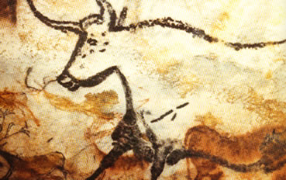
Caves of Lascaux (France)
Denotes the CONCEPT of a BULL using TWISTED PERSPECTIVE

Slide 11
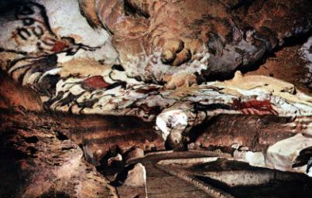
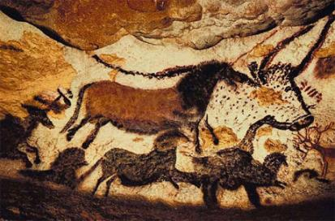
Lascaux Cave Paintings
ca. 17,300 BCE
The cave is the most decorated of all found, containing nearly 2,000 figures, which can be grouped into three main categories: animals, human figures, and abstract signs.
Over 900 can be identified as animals, and 605 of these have been precisely identified. Out of these images, there are 364 paintings of horses as well as 90 paintings of stags. A smattering of other images include seven felines, a bird, a bear, a rhinoceros, and a human. There are no images of reindeer, even though that was the principal source of food for the artists.
The most famous section of the cave is the Great Hall of the Bulls where bulls, equines, and stags are depicted. The four black bulls, or aurochs, are the dominant figures among the 36 animals represented here. One of the bulls is 5.2 meters (17 ft) long, the largest animal discovered so far
in cave art. Additionally, the bulls appear to
be in motion.

Slide 13
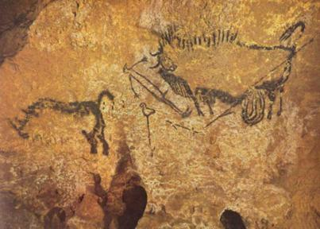
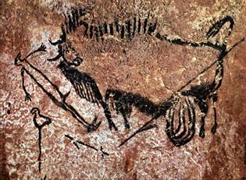
Lascaux Cave Paintings
ca. 17,300 BCE
One of the most puzzling features of Lascaux is what’s known as the ‘Shaft of the Dead Man (or Wounded Man)… Here it depicts a man (which is the only human representation in the cave) with some sort of bird head lying next to a bison who appears to be wounded from a spear. Alongside them are a bird on a long stick and a broken spear. It could be concluded that the man was attempting to kill a bison, but lost the battle!
According to one theory, the eyes of the bull, the bird, and the bird-man may represent the three stars Vega, Altair, and Deneb commonly known as the Summer Triangle.

Slide 14
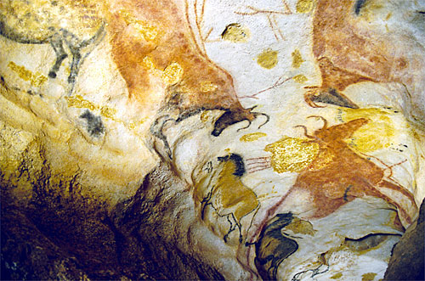
Caves of Lascaux (France)
Magnificent gallery known as the HALL OF BULLS

Slide 15
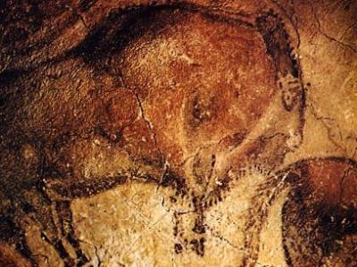
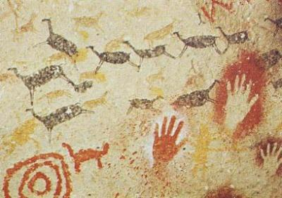
Caves of Altamira, Spain
Discovered in 1879 – some of the first discovered
Were originally considered fakes, but mineral deposits would’ve taken 1000s of years to accumulate
Mostly Bison from a profile view
(Notice that all of the hand paintings are LEFT-HANDED… Why do you think that is?)

Slide 16
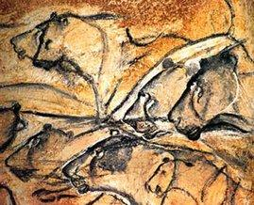
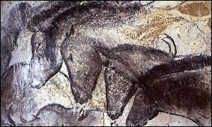
The Chauvet Cave
Discovered in 1994 – named after the exploration leader, Jean-Marie Chauvet
Using c-14 dating, found that these were 15,000 years OLDER than Altamira! The Chauvet Cave contains the oldest human footprint that can be dated accurately.
Lions and bears depicted, but never part of the Paleolithic diet (which confuses theory that paintings were part of a hunting ritual)
Animals are depicted NATURALISTICALLY – not abstractly like other caves

Slide 17
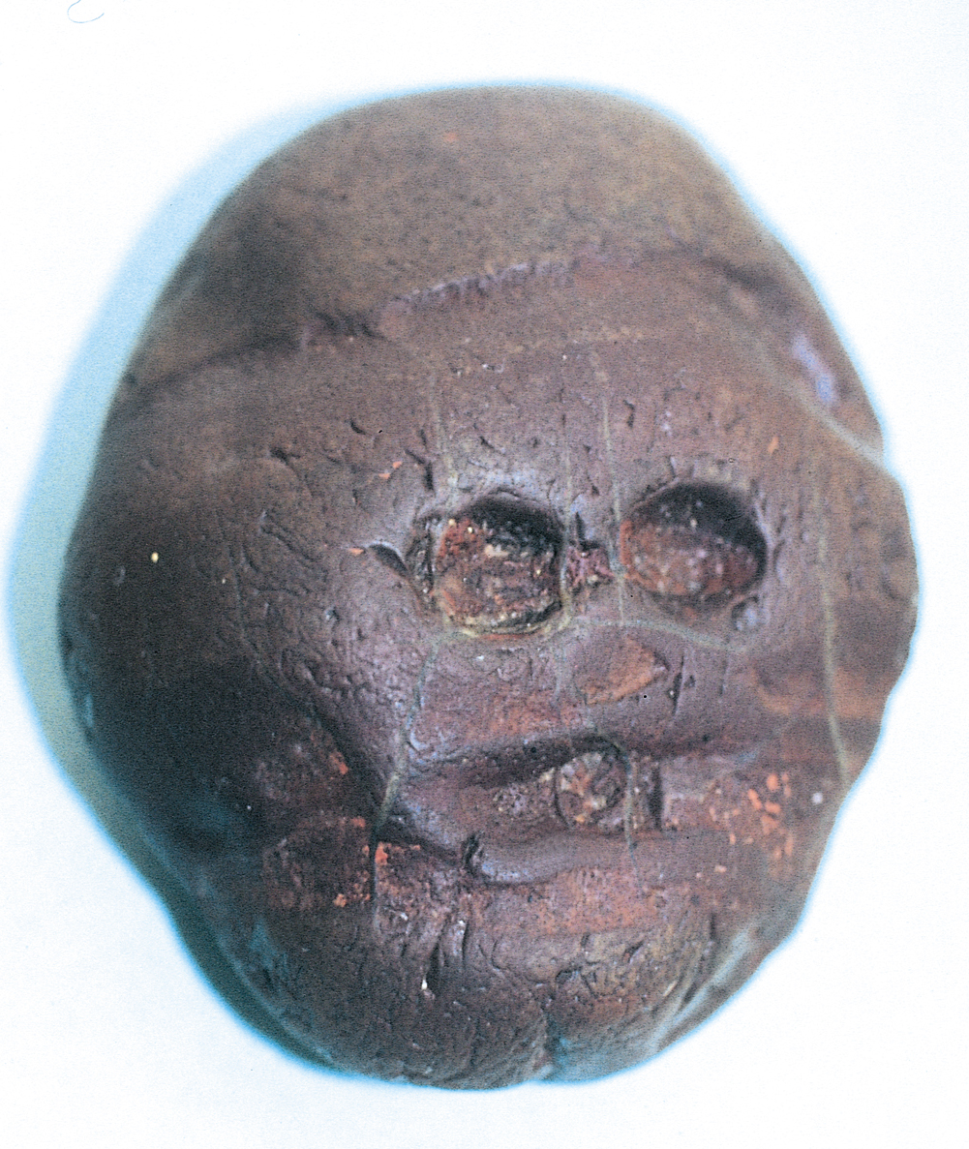
Pebble resembling a human face, from Makapansgat, South Africa, ca. 3,000,000 BCE. Reddish brown jasperite, approx. 2 3/8” wide.

Slide 18
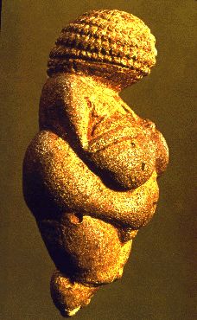
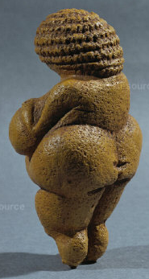
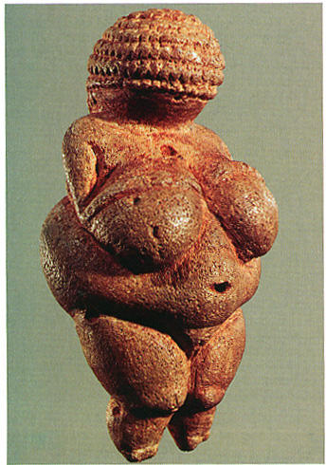
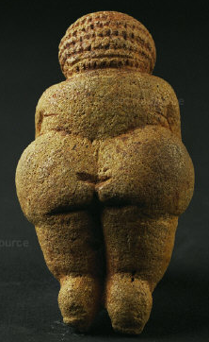
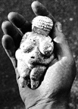
Venus of Willendorf
Subtractive Sculpture
Notes:
Gardner’s 11th ed., p.4

Slide 19
Woman (‘Venus’) of Willendorf
ca. 28,000-25,000 BCE
This is a 4.25-inch limestone figurine that was found in what is now Lower Willendorf in Austria.
The purpose of the carving is the subject of much speculation. It never had feet and doesn’t stand on its own. Parts of the body associated with fertility and childbearing have been emphasized, leading researchers to believe Venus of Willendorf may have been used as a fertility goddess. The figure has no visible face, her head being covered with circular horizontal bands of what might be rows of plaited hair, or a type of headdress.

Slide 20
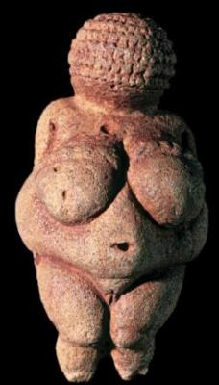
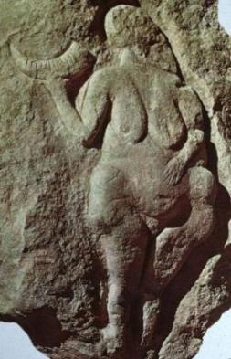
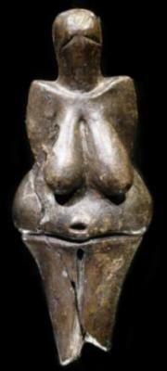
Willendorf, Austria Limestone
Laussel, France Bas-Relief
Moravia, Czech Republic Ceramic
Prehistoric female figurines (or ‘Venuses’) have been found all over lands in Europe. What common characteristics do you see in these figures?

Slide 21
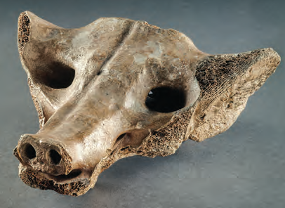
3. Camelid sacrum in the shape of a canine. Tequixquiac, central Mexico 14,000-7000 BCE Bone

Slide 22
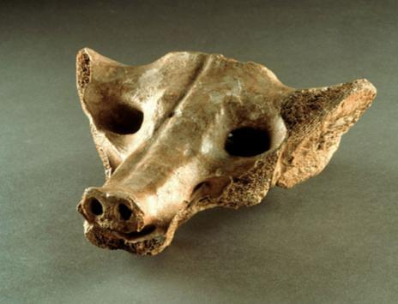
Camelid sacrum in the shape of a canine
ca. 14,000-7,000 BCE
Discovered in 1870 deep in the banks of Lake Texcoco in the Valley of (central) Mexico, this piece is of particular importance, given the fact that it is one of the earliest cultural artifacts to have ever surface from Mesoamerica. Carved from the sacrum of a now extinct American relative of the camel, its original use remains unknown. It’s assumed to represent the skull of the particular extinct camelid from which the sacrum bone was taken. One could also contend that the choice of the sacrum bone for this depiction of an animal head or skull was quite deliberate, since the sacrum bone is part of the pelvic region which gives birth and life to mammals.

Slide 23
Earliest example of rock art
Dotted marks indicate body paint
Featureless face
White parallel patterns represent flowing raffia decor
Horns shown in twisted perspective or composite are part of ceremonial attire
4. Running horned woman. Tassili n’Ajjer, Algeria. 6000–4000 B.C.E. Pigment on rock.
Notes:
2. THE TASSILI ROCK PAINTINGS by Charles van Santen http://www.cvsanten.net/index.php?option=com_content&view=article&id=74&Itemid=77&limitstart=4 2.1 Conditions in the Sahara and the Tassili plateau: Neolithic period 4000 BC-2000 BC. Rainfall in the Sahara during the Neolithic period from 4000 BC to 2000 BC was higher as today as the abundance of wildlife in that period shows. The many wildlife images depicted among the Tassili rock paintings and engravings are a proof of this and include elephants, giraffes, lions, ostriches, gazelle, Oryx, mountain sheep, rhinoceros, wild oxen, apes and wart hogs. We may assume that many parts of the Sahara during this period were covered with savanna vegetation: scattered trees, covered with grass during the rainy season, comparable to the present savanna vegetation in the Sahel, the climatic zone south of the Sahara. Neolithic camp sites with finds of flint stone arrow points and stone tumuli or burial sites on the Hoggar plateau and adjacent areas in the Sahara, confirm human habitation. C14 radio-carbon analysis of campfires remains, including bones of larger wild life, indicate dates of human habitation of the Hoggar plateau between 4000-2000 BC. Present day transhumant pastoralists in the Sahel zone, during the rainy season, move their herds from one suitable grazing spot to another in the low lands, using seasonal rivers and creeks to water their herds. At the beginning of each dry season, when grazing opportunities are running out, these herdsmen move their herds to areas near rivers where still sufficient grazing and water is available for their herds. Similarly we may assume that during the rainy season, the prehistoric transhumant pastoralists grazed their herds at the Hoggar plateau at an elevation of 1 000 meter, which is proven by the many Neolithic campsites found in that area. At the beginning of the dry season the Neolithic pastoralists moved their herds up to the Tassili N Ajjer plateau, at an elevation of 1500 meters, where during this season still sufficient grass and water would have been available for their herds. The many rock paintings and samples of Neolithic household goods found in the Tassili plateau caves confirm human habitation in this area. Household goods included among others: pots, stone knives, axe points and grinding stones. C14 radio-carbon analysis of campfire remains and pollen from the Tassili plateau caves, indicate that this area was also inhabited during the period 4000 -2000 BC. The Tassili n’ Ajjer plateau, the location of the rock paintings, is a large sand stone plateau in the Sahara in South Algeria about 700 km long by 100 km wide, rising above the surrounding Hoggar massif. During the Neolithic period the Tassili plateau rainfall was higher as today, as is proven by the remnants of oak-, cypress-, olive-, alder- and lime trees which still are found to day in Tassili. Today water is rarely present on the Tassili plateau, remaining in deep shaded rocky cracks, locally called gueltas. The only perennial river in the central Sahara is in the Iherir area. In the past long before the Neolithic population lived on the plateau wind erosion and the arid climate created rock formations resembling ruins or stone forests. In other areas of Tassili fluvial action over the millennia formed narrow deep gorges in these flat plateaus, which resulted in a unique network of steep-sided valleys with caves interspersed with some flat areas. The prehistoric rock paintings are mainly found in the caves of these steep sided valleys. Images of the Tassili landscape are shown in cvsalg110-171 2.2 Description of the Tassili rock paintings The Tassili prehistoric rock paintings show a wide range of styles from the naturalistic to the near abstract. Some of the paintings are really beautiful with a high artistic value. As an introduction a selection of details from 21 rock paintings is shown here: tas007-029. These photos were taken by the professional photographer Jean-Dominique Lajoux in 1961. Lajouxs’ images in my opinion give a better impression of the rock paintings as compared with the copies made by the artists of the Lhote team between 1955 and 1970. An overview of the Tassili paintings show following subjects: -Humans, predominantly with Negroid features, while some locations show humans with Caucasian features. The main clothing styles appear to be rather similar to present day traditional rural West African styles of clothing: long flowering dresses and head cloth for women and men and loin cloth for young men, while dancers depicted, used also body paint designs similar to the present West African style. A few images show Egyptian style short clothing. -Village life scenes: Village gatherings in which people meet in front of their huts to chat; pregnant women deliver their babies; parents playing with their children inside and outside their huts; people watering their cattle, sheep and goats; people dancing; women harvesting grains; young men with spears, hunting a lion which had taken one of their sheep; young men picking wild fruits from a tree; ceremonies and rituals, some of an erotic nature, probably related to fertility or procreation rites. -Livestock: Cows with several different types of horns, udders, skin designs and colors; sheep, goats and dogs, also with variations in skin design and types. -Wildlife: Elephants, giraffes, wild mountain sheep, lions, ostriches, gazelle, Oryx, rhinoceros, wild oxen, African buffalo, apes, wart hogs, crocodiles and fishes. -Divinities: Some images show large strange types of divinity figures, with worshippers around. An example is shown in tas006 The average size of the rock paintings The average size of the composite rock paintings is large and measures typically 120- to 300 cm wide and 400- to 600 cm high. For example the composite rock painting with livestock scenes in the Iherir area, which will be analyzed in section 3.4, measures 300 cm wide by 250 cm high and depicts 120 humans, 280 domestic animals, 47 wild animals and 66 objects such as drinking vessels, hut frames and mats. Palimpsest: Overlapping of images. Most paintings show several layers of images in different styles, which overlapping of images is called a palimpsest. This overlapping of two or more layers of images in different styles shows that several different cultural groups and generations of people have used the same area for their paintings, whereby each group painted images in their own style, disregarding images from previous groups. Examples are images: tas013Lajoux and cvsalg016 Composite pictures illustrating village life A major characteristic of these paintings is their composite nature. Each painting describes a specific village life story divided over several components or scenes, whereby each component or scene shows a different aspect of the same story comparable to a “strip” story. To illustrate this point, I refer to the detailed analysis of one Tassili composite rock painting from the Iherir area, recently published in a monograph entitled: Sahara Rock Art, 2004, Archeology of Tassilian Pastoralists Iconography by Holl, A.F.C. Holl, a professional archeologist, anthropologist and university professor specialized in West African anthropology, developed a useful pictorial analysis method for interpretation of composite rock paintings. Holl applied his analysis method to a large composite rock painting depicting many cattle and humans, located in the Dr. Khen shelter in Iheren, in the Central Tassili, north of the Wadi Tadjelamine bend, some thirty kilometers west of Iherir. The structure of this painting was identified as a narrative, representing an allegory and morality play with a complex story line, which was divided into distinct compositions and organized into different tableaux and individual scenes. The analysis of this Tassili rock painting shows that it describes village life of traditional African pastoralists, supporting my assumption on this issue. For an example of Holls’ pictorial analysis method see images tas031-047. A short note explaining his pictorial analysis method is given in section 3.4 Source of the paint material or pigments, range of colors and painting technologies The prehistoric artists obtained their pigment or coloring material from ochreous schists. Schists are rocks whose minerals have aligned themselves in one direction in response to deformation stresses. The result of this is that these rocks split in parallel layers. Each layer of these rocks had a different position and was therefore exposed for a different period to sunshine. This resulted in different ochre pigment colors for different layers, ranging from dark to light depending on the number of hours of sunshine received. Ochre is a mineral composed of clay and hydrated ferric oxide and is used as a pigment varying from dark brown to light yellow. In the case of the Tassili n’Ajjer ochre schists, the range of colors is very wide: The most protected schists gave a very dark ochre color, almost the color of dark chocolate, while colors of other layers ranged from brick red, light red, and yellow shades up to a greenish hue. A white color was obtained from locally available kaolin. The result of the availability on the Tassili plateau of this wide range of ochre shades is that the palette of colors used in the Tassili rock is much richer as compared with the palette of red ochre, kaolin white and oxide of manganese found in prehistoric rock paintings in other locations. Image tas030 taken in the Nubian mountains in West Sudan shows the collection of ochre from caves, in a similar way as during the Neolithic period at the Tassili plateau. Some Nubian tribes, from West Sudan, used ochre as pigment or coloring material base for body painting till recently.(Riefensthal) The artists grounded these pieces of ochre schist to powder in a stone grinder, which is confirmed by the many examples of prehistoric grinding stones found in the Tassili caves. After the colored schist powder was obtained it was mixed with a media. Most likely this was based on casein, a milk product, as cattle were ample available to the prehistoric Tassili people. Another possibility for a media could have been acacia gum, taken from the many acacia trees growing in the area. 2.3. Comparing prehistoric Tassili images of village life with those of 20th Century traditional West African pastoralists: An agriculturalist’s interpretation As mentioned earlier, familiar with present day village life of traditional rural West African societies through my work as a socio economic agriculturalist, I was able to compare 20th century village life scenes of traditional rural West African societies with those depicted in the prehistoric Tassili rock paintings and observed many similarities between the two groups. I also refer to my web site: www.cvsanten.net, : Liberia section, which contain some of my photographs of village life of traditional West African societies. It is my intention to upload in the near future additional photographs of traditional village life scenes from other West African countries. In the following list similarities in village life between the prehistoric pastoralists and modern day West African traditional pastoralists are shown: • Herds with cattle, sheep and goats; • People watering and tendering their livestock; • People making camp sites: unloading or loading household goods on cattle, constructing huts made from straw mats on wooden frames; • Village people meeting in front of their huts; eating; chatting; admiring a newly born baby or a newly born calf or lamb; drinking from large earthenware containers; taking care of dogs as pets; participating in grain harvesting; hunting; picking fruits; dancing; erotic activities; rituals and praying to divinities. The above list of characteristics, relevant for both prehistoric and 20th century traditional rural groups, leads to the following description of pastoralist societies: 1. During the wet season transhumant pastoralists move their herds between areas with good grazing and watering in the savanna, with scattered trees and wet season grass vegetation. During the dry season the herds are moved to higher elevated locations or near to rivers where still sufficient grass for grazing and water is available. 2. The pastoralist economy is based on cattle, sheep and goats, with a diet based on milk and in some tribes with blood, supplemented with grains and fruits collected or exchanged with farmers. 3. Rituals relate to live circles of men and livestock within the seasonal changes. These include practical subjects such as watering, grazing and taking care of livestock; collecting wild fruits and grains; & hunting; and cultural subjects such as praying to divinities and conducting fertility rituals. 4. Huts made from straw mats, easily foldable and movable between seasons and village camp sites. 5. Clothing is made from wool and skins: loin cloth for men and long dresses for men and women; use of earthenware drinking vessels; the keeping of dogs as pets. NB. My personal study of prehistoric rock paintings is based on visits to two major Tassili sites: Sefar and Jabbaran and four minor sites: Tamrit, Tin Aboteka, Tin Tazarift and Tin Itinen. See Map tas002 Tassili plateau & tas003 Tamrit, Sefar and Jabbaren area. Conclusion Comparing the characteristics of village life and culture of present day African transhumant pastoralists as represented by the Fulani or Peul, Tuaregs, Boran, Masai, Nuba and other pastoralist groups, with images shown in the prehistoric rock paintings I found many similarities and refer also to Holl, who in his monograph arrived at a similar conclusion. Based on this I concluded that the prehistoric Tassili people were transhumant pastoralists, who moved their livestock between different grazing lands according to season, in the lowlands during the wet season and on the Tassili plateau during the dry season. NB.1.It should be noted that in spite of the similarities between village life images of the prehistoric Tassili inhabitants and those of traditional rural societies in West Africa of today there is no proof that present day West African traditional rural societies are the direct descendants of the prehistoric pastoralists from the Tassili plateau. 2.In spite of this, I propose to conduct detailed studies of present day traditional rural West African societies, which could provide additional information on specific details of village life of prehistoric Tassili pastoralists. 3.The rock paintings were probably made during the dry season when the herds of the pastoralists were grazing on the Tassili plateau and movement was more restricted as compared during the rainy season, which would have given artist-pastoralists an opportunity to create their rock paintings. 2.4. A hypothesis on the motivation of the prehistoric pastoralists to create rock paintings. Studying the rock paintings, I was also struck with the question: What could have been the motivation of the pastoralists to create these rock paintings? Making the paintings must have taken a lot of time and effort, in particular as some images which were up to 6 m high or located in positions, difficult to reach, as for example paintings on cave ceilings. Reviewing carefully the motifs selected in the rock paintings I concluded that the prehistoric artists had similar motivations as anyone today or whenever during the past who felt the urge to draw pictures. This is a felt need to portray their world and to share this with others, for example with the young generations. I therefore formulated the hypothesis that the Tassili paintings were made to initiate the young Tassili generations in the important aspects of the pastoralists’ life and that the paintings formed part of the teaching material of the Tassili “bush school”. In this context, I refer to the West African “bush school” a traditional informal none literate training institution, which was created probably thousands years ago and which in most traditional West African societies was still in use, till recently. Thus all teenage boys and girls of West African tribal societies were obliged to join the “bush” school for a period of time, ranging from several years in the past to only a few months in modern times. These bush schools are far removed from the villages and the teenagers are for the first time in their life separated from their families. In these training camps, tribal elders teach the teenage boys and girls the most important aspects of the tribe’s culture and practical skills such as traditional medicine, hunting, keeping livestock and farming. Probably at the time of the prehistoric Tassili pastoralists the bush schools were located in the isolated caves on the Tassili plateau and the paintings served as teaching material to explain the pastoralist world. In fact, most of the scenes depicted would fit in very well as teaching material with activities usually undertaken in the African “bush school”. In conclusion, when studying the extraordinary collection of the Tassili rock paintings, one is struck by the observation that: -The rock paintings cover a wide range of fascinating aspects of traditional village life, which are rather similar to village life scenes of present day traditional West African tribal rural societies. -The Tassili rock paintings were probably created with the intention to be used in the initiation of young generations of pastoralists in the African “bush school”.

Slide 24
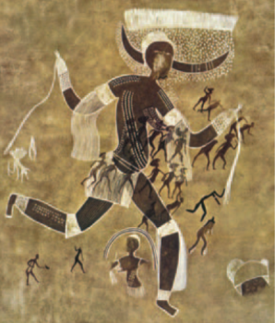
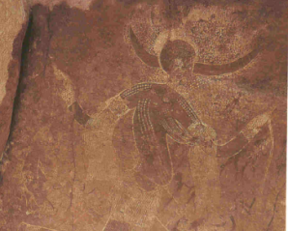
Running Horned Woman
Algeria, ca. 6,000-4,000 BCE.
This early rock painting is thousands of years older than the first African sculptures. It represents a running woman with body paint, raffia skirt, and horned headgear, apparently in a ritual context. She has a more well-defined outline of the human body, and it has more visual detail (such as the dots on the body-shoulders, legs, torso) than the other paleolithic paintings that we have seen. Also, is it a cave painting of a human, whereas the earlier paleolithic paintings were mostly of animals.
Due to the combination of animal and human in the ceremonial headgear here, scholars suggest that she represents some form of supernatural diety.

Slide 25
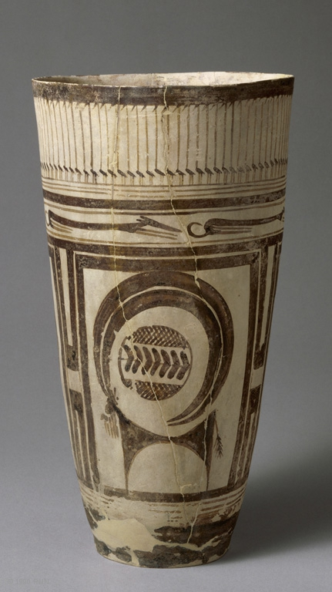
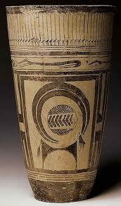
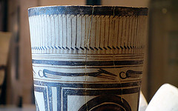
5. Beaker with ibex motifs. Susa, Iran. 4200-3500 BCE. Painted terra cotta
Beaker with Ibex Motifs

Slide 26
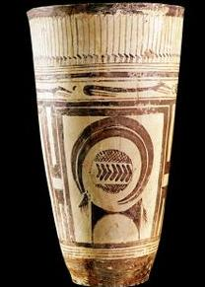
Bushel with ibex motifs
Iran, ca. 4,200-3,500 BCE
This large painted vase, magnificently decorated, was among the funerary objects of the first inhabitants of Susa, Iran. It (along with other ceramic pieces) were found in a large burial mound. The deceased received bushels (cylindrical earthenware pots), bowls and metal objects indicative of the prosperity of the city of Susa.
The top frieze has depictions of stylized aquatic birds followed by running dogs. In the heart of the vessel is an abstracted goat or ibex, whose horns surround an inexplainable round design.

Slide 27
6. Anthropormorphic stele.
Arabian Peninsula. Fourth millennium BCE Sandstone.

Slide 28
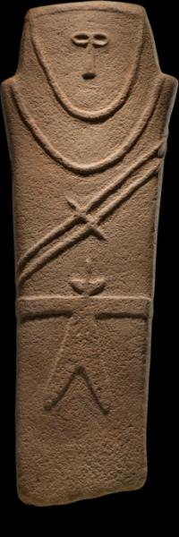
Anthropomorphic stele
4,000 BCE, Arabian Peninsula
Sandstone, about 3 ft. tall
‘Anthropomorphic’ means to give a god, nature or animals some type of human qualities. This haunting stele (most likely a grave marker) is among the earliest known works of art from the Arabian Peninsula and dates back to some six thousand years ago. It was probably associated with religious or burial practices. The figure's distinctive belted robe and double-bladed sword may have been unique to this region.

Slide 29
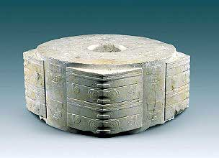
7. Jade cong Liangzhu, China 3300-2200 BCE Carved jade
Jade Cong

Slide 30
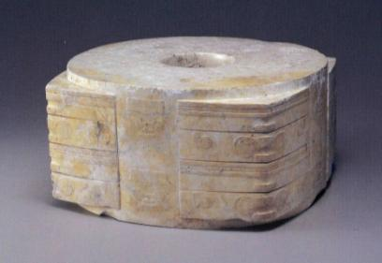
Jade Cong
Liangzhu, China. 3300-2200 BCE.
A cong is a form of ancient Chinese jade artifact. The earliest cong were produced by the Liangzhu culture (3400-2250 BC). As a form, a cong is a tube with a circular inner section and squarish outer section. The outer surface is divided vertically or horizontally such that the whole defines a hollow cylinder embedded in a partial rectangular block. Proportions vary - a cong may be squat or taller than it is wide. The outer faces are sometimes decorated with mask-like faces, which may be related to the taotie designs found on later bronze vessels.

Slide 31
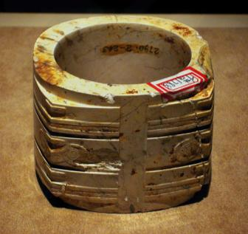
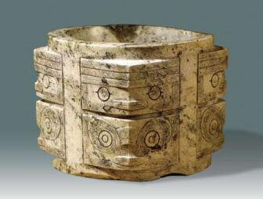
Jade Cong
Liangzhu, China. 3300-2200 BCE.
Although generally considered to be a ritual object of some sort, the original function and meaning of the cong are unknown. Later writings speak of the four sides of the cong as symbolizing the earth, while the bi, or circular hole, represents the heavens.

Slide 33
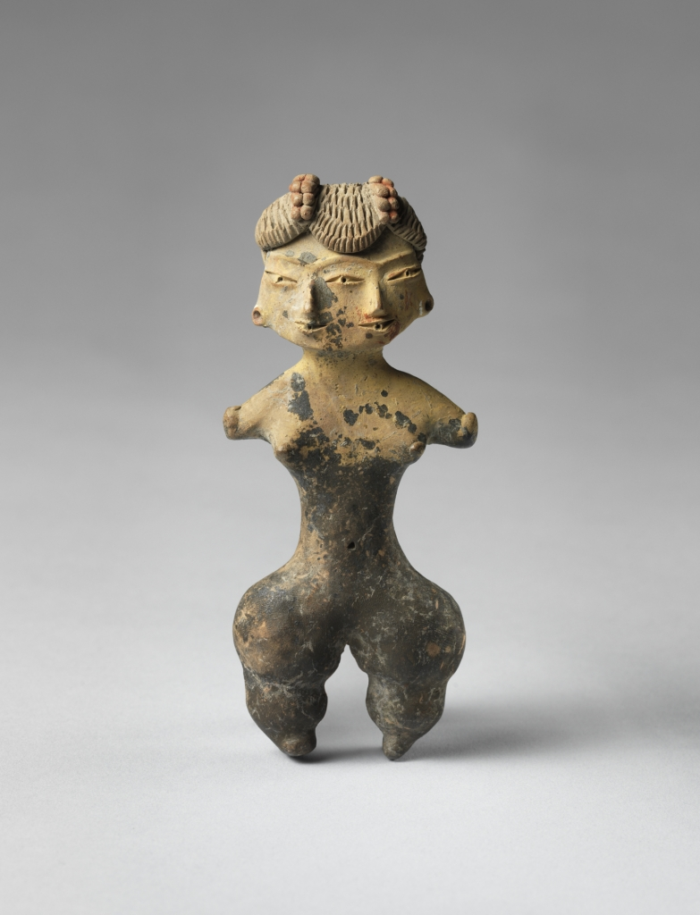
8. Tlatilco
Female figure, 1200–900 B.C.
Ceramic with traces of pigment

Slide 34
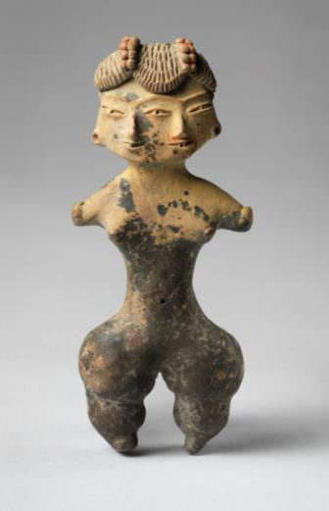
Tlatilco Female Figurine
1200-900 BCE, Central Mexico
Ceramic, about 3.75” tall
Tlatilco is an important Early Formative Mesoamerican site in Central Mexico. Located in the Valley of Mexico, on the shores of Lake Texcoco. The site is now partially covered by the modern town of the same name, and in the 1950s was heavily quarried to obtain clay to make bricks. This activity led to the occasional digging up of burials, unfortunately promoting the looting of figurines, and pottery. Many Tlatilco figurines show deformities or other anomalies, including a "duality" mask and several two-headed female figures. Tlatilco potters were probably most often women because of the size of the fingerprints they left in the clay.
The name "Tlatilco" comes from the Nahuatl language, in which it means "the place of occult (or hidden) things". The name was given by a group of Nahuatl speakers because when they arrived in the valley, the culture of Tlatilco had already disappeared.

Slide 35
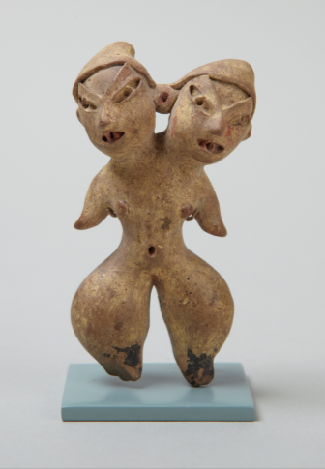
Tlatilco Female Figurine
1200-900 BCE, Central Mexico
Ceramic, about 3.75” tall
Especially important are the hundreds of female figurines, with detailed depictions of hair styles, clothing and body ornaments which carry valuable information about its ancient inhabitants' real or idealized life style. It has been proposed that these figures could depict real individuals or deities. Considering that three quarters of these figurines were not found in a burial context, it’s still unknown whether the were used for domestic or agricultural purposes.

Slide 36
Anthropomorphic stele
4,000 BCE, Arabian Peninsula
Sandstone, about 3 ft. tall
‘Anthropomorphic’ means to give a god, nature or animals some type of human qualities. This haunting stele (most likely a grave marker) is among the earliest known works of art from the Arabian Peninsula and dates back to some six thousand years ago. It was probably associated with religious or burial practices. The figure's distinctive belted robe and double-bladed sword may have been unique to this region.

Slide 37
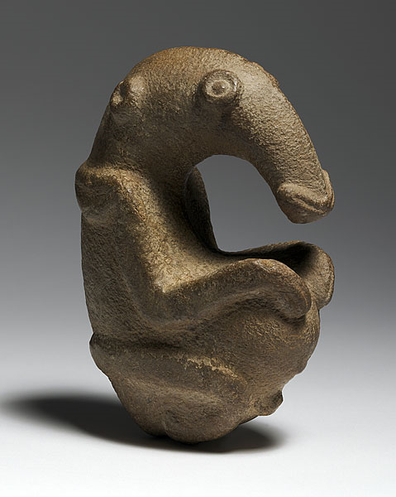
9. The Ambum Stone. Ambum Valley, Enga Province, Papua New Guinea. c. 1500 B.C.E. Greywacke.

Slide 38
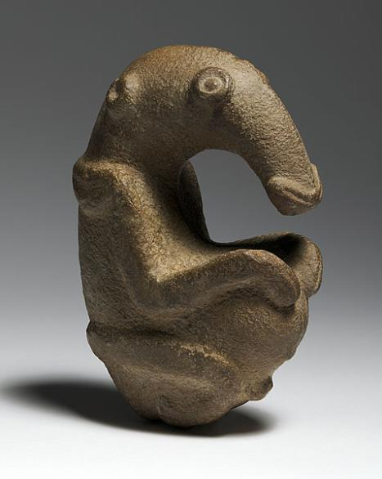
The Ambum Stone
Papua New Guinea, 1,500 BCE.
This sculpture, discovered in a cave during the early 1960s, is one of the earliest known Pacific works of art, was made more than 3500 years ago. It was found with some one hundred other stone objects of which this is the most intricately carved. Made of greywacke (a gray sandstone), it’s most likely a
pestle – a tool used to grind spices or drugs in a mortar.
Ancient stone mortars and pestles from Papua New Guinea are often fashioned into the forms of birds, humans and animals whereas the Ambum stone has a higher level of figurative qualities than other pestles and may be in a unique class of its own.

Slide 39
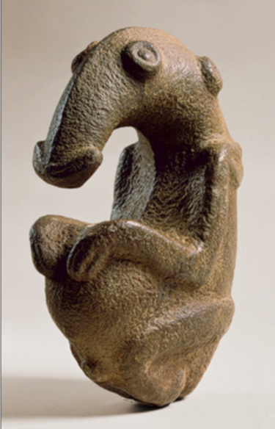
The Ambum Stone
Papua New Guinea, 1,500 BCE.
With various zoomorphic features, it may depict the embryo of a long–beaked echidna (spiny anteater). The significance and function of such stone images remain obscure, although they are often considered sacred and credited with supernatural powers by present day people of the region where they are used as spirit stones in sorcery and other rituals. Stones like these were respected, as they were believed to promote prosperity and fertility.

Slide 40
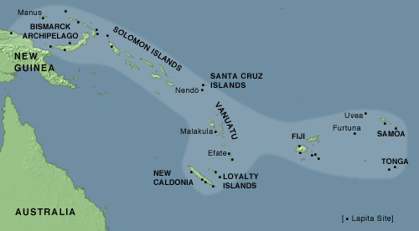
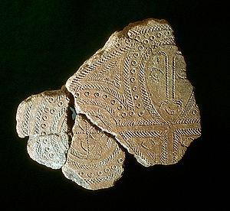
10. Terra cotta fragment. Lapita. Solomon Islands, Reef Islands. 1000 B.C.E. Terra cotta (incised).

Slide 41
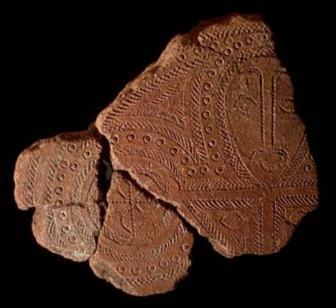
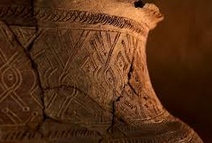
Terra Cotta Fragment. Lapita.
1000 BCE, Solomon Islands.
The term Lapita refers to an ancient Pacific culture that archaeologists believe to be the common ancestor of the contemporary cultures of Polynesia, Micronesia, and some areas of Melanesia.
Lapita art is best known for its ceramics, which feature intricate repeating geometric patterns that occasionally include anthropomorphic faces and figures. The patterns were incised into the pots before firing with a comb-like tool used to stamp designs into the wet clay. Each stamp consisted of a single design element that was combined with others to form elaborate patterns. Many Lapita ceramics are large vessels thought to have been used for cooking, serving, or storing food.

Slide 42
Level VI Catal Hoyuk, Turkey
COMPOSITE RECONSTRUCTION DRAWING OF A SHRINE ROOM

Slide 43
11. Stonehenge. Wiltshire, UK. Neolithic Europe. c. 2500–1600 B.C.E. Sandstone.

Slide 44
Stonehenge (ca. 2550-1660 BCE)
Built in Salisbury Plain, England
Created in 3 phases over a 1,000 years
Keyed up with astronomical events, such as the Summer Solstice… when the Sun rises directly over the Heel Stone as seen from the Altar Stone
Menhirs, Megaliths… BIG STONES!

Slide 45
Megaliths
Trilithon
Cromlech or henge
Post and Lintel
Lintel
Post

Slide 46
Stonehenge

Slide 47
Significant astronomical alignments at Stonehenge
Stonehenge

Slide 48
Carhenge (Alliance, Nebraska - 1987)
Carhenge is a replica of England's Stonehenge located near the city of Alliance, Nebraska on the High Plains. Instead of being built with large standing stones, as is the case with the original Stonehenge, Carhenge is formed from 38 vintage American automobiles, all covered with gray spray paint. It was built by Jim Reinders, who created it to honor his father who studied the structure of Stonehenge, which helped him to copy the structure's shape, proportions, and size. The heelstone is a 1962 Cadillac.

Slide 49
Manhattanhenge
Manhattanhenge, sometimes referred to as the Manhattan Solstice – is a semiannual occurrence during which the setting sun aligns with the east–west streets of the main street grid in the borough of Manhattan in New York City. The term is derived from Stonehenge, where the sun aligns with the stones on the solstices with a similarly dramatic effect. During Manhattanhenge, an observer on one of the gridded east-west streets will see the sun setting over New Jersey directly opposite, from the street, along its centerline.
The dates of Manhattanhenge usually occur around May 28 and July 12 or July 13 – spaced evenly around summer solstice.

